Slide 1

CANNABIS IN DENVER AND CRIMES REPORTED RELATED TO MARIJUANA

Slide 2
CANNABIS IN DENVER AND CRIMES REPORTED RELATED TO MARIJUANA The Colorado amendment 64, which was passed by voters on November 6, 2012, led to legalization in January 2014 Many reports suggests that use of marijuana has decreased in teenagers from 25% to 21% The state has also been able to make a good revenue, with $266 million in taxes alone in the year of 2018

Slide 3
CANNABIS IN DENVER AND CRIMES REPORTED RELATED TO MARIJUANA One the other side of the story the City and County of Denver reports data on its website on marijuana related crime The website mentions that the crime related are in “clear connection or relation to marijuana”

Slide 4
PROBLEM STATEMENT How the crimes related to marijuana can affect the new businesses location where to setup? and which areas and stores can be put under more surveillance by authorities to better control it? Or where to go for a safer marijuana procurement?

Slide 5
DATA SOURCES Denver Metropolitan Crimes Related to Marijuana (reported on website of City of Denver Foursquare database to identify the marijuana stores in the Denver metropolitan area

Slide 6
DATA DESCRIPTION Relational structured data in form of an excel sheet with 14 columns and 1203 entries in rows Columns contain following data: Incident_Id (Primary Key)- Unique for each reported incident. First_Occurance_Date- Date of first occurrence of a crime reported in the neighborhood or the address related to marijuana. Last_Occurance_Date – Date of first occurrence of a crime reported in the neighborhood or the address related to marijuana (both first and last occurrence date are same for most reports, except for majority of last dates are missing). Report date for each incident. Address of each incident Geo_X and Geo_Y (geographic location system for the reported incident, not latitude or longitude data for the addresses of incidents). District Precinct Offense code, type_Id and category_Id MJ Relation (Industry or Non-Industry)- related to marijuana industry or not. Neighborhood_Id

Slide 7
FEATURE SELECTION Following features were selected to be studied: Incident_Id (Unique for each incident) Report date – to track the numbers over time. Incident address – to lookup latitude and longitude data Offense type/category – to identify what kind of offense are the most likely reported related to marijuana. Neighborhood_Id – to identify safe neighborhood for business, tourists and users.

Slide 8
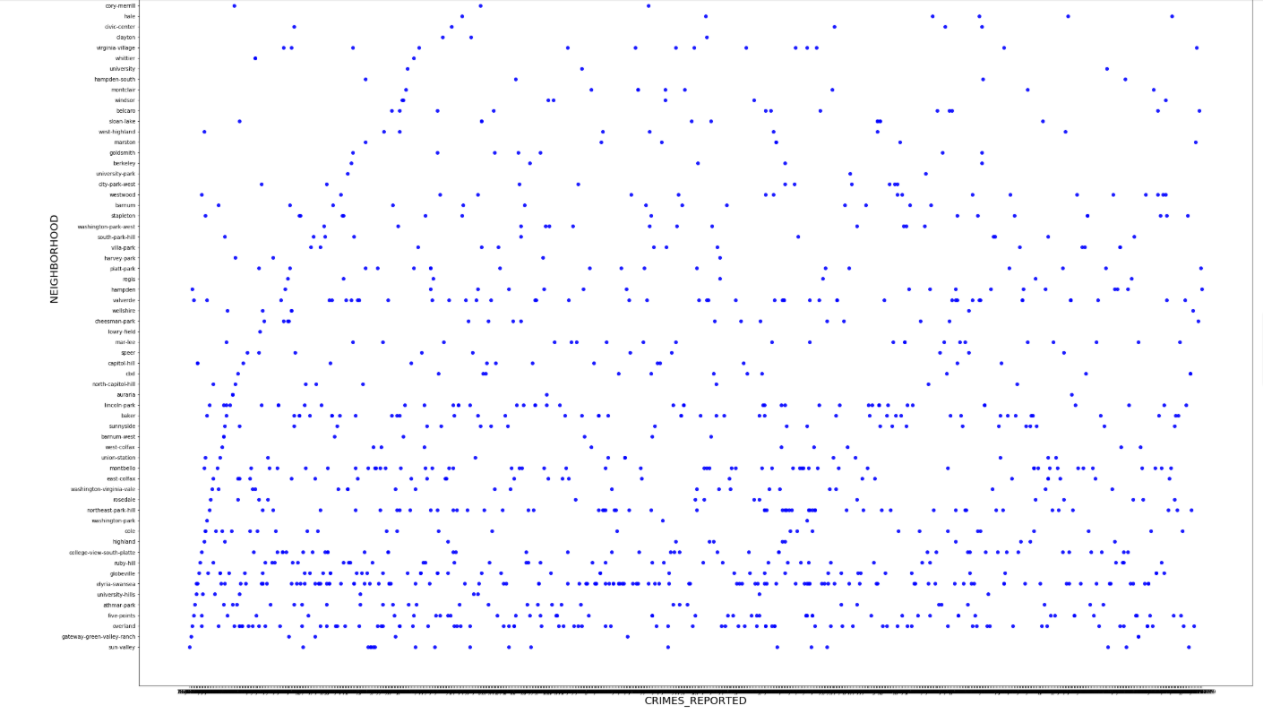
EXPLORATORY DATA ANALYSIS Identified top 4 neighborhood where highest number of crimes are reported: Elyria-Swansea Overland Northeast-park-hill Montebello

Slide 9
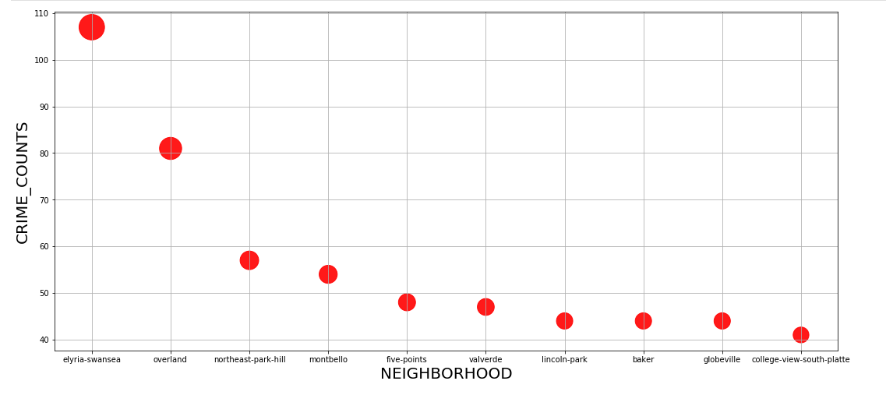
EXPLORATORY DATA ANALYSIS Identified top 4 neighborhood where highest number of crimes are reported: Elyria-Swansea Overland Northeast-park-hill Montebello

Slide 10
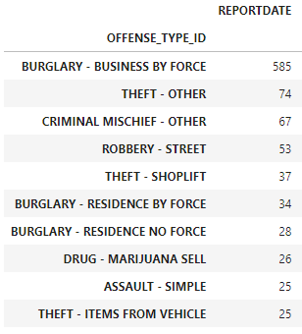
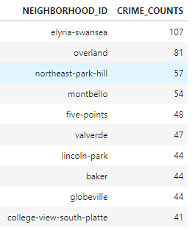
EXPLORATORY DATA ANALYSIS Identified neighborhoods with the greatest number of crimes reported Identified the most common crime reported

Slide 11
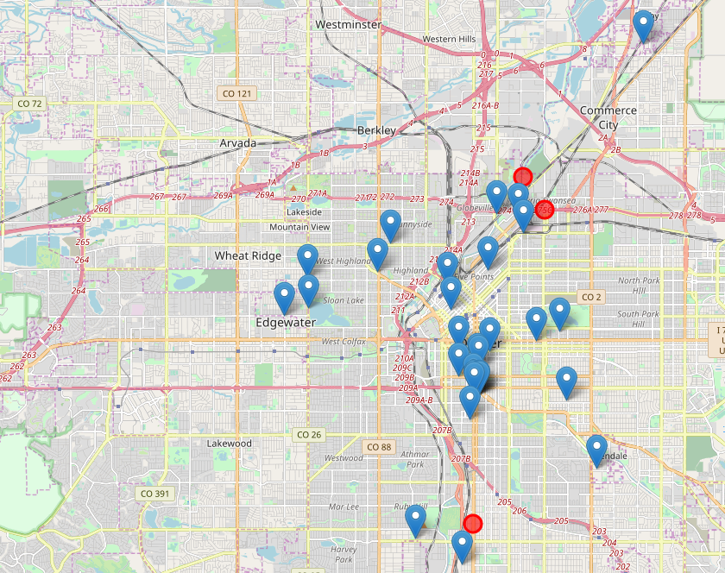
Foursquare was used to plot Marijuana related businesses (blue markers) along with these four neighborhoods (red) Elyria-Swansea Overland Northeast-park-hill Montebello

Slide 12
K-means clustering was run on the latitude and longitude data retrieved from foursquare to identify the clusters and centroid of the clusters which are safer for new businesses

Slide 13
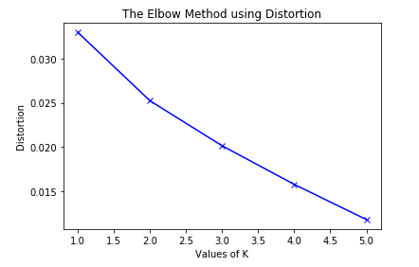
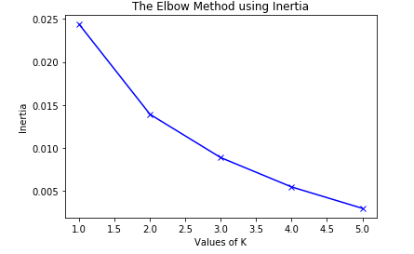
K-means clustering was run multiple times to identify how many clusters should be for the dataset.

Slide 14
K-means clustering was run multiple times to identify how many clusters should be for the dataset.

Slide 15
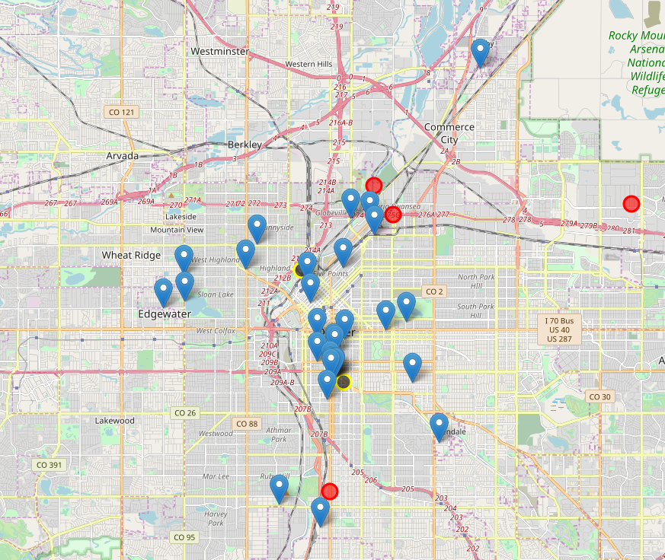
Final clustering results centroids shown in black circle with yellow outline

Slide 16
Recommendations based on the study For New Business: Since the most common reported crime is burglary to businesses using force, it is an important issue to setup the location in a safer neighborhood. Safer choice is downtown area, the Edgewater neighborhood and the Glendale neighborhood area. However, the areas around down can be expensive to setup business but better doing, that’s problem for later. Hence, just for economics sake Glendale and Edgewater neighborhoods are safer and probably less expensive than downtown area. For Users: Easy to choose downtown area if that is closer, however, the safer neighborhood are gain the Glendale and Edgewater neighborhood. For Authorities: Neighborhood and clusters of businesses near the cluster 1 near Elyria Swansea should have more surveillance to avoid increased count of similar crimes.

Slide 17




Thank You

