Slide 1
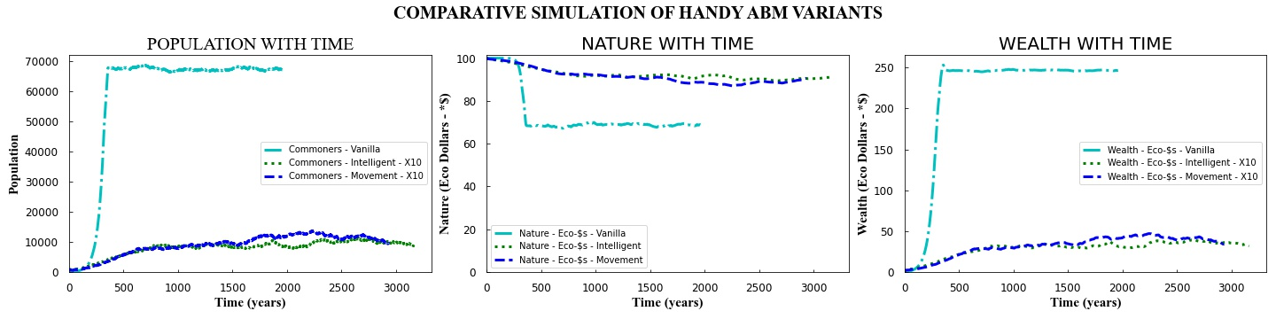
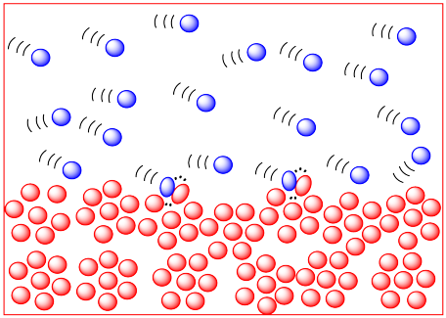
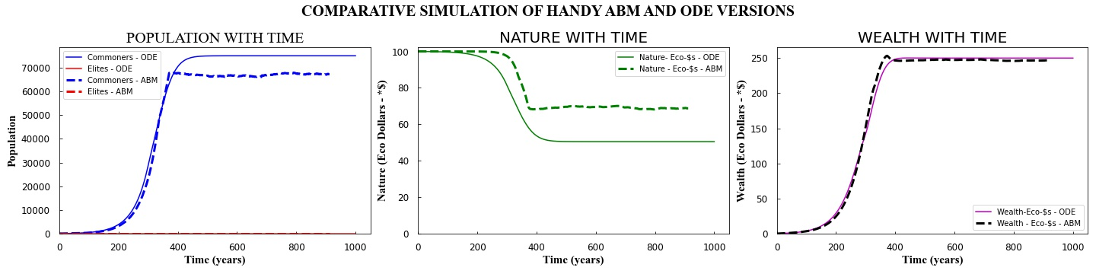

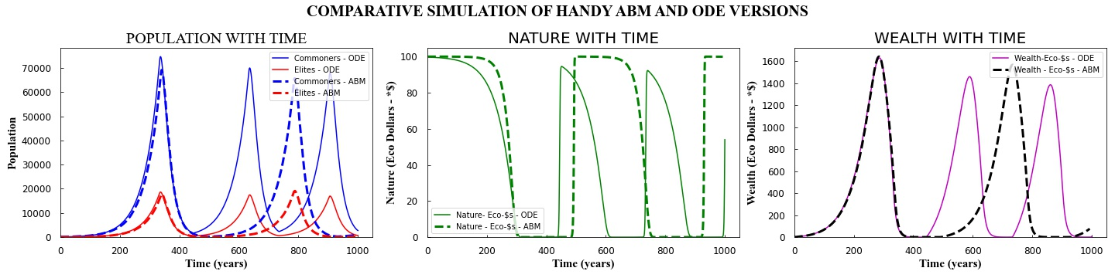


AN AGENT-BASED APPROACH TO CONSUMPTION, INEQUALITY IN DISTRIBUTION AND SUSTAINABILITY OF A LIMITED SOURCED ENERGY-DEPENDENT SOCIETY
Suman Saurabh (saurabh@utexas.edu); Carey W. King (careyking@mail.utexas.edu); Larry Lake (larry_lake@mail.utexas.edu); Michael Marder (marder@chaos.utexas.edu); Eric Abelson (abelson@mail.utexas.edu); Louis Merceron (louis.merceron@ens-lyon.fr)
Background and Motivation
Step 2: Once, the ABM was sufficiently working to produce results in agreement with ODE model, we extended the model to study the following problems:
How does movement of agents to harvest/consume resource affects the society “population/size/stability”? – (Fig. 3)
How does some level of intelligence “seeking a patch of maximum resource and then move there”, affects the society at macroscopic scale? – (Fig. 3).
Comparative results of HANDY ABM variations
The study of human and nature dynamics is a study of complex systems where, simple algorithmic actions by agents (human and nature) and interaction of one agent with other agents at “micro/individual” scale leads to the “emergence” of phenomena at macro scale. (Fig. 0)
Comparative results of ODE and ABM
Fig. 3: Comparative simulation of HANDY ABM variations.
Some extensions
Fig. 0: Molecules colliding and following simple rules causing emergence of pressure.
Various kinds of resources diffused, regenerating and non-regenerating.
Agents interacting with each other more directly and carrying their wealth.
Agents forming networks and sharing information where to go for best resources.
The demand for energy/resources by humans and their substantial footprint on the Earth, has led to the belief that such a trend is unsustainable. One model which discusses two major issues with sustainability of societies is HANDY (Human and nature dynamics) model proposed by Moteshharei et al., (2014). Two issues that lead to instability of societies in the model are, first, rapid consumption of resources before they can regenerate and second, unequal distribution of the resource leading to higher death rate of working agents.
Birth and Death are simulated using direct sampling monte carlo method.
Birth
Extracts nature
Commoners/Workers
Consume
Movement
Fig. 1: Simulation of optimal population in egalitarian society
Die
Intelligence
Birth
Elites/Non-workers
Consume
Die
Regenerating nature in logistic manner
Fig. 4:Rules of HANDY_ABM
Method
Conclusions
Consumption, Govt., Capital Formation, ΔInventory (N)
HANDY ABM model was able to reproduce the HANDY ODE results.
When the agents had to move every step and then harvest the resource the total population of society is smaller, even when macroscopically the nature-amount is the same. Perhaps because the nature is spread out or diffused in quality.
Intelligent movement by agents is where agents can seek to move to the patch where the nature is maximum within a radius. (Not very intelligent because they don’t sense other agents can also do that).
Depletion factor required for moving agents is much higher (15X) to achieve an equilibrium in egalitarian society. Also, it takes longer to reach the equilibrium.
Step 1: We formulated an agent-based model in Netlogo, an Agent-Based Modeling (ABM) software/language. First, we tried to closely replicate the results produced by HANDY ODE (Ordinary differential Equation) model (Example validation exercise presented in Figs 1 and 2).
Fig. 2: Simulation of cyclic population rise and fall in an equitable society
References
Motesharrei, S., Rivas, J., Kalnay, E., 2014. Human and nature dynamics (HANDY): Modeling inequality and use of resources in the collapse or sustainability of societies. Ecological Economics 101, 90–102. https://doi.org/https://doi.org/10.1016/j.ecolecon.2014.02.014

