Slide 1
Why a layered model?
  Easier to teach communication process.
  Speeds development, changes in one layer does not affect how the other levels works.
  Standardization across manufactures.
  Allows different hardware and software to work together.
  Reduces complexity

Slide 2
The OSI Reference Model
OSI

Slide 3
The OSI Model
OSI “ Open Systems Interconnection".
OSI model was first introduced in 1984 by the International Organization for Standardization (ISO).
  Outlines WHAT needs to be done to send data from one computer to another.
  Not HOW it should be done.
  Protocols stacks handle how data is prepared for transmittal (to be transmitted)
In the OSI model, The specification needed
  are contained in 7 different layers that interact with each other.

Slide 4
What is “THE MODEL?”
Commonly referred to as the OSI reference model.
The OSI model
  is a theoretical blueprint that helps us understand how data gets from one user’s computer to another.
  It is also a model that helps develop standards so that all of our hardware and software talks nicely to each other.
  It aids standardization of networking technologies by providing an organized structure for hardware and software developers to follow, to insure there products are compatible with current and future technologies.

Slide 5
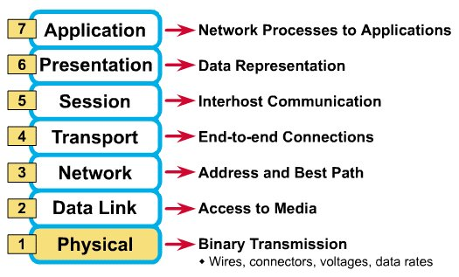
What Each Layer Does
²

Slide 6
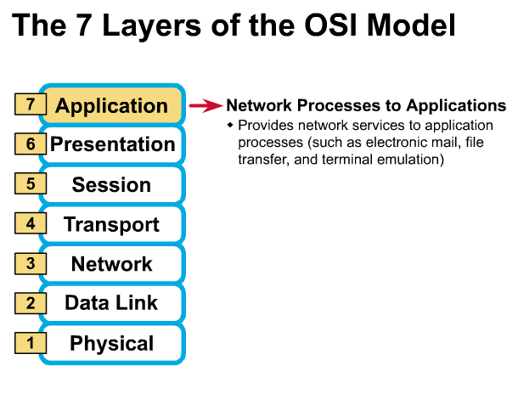
Gives end-user applications access to network resources
Where is it on my computer?
  Workstation or Server Service in MS Windows
³

Slide 7
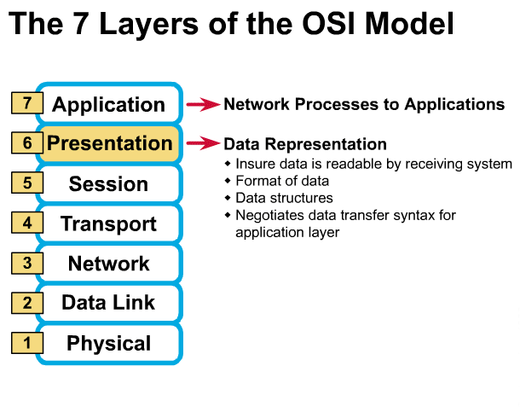
Presentation Layer
³

Slide 8
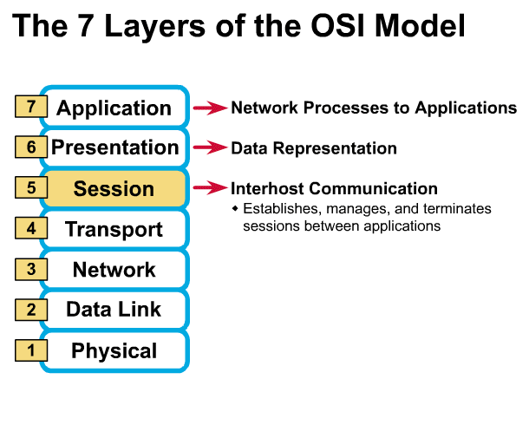
Session Layer
Allows applications to maintain an ongoing session
Where is it on my computer?
  Workstation and Server Service (MS)
  Windows Client for NetWare (NetWare)
³

Slide 9
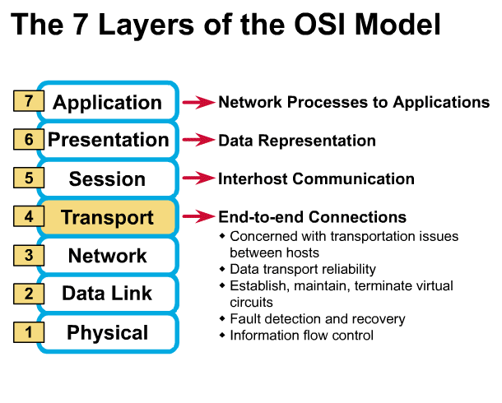
Transport Layer
Provides reliable data delivery
It’s the TCP in TCP/IP
Receives info from upper layers and segments it into packets
Can provide error detection and correction
³

Slide 10
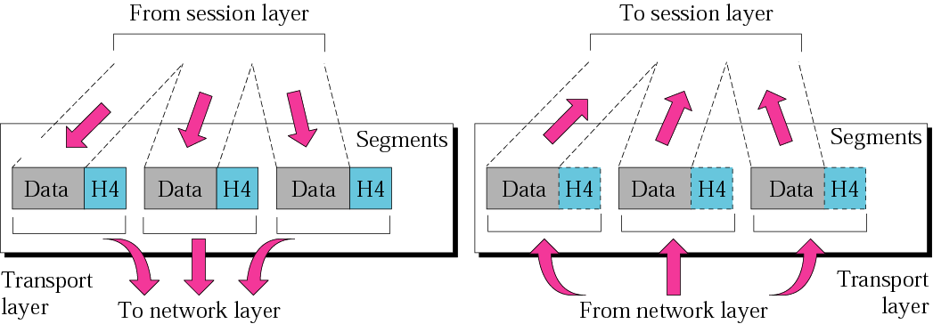
Figure 2.9 Transport layer
The transport layer is responsible for the delivery of a message from one process to another.

Slide 11
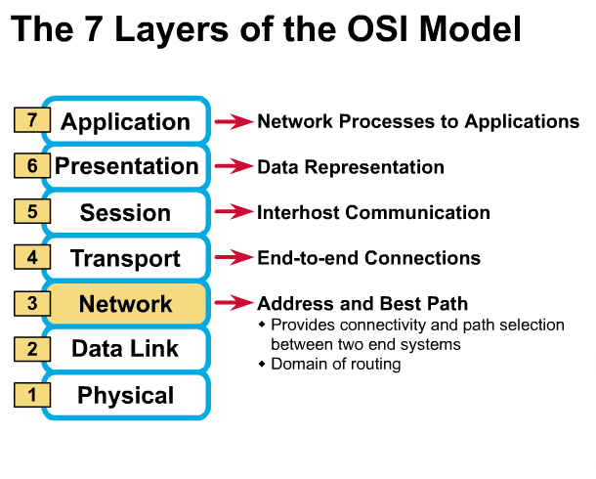
Network Layer
Provides network-wide addressing and a mechanism to move packets between networks (routing)
Responsibilities:
  Network addressing
  Routing
Example:
  IP from TCP/IP
³

Slide 12
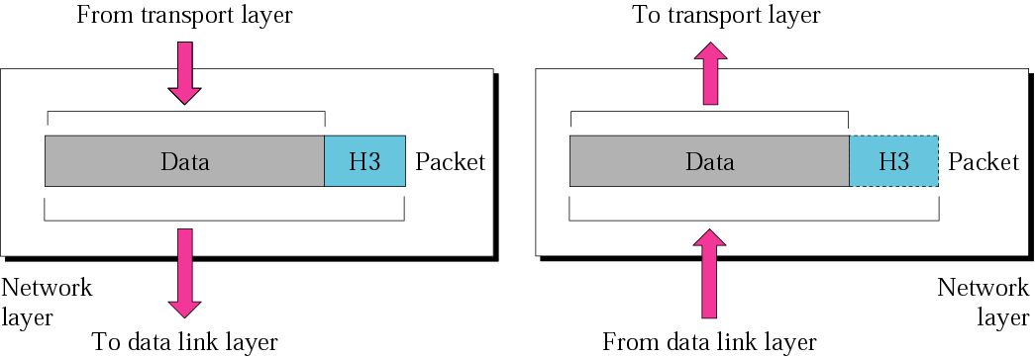
Network layer
The network layer is responsible for the delivery of individual packets from the source host to the destination host.

Slide 13
Network Addresses
Network-wide addresses
Used to transfer data across subnets
Used by routers for packet forwarding
Example:
  IP Address
Where is it on my computer?
  TCP/IP Software

Slide 14
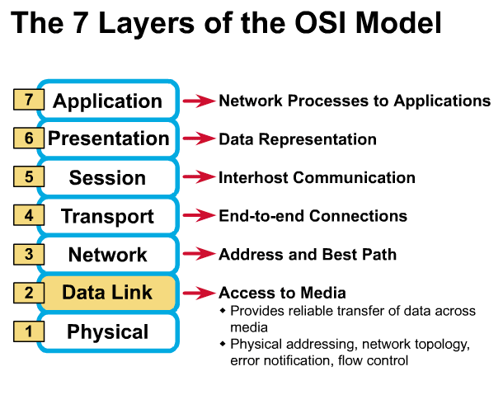
Data Link Layer
Places data and retrieves it from the physical layer and provides error detection capabilities
³

Slide 15
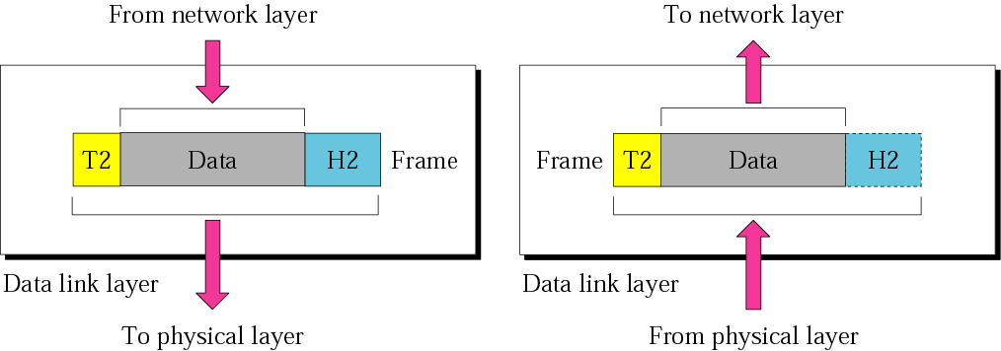
Data link layer
The data link layer is responsible for moving frames from one hop (node) to the next.

Slide 16
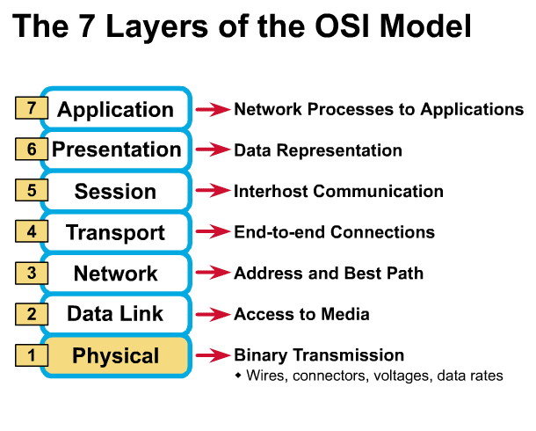
Physical Layer
Determines the specs for all physical components
  Cabling
  Interconnect methods (topology / devices)
  Data encoding (bits to waves)
  Electrical properties
Examples:
  Ethernet (IEEE 802.3)
  Token Ring (IEEE 802.5)
  Wireless (IEEE 802.11b)
³

Slide 17
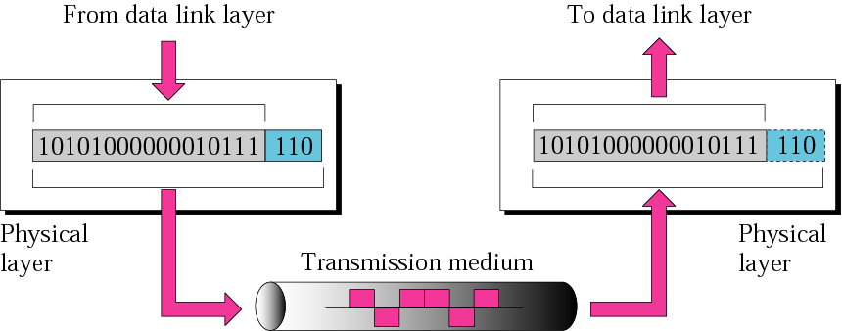
Physical layer
The physical layer is responsible
for the movement of individual bits from one hop (node) to the next.

Slide 18
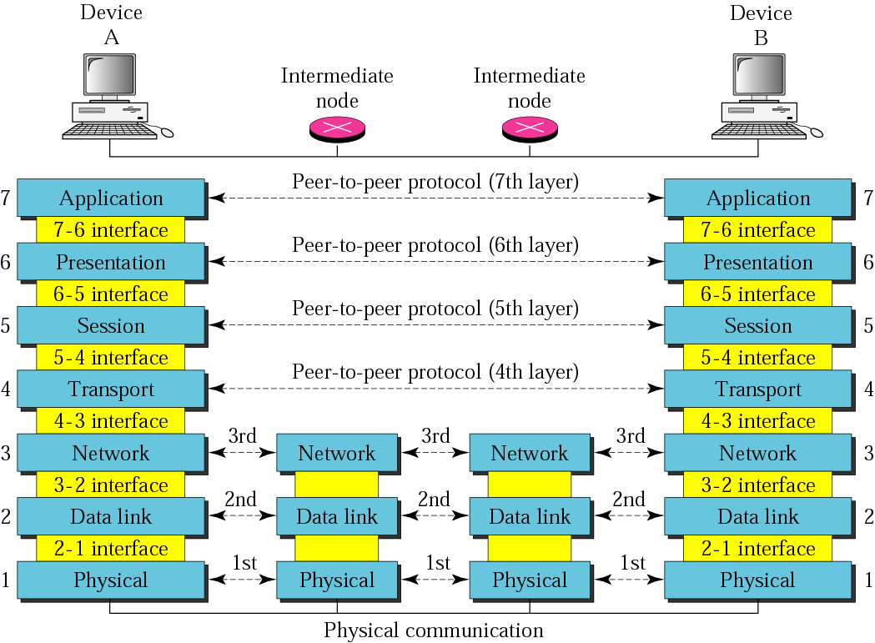
Figure 2.2 OSI layers

Slide 19
Data Encapsulation In TCP/IP
At each layer in the TCP/IP protocol stack
    Outgoing data is packaged and identified for delivery to the layer underneath
PDU – Packet Data Unit – the “envelop” information attached to a packet at a particular TCP/IP protocol
    e.g. header and trailer
Header
    PDU’s own particular opening component
    Identifies the protocol in use, the sender and intended recipient
Trailer (or packet trailer)
  Provides data integrity checks for the payload

Slide 20
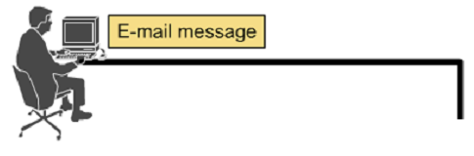




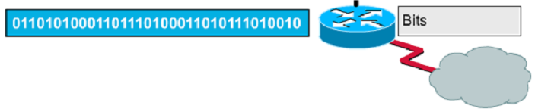
Encapsulation example: E-mail

Slide 21
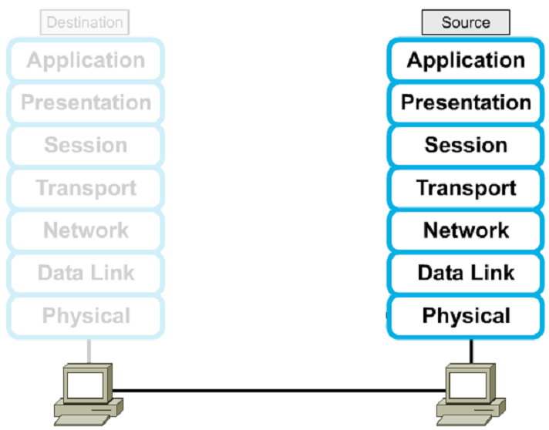




Encapsulation

Slide 22
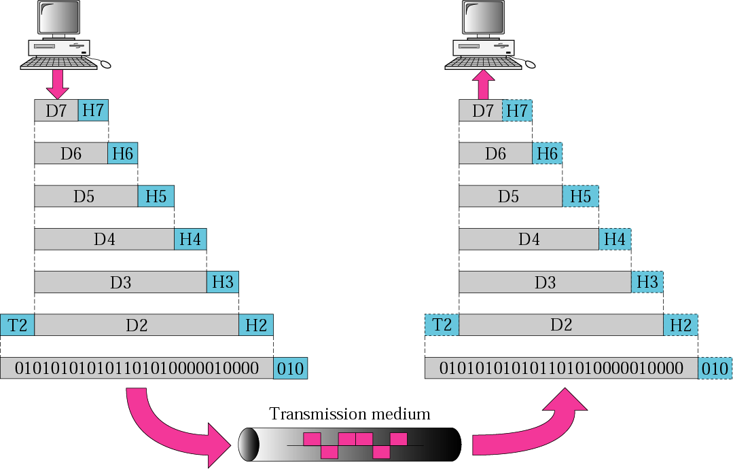
Figure 2.3 An exchange using the OSI model

Slide 23
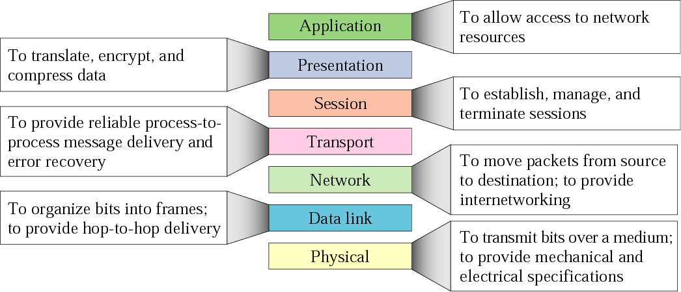
Figure 2.14 Summary of layers

Slide 24
TCP/IP model development
The late-60s The Defense Advance Research Projects Agency (DARPA) originally developed Transmission Control Protocol/Internet Protocol (TCP/IP) to interconnect various defense department computer networks.
The Internet, an International Wide Area Network, uses TCP/IP to connect networks across the world.

Slide 25
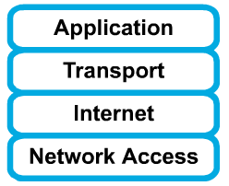
4 layers of the TCP/IP model
Layer 4: Application
Layer 3: Transport
Layer 2: Internet
Layer 1: Network access
It is important to note that some of the layers in the TCP/IP model have the same name as layers in the OSI model.
Do not confuse the layers of the two models.

Slide 26
The network access layer
Concerned with all of the issues that an IP packet requires to actually make the physical link. All the details in the OSI physical and data link layers.
  Electrical, mechanical, procedural and functional specifications.
  Data rate, Distances, Physical connector.
  Frames, physical addressing.
  Synchronization, flow control, error control.

Slide 27
The internet layer
Send source packets from any network on the internetwork and have them arrive at the destination independent of the path and networks they took to get there.
  Packets, Logical addressing.
  Internet Protocol (IP).
  Route , routing table, routing protocol.

Slide 28
The transport layer
The transport layer deals with the quality-of-service issues of reliability, flow control, and error correction.
  Segments, data stream, datagram.
  Connection oriented and connectionless.
  Transmission control protocol (TCP).
  User datagram protocol (UDP).
  End-to-end flow control.
  Error detection and recovery.

Slide 29
TCP/IP Reference Model (cont)
3. Transport layer (layer 3)
  Allows end-to-end communication
  Connection establishment, error control, flow control
  Two main protocols at this level
    Transmission control protocol (TCP),
      Connection oriented
        Connection established before sending data
        Reliable
    user datagram protocol (UDP)
      Connectionless
        Sending data without establishing connection
        Fast but unreliable

Slide 30
The application layer
Handles high-level protocols, issues of representation, encoding, and dialog control.
The TCP/IP combines all application-related issues into one layer, and assures this data is properly packaged for the next layer.
  FTP, HTTP, SMNP, DNS ...
  Format of data, data structure, encode …
  Dialog control, session management …

Slide 31
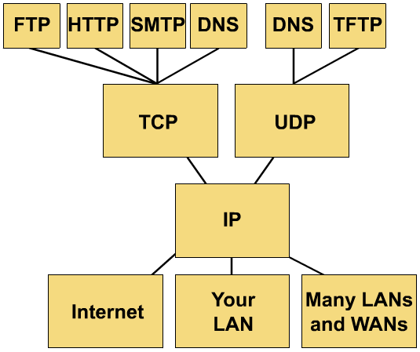
TCP/IP protocol stack

Slide 32
TCP/IP Reference Model
Layer
Protocols
Application
HTTP
TELNET
FTP
SMTP
SNMP
Transport
TCP
UDP
Internet
IP
ICMP
Network Access
(Host-to-network)
ETHERNET
PACKET RADIO

Slide 33
Protocols at the application layer
HTTP:
  browser and web server communicatin
FTP :
  file transfer protocol
TELNET:
  remote login protocol
POP3: Retrieve email
  POP3 is designed to delete mail on the server as soon as the user has downloaded it
IMAP (Internet Message Access Protocol )
  Retrieve emails,
  retaining e-mail on the server and for organizing it in folders on the serve

Slide 34
Protocols at the transport layer
    Transmission control protocol (TCP),
      Connection oriented
        Connection established before sending data
        Reliable
    user datagram protocol (UDP)
      Connectionless
        Sending data without establishing connection
        Fast but unreliable

Slide 35
Protocol at the network layer
IP
  Path selection ,
  routing and addressing
ICMP (Internet Control Message Protocol )
  sends error messages relying on IP
    a requested service is not available
    a host or router could not be reached

Slide 36
Protocols at the link layer
Ethernet
  Uses CSMA/CD
Token Ring

Slide 37
Data Formats
Application data
message
application
layer
transport
layer
TCP
header
data
TCP
header
data
TCP
header
data
segment
network
layer
IP
header
TCP
header
data
packet
data link
layer
Ethernet
header
IP
header
TCP
header
data
Ethernet
trailer
frame

Slide 38
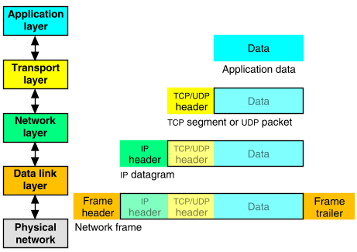
Packet Encapsulation (TCP/IP)
The data is sent down the protocol stack
Each layer adds to the data by prepending headers
22Bytes
20Bytes
20Bytes
4Bytes
64 to 1500 Bytes

Slide 39
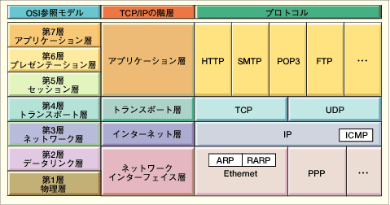
Comparing TCP/IP with OSI
OSI Model
TCP/IP Hierarchy
Protocols
7th
Application Layer
6th
Presentation Layer
Application Layer
5th
Session Layer
4th
Transport Layer
Transport Layer
3rd
Network Layer
Network Layer
2nd
Link Layer
Link Layer
1st
Physical Layer
Link Layer : includes device driver and network interface card
Network Layer : handles the movement of packets, i.e. Routing
Transport Layer : provides a reliable flow of data between two hosts
Application Layer : handles the details of the particular application

Slide 40
Internet applications
TCP/IP takes care of the hard problems
  Location of the destination host
  Making sure the data is received in the correct order and error free
Coding Internet applications
  Turns out to be straightforward.
The key concept of Internet programming is
  The client-server model

Slide 41
Client-Server model
Client and server processes operate on machines which are able to communicate through a network:
  The Server waits for requests from client
  When a request is received
  The server lookup for the requested data
  And send a response the client
Sockets and ports
  A socket is and end-point of way communication link between two programs
  A port number bound to a socket specifies the protocol need the be used at the receiving end
Example of servers
  File servers
  Web servers
Example of client applications
  Browsers
  Email clients

