Slide 1



AIR QUALITY INDEX PREDICTION

Slide 2

Learning Objectives
Understanding the impact of air pollution on health and environment.
Developing a predictive model to forecast Air Quality Index(AQI).
Enhancing skills in data analysis, machine learning, and data visualization.
GOAL
Source :
www.freepik.com/

Slide 3
Tools and Technology used
Python
Libraries like Pandas, NumPy, Scikit-learn, and Matplotlib
Jupyter Notebook for coding and visualization

Slide 4
Methodology
Data Collection : Acquiring relevant air quality datasets.
Data Preprocessing : Cleaning and transforming data for model training.
Model Development : Implementing machine learning models for AQI prediction.
Evaluation : Assessing model performance using appropriate metrics.

Slide 5
Problem Statement:
Air pollution poses a severe threat to human and environment. Predicting AQI can help in taking preventive measures to minimize exposure.

Slide 6
Solution:
Developing a machine learning model that accurately predicts AQI based on historical data and environmental parameters.

Slide 7
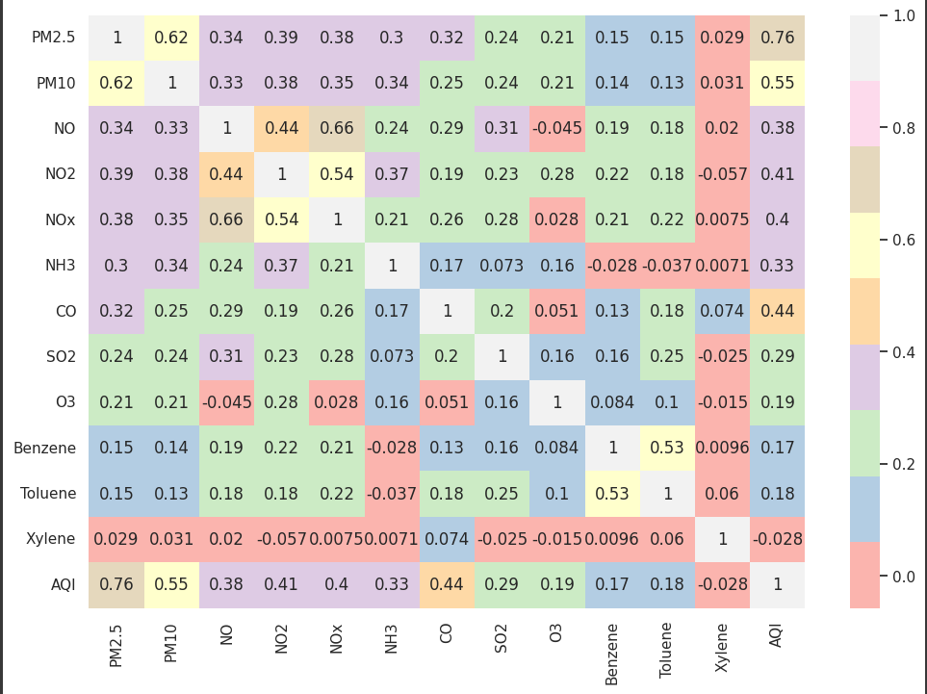
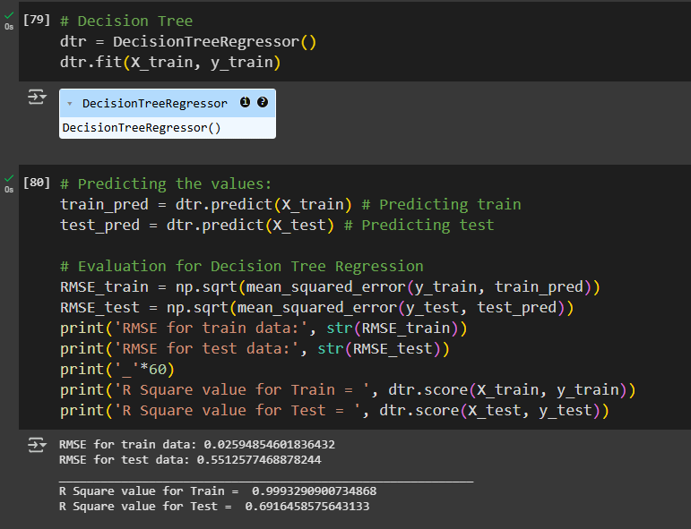
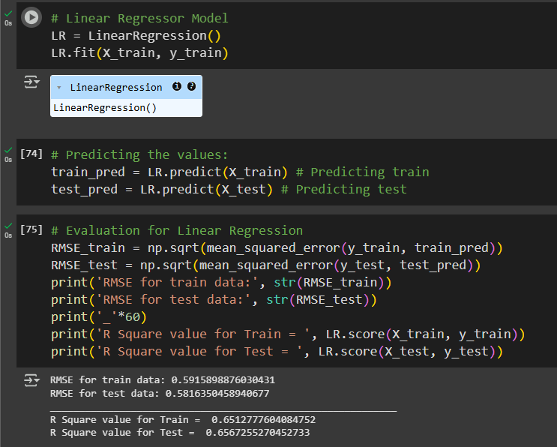
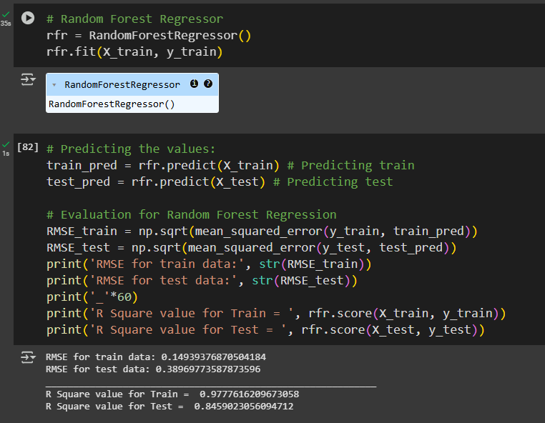
Screenshot of Output:
GitHub Link - https://github.com/sumanghosh108/Air-Quality-Index-Prediction.git

Slide 8
Conclusion:
The AQI Prediction model effectively demonstrates the use of machine learning in forecasting air quality. By analyzing historical data, the model provides accurate predictions, aiding proactive pollution control. This project emphasizes data-driven solutions for real-world challenges. Future enhancements could include real-time data integration, improved accuracy with advanced models, and web-based deployment for broader accessibility.

