Slide 1
Text
Classification

Slide 2
What is Text Classification and What does a classifier do..??
Text Classification assigns one or more classes to a document according to their content.
Classes are selected from a previously established taxonomy (a hierarchy of catergories or classes).
The Text Classification API takes care of all preprocessing tasks (extracting text, tokenization, stopword removal and lemmatization) required for automatic classification.
The algorithm combines statistical document classification with rule-based filtering, which allows to obtain a high degree of precision in a wide range of environments.
Statistical classifiers provide a means to use example documents to define each category. In turn, rule base classifiers may help to fine-tune the classification and correct the output of statistical classifiers.

Slide 3
Uses for Text Classification
Assigning subject categories, topics, or genres
Spam detection
Authorship identification
Age/gender identification
Language Identification
Sentiment analysis
…

Slide 4


Positive or negative movie
review?
unbelievably disappointing
Full of zany characters and richly applied satire, and some great plot twists
•
this is the greatest screwball comedy ever
filmed
•
It was pathetic. The worst part about it was the
boxing scenes.

Slide 5
Text Classification: definition
Input:
a document d
a fixed set of classes C = {c1, c2,…, cJ}
Output: a predicted class c ∈ C

Slide 6
Classification Methods:
Hand-coded rules
Rules based on combinations of words or other features
spam: black-list-address OR (“dollars” AND“have been selected”)
Accuracy can be high
If rules carefully refined by expert
But building and maintaining these rules is expensive

Slide 7
Classification Methods: Supervised Machine Learning
Input:
a document d
a fixed set of classes C = {c1, c2,…, cJ}
A training set of m hand-labeled documents
(d1,c1),....,(dm,cm)
Output:
a learned classifier γ:d → c

Slide 8
Classification Methods: Supervised Machine Learning
Any kind of classifier
Naïve Bayes
Logistic regression
Support-vector machines
Maximum Entropy Model
Generative Vs Discriminative
…

Slide 9
Naïve Bayes Classification
Simple (“naïve”) classification method based on Bayes rule
Relies on very simple representation of document
Bag of words

Slide 10
Bayesian Methods
Learning and classification methods based on probability theory (see spelling / POS)
Bayes theorem plays a critical role
Build a generative model that approximates how data is produced
Uses prior probability of each category given no information about an item.
Categorization produces a posterior probability distribution over the possible categories given a description of an item.

Slide 11

The bag of words
representation
I love this movie! It's sweet, but with satirical humor. The dialogue is great and the
γ
)=c
adventure scenes are fun… It
manages to be whimsical and
romantic while laughing at the conventions of the fairy tale genre. I would recommend it to just about anyone. I've seen it several times, and I'm always happy to see it again whenever I have a friend who hasn't seen it yet.
(

Slide 12
The bag of words
representation
I love this movie! It's sweet, but with satirical humor. The dialogue is great and the
γ
)=c
adventure scenes are fun… It
manages to be whimsical and
romantic while laughing at the conventions of the fairy tale genre. I would recommend it to just about anyone. I've seen it several times, and I'm always happy to see it again whenever I have a friend who hasn't seen it yet.
(

Slide 13
The bag of words representation:
using a subset of words
x love xxxxxxxxxxxxxxxx sweet xxxxxxx satirical xxxxxxxxxx xxxxxxxxxxx great xxxxxxx xxxxxxxxxxxxxxxxxxx fun xxxx xxxxxxxxxxxxx whimsical xxxx romantic xxxx laughing xxxxxxxxxxxxxxxxxxxxxxxxxxxxxx xxxxxxxxxxxxxx recommend xxxxx xxxxxxxxxxxxxxxxxxxxxxxxxxxxxx xx several xxxxxxxxxxxxxxxxx xxxxx happy xxxxxxxxx again xxxxxxxxxxxxxxxxxxxxxxxxxxxxxx xxxxxxxxxxxxxxxxx
γ
)=c
(

Slide 14
Bag of words for document
classification
?
Test
document
Machine Learning
NLP
Garbage Collection
Planning
GUI
parser language
learning training algorithm shrinkage network...
parser tag training
translation language...
garbage collection
planning temporal
...
label translation
…
memory reasoning
optimization plan
region... language...

Slide 15
Bayes’ Rule Applied to Documents and Classes
For a document d and a class c
_{P(c| d) =} P(d | c)P(c)
P(d)

Slide 16
c_{MAP} = argmax P(c| d)
Naïve Bayes Classifier (I):Task: Classify a new instance based on a tuple of attribute values
MAP is “maximum a posteriori” = most likely class
c∈C
_{= argmax} P(d | c)P(c)
Bayes Rule
P(d)
c∈C
= argmax P(d | c)P(c)
c∈C
Dropping the denominator

Slide 17
Naïve Bayes Classifier (II):Task: Classify a new instance based on a tuple of attribute values
c_{MAP} = argmax P(d | c)P(c)
c∈C
= argmax P(x₁, x₂,…, x_{n} | c)P(c)
c∈C
Document d represented as features x1..xn

Slide 18
Naïve Bayes Classifier (III):Task: Classify a new instance based on a tuple of attribute values
c_{MAP} = argmax P(x₁, x₂,…, x_{n} | c)P(c)
c∈C
O(|X|n•|C|) parameters
How often does this class occur?
Could only be estimated if a very, very large number of training examples was available.
We can just count the relative frequencies in a corpus

Slide 19
Multinomial Naïve Bayes
Independence Assumptions
P(x₁, x₂,…, x_{n} | c)
Bag of Words assumption: Assume position doesn’t matter
Conditional Independence: Assume the feature probabilities P(xi|cj) are independent given the class c.
P(x₁,…, x_{n} | c) = P(x₁ | c)• P(x₂ | c)• P(x₃ | c)•... • P(x_{n} | c)

Slide 20
Multinomial Naïve Bayes Classifier
c_{MAP} = argmax P(x₁, x₂,…, x_{n} | c)P(c)
c∈C
c_{NB} = argmax P(c_{j} )∏ P(x| c)
c∈C
x∈ X

Slide 21
Learning the Multinomial Naïve Bayes Model
First attempt: maximum likelihood estimates
simply use the frequencies in the data
doccount(C = c )
ˆ
j
P(c ) =
j
N
doc
count(w_{i}, c_{j} )
P^{ˆ}(w_{i} | c_{j} ) =
∑ count(w, c )
j
w∈V

Slide 22
Parameter estimation
count(w_{i}, c_{j} )
fraction of times word wi
P^{ˆ}(w_{i} | c_{j} ) =
∑ count(w, c )
appears
j
among all words in documents of topic cj
w∈V
Create mega-document for topic j by concatenating all docs in this topic
Use frequency of w in mega-document

Slide 23
Feature Evaluation Metrics for Naïve Bayes Classifiers:
The Naïve Bayesian classifier is very simple and efficient. But it is highly sensitive to feature selection.
So the study of feature evaluation metrics for it is very necessary. Mladenic and Grobelnik (1999) presented some good results in this area.They found that on all their binary-class domains Odds Ratio was among the best performing measures for the Naïve Bayes classifier.
As numerous text datasets are multi-class, it is natural to adapt Odds Ratio for multi-class problems. As we have not expected that the directly extending of it performs badly.
Two effective metrics for the Naïve Bayes classifier applied on multiclass datasets: Multi-class Odds Ratio (MOR) and Class Discriminating Measure (CDM).Experiments of text classification with Naïve Bayesian classifiers were carried out on two multi-class texts collections.
As the results indicate, CDM and MOR gain obviously better selecting effect than other feature selection approaches.

Slide 24
Summary: Naive Bayes is Not So Naive
Very Fast, low storage requirements
Robust to Irrelevant Features
Irrelevant Features cancel each other without affecting results
Very good in domains with many equally important features
Decision Trees suffer from fragmentation in such cases –
especially if little data
Optimal if the independence assumptions hold: If assumed independence is correct, then it is the Bayes Optimal Classifier for problem
A good dependable baseline for text classification

Slide 25
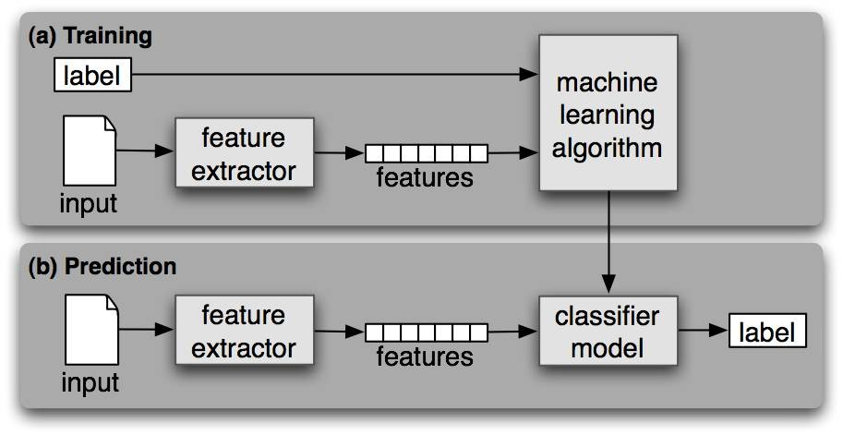
The Text Classifier
4

Slide 26
Conlcusion:
On it’s face, using text classification to understand text sounds like magical thinking. With a traditional NLP pipeline, we have to do a lot of work to understand the grammatical structure of text.
With a classifier, we’re just throwing huge buckets of text into a wood chipper and hoping for the best.
While text classification models are simple to set up, that’s not to say they are always easy to get working well.
The big catch is that you need a lot of training data. If you don’t have enough training data to cover the wide range of the ways that people write things, the model won’t ever be very accurate. The more training data you can collect, the better the model will perform.
The real art of applying text classification well is in finding clever ways of automatically collecting or creating training data.

