Slide 1


SMART INDIA HACKATHON 2024
TITLE PAGE
Problem Statement ID –1707
Problem Statement Title- Development of Geolocation
Based on attendance tracking mobile application
Theme-Human Resource Management and Attendance
Tracking
PS Category- Software
Team ID-
Team Name (Registered on the portal) InnoVentures

Slide 2
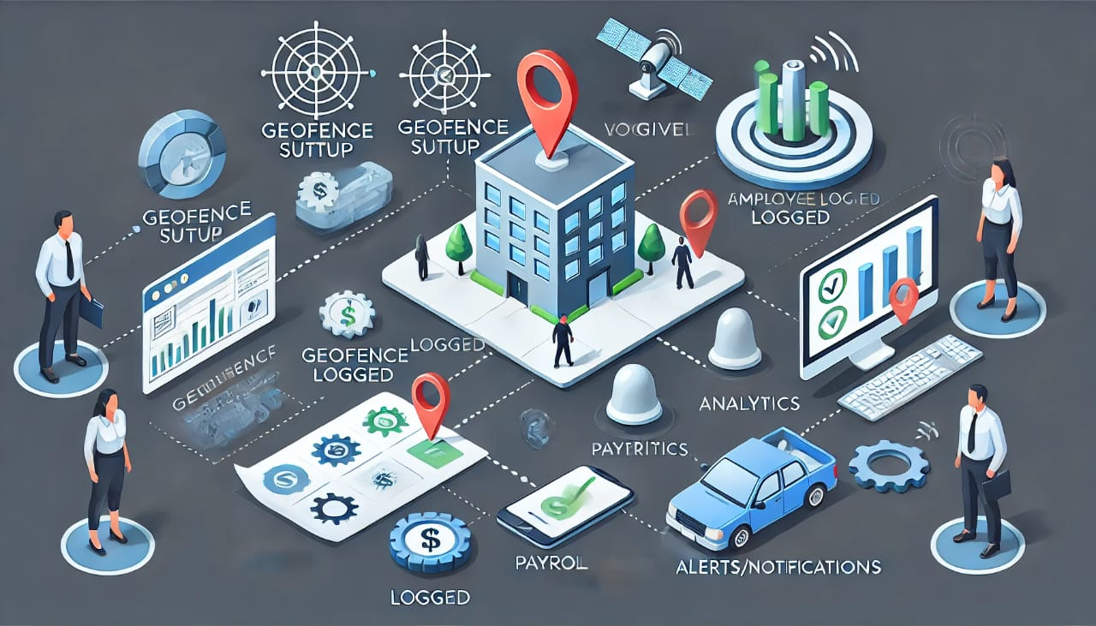
GeoTracker
InnoVentures
How does it address the problem?
Innovation and Uniqueness of the solution
Automates check-in/check-out using geolocation, reducing human errors.
Automates attendance of employees across multiple office locations.
Provides manual check-in & check-out for offsite works.
Real-time Synchronization ensures all data is accurate and securely stored.
Ensures Data Accuracy and Data Integrity
The productivity rate of the company increases based on attendance analysis.
Geofencing
Location-based Verification
Enhanced Data Security
User-friendly interface

Slide 3
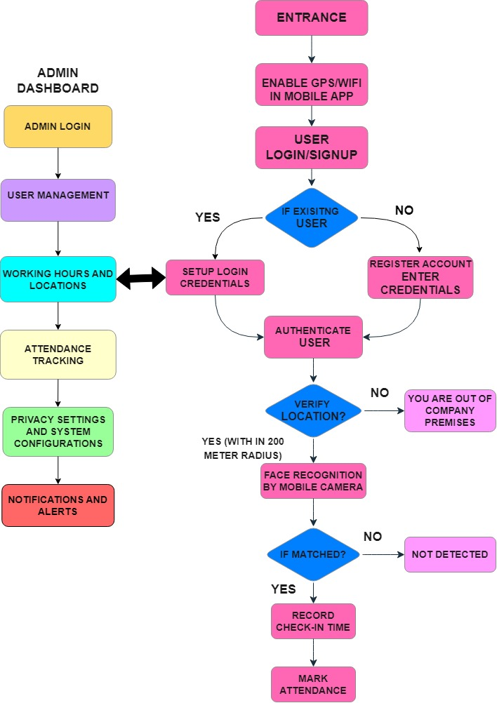




InnoVentures
Detailed Explanation of Proposed Solution
1.
2.
3.
4.
InnoVentures

Slide 4
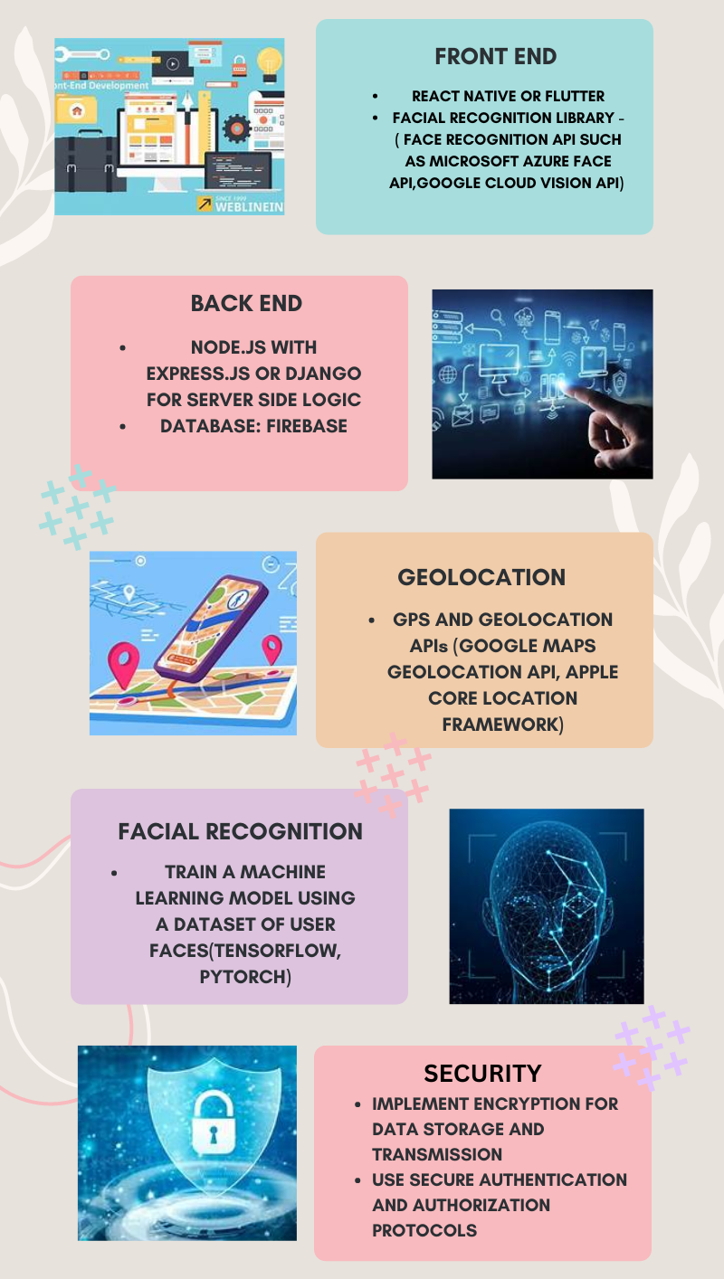
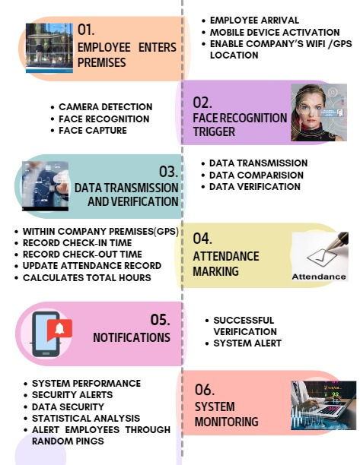
TECHNICAL APPROACH
InnoVentures
Technologies to be used
Process of Implementation and its Methodology

Slide 5
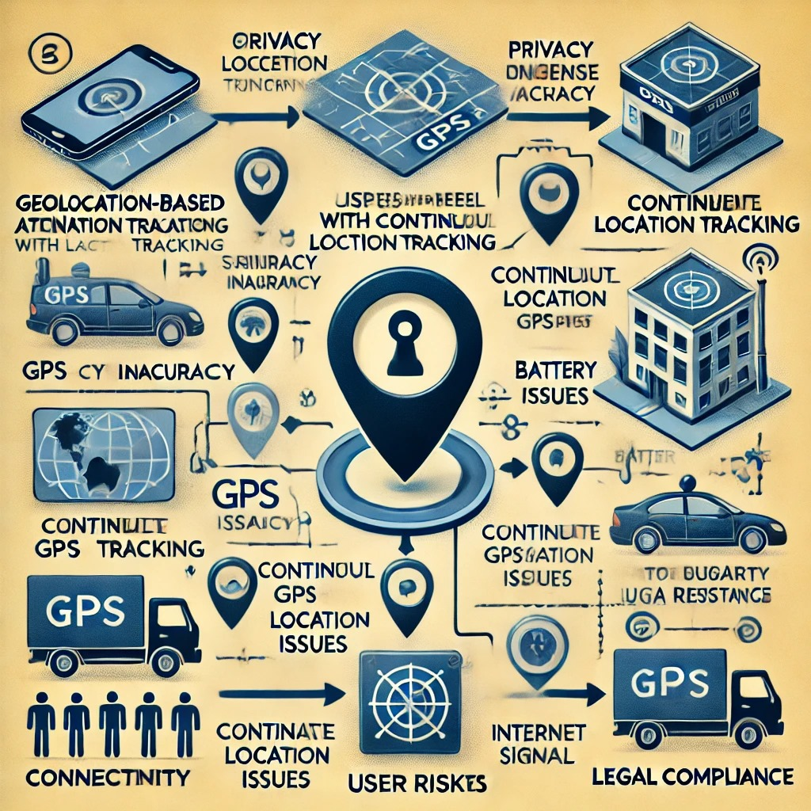
FEASIBILITY AND VIABILITY
InnoVentures
Potential Challenges and Risks
Strategies to overcome risks and challenges
Feasibility of idea
Use Wi-Fi/Network based verification
Multi-factor Authentication
Geofencing with buffer Zones and Tolerance
Integrate With biometric System
Regular audits and anomaly detection
Employe self check-in with manager approval
Mobile app integration with device sensors
Educate employees on proper uses and policies
Security measures can be implemented using encryption methods.
Continuous monitoring and updates will be required to maintain accuracy and security.
Development costs will be significant, server costs will be necessary for backend development and for data storage.

Slide 6
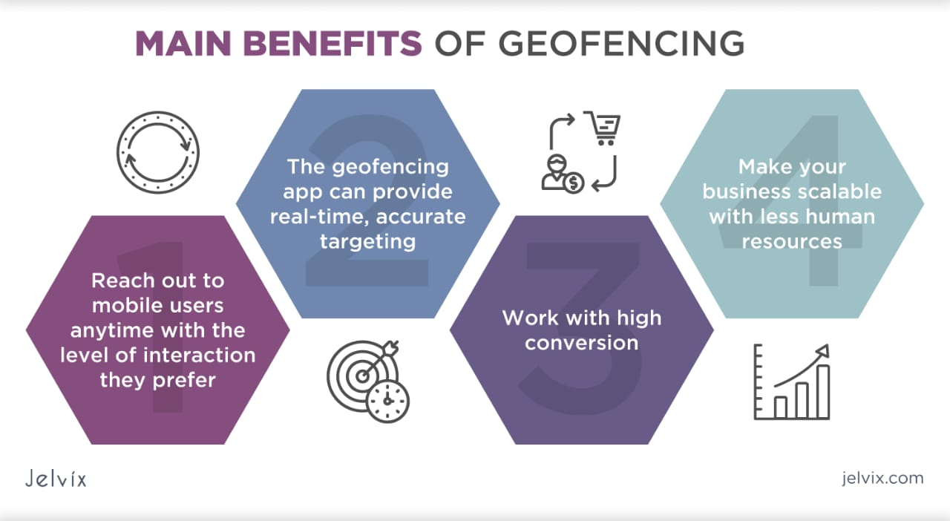





IMPACT AND BENEFITS
InnoVentures
Impacts
Better Time Management
Increased efficiency
Enhanced Transparency
Productivity Increases
Ensures data security and privacy
This Photo by Unknown Author is licensed under CC BY-SA

Slide 7
RESEARCH AND REFERENCES
InnoVentures
https://trackobit.com/blog/geofencing-attendance-system-work-and-benefits
https://www.workstatus.io/blog/workforce-management/location-based-attendance-tracking/
https://www.salarybox.in/blog/geofencing-attendance-system-the-future-of-employee-management/
https://youtu.be/AlnYmT22_Mg?si=ywYAiVMXx8X5K5O2

