Slide 1
SENTIMENT ANALYSIS
USING NAÏVE BAYES CLASSIFIER
Guide:
J. Sharmila
Team 6B
T.Pallavi - 100
P.Subodh - 77
Suman Mishra - 95
G.Bala Raju - 136
13/3/2018
<number>
CREATED BY:-

Slide 2
Introduction
Objective
sentimental analysis is the task to identify an e-text (text in the form of electronic data such as comments, reviews) to be positive or negative.
<number>

Slide 3
MOTIVATION
Sentimental analysis is a hot topic of research.
Use of electronic media is increasing day by day.
Time is money or even more valuable than money therefore instead of spending times in reading and figuring out the positivity or negativity of text we can use automated techniques for sentimental analysis.
Sentiment analysis is used in opinion mining.
Example – Analyzing a product based on it’s reviews and comments.
<number>

Slide 4
Problem Description
When we Implement a sentiment analyzer we can
suffer following problems.
1. Searching problem.
Tokenization and classification .
Reliable content identification
10/2/2014
[Project Name]
<number>

Slide 5
Continue….
Problem faced
Searching problem
We have to find a particular word in about 2500 files.
All words are weighted same for example good and
best belongs to same category.
The sequence in which words come in test data is neglected. Other issues-
Efficiency provided from this implementation Is only
40-50%
10/2/2014
[Project Name]
<number>

Slide 6
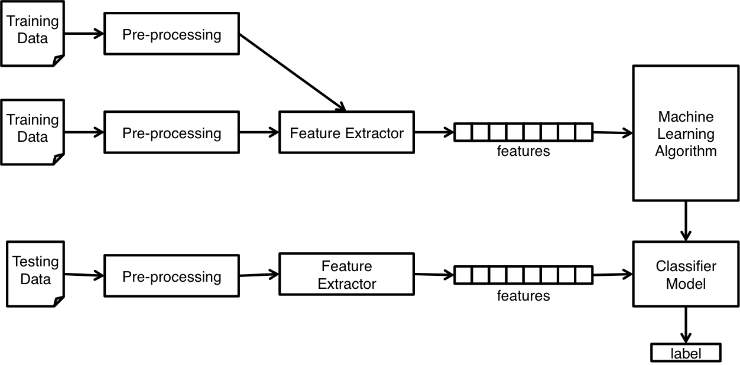
Architecture

Slide 7
Continue…
Naïve Bayes Classifier
Simple classification of words based on ‘Bayes theorem’.
It is a ‘Bag of words’ (text represented as collection of it’s words, discarding grammar and order of words but keeping multiplicity) approach for subjective analysis of a content.
Application -: Sentiment detection, Email spam
detection, Document categorization etc..
Superior in terms of CPU and Memory utilization as shown by Huang, J. (2003).
10/2/2014
[Project Name]
<number>

Slide 8
Continue…
Probabilistic Analysis of Naïve Bayes
for a document d and class c , By Bayes theorem
_{P(c | d ) =} P(d / c) P(c)
P(d )
Naïve Bayes Classifier will be - :
c* = arg maxc P(c | d )
10/2/2014
[Project Name]
<number>

Slide 9
Continue…
Multinomial Naïve Bayes Classifier
Accuracy – around 75%
Algorithm - :
Dictionary Generation
Count occurrence of all word in our whole data set and
make a dictionary of some most frequent words.
Feature set Generation
- All document is represented as a feature vector over the
space of dictionary words.
- For each document, keep track of dictionary words along with their number of occurrence in that document.
10/2/2014
[Project Name]
<number>

Slide 10
Continue…
Formula used for algorithms - :
^{φ}k |label = y
= P( x _{j}
= k | label = y)
^{φ}k|label = y =
m
n_{i}
∑∑
i =1 j =1
1{x^{(i )} = k and label ^{(i )}
= y} + 1
j
m
∑
(
1{label ^{(i )} = y}n )+ | V |
i
i =1
φ_{k|label = y} = probability that a particular word in document of
label(neg/pos) = y will be the k^{th} word in the dictionary.
n_{i}
m
= Number of words in i^{th} document.
= Total Number of documents.
<number>

Slide 11
Continue…
Training
In this phase We have to generate training data(words with
probability of occurrence in positive/negative train data files ).
Calculate P(label = y)for each label .
Calculate ^{φ}k |label = y for each dictionary words and store the
result (Here: label will be negative and positive).
Now we have , word and corresponding probability for each of
the defined label .
10/2/2014
[Project Name]
<number>

Slide 12
Continue…
Testing
Goal – Finding the sentiment of given test data file.
Generate Feature set(x) for test data file.
For each document is test set find
Decision1 = log P(x | label = pos) + log P(label = pos)
Similarly calculate
Decision2 = log P(x | label = neg) + log P(label = neg)
Compare decision 1&2 to compute whether it has
Negative or Positive sentiment.
Note – We are taking log of probabilities for Laplacian smoothing.
10/2/2014
[Project Name]
<number>

Slide 13
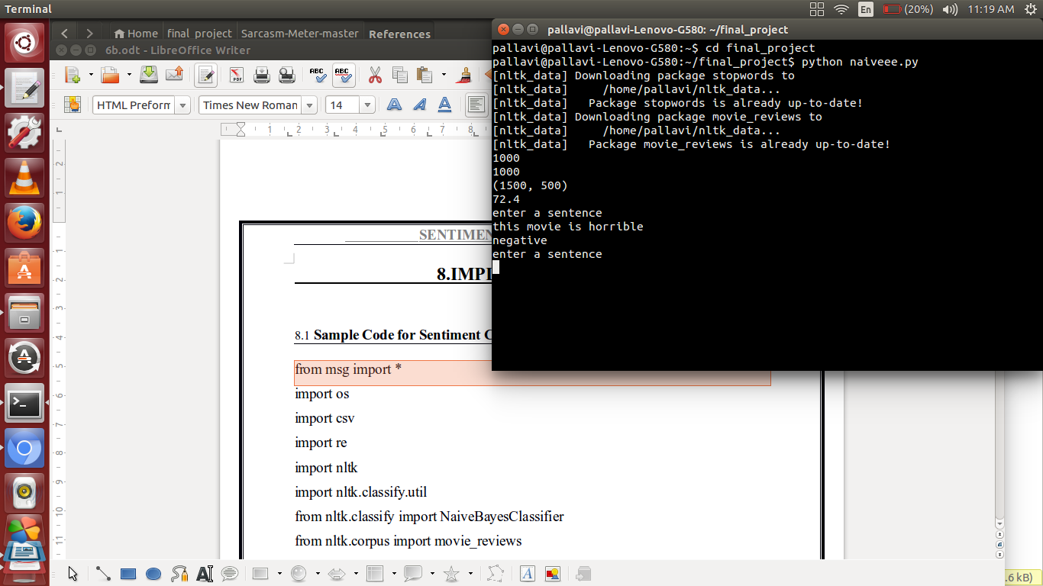
10/2/2014
[Project Name]
<number>

Slide 14
