Slide 1

Vellore Institute of Technology - VIT Bhopal
(MCA) SESSION: 2022-24
School of Computing Science Engineering (SCSE)
LAB EXPERIMENT - PROBLEM ON SINGLY LINKED LIST
UNDER THE GUIDANCE OF
G.GANESAN
SCHOOL OF CSE.
ganesan.g@vitbhopal.ac.in
SUBMITTED BY
Reg No - 22MCA10189 (VAISHNAVI)
Reg No - 22MCA10194 (VIDHI)
Reg No - 22MCA10142 (SUMAN)

Slide 2


OBJECTIVES
What is LinkedList
​LinkedList question
METHODS TO SOLVE
​OUTPUT screenshot
Why Use LinkedList Over Array?

Slide 3
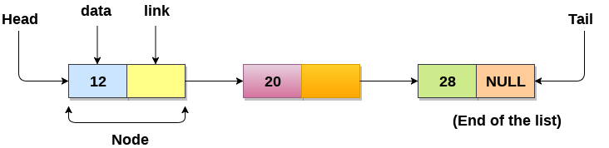
What is linked list ?
Like arrays, Linked List is a linear data structure. Unlike arrays, linked list elements are not stored at a contiguous location; the elements are linked using pointers. They include a series of connected nodes. Here, each node stores the data and the address of the next node.

Slide 4
Why Use Linked List Over Array?
The size of the arrays is fixed:
So we must know the upper limit on the number of elements in advance. Also, generally, the allocated memory is equal to the upper limit irrespective of the usage.
Insertion of a new element / Deletion of a existing element in an array of elements is expensive:
The room has to be created for the new elements and to create room existing elements have to be shifted but in Linked list if we have the head node then we can traverse to any node through it and insert new node at the required position.

Slide 5
LINKEDLIST QUESTION
GIVEN A SINGLY LINKED LIST AND A KEY, COUNT THE NUMBER OF OCCURRENCES OF THE GIVEN KEY IN THE LINKED LIST. FOR EXAMPLE, IF THE GIVEN LINKED LIST IS 1->2->1->3->1 AND THE GIVEN KEY IS 1, THEN THE OUTPUT SHOULD BE 3.​
Key = 1
Head
1
2
1
3
1
Null
OUTPUT = 3

Slide 6
Method 1- Without Recursion
Algorithm :
Step 1: Start
Step 2: Create A Function Of A Linked List, Pass A Number As Arguments And Provide The Count Of The Number To The Function.
Step 3: Initialize Count Equal To 0.
Step 4: Traverse In Linked List Until Equal Number Found.
Step 5: If Found A Number Equal To Update Count By 1.
Step 6: After Reaching The End Of The Linked List Return Count.
Step 7: Call The Function.
Step 8: Prints The Number Of Int Occurrences.
Step 9: Stop.

Slide 7
Method 2 - With Recursion
Algorithm :
Step 1: count(head, key);
Step 2: Create A Function Of A Linked List, Pass A Number As Arguments And Provide The Count Of The Number To The Function.​
Step 3: return frequency
Step 4: if(head->data == key)
Step 5: increase frequency by 1
Step 6: count(head->next, key)

Slide 8
Method 1- Without Recursion​
CODE
int count(int search_for)
{
Node current = head;
int count = 0;
while (current != null) {
if (current.data == search_for)
count++;
current = current.next;
}
return count;
}
Time Complexity: O(n) ​ Auxiliary Space: O(1)

Slide 9
Method 2 - With Recursion​
CODE
static int count(Node head, int key)
{
if (head == null)
return frequency;
if (head.data == key)
frequency++;
return count(head.next, key);
}
Time complexity: O(n) where n is size of linked list
Auxiliary Space: O(n) for call stack since using recursion

Slide 10
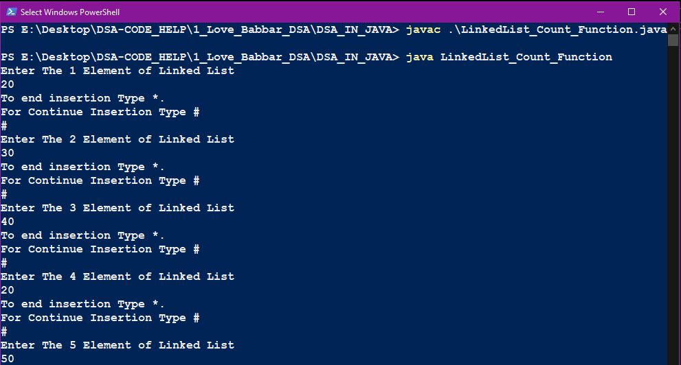
OUTPUT SCREENSHOT

Slide 11
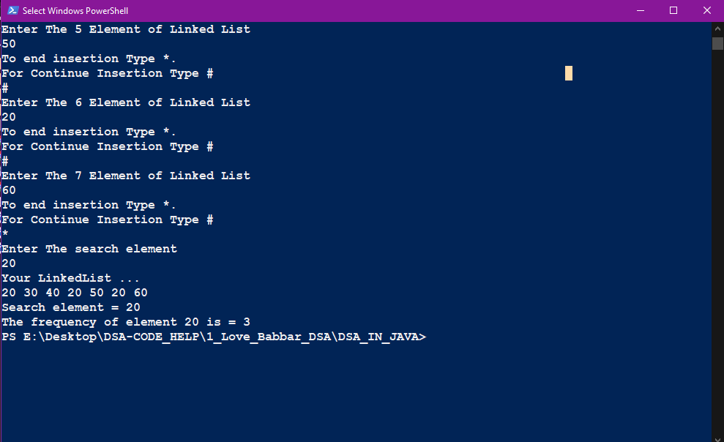
OUTPUT SCREENSHOT

Slide 12
THANK YOU

