Slide 1
Assignment
Objective: Demo the desktop application to display the bottle’s status using Pyqt5,python 3.6.9 and MongoDb

Slide 2
Environment Setup:
Create a new anaconda environment with python 3.6.9
Install the pyqt5 and pymongo packages using pip
Install MongoDB compass

Slide 3
Pre-requisite
Get the images data into local drive for display purpose
Create a document and collection in the mongoDB
Insert the images details such as status, SKU Id and unit Id in the mongoDB

Slide 4
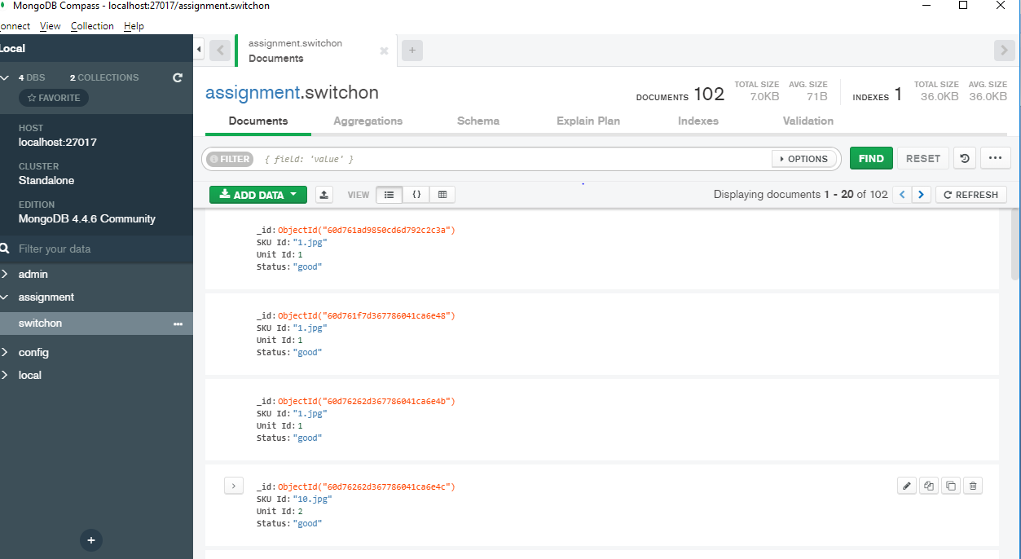
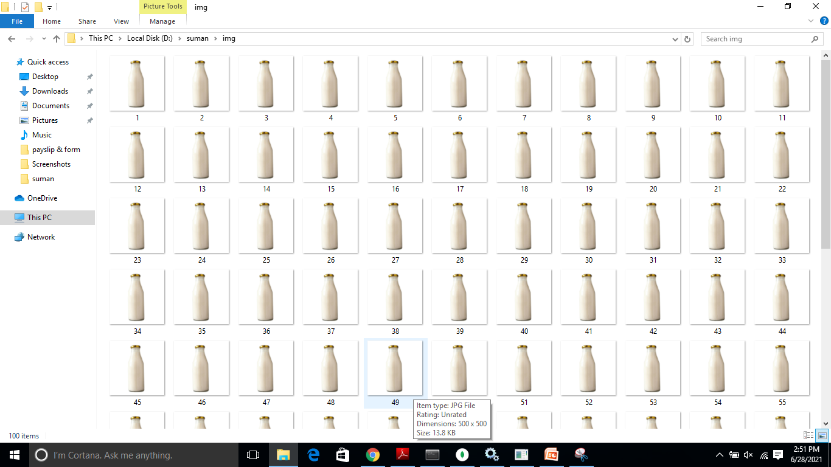
Sample mongoDB data and images data:

Slide 5
Create GUI
Create the 3 buttons All, Good and Bad
Create a Grid layout to manage the images and resize it as per the grid before it get displayed

Slide 6
Backend Process
Connect to the mongoDB using MongoClient
Get the image details such as SKU Id, Unit Id and Status
Concatenate the images and redline/green line based on the status using the Qpixmap and paitnter
Display the images and it’s status

Slide 7
Default loaded GUI
When the application launches it display’s all the images
Those images are mixed contains the bad and good bottles
The default loaded GUI is shown below.

Slide 8
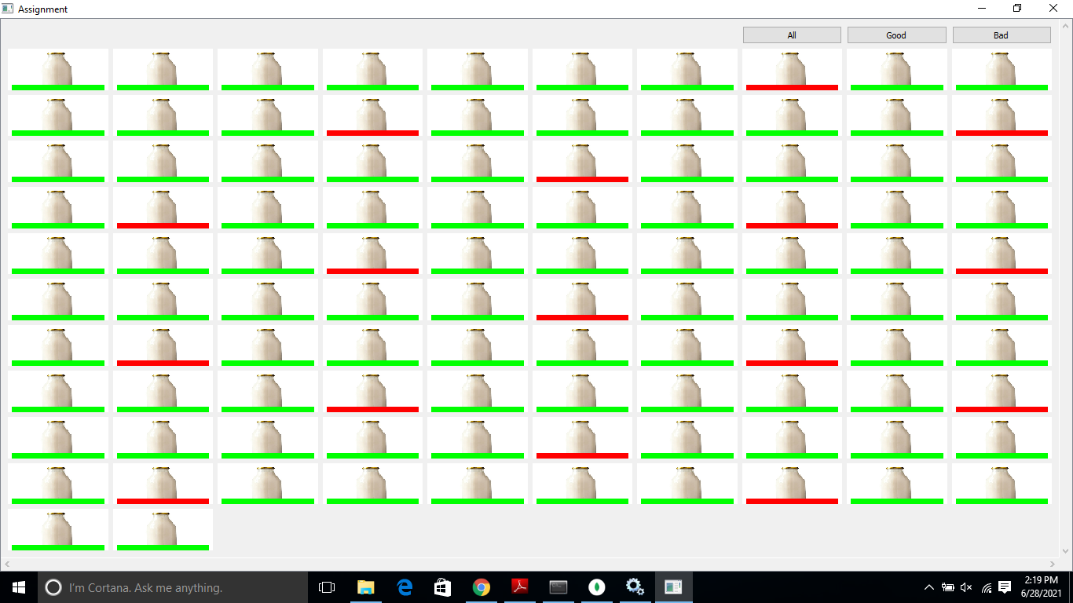

Slide 9
Good click
When clicked on the good the previous layout will be removed
A new layout is created and displayed good status bottles with green lines
Verify the below image to check the Good button functionality

Slide 10
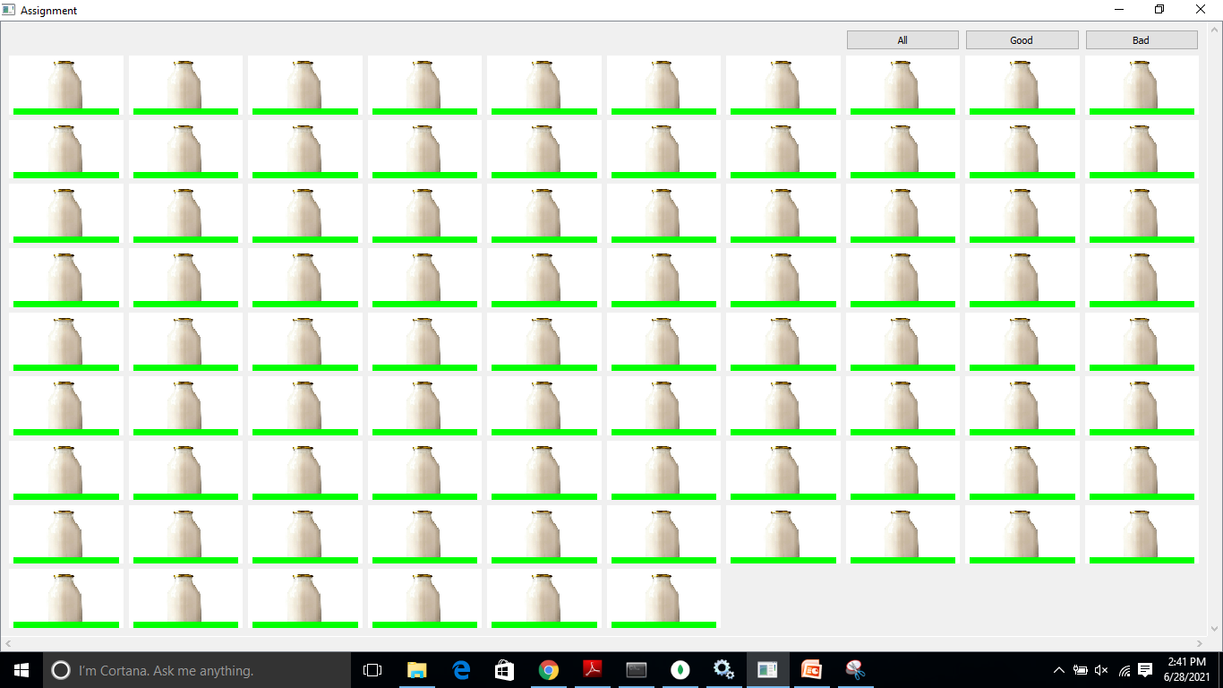

Slide 11
Bad click button
After clicking on the bad click button it removes the previous layout
Creates a new layout with bad bottles along with a red color tag
Check the functionality output in the below image

Slide 12
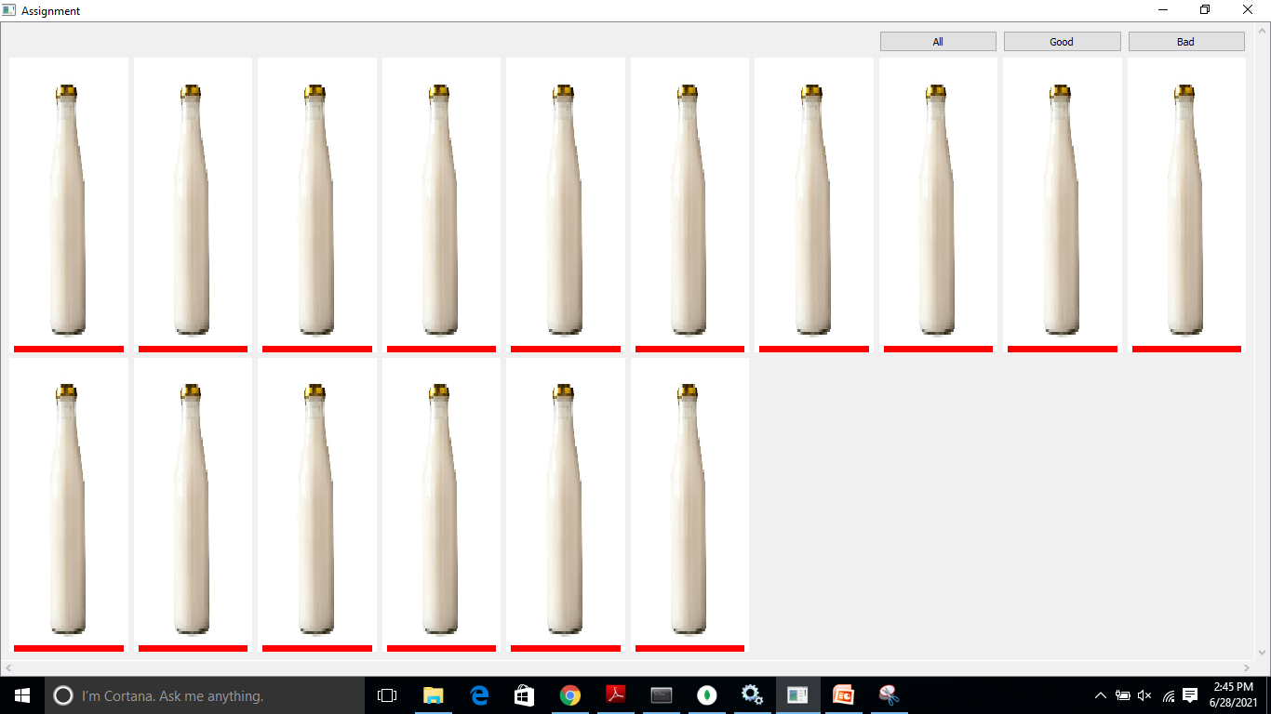

Slide 13
All button:
The previous layout is removed and add new layout with all bottles with mixed status
Check the functionality output in the below image

Slide 15
Thank you

