Slide 1
WEEK 1 • FINAL PRESENTATION
Data Cleaning,
Sales Analysis
& Visualization
From raw data quality checks to evidence-based business insights and a Power BI dashboard.
WeIntern Pvt Ltd • Python • Pandas • Jupyter Notebook • Power BI

Slide 2
Week 1 in one view
Three connected tasks, one end-to-end analytical workflow
01 Clean
02 Analyze
03 Visualize
Customer Shopping Behavior
Sample Superstore
Power BI Dashboard
3,900 raw rows
5,009 unique orders
1-page dashboard
Nulls • duplicates • validation
Cleaned dataset saved separately
KPIs • trends • customers
Regions • categories • products
Bar • line • pie • KPI cards
Filters + business interpretations
The key discipline throughout: use the correct data grain, document decisions, and separate observations from recommendations.

Slide 3
Task 1 — cleaning before analysis
Customer Shopping Behavior dataset
RAW DATA
MISSING
DUPLICATES
CLEAN OUTPUT
3,900 × 18
37
0
3,900 × 19
rows × columns
Review Rating • 0.95%
fully duplicated rows
0 missing values
Imputed missing Review Rating using the median within each product category.
Standardized column names to lowercase snake_case.
Created age_group and purchase_frequency_days for downstream analysis.
Validated age, purchase amount, previous purchases, and categorical whitespace.
Removed promo_code_used after confirming it duplicated discount_applied.
Outcome: all 3,900 records were preserved while completeness, consistency, and usability improved.

Slide 4
Task 2 — core sales performance
Order-based metrics use DISTINCT Order ID because the dataset is at order-line level
TOTAL REVENUE
TOTAL ORDERS
AVG ORDER VALUE
UNITS SOLD
$2.30M
5,009
$458.61
37,873
$2,297,200.86
unique Order IDs
Revenue ÷ Orders
sum of Quantity
Top category
Top revenue-generating product
Technology
Canon imageCLASS 2200
Advanced Copier
$836,154.03 • 36.40% of revenue
$61,599.82

Slide 5
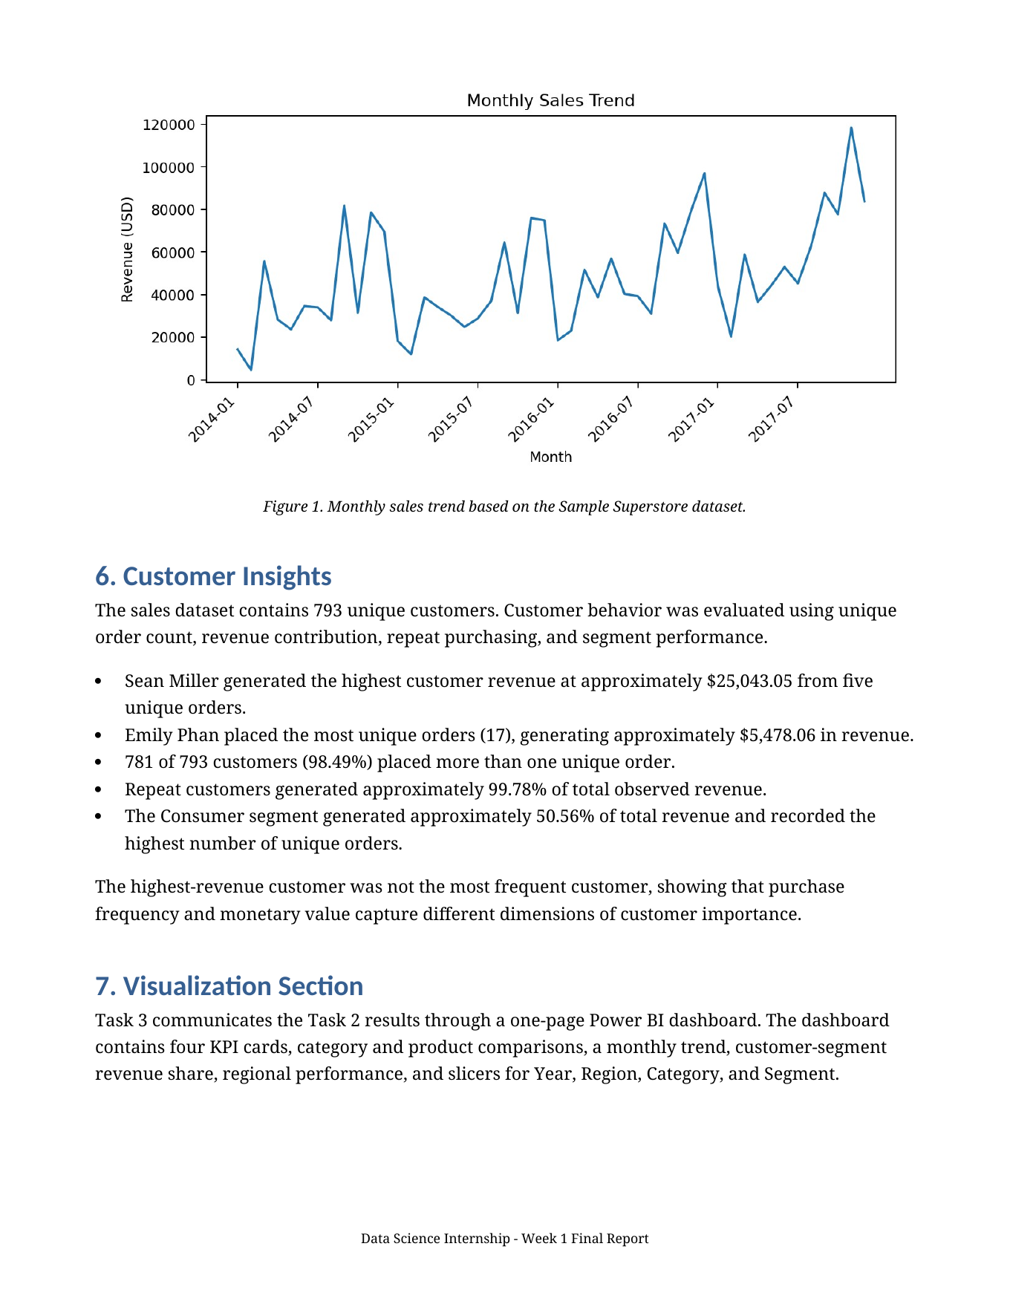
Sales momentum strengthened in the later years
Revenue dipped in 2015, then accelerated in 2016 and 2017
Year-over-year revenue
2014
$484K
baseline
2015
$471K
−2.83%
2016
$609K
+29.47%
2017
$733K
+20.36%
Peak month: November 2017 — ~$118,448 revenue, 261 orders, 1,840 units. The data shows the pattern, not its cause.
Report screenshot used as evidence

Slide 6
Customer behavior — frequency and value are different
793 unique customers in the sales dataset
REPEAT CUSTOMERS
REPEAT REVENUE SHARE
CONSUMER SHARE
98.49%
99.78%
50.56%
781 of 793 customers
of observed revenue
largest customer segment
Highest-value customer
Most frequent customer
Sean Miller
Emily Phan
$25,043.05 revenue • 5 orders
17 orders • $5,478.06 revenue
Implication: customer value should be evaluated using both purchase frequency and monetary contribution.

Slide 7
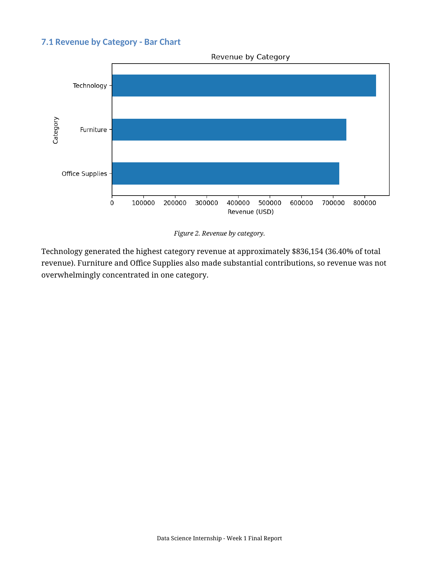
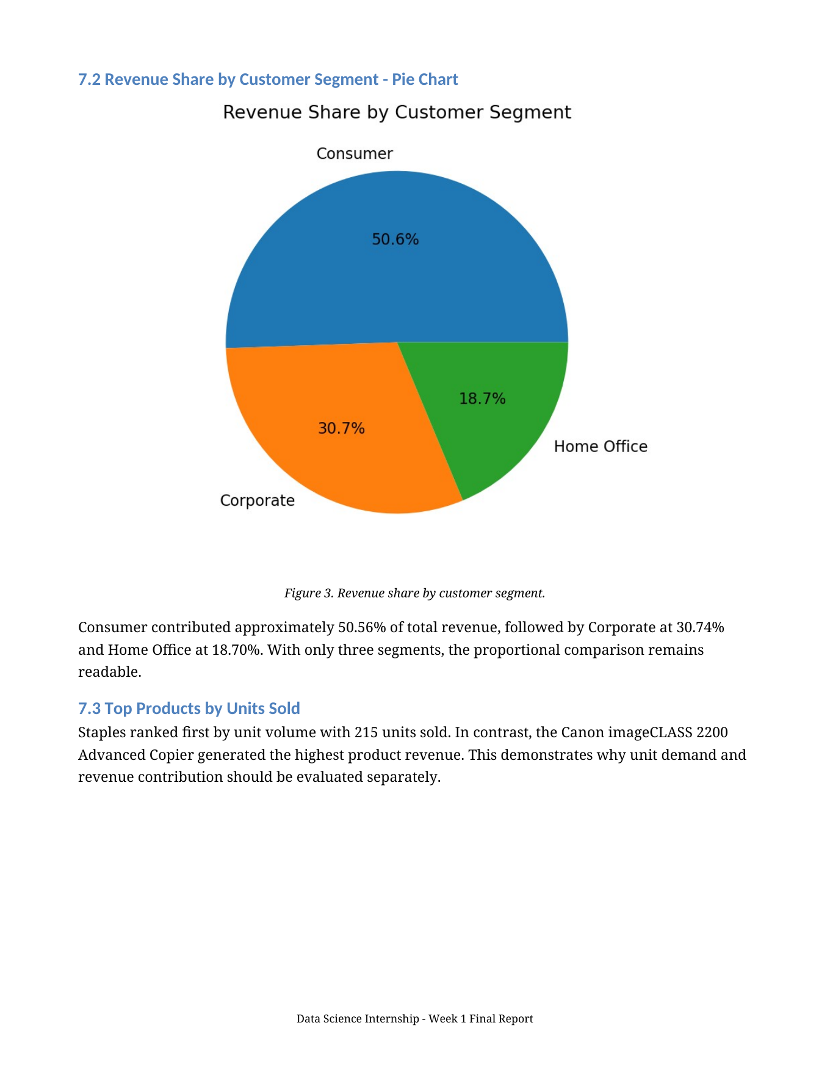
Dashboard story — category and customer mix
Screenshots from the final report visual section
Technology leads revenue
$836K • 36.40% share
Consumer is the largest segment
50.56% revenue share

Slide 8
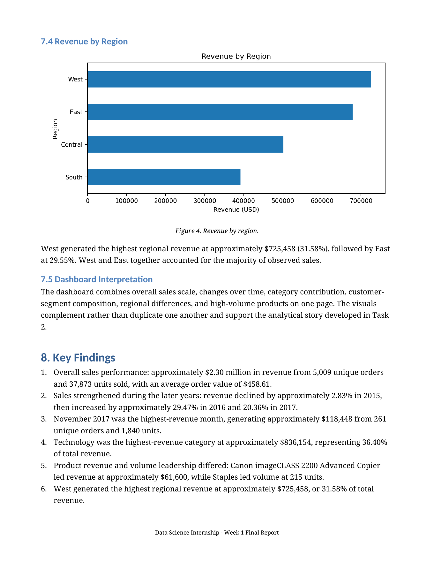
Geography and product performance
Revenue leadership and unit-volume leadership are not the same thing
Regional leader
WEST
$725,458 • 31.58%
Product contrast
Staples
Canon imageCLASS 2200
215 units • highest volume
$61.6K • highest revenue
Inventory and merchandising decisions should consider both unit demand and monetary contribution.

Slide 9
What the analysis tells us
Eight findings distilled into four business themes
Growth
Portfolio
$2.30M revenue
Technology leads
Later-year momentum strengthened; Nov 2017 was the peak month.
But all three categories contribute materially to revenue.
Customers
Market
Repeat behavior dominates
West leads regionally
98.49% repeat customers generated 99.78% of revenue.
West contributed 31.58%; East followed at 29.55%.
The dataset supports these descriptive findings; it does not by itself establish why the patterns occurred.

Slide 10
Recommended next actions
Potential actions derived from the observed patterns — not causal conclusions
01
Retention
02
Diagnose growth
Evaluate loyalty and repeat-purchase initiatives while monitoring acquisition.
Investigate promotions, product mix and customer activity behind 2016–2017 strength.
03
Dual product lens
04
Balanced portfolio
Use both revenue and unit volume in inventory and merchandising decisions.
Support Technology leadership without neglecting Furniture and Office Supplies.
05
Regional deep dive
06
Segment planning
Compare profitability, customer density and product mix across regions.
Tailor engagement by segment while preserving Corporate and Home Office focus.
Decision principle: validate the “why” with additional operational evidence before acting on a causal explanation.

Slide 11
Close — what to remember
A complete Week 1 workflow from raw data to business communication
Three takeaways
Q&A
Data quality decisions were documented and validated before analysis.
Correct order-level logic produced reliable KPIs and customer insights.
The Power BI dashboard translated the analysis into a concise visual story.
$2.30M
revenue analyzed
5,009
Key limitation
Task 1 and Tasks 2/3 use separate datasets; sales patterns are descriptive and do not establish causality.
unique orders

