Slide 1
PLANT DISEASES DETECTION & CLASSIFICATION USING DEEP LEARNING TECHNIQUES
Team Members:
Abrar Ahmed - 12023006015040
Atrika Show - 12023006015114
Suman Paul - 12023006015035
Sudip Pattanayak - 12023006015030
Manshi Chaturvedi - 12023006015071

Slide 2
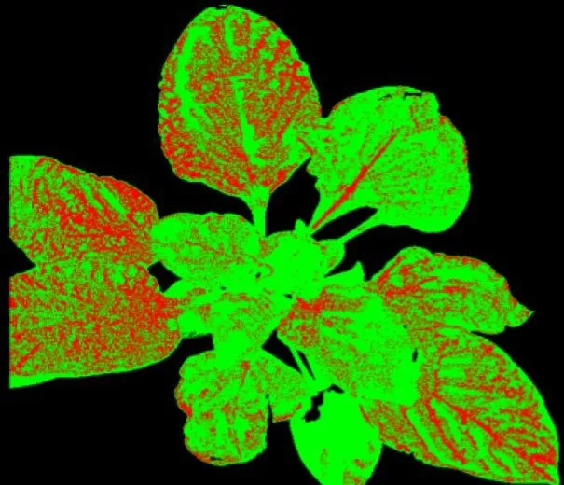
Abstract
The project aims to design a machine learning model for detecting potato plant diseases like early blight and late blight using a CNN implemented with TensorFlow. The model achieves 99% accuracy in classifying leaves into healthy, early blight, or late blight categories.

Slide 3
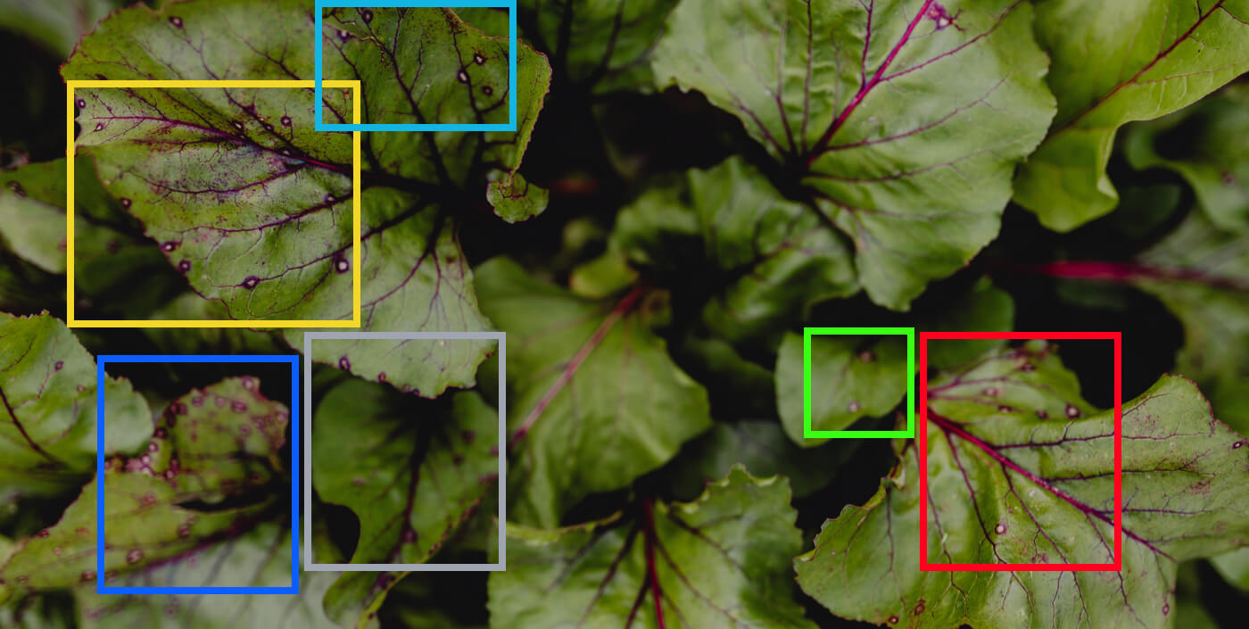
Objectives
Develop a machine learning model for potato leaf disease detection.
Classify leaf images into healthy, early blight, and late blight categories.
Support farmers by providing early disease detection tools.

Slide 4

Methodology
Used Convolutional Neural Networks (CNN) for image classification.
Preprocessed images: resized to 256x256 pixels, normalized pixel values.
Data augmentation techniques: rotation, flipping, zooming.

Slide 5
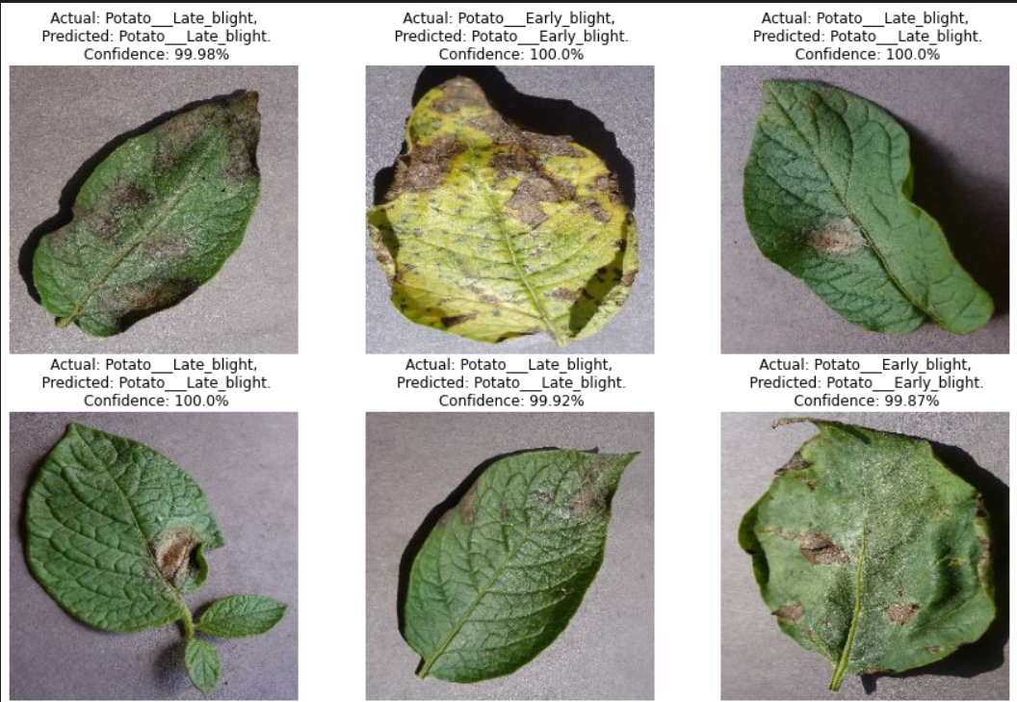
Results
Achieved 99% accuracy on test data.
No misclassifications observed in the confusion matrix.
High generalization and robustness demonstrated.

Slide 6

Challenges
Dataset variability due to environmental conditions.
Balancing data augmentation to avoid overfitting.
Generalizing the model for real-world applications.

Slide 7
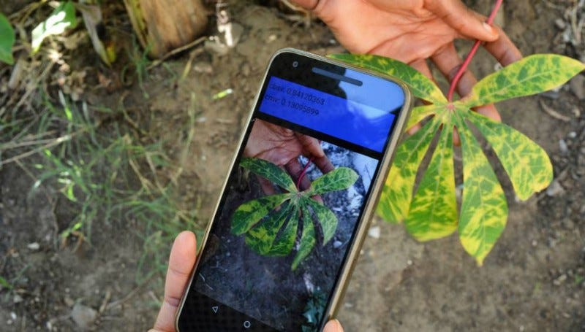
Future Scope
Expand dataset for improved robustness.
Develop mobile and web-based real-time detection applications.
Adapt the model to other crops beyond potatoes.

Slide 8
References
Ferentinos, K. P. (2018). 'Deep learning models for plant disease detection.'
Mohanty, S. P., Hughes, D. P., & Salathe, M. (2016). 'Using deep learning for plant disease detection.'
Shorten, C., & Khoshgoftaar, T. M. (2019). 'A survey on image data augmentation for deep learning.'

