Slide 1

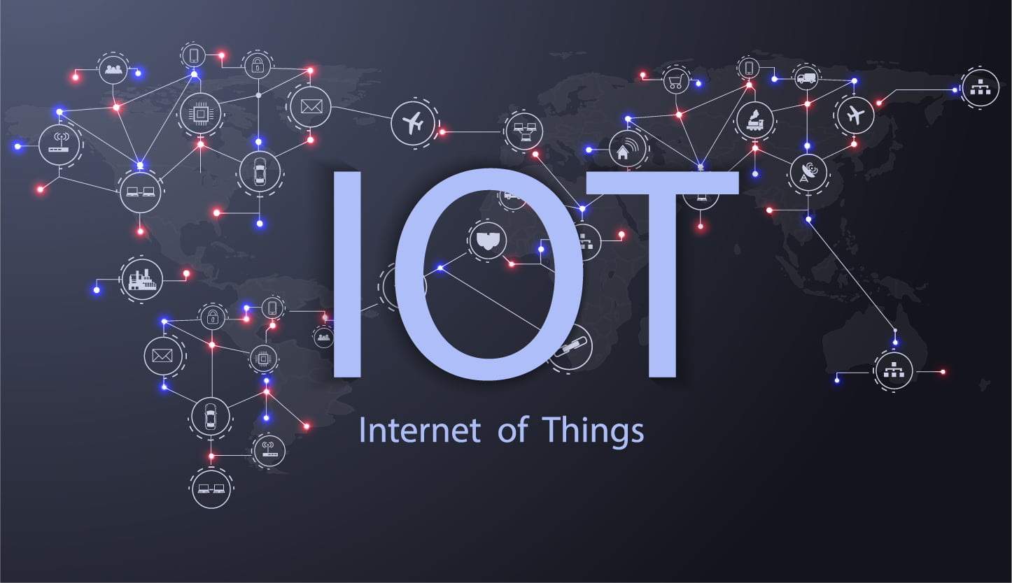
National Institute of Science & Technology
Suman Priya Sahu - CSE/201711357 & Manisha Panda- CSE/ 201741413
[1]

Slide 2
CONTENT
What is IOT?
Working
Components used in IOT.
Types of Sensors.
Enhancement of IOT in present trends.
Current Technologies.
IOT based on Real life devices.
Conclusion
National Institute of Science & Technology
Suman Priya Sahu - CSE/201711357 & Manisha Panda- CSE/ 201741413
[2]

Slide 3
IOT – Internet of Things
The Internet of Things (IOT) refers to a system of interrelated, internet-connected objects that are able to collect and transfer data over a wireless network without human intervention.
It generally used to monitor and control the mechanical, electrical and electronic systems used in various types of buildings (e.g., public and private, industrial, institutions, or residential) in home automation and building automation systems.
The Internet of Things (IOT) describes the network of physical objects—“things”—that are embedded with sensors, software, and other technologies for the purpose of connecting and exchanging data with other devices and systems over the internet.
National Institute of Science & Technology
Suman Priya Sahu -CSE/201711357 & Manisha Panda- CSE/ 201741413
[3]

Slide 4
Working of IOT
How IOT works :-
An IOT consists of web-enabled smart devices that use embedded systems, such as processors, sensors and communication hardware, to collect, send and act on data they acquire from their environments. These devices share the sensor data they collect by connecting to an IOT gateway or other edge device where data is either sent to the cloud to be analyzed. Sometimes, these devices communicate with other related devices and act on the information they get from one another. The devices do most of the work without human intervention, although people can interact with the devices -- for instance, to set them up, give them instructions or access the data.
The connectivity, networking and communication protocols used with these web-enabled devices largely depend on the specific IOT applications deployed.
IOT can also make use of artificial intelligence (AI) and machine learning to aid in making data collecting processes easier and more dynamic.
National Institute of Science & Technology
Suman Priya Sahu - CSE/201711357 & Manisha Panda- CSE/ 201741413
[4]

Slide 5
Components of IOT
A complete IOT system integrates four distinct components: sensors/devices, connectivity, data processing, and a user interface.
Sensors/Devices:-
First, sensors or devices collect data from their environment. This could be as simple as a temperature reading or as complex as a full video feed because multiple sensors can be bundled together or sensors can be part of a device that does more than just sense things.
For example, phone is a device that has multiple sensors (camera, accelerometer, GPS, etc), but phone is not just a sensor.
However, whether it’s a standalone sensor or a full device, in this first step data is being collected from the environment by something..
National Institute of Science & Technology
Suman Priya Sahu - CSE/201711357 & Manisha Panda- CSE/ 201741413
[5]

Slide 6
2) Connectivity:-
Next, that data is sent to the cloud. The sensors/devices can be connected to the cloud through a variety of methods including: cellular, satellite, Wi-Fi, Bluetooth, low-power wide-area networks (LPWAN), or connecting directly to the internet via Ethernet.
Each option has tradeoffs between power consumption, range and bandwidth.
3) Data Processing:-
Once the data gets to the cloud, software performs some kind of processing on it.
This could be very simple, such as checking that the temperature reading is within an acceptable range and also be very complex, such as using computer vision on video to identify objects (such as intruders in your house).
National Institute of Science & Technology
Suman Priya Sahu - CSE/201711357 & Manisha Panda- CSE/ 201741413
[6]

Slide 7
4) User Interface:-
Next, the information is made useful to the end-user. This could be via an alert to the user (email, text, notification, etc).
For example, a text alert when the temperature is too high in the company’s cold storage.
Also, a user might have an interface that allows them to proactively check in on the system.
For example, a user might want to check the video feeds in their house via a phone app or a web browser.
Depending on the IOT application, the user may also be able to perform an action and affect the system.
For example, the user might remotely adjust the temperature in the cold storage via an app on their phone.
National Institute of Science & Technology
Suman Priya Sahu - CSE/201711357 & Manisha Panda- CSE/ 201741413
[7]

Slide 8
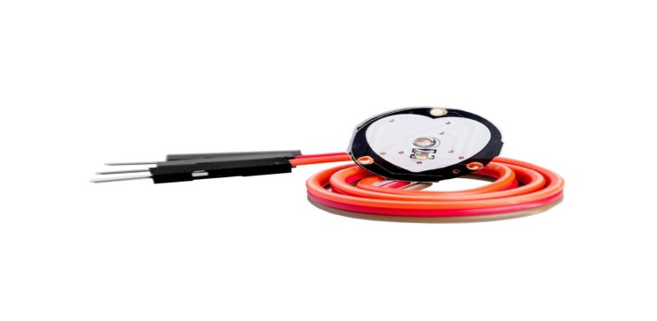
Types of Sensors
Heart Rate Sensor:-
The Heart Rate Monitoring system is developed using IOT technology with an objective of detecting the heart beat of the patient in order to monitor the risk of heart attack and also the regular checkups.
Then the Pulse Sensor will measure the change in volume of blood, which occurs when every time heart pumps blood in the body. This change in volume of blood causes a change in the light intensity through that organ. The Arduino will then convert this change into the heart beat per minute (BPM).
Body health monitoring is very important to us to make sure our health is in excellent condition.
National Institute of Science & Technology
Suman Priya Sahu - CSE/201711357 & Manisha Panda- CSE/ 201741413
[8]

Slide 9
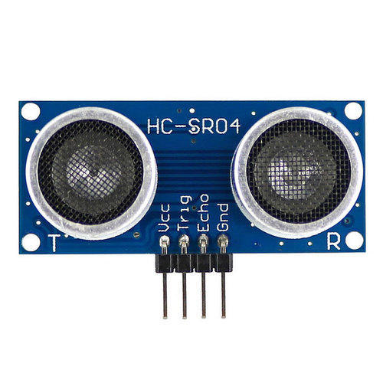
Ultrasonic Sensor:-
National Institute of Science & Technology
An ultrasonic sensor is an electronic device that measures the distance of a target object by emitting ultrasonic sound waves, and converts the reflected sound into an electrical signal. Ultrasonic waves travel faster than the speed of audible sound (i.e. the sound that humans can hear).
Ultrasonic sensors have two main components: the transmitter (which emits the sound using piezoelectric crystals) and the receiver (which encounters the sound after it has travelled to and from the target).
Suman Priya Sahu - CSE/201711357 & Manisha Panda- CSE/ 201741413
[9]

Slide 10
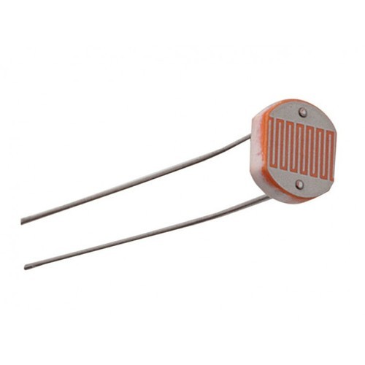
LDR Sensor:-
Photo resistors, also known as light dependent resistors (LDR), are light sensitive devices most often used to indicate the presence or absence of light, or to measure the light intensity. In the dark, their resistance is very high, sometimes up to 1MΩ, but when the LDR sensor is exposed to light, the resistance drops dramatically, even down to a few ohms, depending on the light intensity. LDRs have a sensitivity that varies with the wavelength of the light applied and are nonlinear devices. They are used in many applications but are sometimes made obsolete by other devices such as photodiodes and phototransistors. Some countries have banned LDRs made of lead or cadmium over environmental safety concerns.
National Institute of Science & Technology
Suman Priya Sahu- CSE/201711357 & Manisha Panda- CSE/ 201741413
[10]

Slide 11
Enhancement of IOT
IOT in Agriculture Sector:-
IOT have the potential to transform agriculture in many aspects and these are the main ones:-
Data collected by smart agriculture sensors, in this approach of farm management, a key component are sensors, control systems, robotics, autonomous vehicles, automated hardware, variable rate technology, motion detectors, button camera, and wearable devices. This data can be used to track the state of staff performance, equipment efficiency. The ability to foresee the output of production allows to plan for better product distribution.
Agricultural Drones Ground-based and aerial-based drones are being used in agriculture in order to enhance various agricultural practices: crop health assessment, irrigation, crop monitoring, crop spraying, planting, and soil and field analysis.
National Institute of Science & Technology
Suman Priya Sahu - CSE/201711357 & Manisha Panda- CSE/ 201741413
[11]

Slide 12
IOT in health Field:-
Internet of Things (IOT)-enabled devices have made remote monitoring in the healthcare sector possible, unleashing the potential to keep patients safe and healthy, and empowering physicians to deliver superlative care.
It has also increased patient engagement and satisfaction as interactions with doctors have become easier and more efficient. Furthermore, remote monitoring of patient’s health helps in reducing the length of hospital stay and prevents re-admissions.
IOT also has a major impact on reducing healthcare costs significantly and improving treatment outcomes.
Devices in the form of wearable like fitness bands and other wirelessly connected devices like blood pressure and heart rate monitoring cuffs, glucometer etc. give patients access to personalized attention. These devices can be tuned to remind calorie count, exercise check, appointments, blood pressure variations and much more.
National Institute of Science & Technology
Suman Priya Sahu - CSE/201711357 & Manisha Panda- CSE/ 201741413
[12]

Slide 13
IOT in Bar code Scanner :-
A barcode, consisting of bars and spaces, is a machine-readable representation of numerals and characters. ... These are barcodes. A barcode consists of bars and spaces of varying width that can be read with an optical barcode scanner.
In the early days of the IOT, radio-frequency identification (RFID) was believed to be the primary method of labelling items. However, combining the use of RFID tags with both barcodes and QR codes allows the consumer to connect to the IOT with the simple scan of a smart phone or tablet. Having all objects marked with a QR code or barcode means improving the retail environment for consumers because they will be more educated about the item before purchasing and they will be able to check for an item’s availability. If all inventory is tagged with barcodes, not only will managers have a better idea of their inventory status but so will the consumers of those products.
National Institute of Science & Technology
Suman Priya Sahu - CSE/201711357 & Manisha Panda- CSE/ 201741413
[13]

Slide 14
Technologies based on IOT
Agriculture and Pest Control
Environment
Smart Home Applications
Health Care
Smart Cities
Safe Driving
Waste Management
Tackling Industrial Issues
National Institute of Science & Technology
Suman Priya Sahu - CSE/201711357 & Manisha Panda- CSE/ 201741413
[14]

Slide 15
IOT based on Real Life Devices
IOT Security.
IOT Analytics.
IOT Device Management
Low-Power, Short-Range IOT Networks. ...
Low-Power, Wide-Area Networks. ...
IOT Processors. ...
IOT Operating Systems. ...
Event Stream Processing.
National Institute of Science & Technology
Suman Priya Sahu - CSE/201711357 & Manisha Panda- CSE/ 201741413
[15]

Slide 16
CONCLUSION
Internet of Things is the concept in which the virtual world of information technology connected to the real world of things. The technologies of Internet of things such as RFID and Sensor make our life become better and more comfortable.
In order for IOT to provide its utmost potential, the sensing technology implemented must provide highly accurate information.
IOT offers some pretty interesting applications in making our lives easier like in health care, transportation and agriculture, however various factors like security, privacy and data storage also need to be considered.
National Institute of Science & Technology
Suman Priya Sahu - CSE/201711357 & Manisha Panda- CSE/ 201741413
[16]

