Slide 1
ONLINE HEALTHCARE
HEALTHCARE
MANAGEMENT SYSTEM
A Java-Based Healthcare Management Application
GROUP MEMBER
1. SUMAN KUMAR ( leader)
2. ASHUTOSH JHA
3. ABHIJIT SRIVASTAV
4. ADITYA KUMAR

Slide 2

01 / THE SYSTEM
Introduction
PATIENTS
Register, search doctors, book appointments, and access prescriptions and bills.
A centralized platform for managing healthcare activities.
DOCTORS
Manage appointments, review patient details, and record diagnosis and prescriptions.
ADMIN
Manage doctors, patients, departments, appointments, and system records.
Goal: make healthcare management more organized, efficient, and less dependent on manual processes.

Slide 3
02 / THE GAP
Disconnected records and manual coordination make healthcare activity harder to manage.
Problem Statement
Patient records are often difficult to maintain and retrieve.
Manual appointment scheduling can be slow and error-prone.
Paper-based prescriptions and records create unnecessary paperwork.
Healthcare information may not be centralized.
Patients, doctors, and administrators need a simpler workflow.
PROPOSED SOLUTION → One centralized digital healthcare management system

Slide 4
03 / PROJECT DIRECTION
Project Objectives
Six practical objectives define what the system must improve.
01
02
03
Digitize records
Simplify appointments
Manage prescriptions
04
05
06
Maintain billing
Reduce paperwork
Improve efficiency

Slide 5
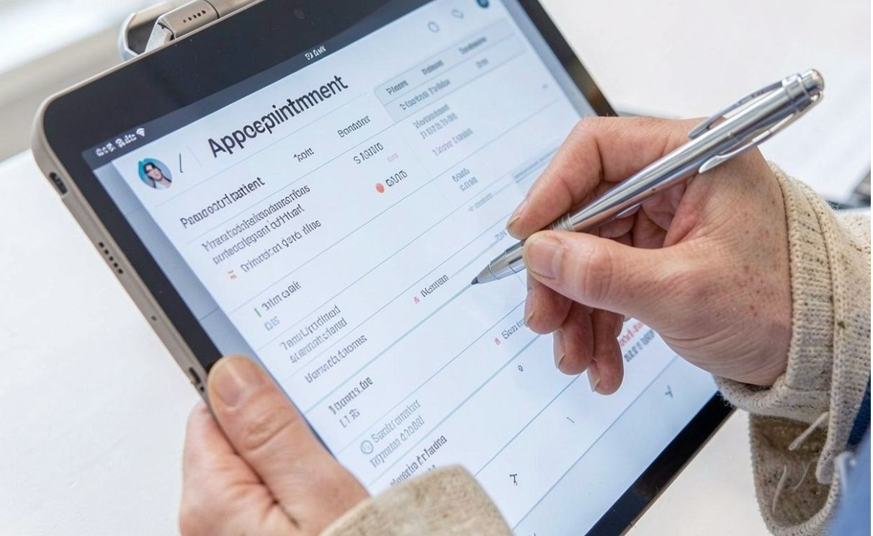
04 / ROLE-BASED FUNCTIONALITY
Proposed System
Each role sees the healthcare tasks it needs to complete.
ADMIN
Manage doctors, patients, departments, and monitor appointments.
DOCTOR
View appointments, view patient details, update status, and add diagnosis & prescription.
PATIENT
Register / Login, search doctors, book appointments, and view history & bills.

Slide 6
05 / TECHNICAL FOUNDATION
System Architecture
A four-layer structure separates interface, logic, connectivity, and storage.
01
02
03
04
PRESENTATION LAYER
APPLICATION LAYER
DATA ACCESS LAYER
DATABASE LAYER
MySQL
Java Swing User Interface
Java business logic & validation
JDBC / DAO

Slide 7
06 / IMPLEMENTATION
Technology Stack
The system combines Java development, desktop UI, relational storage, and structured connectivity.
Java
Java Swing
MySQL
Core programming & OOP
Desktop graphical interface
Relational database
JDBC
IDE
Architecture
Java–database connectivity
Eclipse / IntelliJ / NetBeans
MVC / 3-Tier approach
Java concepts: Classes · Objects · Encapsulation · Inheritance · Polymorphism · Exception Handling · Collections

Slide 8
07 / FUNCTIONAL MAP
Major Modules
Eight modules organize access, care delivery, records, and administration.
01
02
03
04
Authentication
Patient Management
Doctor Management
Appointment Management
05
06
07
08
Prescription Management
Billing Management
Admin Management
Department Management

Slide 9
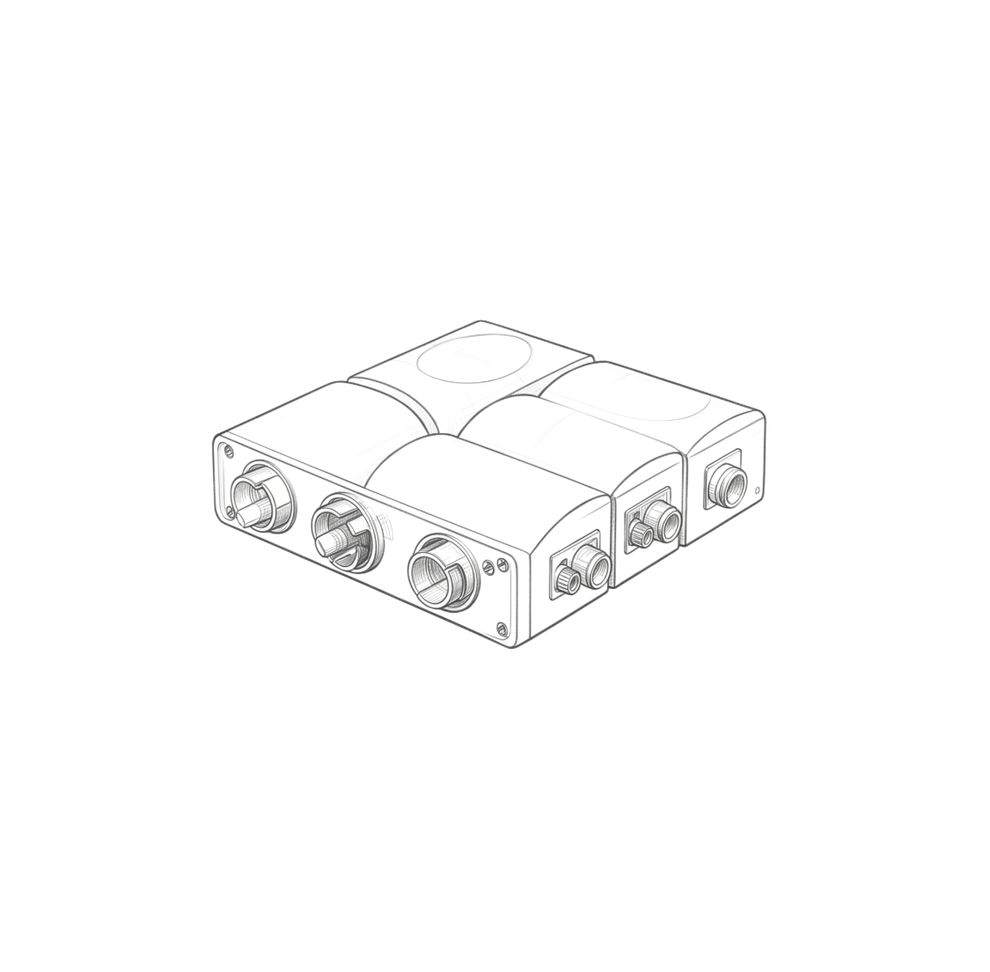
08 / DATA MODEL
Database Design
A MySQL relational database connects the people, care events, and financial records.
ADMIN
PATIENT
DOCTOR
DEPARTMENT
APPOINTMENT
PRESCRIPTION
BILL
PATIENT → APPOINTMENT ← DOCTOR
APPOINTMENT → PRESCRIPTION · APPOINTMENT → BILL

Slide 10
09 / APPOINTMENT TO PRESCRIPTION
System Workflow
The patient journey moves from access and selection to confirmed care and a recorded prescription.
01
02
03
REGISTER / LOGIN
VIEW DOCTORS
SELECT DOCTOR
04
05
06
CHOOSE DATE & TIME
BOOK APPOINTMENT
DOCTOR CONFIRMS
07
08
09
CONSULTATION
PRESCRIPTION
BILL
PENDING → ACCEPTED → COMPLETED

