Slide 1
SystemVerilog for Functional Verification

Slide 2
What is SystemVerilog?
SystemVerilog is a hardware description and verification language (HDVL)
It’s an extension of Verilog that supports both:
Design modelling (RTL, synthesis, simulation), and
Verification
2002 → SystemVerilog was developed by Accellera
2005 → IEEE 1800-2005: SystemVerilog Standard

Slide 3
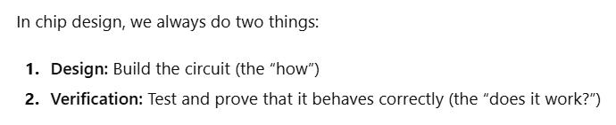
What is Verification?
Verification ensures the RTL design matches the specification for all valid inputs

Slide 4
Most important pillars of modern verification:
Randomization → how we generate test inputs intelligently
Coverage measurement → how we measure what we’ve tested
Why Randomization is Powerful
Saves time: you can test thousands of legal scenarios automatically.
Finds corner cases: unplanned combinations that might cause hidden bugs.
Constrained randomization:
To automatically generate many different input combinations that follow certain rules or constraints, instead of manually coding every test case

Slide 5
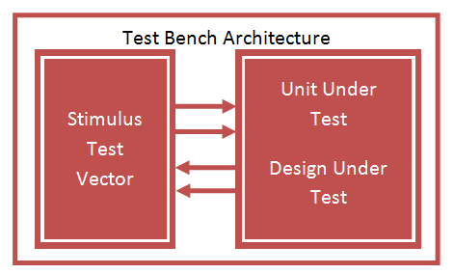
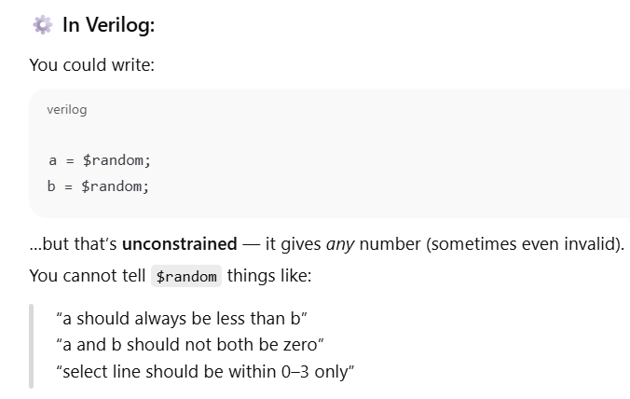

Slide 6
Coverage Measurement
To measure how much of the design’s behaviour, your tests have actually exercised.
In other words:
“Have I tested everything I was supposed to?”
Functional Coverage
Did we test all important scenarios?
Did we try all valid sel values for MUX?

Slide 7
Verilog → Directed
// 2x1 Multiplexer
module mux2x1 (
input wire a, b, // data inputs
input wire sel, // select line
output wire y // output
);
assign y = sel ? b : a;
endmodule

Slide 8
`timescale 1ns/1ps
module tb_mux2x1;
reg a, b, sel; // inputs
wire y; // output
// Instantiate DUT
mux2x1 dut (.a(a), .b(b), .sel(sel), .y(y));
// Stimulus
initial begin
// Apply test vectors
a=0; b=0; sel=0; #10; // Expect Y=0
a=0; b=0; sel=1; #10; // Expect Y=0
a=0; b=1; sel=0; #10; // Expect Y=0
a=0; b=1; sel=1; #10; // Expect Y=1
a=1; b=0; sel=0; #10; // Expect Y=1
a=1; b=0; sel=1; #10; // Expect Y=0
a=1; b=1; sel=0; #10; // Expect Y=1
a=1; b=1; sel=1; #10; // Expect Y=1
$finish;
end
endmodule

Slide 9
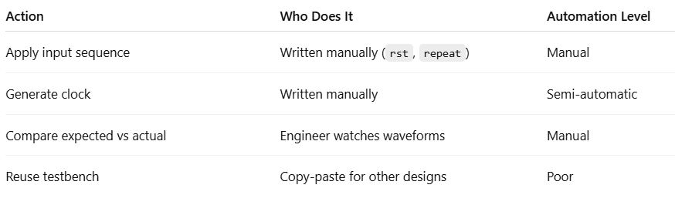
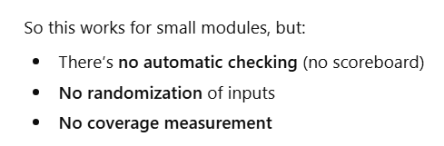

Slide 10
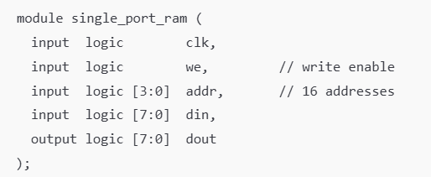
The Design (DUT) — Single-Port RAM

Slide 11
What Does “Coverage” Mean Here?
Functional coverage answers:
“Have we tested all possible read/write behaviours of the RAM?”
That means:
Have we accessed all addresses?
Have we done both read and write operations?
Have we tested different data patterns?
Have we checked corner cases (e.g., read after write, same address read/write)?
So, functional coverage helps measure how thoroughly we’ve exercised the RAM’s functionality, not just how many times it ran.

Slide 12
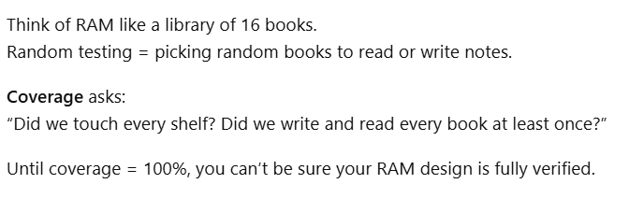
Analogy

Slide 13
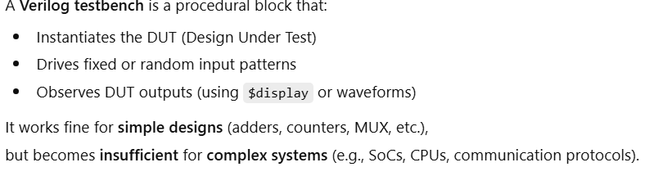
A Verilog testbench is like a manual tester who runs fixed tests and looks at results on paper.

Slide 14
What we need…
A software framework which creates an intelligent testing environment that can generate thousands of valid scenarios, check correctness automatically, and measure what’s been tested (coverage).

Slide 15
Why SV?
You can create your own layered testbench using SystemVerilog
A layered testbench organizes verification logic into modular layers — so that stimulus generation, driving, monitoring, checking, and coverage are separated.
You can use UVM which is a framework built on top of SystemVerilog — it defines a standardized structure for building reusable verification environments.

Slide 16
The word “layered” simply means that the testbench is organized in distinct levels (or layers) —
each layer performs one specific function in the verification process.

Slide 17
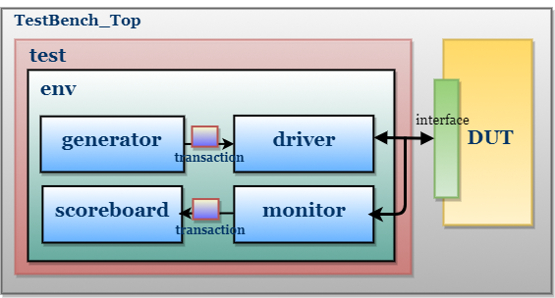
A layered testbench has multiple logical layers that work together to verify the DUT (Device Under Test).

Slide 18
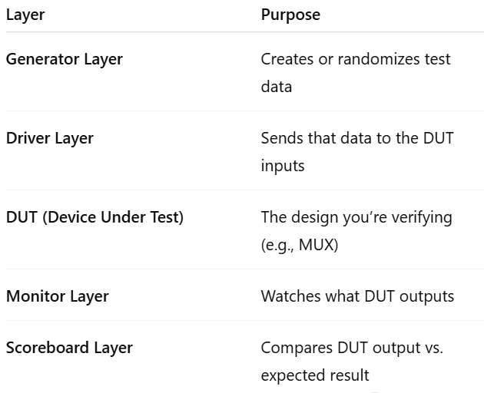

Slide 19
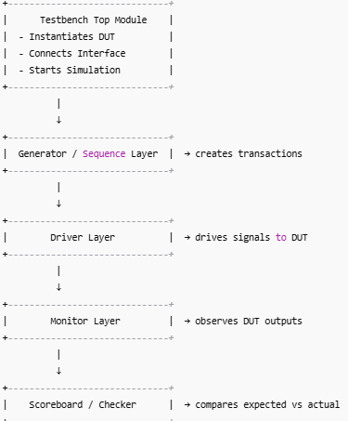

Slide 20
Verification framework
The industry needed a common verification framework to avoid each company writing its own structure.
The Universal Verification Methodology (UVM) was born — built entirely on top of SystemVerilog using its OOP features.
UVM is not a separate language — it’s a SystemVerilog class library.

Slide 21

UVM (Universal Verification Methodology)
A library/framework written in SystemVerilog (SV) that defines how to organize and reuse features (randomization, coverage, OOP, interfaces, and assertions) of verification setup.

Slide 22
SV datatype
In Verilog, data types were simple but limited — mostly just reg, wire, and integer.
SystemVerilog extended this to provide stronger typing, 4-state logic control, signed arithmetic, and high-level verification types

Slide 23
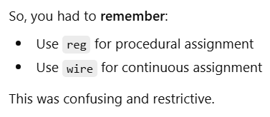
Verilog rule --> “Net type wire cannot be assigned in a procedural block.”
module and_gate1;
reg a, b, y;
always @(*) begin
y = a & b; // Procedural assignment
end
endmodule
module and_gate2;
wire a, b, y;
assign y = a & b; // Continuous assignment
endmodule

Slide 24

SystemVerilog: Use logic for both!
module and_gate1;
logic y;
always @(*) begin
y = a & b; // Procedural assignment
end
endmodule
module and_gate2;
logic a, b, y;
assign y = a & b; // Continuous assignment only
endmodule
logic can be used in both continuous and procedural assignments.

Slide 25
SystemVerilog was born as an extension of Verilog
SystemVerilog wasn’t created to replace Verilog, but to extend it.
Its early versions (IEEE 1800-2005) were meant mainly for verification, not RTL.
So, for RTL module design, Verilog’s limited feature set is enough and safer.
SystemVerilog adds complexity that’s often not needed for pure RTL.

Slide 26
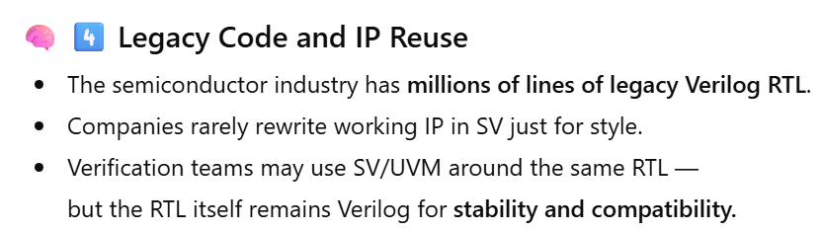

Slide 27
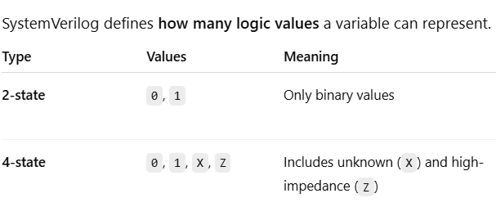

Slide 28
bit [3:0] a; // 2-state variable
a = 4'b10xz; // X and Z converted to 0 automatically
$display("a = %b", a); // prints a = 1000
logic [3:0] b;
b = 4'b10xz;
$display("b = %b", b); // prints b = 10XZ

Slide 29
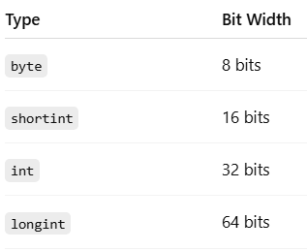
SystemVerilog introduced four standardized, sized integer types

Slide 30
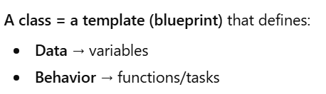
OOP in SystemVerilog
For big verification projects, we need to group related data and functions together and reuse them easily.
Introduce the Concept of a Class

Slide 31
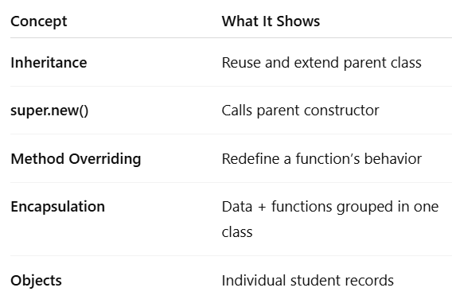

Slide 32
A layered testbench is an OOP-based verification structure where each class (generator, driver, monitor, scoreboard) plays a specific role — working together through objects instead of procedural code.

Slide 33
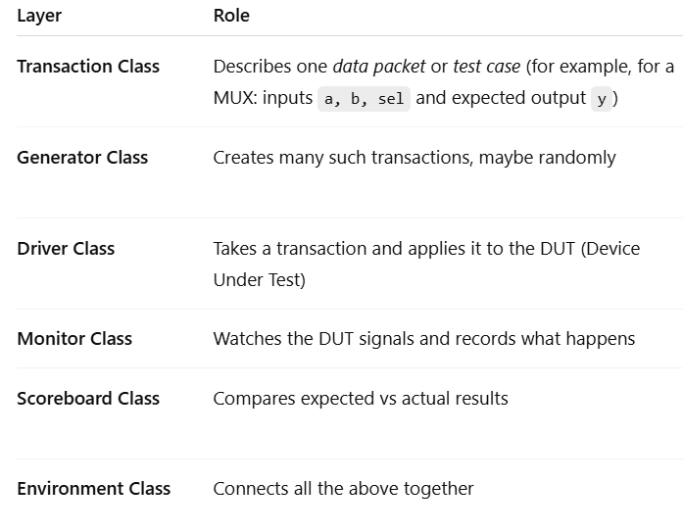
That’s the foundation of a layered testbench —
and the same idea scales up to UVM.

Slide 34
Inheritance and Constructors in SystemVerilog
• Inheritance allows child classes to reuse and extend base classes.
• Supports method overriding using virtual/override.
• Promotes modular and reusable testbench components.
• Constructors (new) allocate memory and initialize objects.

Slide 35
Role of Constructor (new)
• Object handles are null until new is called.
• new creates the actual object instance.
• Can include arguments for initialization.
• Essential for safe access of class members.

Slide 36
Classes, Objects & Mailboxes in Testbench
• Classes define generator, driver, monitor, scoreboard.
• Objects are runtime instances enabling modularity.
• Mailboxes provide thread-safe communication.
• Enable transaction flow between testbench layers.

Slide 37
Mailbox-Based Communication Flow
• Generator → sends transactions → Driver
• Driver → drives DUT
• Monitor → captures DUT outputs → sends to Scoreboard
• Scoreboard → compares expected vs actual behavior

