Slide 1
More insight on Testbench
From Simple Verilog to Structured Verification

Slide 2
Features
System task
File interaction
Applying stimulus at signal transition

Slide 3
System task
A system task is a built-in command provided by the simulator, not synthesized into hardware.
They control or observe the simulation, but do not describe real hardware.
All system tasks start with a $ symbol (dollar sign) —
They are part of the simulation system, not the circuit.

Slide 4


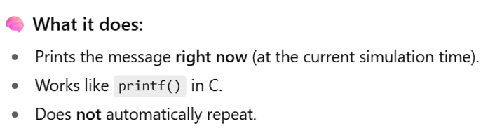
Most useful system tasks in Verilog TB

Slide 5
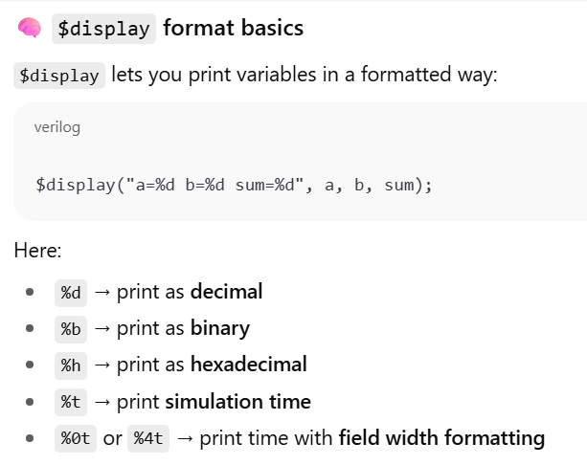

Slide 6

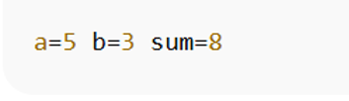

Slide 7

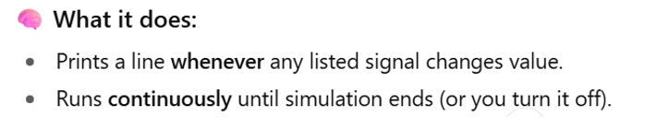

Slide 8
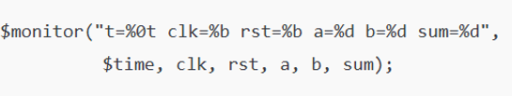
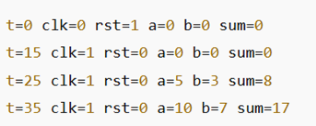
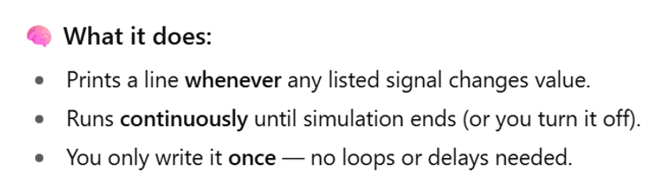

Slide 9
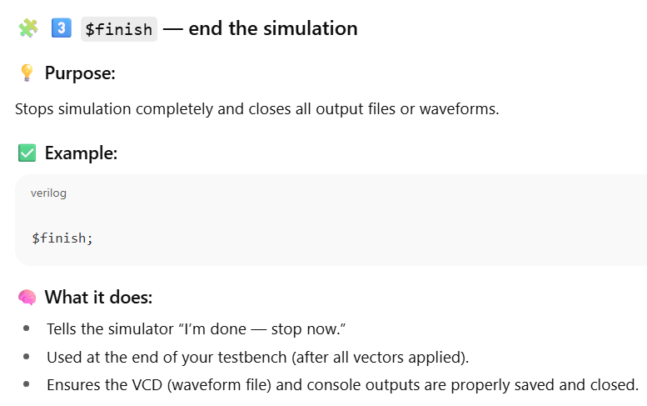

Slide 10
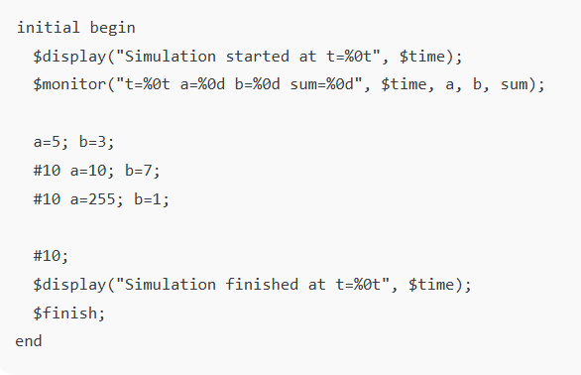

Slide 11
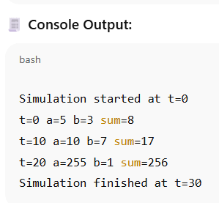

Slide 12
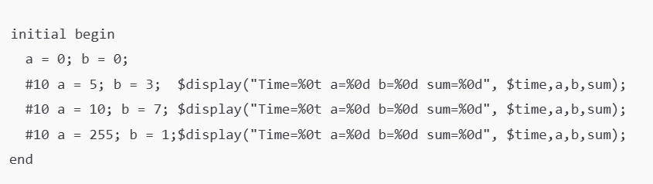

Slide 13
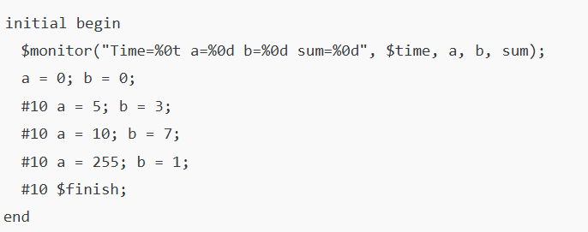

Slide 14
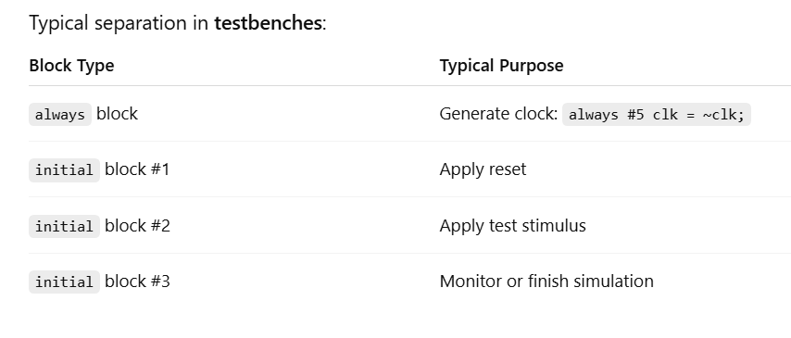

Slide 15
Test Stimulus
Case-I: # delay & explicit signal value assignment for specific test cases
(Can we provide the stimulus for all possible test cases).
Case-II: # delay & signal value come from file (result may be stored in file)
Case-III: No # delay, but signal value (explicitly) would be changed before every positive edge
Case-IV: No # delay & signal value come from file & signal value (explicitly) would be changed before every positive edge

Slide 16
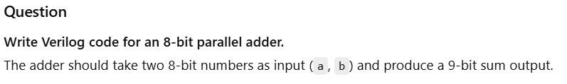

Slide 17
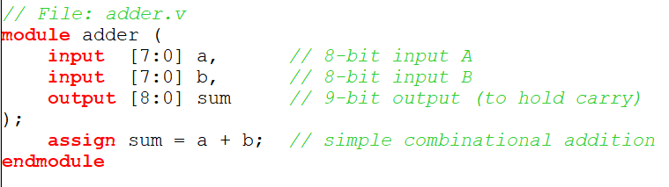

Slide 18
Write a testbench for the 8-bit adder
“Apply the following input pairs to a and b at 0 ns, 10 ns, 20 ns, and 30 ns respectively:(5, 3), (10, 7), (100, 55), (255, 1).”

Slide 19
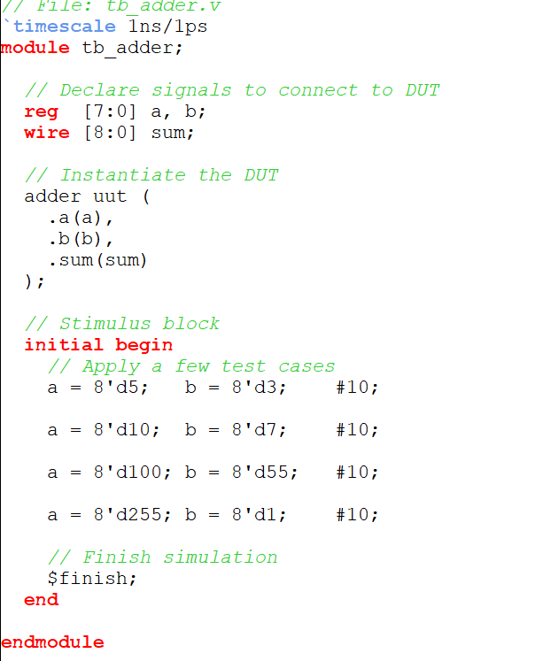
Explicit time (delay) and the value of the signals

Slide 20
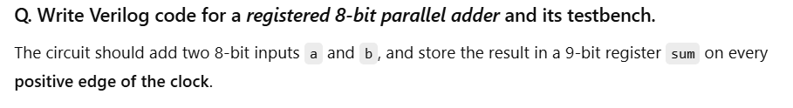

Slide 21
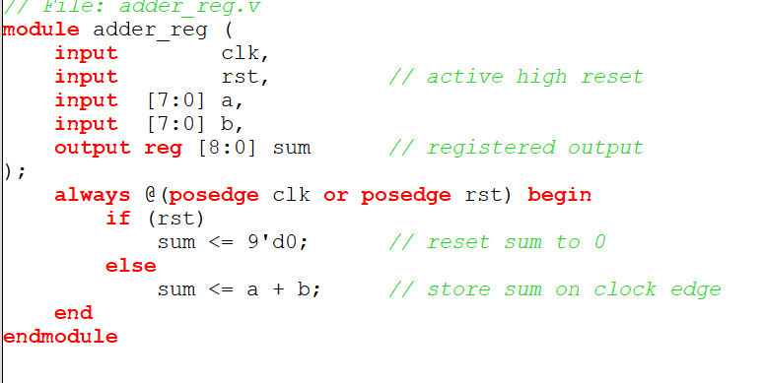

Slide 22
Write a testbench for the 8-bit adder
Clk period = 10 ns
rst should be high initially till t=15 ns
Apply the following input pairs to a and b at 0 ns, 20 ns, 40 ns, and 60 ns respectively:(5, 3), (10, 7), (255, 1).”

Slide 23
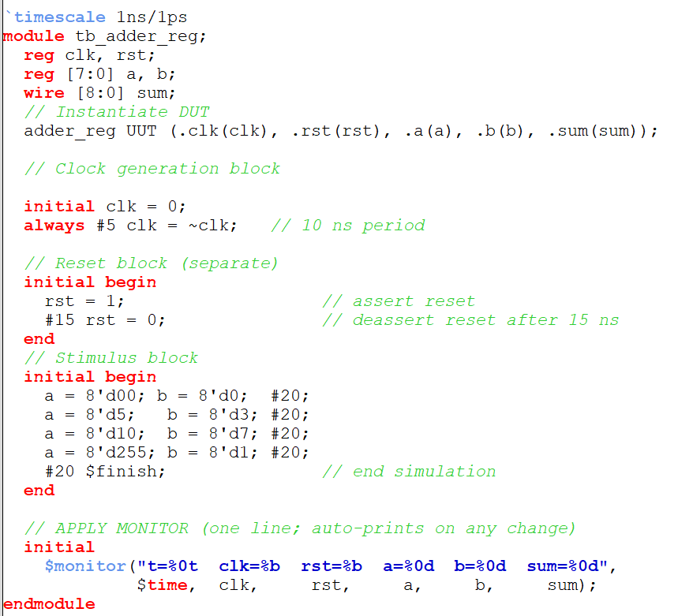

Slide 24
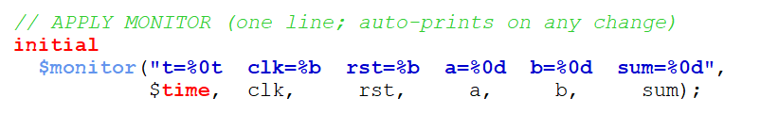

Slide 25
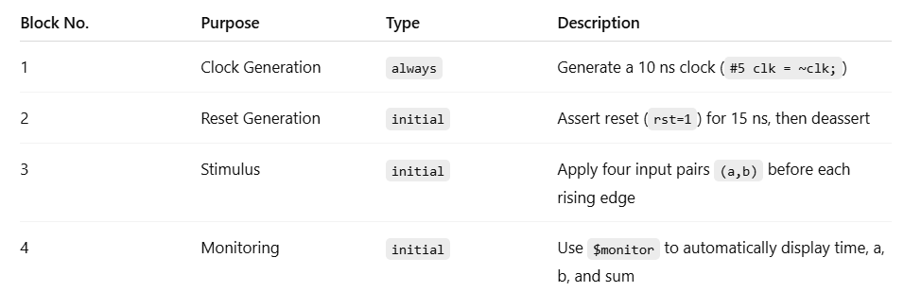
Four separate blocks:
Each serving one specific purpose

Slide 26
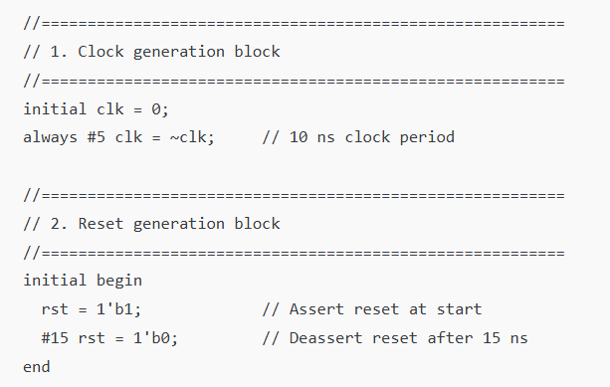

Slide 27
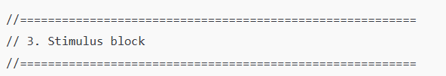
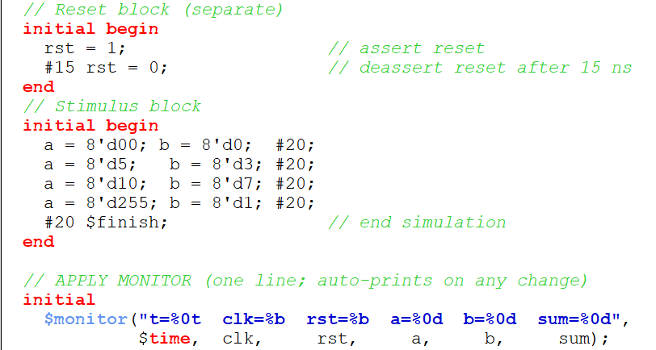

Slide 28
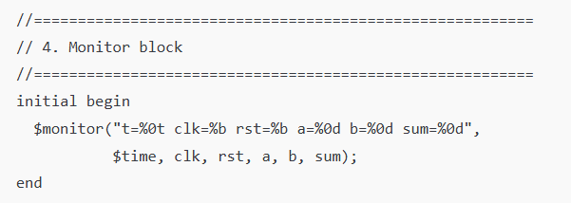

Slide 29

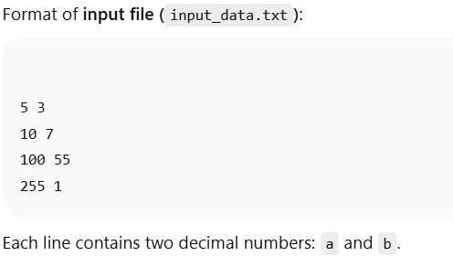

File-Based Testbench for Registered 8-bit Adder

Slide 30
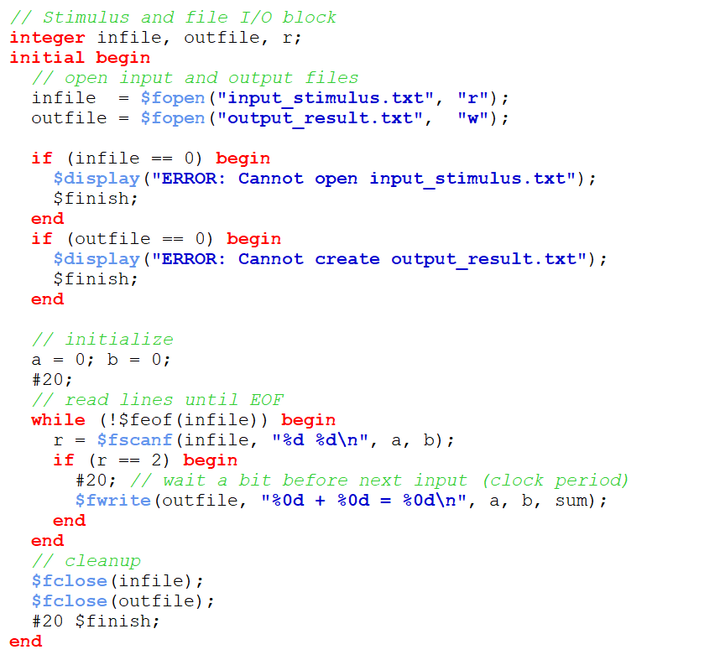
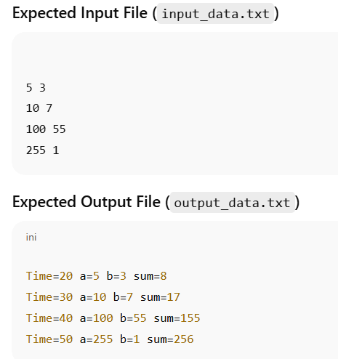

Slide 31
TestBench
Write a Verilog testbench for the registered 8-bit adder such that the inputs a and b are changed only at the negedge of the clock, ensuring the DUT samples them on the next posedge.

Slide 32
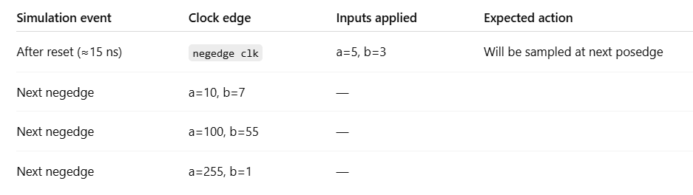

Slide 33
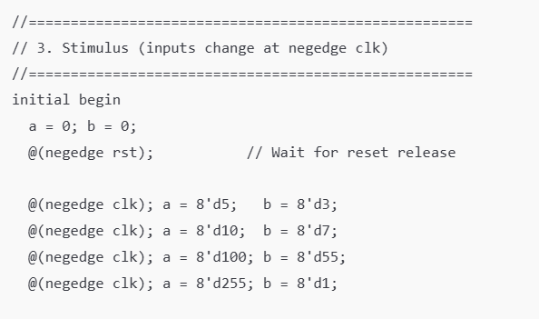



Slide 34
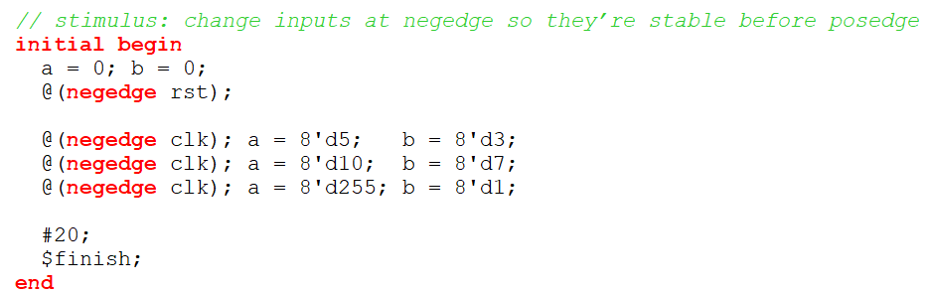

Slide 35
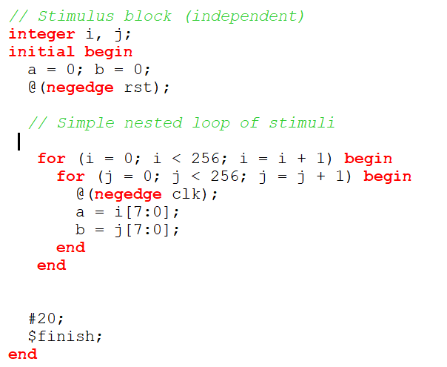
We can automatically provide all possible input
stimuli for a and b

Slide 36
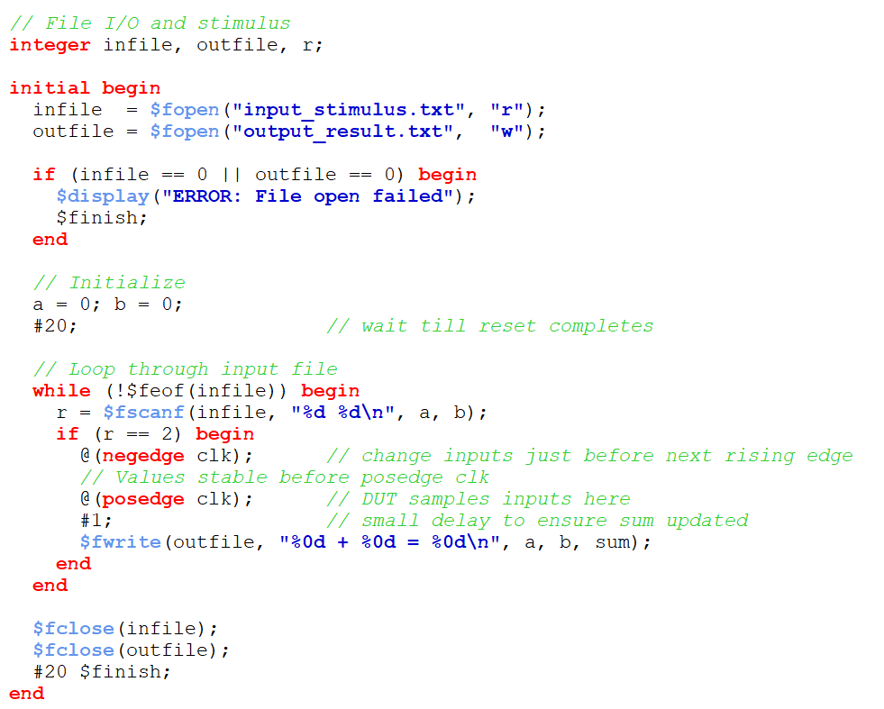

Slide 37
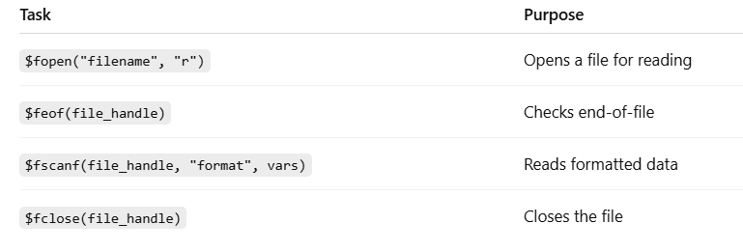

Slide 38
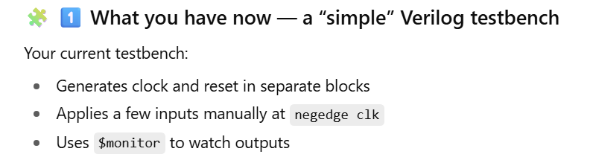
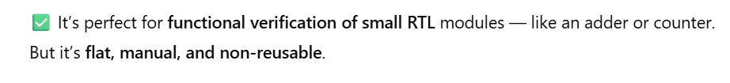

Slide 39
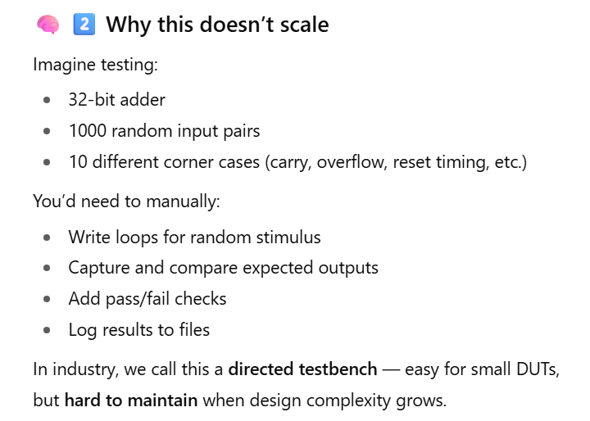

Slide 40
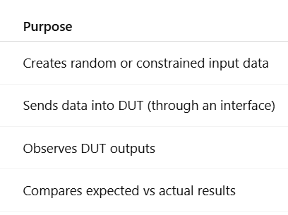
Structured testbench

Slide 41
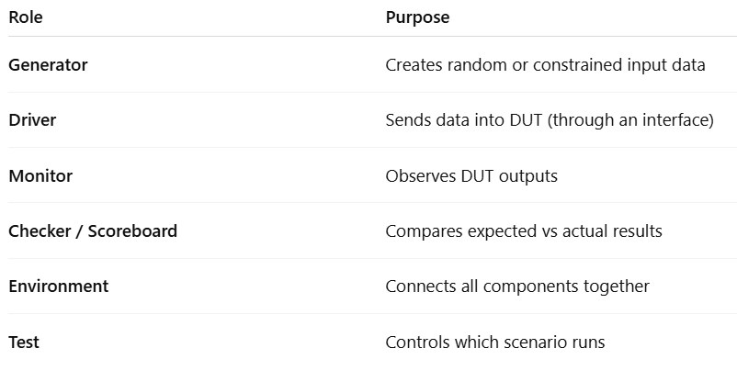
Software framework → Structured TB

Slide 42
Coding style
In plain (directed TB) Verilog, you write all of this in one file;
In structured/Layered TB approach, we split the code into separate blocks
  Classes
  Interface.
  They are reusable.

Slide 43
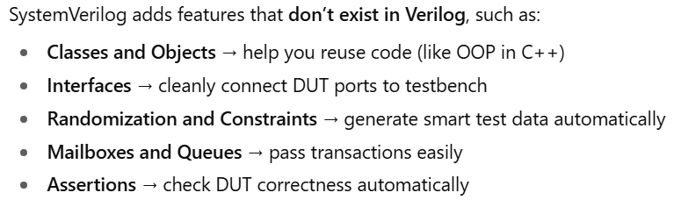
SystemVerilog
Modular approach in TB: Reusable classes and interfaces.

