Slide 1
Regularized Linear Model

Slide 2
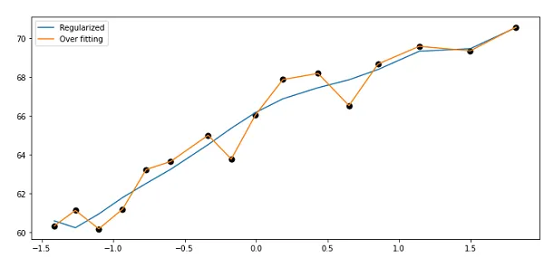

Slide 3
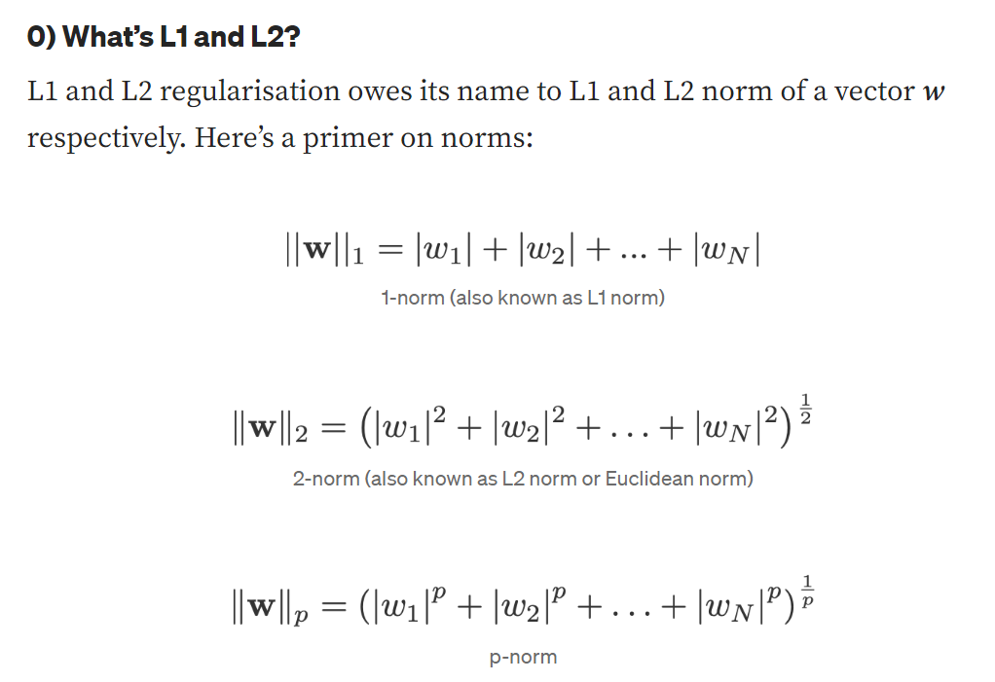
Intuitions on L1 and L2 Regularization

Slide 6
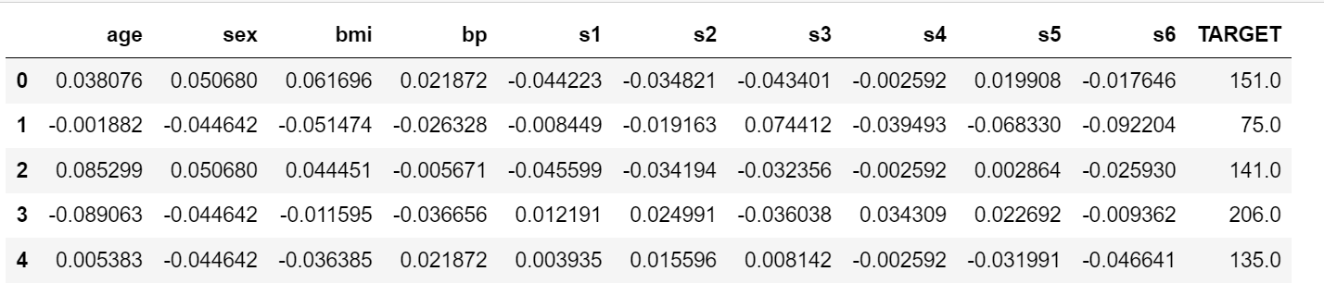
Case study on L2 Regression
Diabetes dataset
Multivariate Linear Regression Model
How many parameters ?

Slide 7
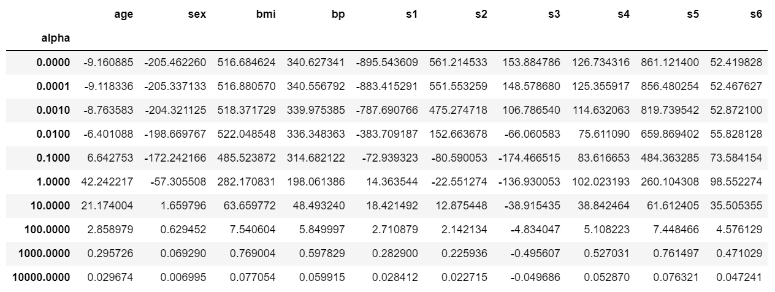
What is your observation?

Slide 8
Case study on L1 Regression (LASSO)
Diabetes dataset
Multivariate Linear Regression Model
How many parameters ?

Slide 9
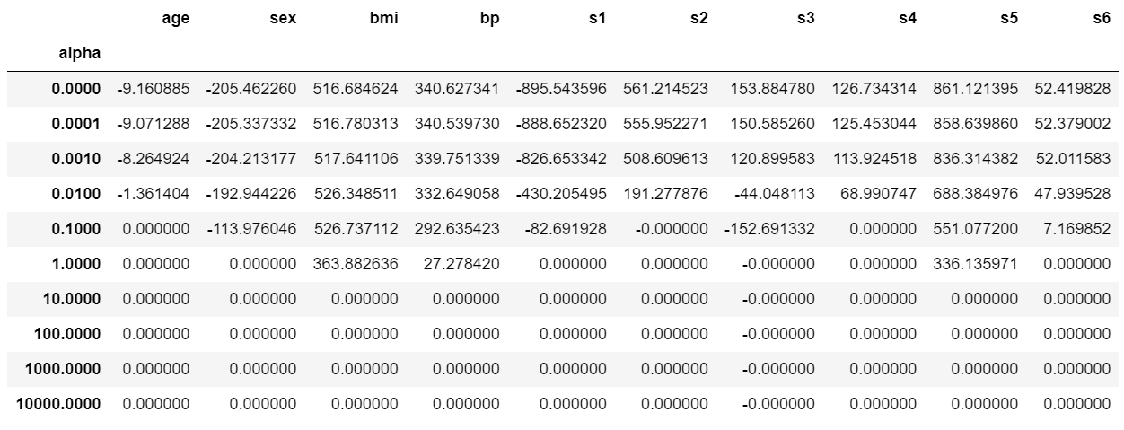
What is your observation?

Slide 10
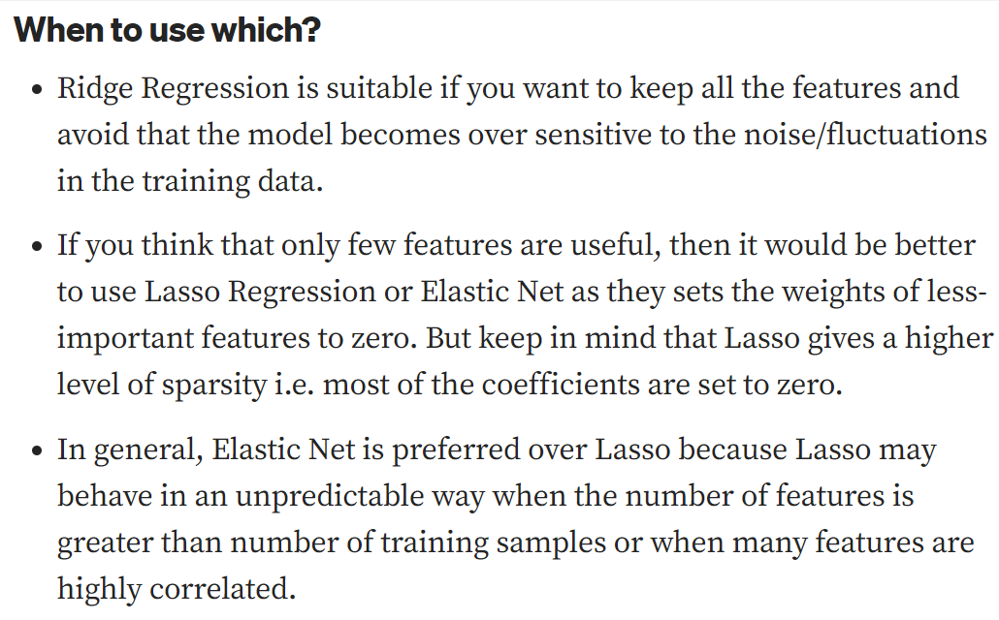

Slide 11
Early Stopping

