Slide 1
Support Vector Machine (SVM)

Slide 2
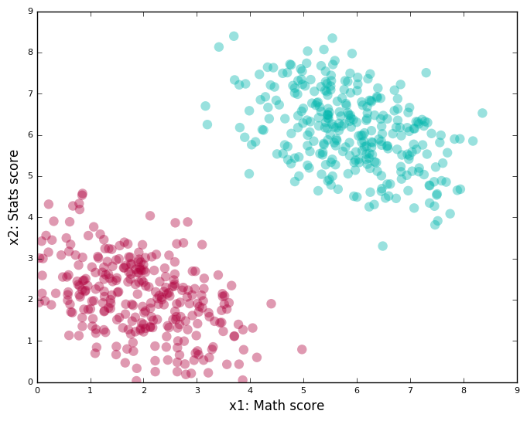
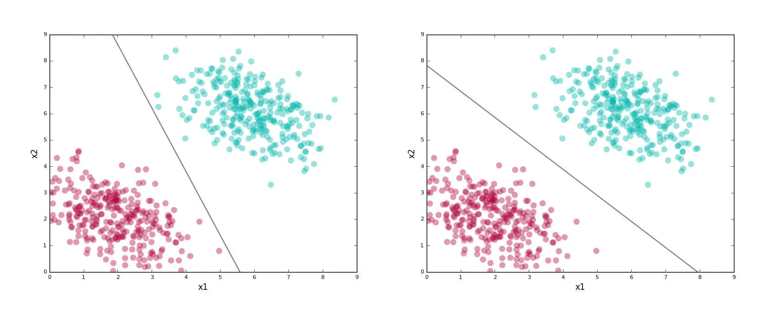

Slide 3
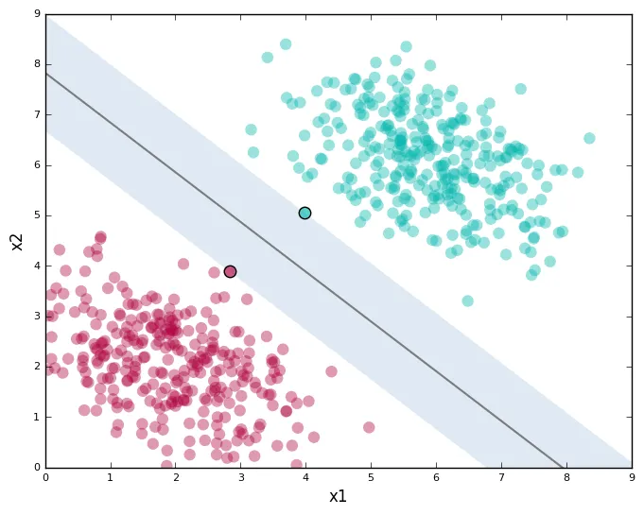
The underlying philosophy of SVM classifiers
Find lines (hyperplanes) that correctly classify the training data
Among all such lines (hyperplanes), pick the one that has the greatest distance to the points closest to it.

Slide 4
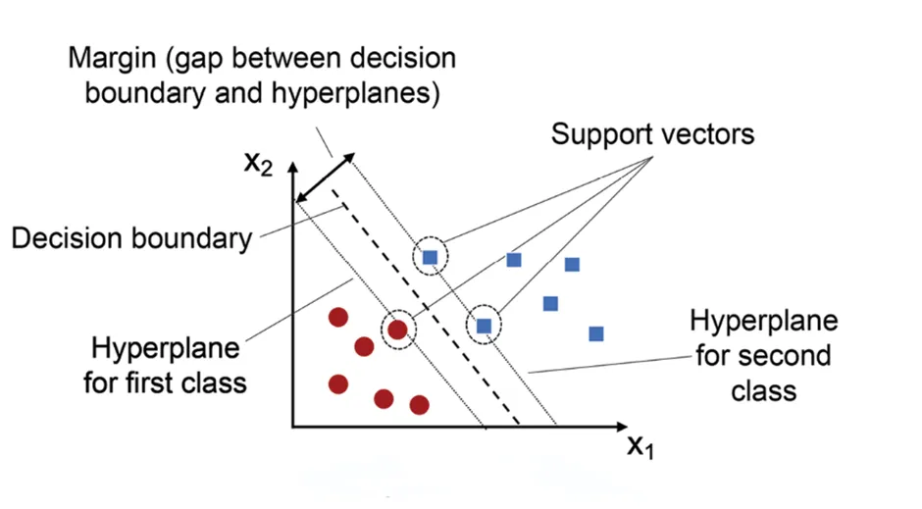

Slide 5
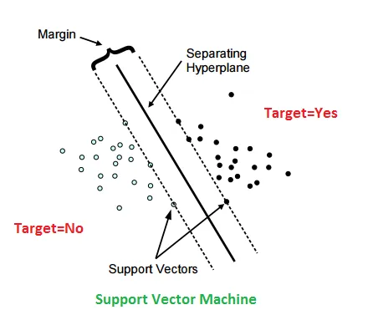
“Decision Boundary”
A linear classifier’s decision boundary is also called a “hyperplane”. Hyperplane is a (n-1)-dimensional subspace, for example, a line for observations in a 2D space and a plane for observations in a 3D space, separating different classes of data observed in a n-dimensional space.
“Margin”
Margin is defined as the perpendicular distance of the nearest data points to the hyperplane. There are “hard margin” and “soft margin”. Our objective is to find the hyperplane with the maximum margin.
“Support Vector”
The nearest data points on the edge of margins are support vectors.

Slide 6
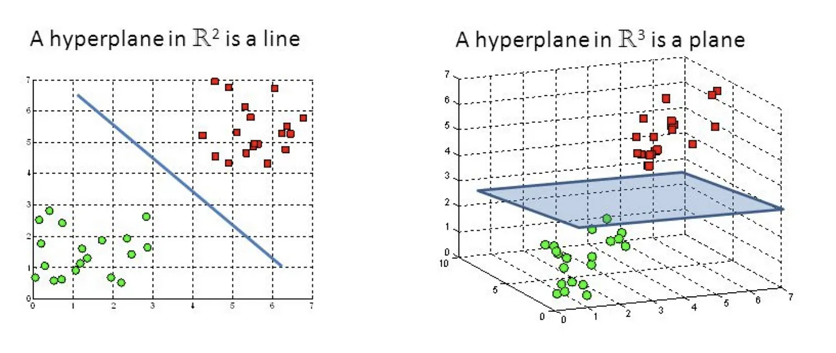

Slide 7
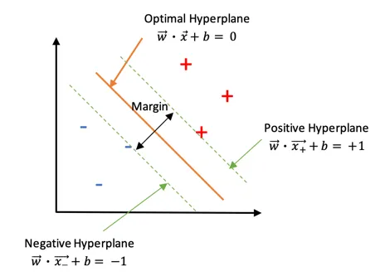
Optimal hard margin classifier

Slide 8
Geometric Intuition and basic understanding
W (parameters of the model) is a vector (geometric) perpendicular to hyperplane w^{T}X + b=0
b is the offset of the hyperplane in vector space
Our objective to train SVM is to find w and b which maximize the margin.

Slide 9
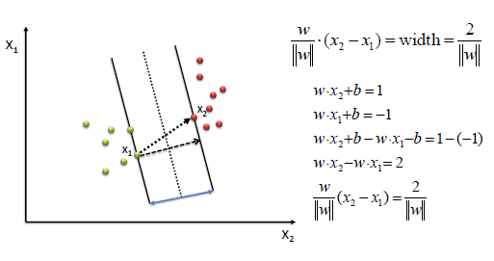

Slide 10
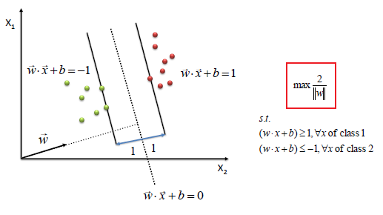

Slide 11
Mathematical intuition of Support Vector Machine
We find w and b by solving the following objective function using Quadratic Programming.

Slide 12
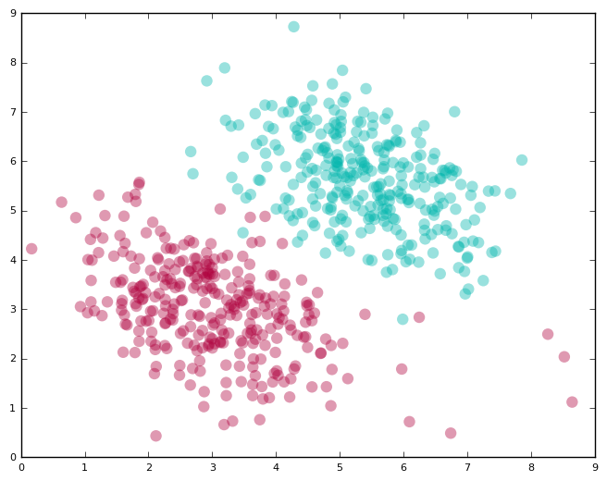
When a hard margin classifier is not applicable

Slide 13
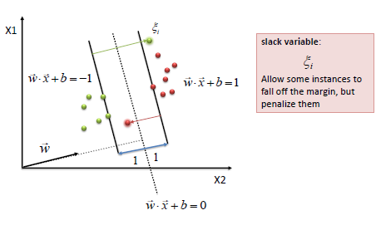

Slide 16
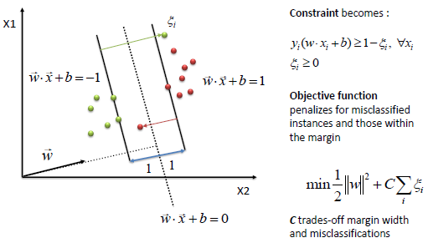

Slide 17
