Slide 1
Astronomy I
Chapter 1
SCIENCE AND THE UNIVERSE: A BRIEF TOUR
Introduction
1.1 The Nature of Astronomy
1.2 The Nature of Science
1.3 The Laws of Nature
1.4 Numbers in Astronomy
1.5 Consequences of Light Travel Time
1.6 A Tour of the Universe
1.7 The Universe on the Large Scale
1.8 The Universe of the Very Small
1.9 A Conclusion and a Beginning

Slide 2
What is Astronomy ?
The study of the universe and everything in it!
Planets & Moons
Asteroids & Comets
Stars
Galaxies
Nebulae
Black Holes
And More!
… and the processes by which these objects interact with one another. These interactions causes the Cosmos to evolve.

Slide 3
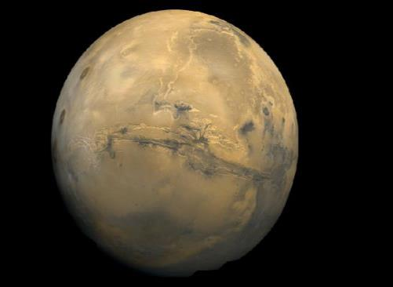
What is Astronomy ?
The study of the universe and everything in it!
Planets & Moons
Asteroids & Comets
Stars
Galaxies
Nebulae
Black Holes
And More!
This image of Mars is centered on the Valles Marineris (Mariner Valley) complex of canyons, which is as long as the United States is wide. (credit: modification of work by NASA)

Slide 4
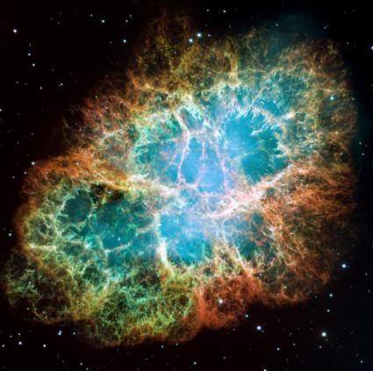
What is Astronomy ?
The study of the universe and everything in it!
Planets & Moons
Asteroids & Comets
Stars
Galaxies
Nebulae
Black Holes
And More!
We observe the remains of a star that was seen to explode in our skies in 1054 (and was, briefly, bright enough to be visible during the daytime). Today, the remnant is called the Crab Nebula and its central region is seen here. Such exploding stars are crucial to the development of life in the universe. (credit: NASA, ESA, J. Hester (Arizona State University))

Slide 5
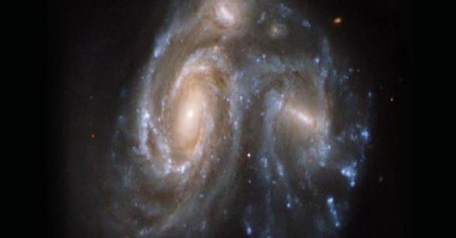
What is Astronomy ?
The study of the universe and everything in it!
Planets & Moons
Asteroids & Comets
Stars
Galaxies
Nebulae
Black Holes
And More!
These two interacting islands of stars (galaxies) are so far away that their light takes hundreds of millions of years to reach us on Earth (photographed with the Hubble Space Telescope). (credit: modification of work by NASA, ESA, the Hubble Heritage (STScl/AURA)-ESA/Hubble Collaboration, and K. Noll (STScl))

Slide 6
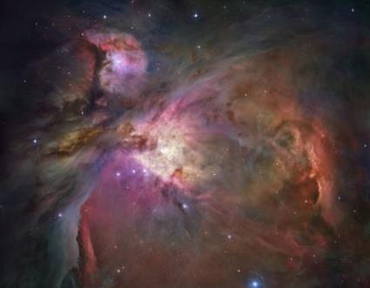
What is Astronomy ?
The study of the universe and everything in it!
Planets & Moons
Asteroids & Comets
Stars
Galaxies
Nebulae
Black Holes
And More!
This beautiful cloud of cosmic raw material (gas and dust from which new stars and planets are being made) called the Orion Nebula is about 1400 light-years away. That’s a distance of roughly 1.34 x 10¹⁶ kilometers—a pretty big number. The gas and dust in this region are illuminated by the intense light from a few extremely energetic adolescent stars. (credit: NASA, ESA, M. Robberto (Space Telescope Science Institute/ESA) and the Hubble Space Telescope Orion Treasury Project Team)

Slide 7
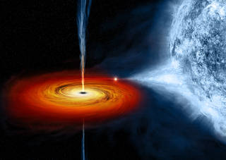
What is Astronomy ?
The study of the universe and everything in it!
Planets & Moons
Asteroids & Comets
Stars
Galaxies
Nebulae
Black Holes
And More!
Black Hole sucking materials from a neighboring Star

Slide 8
Chapter 1
SCIENCE AND THE UNIVERSE: A BRIEF TOUR
Introduction
1.1 The Nature of Astronomy
1.2 The Nature of Science
1.3 The Laws of Nature
1.4 Numbers in Astronomy
1.5 Consequences of Light Travel Time
1.6 A Tour of the Universe
1.7 The Universe on the Large Scale
1.8 The Universe of the Very Small
1.9 A Conclusion and a Beginning

Slide 9
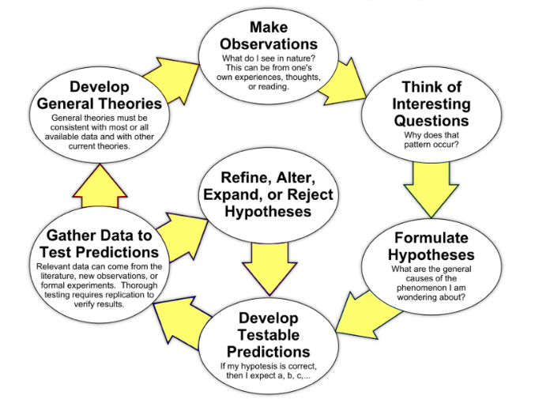
The nature of science
Science is a METHOD by which we attempt to understand nature and how it behaves.
Starts with an observation – but never ends!
Come up with a hypothesis to explain the observation
Must make a testable prediction
Test the predictions made – make more observations
Predictions found to be correct
Great! Make more predictions and continue testing
Predictions found to be incorrect
Oops! Modify or reject your hypothesis

Slide 10
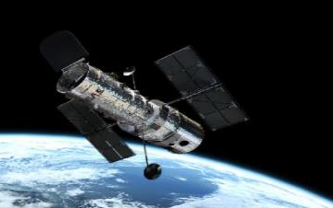
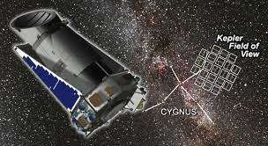
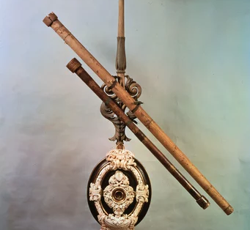
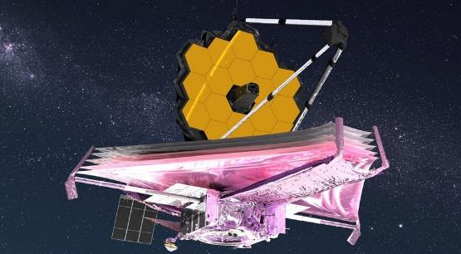
The Nature of science
Astronomy is sometimes called an observational science; we often make our tests by observing many samples of the kind of object we want to study and noting carefully how different samples vary.
New instruments and technology can let us look at astronomical objects from new perspectives and in greater detail.
The Hubble Space Telescope, shown here in orbit around Earth, is one of many astronomical instruments in space. (credit: modification of work by European Space Agency)
Kepler Space Telescope
Galilean Telescope
James Webb Space Telescope

Slide 11
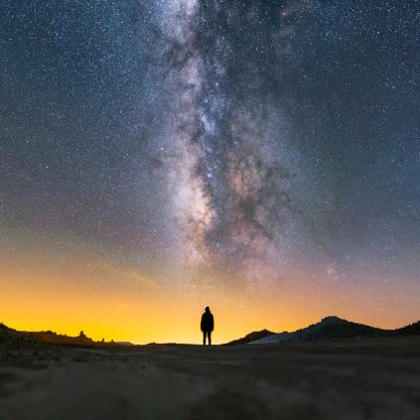
The Nature of science
Much of astronomy is also a historical science—meaning that what we observe has already happened in the universe
Because we are inside the Milky Way Galaxy, we see its disk in cross-section flung across the sky like a great milky white avenue of stars with dark “rifts” of dust. In this dramatic image, part of it is seen above Trona Pinnacles in the California desert. (credit: Ian Norman)

Slide 12
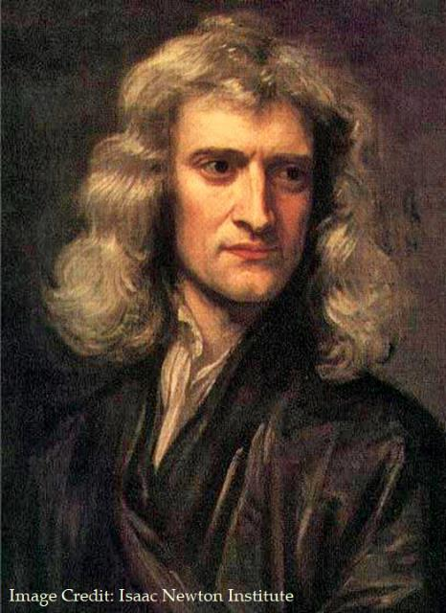

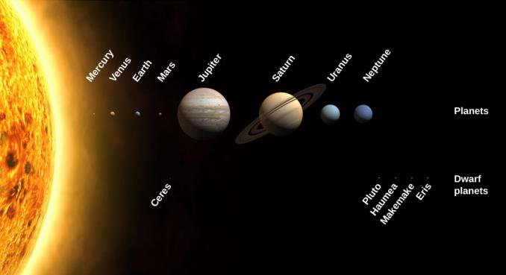
The Laws of nature
Scientists have extracted various scientific laws from countless observations, hypotheses, and experiments.
Scientific laws are the “rules” of the game that nature plays.
The same laws apply everywhere in the universe.
The consistency of the laws of nature gives us enormous power to understand distant objects without traveling to them

Slide 13
Chapter 1
SCIENCE AND THE UNIVERSE: A BRIEF TOUR
Introduction
1.1 The Nature of Astronomy
1.2 The Nature of Science
1.3 The Laws of Nature
1.4 Numbers in Astronomy
1.5 Consequences of Light Travel Time
1.6 A Tour of the Universe
1.7 The Universe on the Large Scale
1.8 The Universe of the Very Small
1.9 A Conclusion and a Beginning

Slide 14
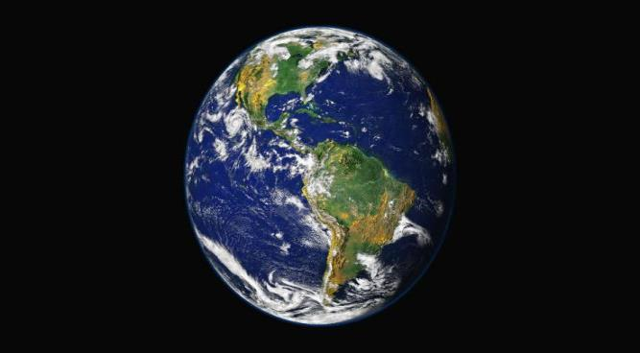
Numbers in astronomy
Astronomy studies both the very large and very small
Numbers need to be expressed in scientific notation
Example – The distance from the Earth to the Sun can be written as:
150,000,000 km or 1.5x10⁸ km. The latter is more convenient for the vastly larger distances we will deal with!
Scientific Notation
To convert a number to scientific notation, move the decimal point until there is only 1 number to the left – Count the number of places moved
Move the decimal point to the left – positive exponent ; to the right – negative exponent
This image shows the Western hemisphere as viewed from space 35,400 kilometers (about 22,000 miles) above Earth. Data about the land surface from one satellite was combined with another satellite’s data about the clouds to create the image. (credit: modification of work by R. Stockli, A. Nelson, F. Hasler, NASA/GSFC/NOAA/USGS)

Slide 15
Numbers in astronomy
Example 1:
314,000,000
We move the decimal point to the left 8 places
The number becomes 3.14x10⁸
Example 2:
0.00004563
We move the decimal point to the right 5 places
The number becomes 4.563x10⁻⁵
Measurements must have:
Number
Unit
All scientific measurements are made in metric units
Meter for length
Second for time
Kilogram for mass

Slide 16
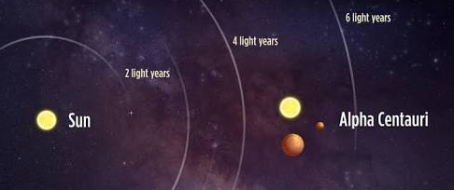
Numbers in astronomy
The nearest star is 40,000,000,000,000 km from the Earth (40 trillion km!)
We can write this in scientific notation as 4.0x10¹³ but it is still a number beyond our comprehension
Astronomers use the light-year for measuring large distances
The speed of light in a vacuum is a constant: 300,000 km/sec
The light-year is the distance light travels in one year (about 10 trillion km!)
In light-years, the nearest star is 4.3 light years away
We may not be able to comprehend the distance,
but the number is now more manageable

Slide 17
Numbers in astronomy
The light-year is too large to be used in the solar system
We use the astronomical unit (AU) to measure distances in the solar system
The AU is defined to be the average distance between the Earth and the Sun
1 AU = 150,000,000 km
At this scale: Mars would be 1.5 AU from the Sun and Neptune would be about 30 AU from the Sun
It is much easier to comprehend 1 mile than 5280 feet or 63,360 inches
These definitions make the numbers more manageable

Slide 18

Light travel time
Because light does not travel infinitely fast, it takes a certain amount of time to get to us
The light from the Sun takes about 8.5 minutes to get to Earth
The light from Alpha Centauri takes about 4.3 years to get to us
The light from the Andromeda Galaxy to us takes about 2.5 million years to get to us
This means that:
We see the Sun as it was 8.5 minutes ago
We Alpha Centauri as it was 4.3 years ago
We see the Andromeda Galaxy as it was 2.5 million years ago!
We can never see any object as it is right now
When we look out into space, we are also looking back into time
This means we can see what objects looked like long ago

Slide 19
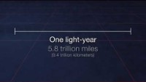
Light year

Slide 20
Chapter 1
SCIENCE AND THE UNIVERSE: A BRIEF TOUR
Introduction
1.1 The Nature of Astronomy
1.2 The Nature of Science
1.3 The Laws of Nature
1.4 Numbers in Astronomy
1.5 Consequences of Light Travel Time
1.6 A Tour of the Universe
1.7 The Universe on the Large Scale
1.8 The Universe of the Very Small
1.9 A Conclusion and a Beginning

Slide 21
Tour of the universe
This image shows the Western hemisphere as viewed from space 35,400 kilometers (about 22,000 miles) above Earth. Data about the land surface from one satellite was combined with another satellite’s data about the clouds to create the image. (credit: modification of work by R. Stockli, A. Nelson, F. Hasler, NASA/GSFC/NOAA/USGS)
Earth and Moon, Drawn to Scale. This image shows Earth and the Moon shown to scale for both size and distance. (credit: modification of work by NASA)

Slide 22
Our Solar Family
Our Solar Family. The Sun, the planets, and some dwarf planets are shown with their sizes drawn to scale. The orbits of the planets are much more widely separated than shown in this drawing. Notice the size of Earth compared to the giant planets. (credit: modification of work by NASA)

Slide 23
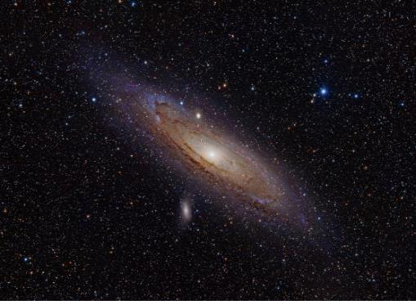
Closest Spiral Galaxy
The Andromeda galaxy (M31) is a spiral-shaped collection of stars similar to our own Milky Way. (credit: Adam Evans)
2.5 million light years away.

Slide 24
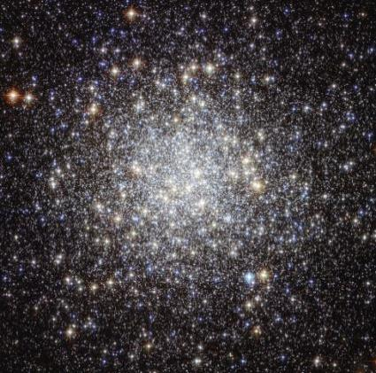
Star Cluster
This large star cluster is known by its catalog number, M9. It contains some 250,000 stars and is seen more clearly from space using the Hubble Space Telescope. It is located roughly 25,000 light-years away. (credit: NASA, ESA)

Slide 25
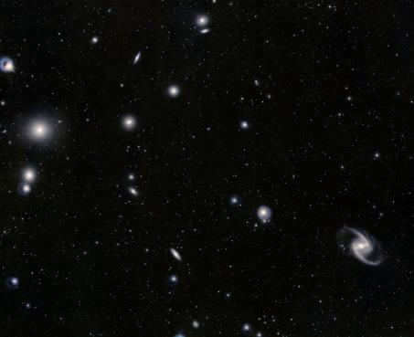
Fornax Cluster of Galaxies
In this image, you can see part of a cluster of galaxies located about 60 million light-years away in the constellation of Fornax. All the objects that are not pinpoints of light in the picture are galaxies of billions of stars. (credit: ESO, J. Emerson, VISTA. Acknowledgment: Cambridge Astronomical Survey Unit)

Slide 26
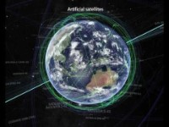
A Tour of the Universe

Slide 27
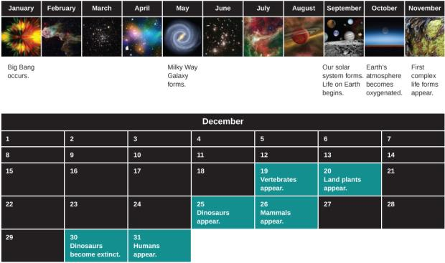
Charting Cosmic Time
On a cosmic calendar, where the time since the Big Bang is compressed into 1 year, creatures we would call human do not emerge on the scene until the evening of December 31. (credit: February: modification of work by NASA, JPL-Caltech, W. Reach (SSC/Caltech); March: modification of work by ESA, Hubble and NASA, Acknowledgement: Giles Chapdelaine; April: modification of work by NASA, ESA, CFHT, CXO, M.J. Jee (University of California, Davis), A. Mahdavi (San Francisco State University); May: modification of work by NASA, JPL-Caltech; June: modification of work by NASA/ESA; July: modification of work by NASA, JPL-Caltech, Harvard-Smithsonian; August: modification of work by NASA, JPL-Caltech, R. Hurt (SSC-Caltech); September: modification of work by NASA; October: modification of work by NASA; November: modification of work by Dénes Emőke)

Slide 28
END OF CHAPTER 1
Credit:
This OpenStax ancillary resource is © Rice University under a CC-BY 4.0 International license; it may be reproduced or modified but must be attributed to OpenStax, Rice University and any changes must be noted.
And OER Common Hub Resources

