Slide 1
ASTRONOMY
Chapter 2
OBSERVING THE SKY: THE BIRTH OF ASTRONOMY
2.1 The Sky Above
2.2 Ancient Astronomy
2.3 The Birth of Modern Astronomy
LEARNING OBJECTIVES
By the end of the Section 2.1, you will be able to:
Define the main features of the celestial sphere
Explain the system astronomers use to describe the sky
Describe how motions of the stars appear to us on Earth
Describe how motions of the Sun, Moon, and planets appear to us on Earth
Understand the modern meaning of the term Constellation

Slide 2
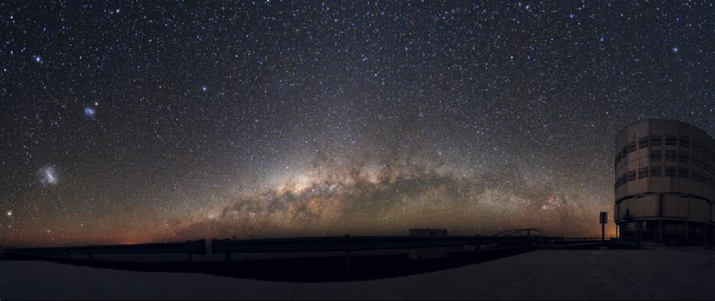
Night Sky
In this panoramic photograph of the night sky from the Atacama Desert in Chile, we can see the central portion of the Milky Way Galaxy arcing upward in the center of the frame. On the left, the Large Magellanic Cloud and the Small Magellanic Cloud (smaller galaxies that orbit the Milky Way Galaxy) are easily visible from the Southern Hemisphere. (credit: modification of work by ESO/Y. Beletsky)
Ancient civilizations around the world noticed, worshipped and tried to understand the lights in night-sky.
Today, electric lights have robbed us of the beauty of the night-sky

Slide 3
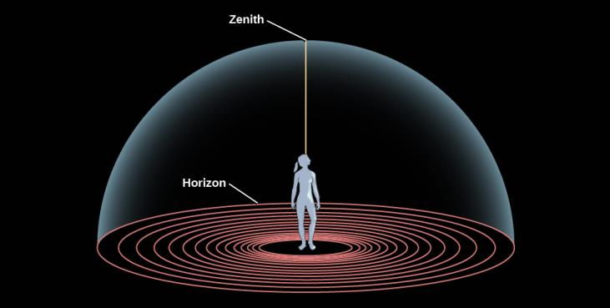
The sky above
Standing on a large empty field, when you gaze up, you get the impression that you are at the center of a great hollow dome.
Zenith: A point directly above your head
Horizon: A point where the dome meets the Earth

Slide 4
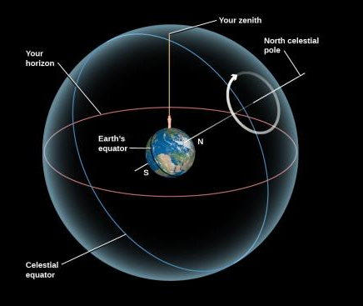
The Celestial sphere
Stars rise on the eastern horizon (like the Sun and Moon) and sets on the western horizon.
Dome of the sky is a great sphere that turns and brings different stars into view.
This sky is the Celestial Sphere.
The Earth rotates and not the celestial sphere.
Celestial Poles: The projection of the Earth’s North Pole and South Pole into the Celestial Sphere.
Celestial Equator: The Projection of the Earth’s Equator
Circles on the Celestial Sphere. Here we show the (imaginary) celestial sphere around Earth, on which objects are fixed, and which rotates around Earth on an axis. In reality, it is Earth that turns around this axis, creating the illusion that the sky revolves around us. Note that Earth in this picture has been tilted so that your location is at the top and the North Pole is where the N is. The apparent motion of celestial objects in the sky around the pole is shown by the circular arrow.

Slide 5
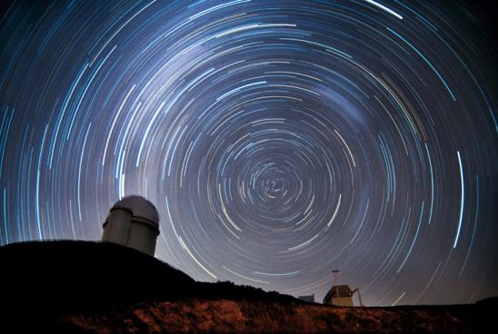
Circling the South Celestial Pole
As Earth rotates about its axis, the sky appears to turn in the opposite direction around those celestial poles
The apparent motion of the celestial sphere depends on our latitude (position north or south of the equator).
This long-exposure photo shows trails left by stars as a result of the apparent rotation of the celestial sphere around the south celestial pole. (In reality, it is Earth that rotates.) (Credit: ESO/Iztok Bončina)

Slide 6
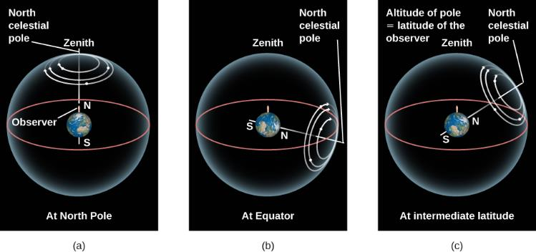
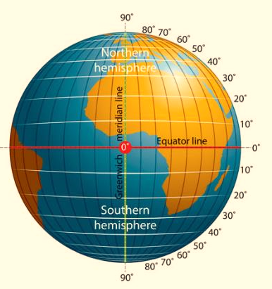
Star Circles at Different Latitudes
The turning of the sky looks different depending on your latitude on Earth.
The red circle in each case is your horizon. Your zenith is the point above your head.
At the North Pole, the stars circle the zenith and do not rise and set.
At the equator, the celestial poles are on the horizon, and the stars rise straight up and set straight down.
At intermediate latitudes, the north celestial pole is at some position between overhead and the horizon. Its angle above the horizon turns out to be equal to the observer’s latitude. Stars rise and set at an angle to the horizon.

Slide 7
Circumpolar Zone
For an observer at 38° N latitude, the south celestial pole is 38° below the southern horizon and, thus, never visible.
As Earth turns, the whole sky seems to pivot about the north celestial pole. For this observer, stars within 38° of the North Pole can never set. They are always above the horizon, day and night.
This part of the sky is called the north circumpolar zone.
For observers in the continental United States, the Big Dipper, Little Dipper, and Cassiopeia are examples of star groups in the north circumpolar zone.
On the other hand, stars within 38° of the south celestial pole never rise. That part of the sky is the south circumpolar zone.
Latitude:
0 degrees at the Equator
90 degrees at the Poles

Slide 8
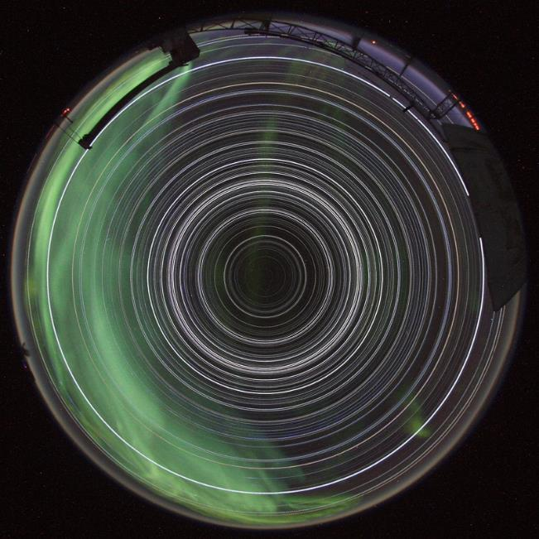
Star trails seen from the south pole
No star dips below the horizon and the Sun never climbs above it in this remarkable image of 24-hour long star trail.
Showing all the trails as complete circles, such an image could be achieved only from two places on planet Earth.
A shimmering apparition of the Aurora Australis is seen as green cloud
When you stand on South Pole, the south celestial pole is at the zenith. The celestial equator, 90° from the celestial poles, would lie along your horizon. As you watched the stars during the course of the night, they would all circle around the celestial pole, with none rising or setting.
Photo: Robert Schwarz

Slide 9
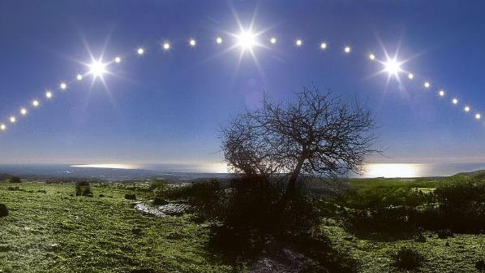
Rising and setting of the sun
What happens during the daytime?
The stars continue to circle during the day, but the brilliance of the Sun makes them difficult to see.
We can think of the Sun as being located at some position on the hypothetical celestial sphere.
When the Sun rises—that is, when the rotation of Earth carries the Sun above the horizon—sunlight is scattered by the molecules of our atmosphere, filling our sky with light and hiding the stars above the horizon.
Ancient astronomers knew that the Sun gradually changes position on the celestial sphere. This gave them an idea that the Sun slowly moved around the Earth, taking a period of time we call 1 year to make a full circle.
Today, of course, we know it is Earth that goes around the Sun, but the effect is the same: the Sun’s position in our sky changes day to day.

Slide 10
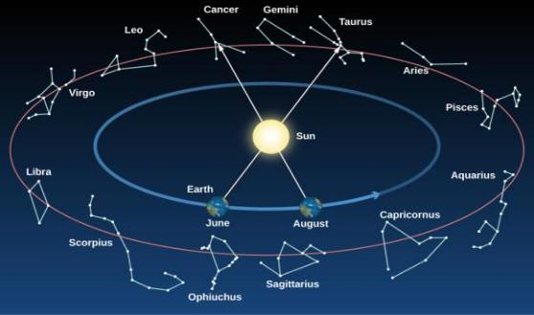
Ecliptic
….the path the Sun appears to take around the celestial sphere each year.
Daily Motion (Rising and Setting)
Caused by the Earth’s Rotation
Annual Motion
Caused by the revolution of the Earth around the Sun
Sun moves about 1 degree/day eastward relative to the stars
Slowly travel through the constellations of the zodiac
Planets (and other objects near the ecliptic) will also travel through these constellations
Constellations on the Ecliptic. As Earth revolves around the Sun, we sit on “platform Earth” and see the Sun moving around the sky. The circle in the sky that the Sun appears to make around us in the course of a year is called the ecliptic. This circle (like all circles in the sky) goes through a set of constellations (group stars). Note that at any given time of the year, some of the constellations crossed by the ecliptic are visible in the night sky; others are in the day sky and are thus hidden by the brilliance of the Sun.

Slide 11
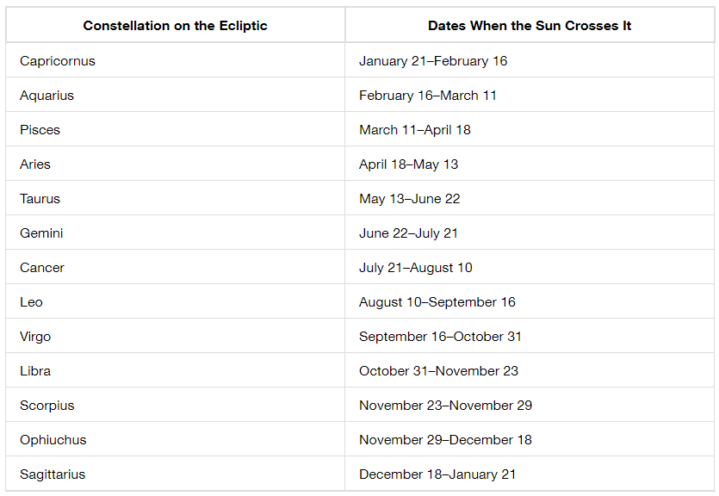
Constellation on the Ecliptic
Constellations on the Ecliptic. As Earth revolves around the Sun, we sit on “platform Earth” and see the Sun moving around the sky. The circle in the sky that the Sun appears to make around us in the course of a year is called the ecliptic. This circle (like all circles in the sky) goes through a set of constellations (group stars). Note that at any given time of the year, some of the constellations crossed by the ecliptic are visible in the night sky; others are in the day sky and are thus hidden by the brilliance of the Sun.

Slide 12
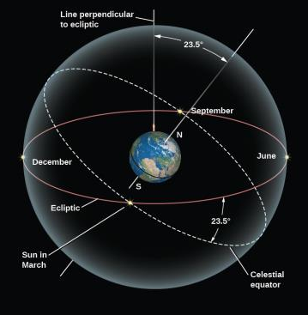
The Celestial Tilt
The ecliptic does not lie along the celestial equator
It is inclined to it at an angle of about 23.5°
In other words, the Sun’s annual path in the sky is not linked with Earth’s equator
This is because our planet’s axis of rotation is tilted by about 23.5° from a vertical line sticking out of the plane of the ecliptic
Being tilted from “straight up” is not at all unusual among celestial bodies
Uranus and Pluto are actually tilted so much that they orbit the Sun “on their side.”
The inclination of the ecliptic is the reason the Sun moves north and south in the sky as the seasons change
The celestial equator is tilted by 23.5° to the ecliptic. As a result, North Americans and Europeans see the Sun north of the celestial equator and high in our sky in June, and south of the celestial equator and low in the sky in December.

Slide 13
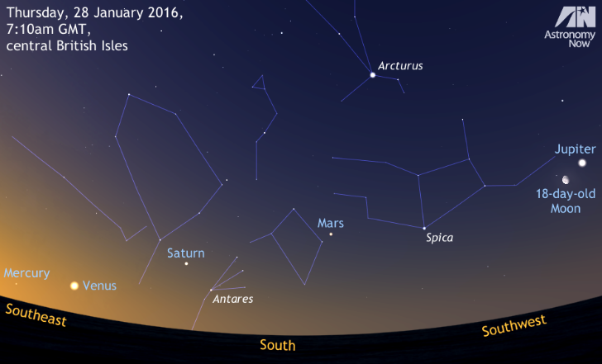
Fixed and Wandering Stars
The Moon and each of the planets that are visible to the unaided eye — Mercury, Venus, Mars, Jupiter, Saturn, and Uranus also change their positions slowly from day to day.
Like the Sun, they have independent motions among the stars, superimposed on the daily rotation of the celestial sphere.
The Greeks of 2000 years ago distinguished between what they called the fixed stars—those that maintain fixed patterns among themselves through many generations—and the wandering stars, or planets. The word “planet,” in fact, means “wanderer” in ancient Greek.

Slide 14
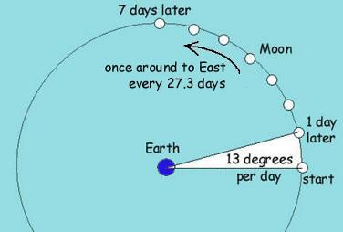
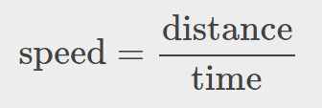
Angles in the sky
The Moon, being Earth’s nearest celestial neighbor, has the fastest apparent motion; it completes a trip around the sky in about 1 month (or moonth).
To do this, the Moon moves about 12 - 13 degrees on the sky, each day.
A circle consists of 360 degrees (°). When we measure the angle in the sky, we can use this formula:
This is true whether the motion is measured in kilometers per hour or degrees per hour; we just need to use consistent units.

Slide 15
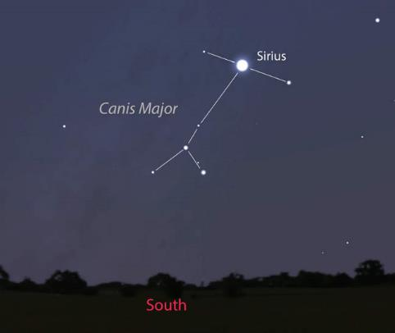
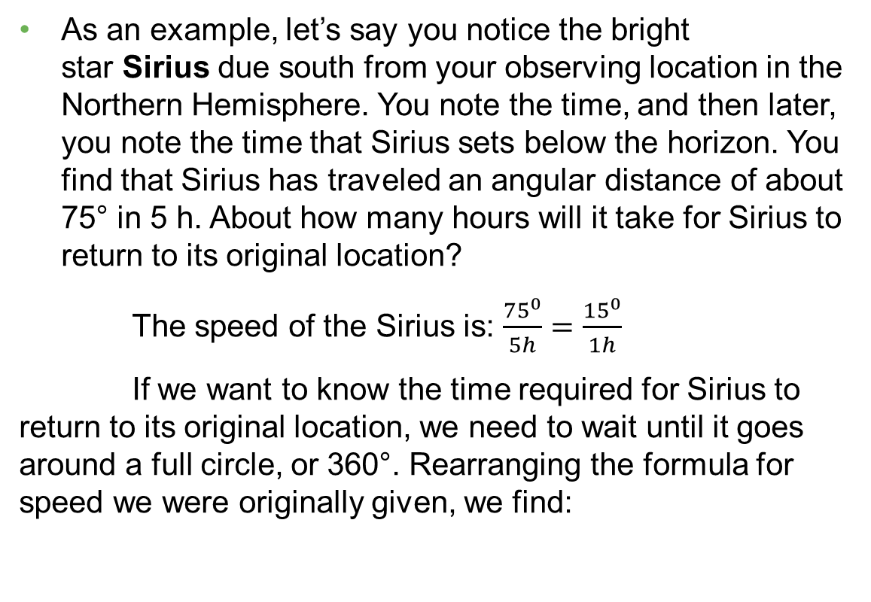
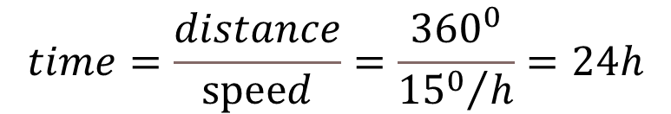
Angles in the sky
As an example, let’s say you notice the bright star Sirius due south from your observing location in the Northern Hemisphere. You note the time, and then later, you note the time that Sirius sets below the horizon. You find that Sirius has traveled an angular distance of about 75° in 5 h. About how many hours will it take for Sirius to return to its original location?
The speed of the Sirius is: $\frac{{75}^{0}}{5h}=\frac{{15}^{0}}{1h}$
If we want to know the time required for Sirius to return to its original location, we need to wait until it goes around a full circle, or 360°. Rearranging the formula for speed we were originally given, we find:
$$time=\frac{distance}{speⅇd}=\frac{{360}^{0}}{{{15}^{0}}/h}=24h$$

Slide 16
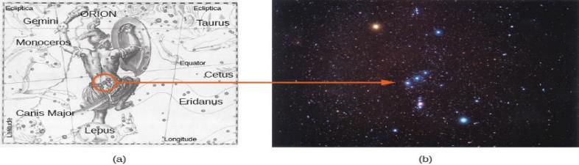
Constellation
Orion
The winter constellation of Orion, the hunter, is surrounded by neighboring constellations, as illustrated in the seventeenth-century atlas by Hevelius.
A photograph shows the Orion region in the sky. Note the three blue stars that make up the belt of the hunter. The bright red star above the belt denotes his armpit and is called Betelgeuse (pronounced “Beetel-juice”). The bright blue star below the belt is his foot and is called Rigel.
constellation means one of 88 sectors into which we divide the sky
The modern boundaries between the constellations are imaginary lines in the sky running north–south and east–west, so that each point in the sky falls in a specific constellation
The modern constellation of Orion is a kind of box on the sky, which includes, among many other objects, the stars that made up the ancient picture of the hunter.

Slide 17
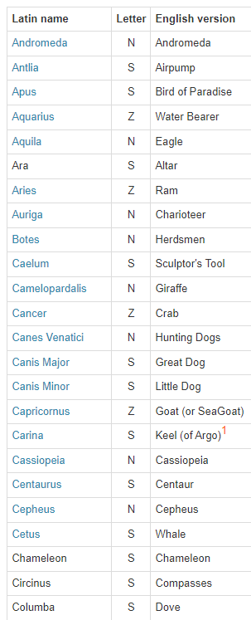
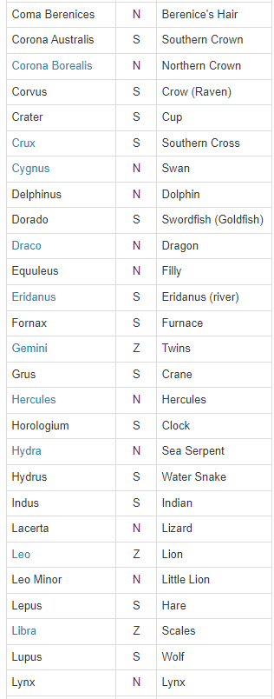
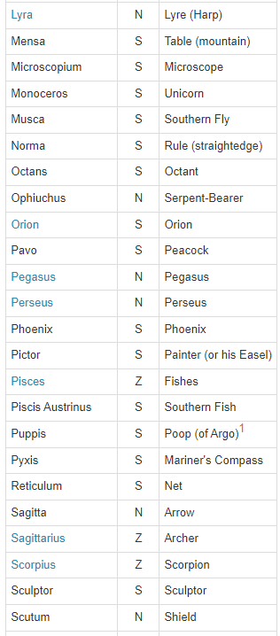
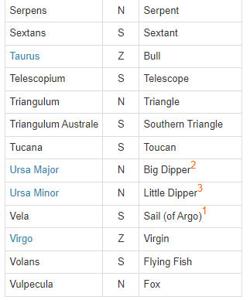
88 Constellations
The letter N or S following the Latin name indicates whether the constellation is located to the north or south of the Zodiac. The letter Z indicates that the constellation is within the Zodiac.

Slide 18
OBSERVING THE SKY: THE BIRTH OF ASTRONOMY
2.1 The Sky Above
2.2 Ancient Astronomy
2.3 The Birth of Modern Astronomy
By the end of this Section, you will be able to:
Describe early examples of astronomy around the world
Explain how Greek astronomers were able to deduce that Earth is spherical
Explain how Greek astronomers were able to calculate Earth’s size
Describe the motion of Earth called precession
Describe Ptolemy’s geocentric system of planetary motion

Slide 19
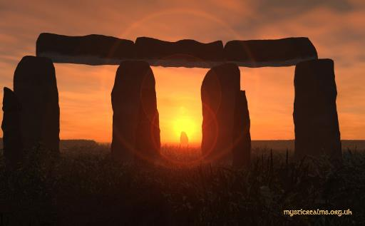
Astronomy around the world
The Egyptians of 3000 years ago adopted a calendar based on a 365-day year. They kept careful track of the rising time of the bright star Sirius in the predawn sky, which has a yearly cycle that corresponded with the flooding of the Nile River.
1000 years ago, the Chinese also recorded comets, bright meteors, and dark spots on the Sun.
Chinese astronomers kept careful records of “guest stars”—those that are normally too faint to see but suddenly flare up to become visible to the unaided eye for a few weeks or months.
Mayan, British, Indian, Hawaiian… all major civilization in the world devised some sort of methods to keep track of Moon, Sun, Seasons, etc.
Stonehenge is a prehistoric monument in England. It consists of an outer ring of vertical sarsen standing stones, each around 13 feet high, seven feet wide, and weighing around 25 tons, topped by connecting horizontal lintel stones.
It built in three phases between 3,000 B.C. and 1,600 B.C.

Slide 20

Greek and roman cosmology
Earth’s Round Shadow. A lunar eclipse occurs when the Moon moves into and out of Earth’s shadow. Note the curved shape of the shadow—evidence for a spherical Earth that has been recognized since antiquity.
The writings of Aristotle (384–322 BCE), the tutor of Alexander the Great, summarize many of the ideas of his day. They describe how the progression of the Moon’s phases—its apparent changing shape—results from our seeing different portions of the Moon’s sunlit hemisphere as the month goes by.
Aristotle also knew that the Sun has to be farther away from Earth than is the Moon because occasionally the Moon passed exactly between Earth and the Sun and hid the Sun temporarily from view. We call this a solar eclipse.
Aristotle cited convincing arguments that Earth must be round. First is the fact that as the Moon enters or emerges from Earth’s shadow during an eclipse of the Moon, the shape of the shadow seen on the Moon is always round
Aristotle explained that travelers who go south a significant distance are able to observe stars that are not visible farther north.

Slide 21
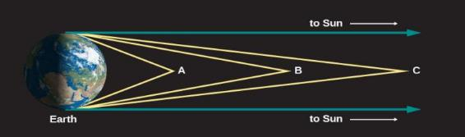
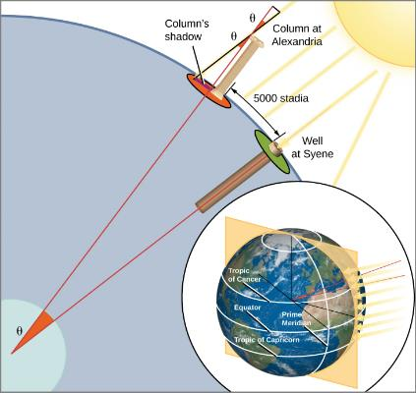
Measurement of earth
The first fairly accurate determination of Earth’s diameter was made in about 200 BCE by Eratosthenes (276–194 BCE) a Greek living in Alexandria, Egypt.
Light Rays from Space. The more distant an object, the more nearly parallel the rays of light coming from it.
How Eratosthenes Measured the Size of Earth
Eratosthenes measured the size of Earth by observing the angle at which the Sun’s rays hit our planet’s surface. The Sun’s rays come in parallel, but because Earth’s surface curves, a ray at Syene comes straight down whereas a ray at Alexandria makes an angle of 7° with the vertical. That means, in effect, that at Alexandria, Earth’s surface has curved away from Syene by 7° of 360°, or 1/50 of a full circle. Thus, the distance between the two cities must be 1/50 the circumference of Earth.
Stadia = 1 stadium = 1/6 kilometer
→ Earth’s Circumference ~ 41,000 kilometers

Slide 22
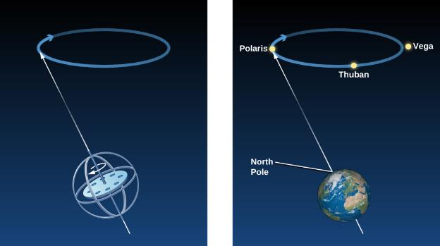
Hipparchus and precession
By observing the stars and comparing his data with older observations, Hipparchus made one of his most remarkable discoveries: the position in the sky of the north celestial pole had altered over the previous century and a half.
Hipparchus deduced correctly that this had happened not only during the period covered by his observations but was in fact happening all the time: the direction around which the sky appears to rotate changes slowly but continuously.
The direction in which Earth’s axis points does indeed change slowly but regularly—a motion we call precession.
Precession. Just as the axis of a rapidly spinning top wobbles slowly in a circle, so the axis of Earth wobbles in a 26,000-year cycle. Today the north celestial pole is near the star Polaris, but about 5000 years ago it was close to a star called Thuban, and in 14,000 years it will be closest to the star Vega.

Slide 23

Precession explained

Slide 24
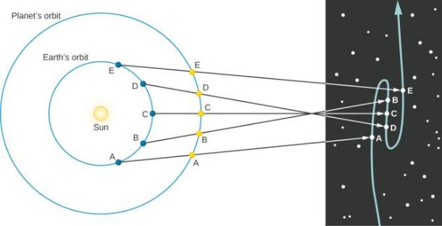
Ptolemy’s model of the solar system
Ptolemy
Lived in Alexandria in 140 AD
Used data from previous observation by Hipparchus
Ptolemy’s most important contribution was a geometric representation of the solar system that predicted the positions of the planets for any desired date and time.
The apparent wandering of the planets in the sky results from the combination of their own motions with Earth’s orbital revolution.
Normally, planets move eastward in the sky over the weeks and months as they orbit the Sun, but from positions B to D, as Earth passes the planets in our example, it appears to drift backward, moving west in the sky.
As Earth rounds its orbit toward position E, the planet again takes up its apparent eastward motion in the sky.
The temporary apparent westward motion of a planet as Earth swings between it and the Sun is called retrograde motion.
Retrograde Motion of a Planet beyond Earth’s Orbit. The letters on the diagram show where Earth and Mars are at different times. By following the lines from each Earth position through each corresponding Mars position, you can see how the retrograde path of Mars looks against the background stars.

Slide 25
OBSERVING THE SKY: THE BIRTH OF ASTRONOMY
2.1 The Sky Above
2.2 Ancient Astronomy
2.3 The Birth of Modern Astronomy
By the end of this section, you will be able to:
Explain how Copernicus developed the heliocentric model of the solar system
Explain the Copernican model of planetary motion and describe evidence or arguments in favor of it
Describe Galileo’s discoveries concerning the study of motion and forces
Explain how Galileo’s discoveries tilted the balance of evidence in favor of the Copernican model

Slide 26
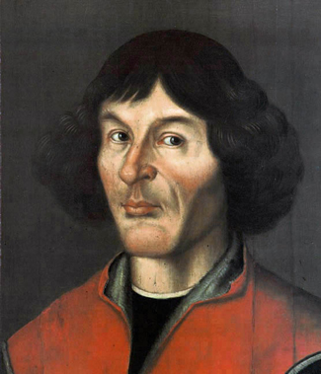
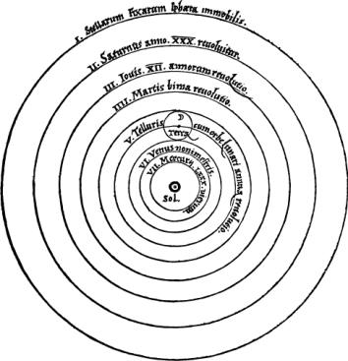
The birth of modern astronomy
Europe came out of dark age to Renaissance “rebirth”.
Copernicus described his ideas in detail in his book De Revolutionibus Orbium Coelestium (On the Revolution of Celestial Orbs), published in 1543, the year of his death.
A century later his ideas made a profound influence in the world history
6 known planets at the time
Nicolaus Copernicus (1473–1543) Copernicus was a cleric and scientist who played a leading role in the emergence of modern science. Although he could not prove that Earth revolves about the Sun, he presented such compelling arguments for this idea that he turned the tide of cosmological thought and laid the foundations upon which Galileo and Kepler so effectively built in the following century.
Copernicus’ System Copernicus developed a heliocentric plan of the solar system. This system was published in the first edition of De Revolutionibus Orbium Coelestium. Notice the word Sol for “Sun” in the middle. (credit: Nicolai Copernici)

Slide 27
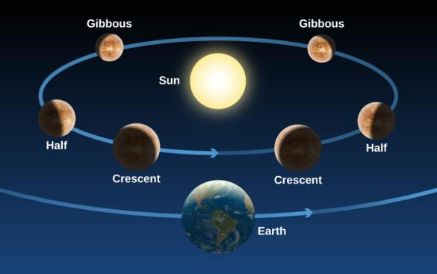
The heliocentric model
Copernicus could not prove that Earth revolves about the Sun.
It was hard to change the existing philosophical (religious) traditions.
In fact, in the North American colonies, the older geocentric system was still taught at Harvard University in the first years after it was founded in 1636.
Lack of Model Testing
If Venus circles the Sun, the planet should go through the full range of phases just as the Moon does, whereas if it circles Earth, it should not.
Phases of Venus. As Venus moves around the Sun, we see changing illumination of its surface, just as we see the face of the Moon illuminated differently in the course of a month.

Slide 28
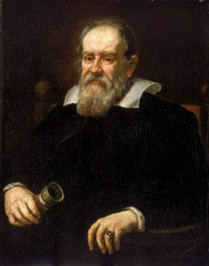
Galileo Galilei
Many of the modern scientific concepts of observation, experimentation, and the testing of hypotheses through careful quantitative measurements were pioneered by a man who lived nearly a century after Copernicus.
Galileo Galilei a contemporary of Shakespeare, was born in Pisa.
Like Copernicus, he began training for a medical career, but he had little interest in the subject and later switched to mathematics.
He held faculty positions at the University of Pisa and the University of Padua, and eventually became mathematician to the Grand Duke of Tuscany in Florence.
Greatest Contributions:
Mechanics: the study of motion and actions of forces on bodies
Objects at motions tends to stay at motion and objects at rest tends to stay at rest.
Force is required to stop or start, speed up or slow down.
Acceleration: Change rate of change of speed
Astronomy:
Heliocentric Solar System
Galileo Galilei (1564–1642) Galileo advocated that we perform experiments or make observations to ask nature its ways. When Galileo turned the telescope to the sky, he found things were not the way philosophers had supposed.

Slide 29
Galileo’s Astronomical Observations
Telescope Used by Galileo. The telescope has a wooden tube covered with paper and a lens 26 millimeters across.
The first “spyglasses” (now called telescopes) that attracted much notice were made in 1608 by the Dutch spectacle maker Hans Lippershey (1570–1619).
Galileo heard of the discovery and, without ever having seen an assembled telescope, constructed one of his own with a three-power magnification (3×), which made distant objects appear three times nearer and larger.
His salary was doubled by the Government for making a telescope with 9X magnification
After 30X magnification, he was able to see Jupiter's moons (Io, Europa, Ganymede, Callisto)
Galileo tested the Copernican theory mentioned earlier, based on the phases of Venus.

Slide 30
Observing the Planets
At most any time of the night, and at any season, you can spot one or more bright planets in the sky. All five of the planets known to the ancients—Mercury, Venus, Mars, Jupiter, and Saturn—are more prominent than any but the brightest stars, and they can be seen even from urban locations if you know where and when to look. One way to tell planets from bright stars is that planets twinkle less.
Venus, which stays close to the Sun from our perspective, appears either as an “evening star” in the west after sunset or as a “morning star” in the east before sunrise. It is the brightest object in the sky after the Sun and Moon. It far outshines any real star, and under the most favorable circumstances, it can even cast a visible shadow. Some young military recruits have tried to shoot Venus down as an approaching enemy craft or UFO.
Mars, with its distinctive red color, can be nearly as bright as Venus is when close to Earth, but normally it remains much less conspicuous. Jupiter is most often the second-brightest planet, approximately equaling in brilliance the brightest stars. Saturn is dimmer, and it varies considerably in brightness, depending on whether its large rings are seen nearly edge-on (faint) or more widely opened (bright).
Mercury is quite bright, but few people ever notice it because it never moves very far from the Sun (it’s never more than 28° away in the sky) and is always seen against bright twilight skies.
True to their name, the planets “wander” against the background of the “fixed” stars. Although their apparent motions are complex, they reflect an underlying order upon which the heliocentric model of the solar system, as described in this chapter, was based. The positions of the planets are often listed in newspapers (sometimes on the weather page), and clear maps and guides to their locations can be found each month in such magazines as Sky & Telescope and Astronomy (available at most libraries and online). There are also a number of computer programs and phone and tablet apps that allow you to display where the planets are on any night.

Slide 31
End of chapter 2
This OpenStax ancillary resource is © Rice University under a CC-BY 4.0 International license; it may be reproduced or modified but must be attributed to OpenStax, Rice University and any changes must be noted.

