Slide 1
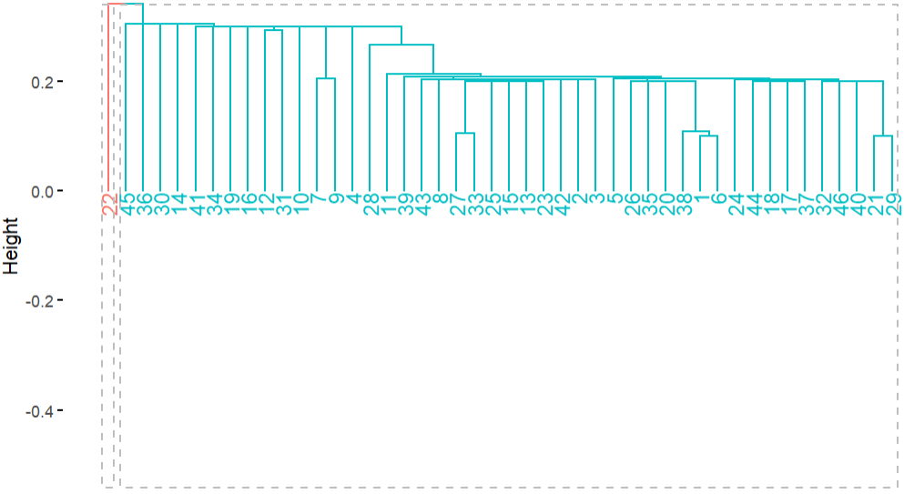
Single Linkage

Slide 2
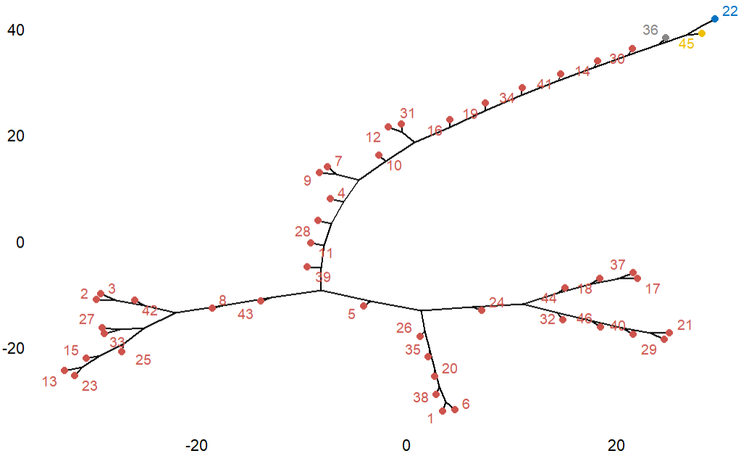
Single Linkage

Slide 3
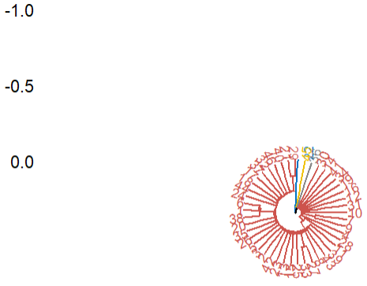
Single Linkage

Slide 4
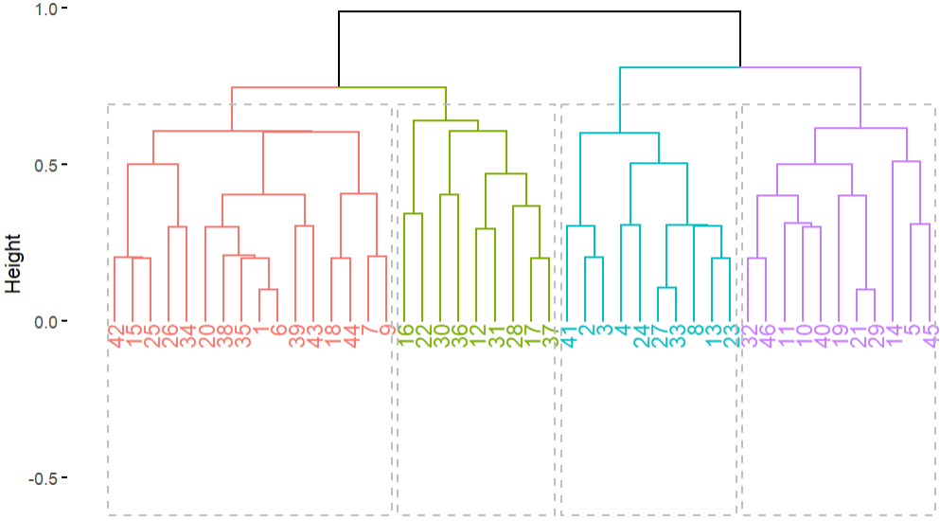
Complete Linkage

Slide 5
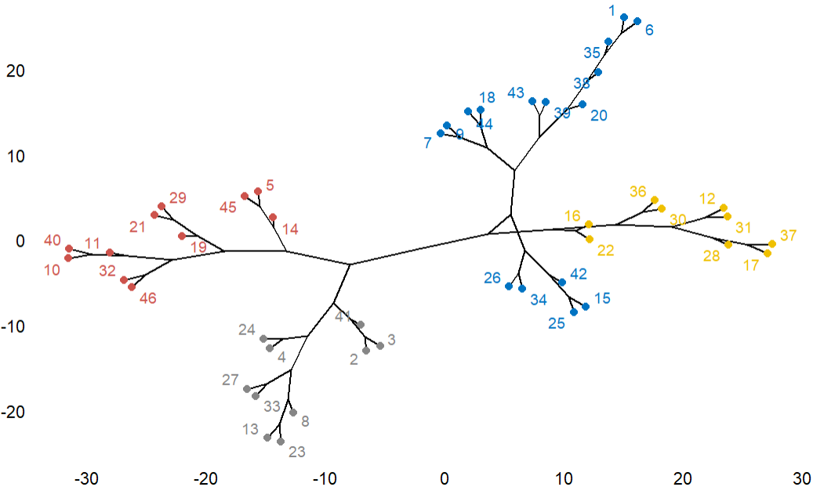
Complete Linkage

Slide 6
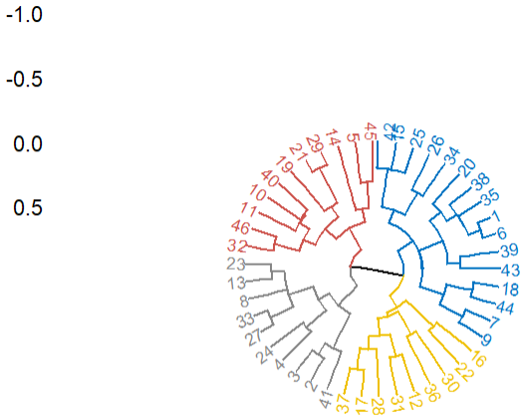
Complete Linkage

Slide 7
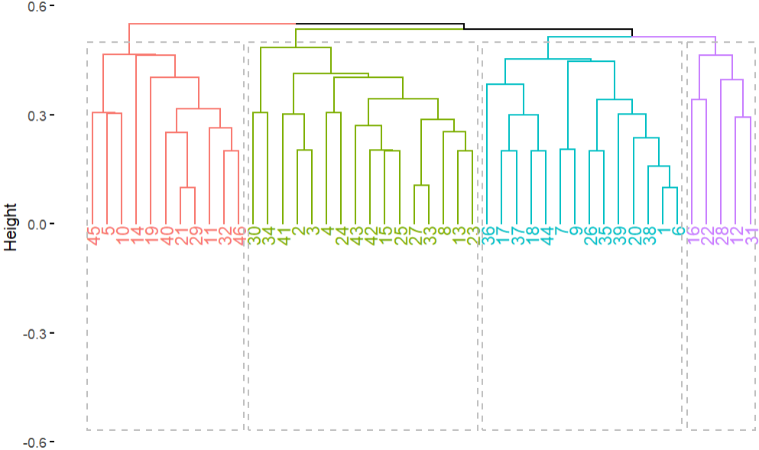
Average Linkage

Slide 8
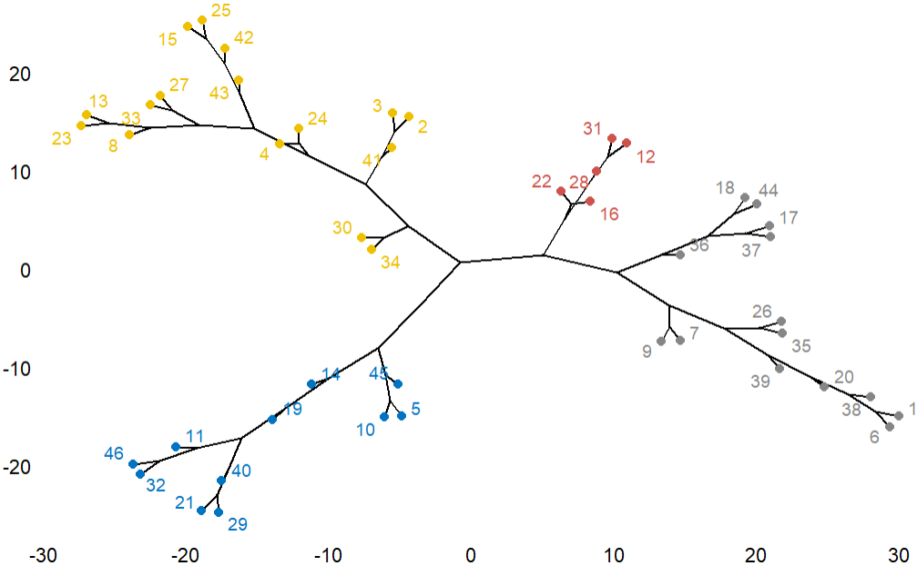
Average Linkage

Slide 9
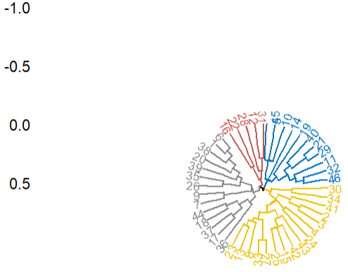
Average Linkage

Slide 10
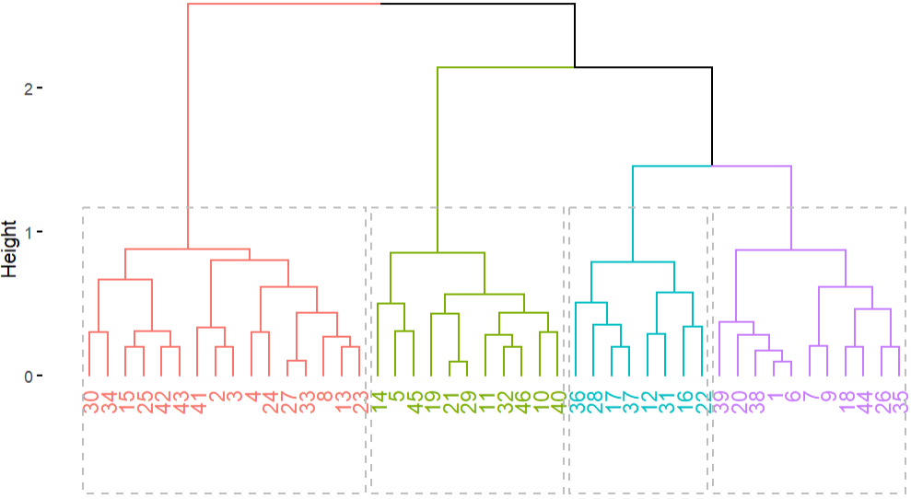
Ward.D Linkage

Slide 11
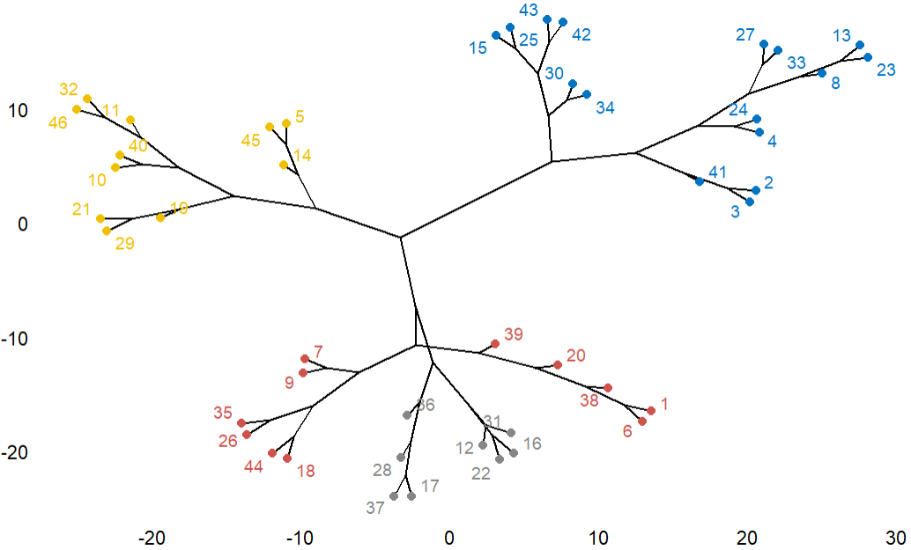
Ward.D Linkage

Slide 12
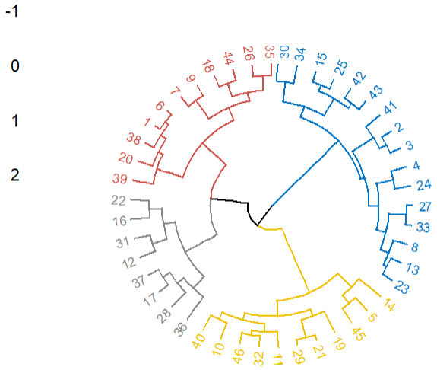
Ward.D Linkage

Slide 13
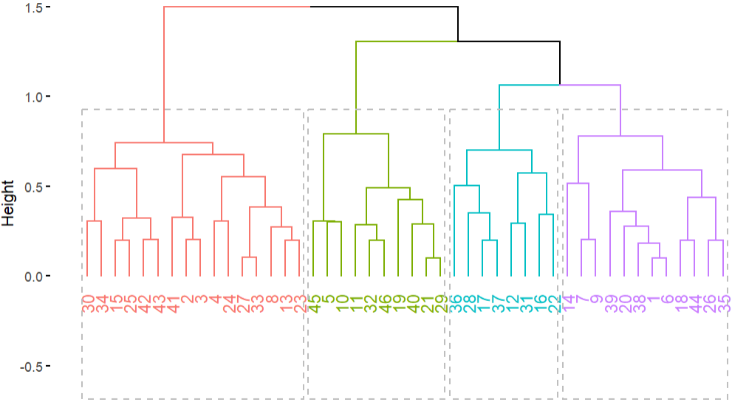
Ward.D2 Linkage

Slide 14
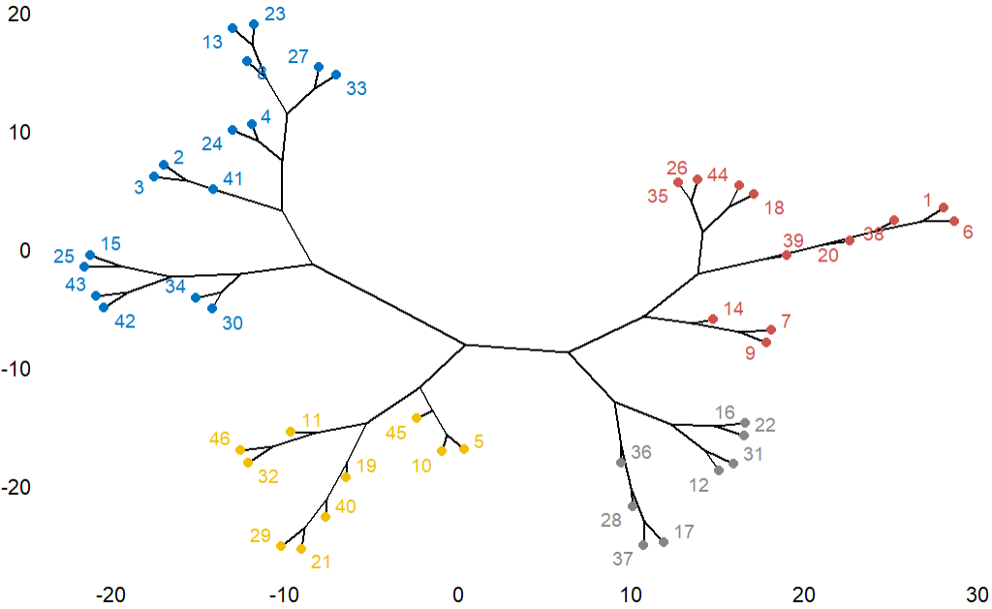
Ward.D2 Linkage

Slide 15
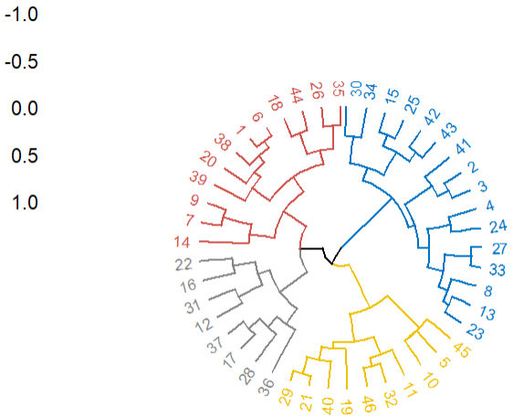
Ward.D2 Linkage

Slide 16
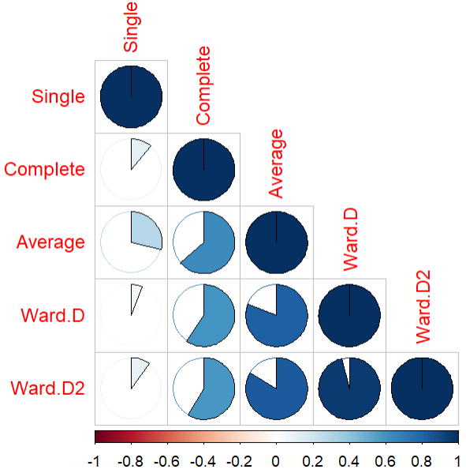
Correlation Plot

Slide 17
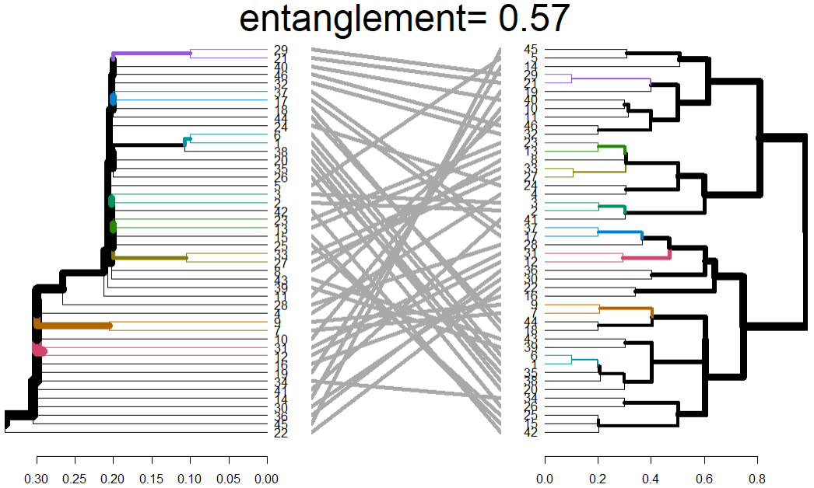
Single vs Complete

Slide 18
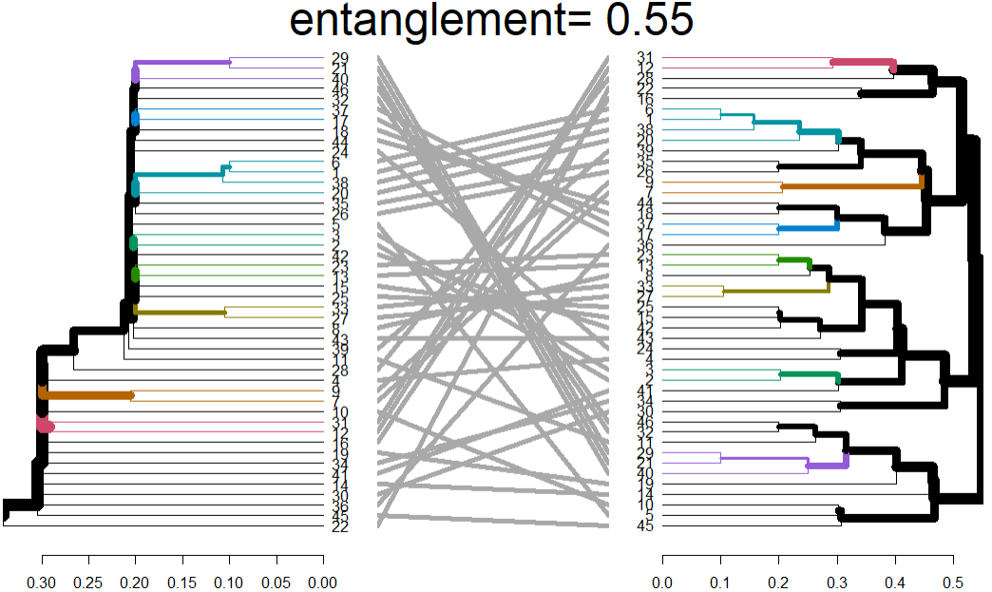
Single vs Average

Slide 19
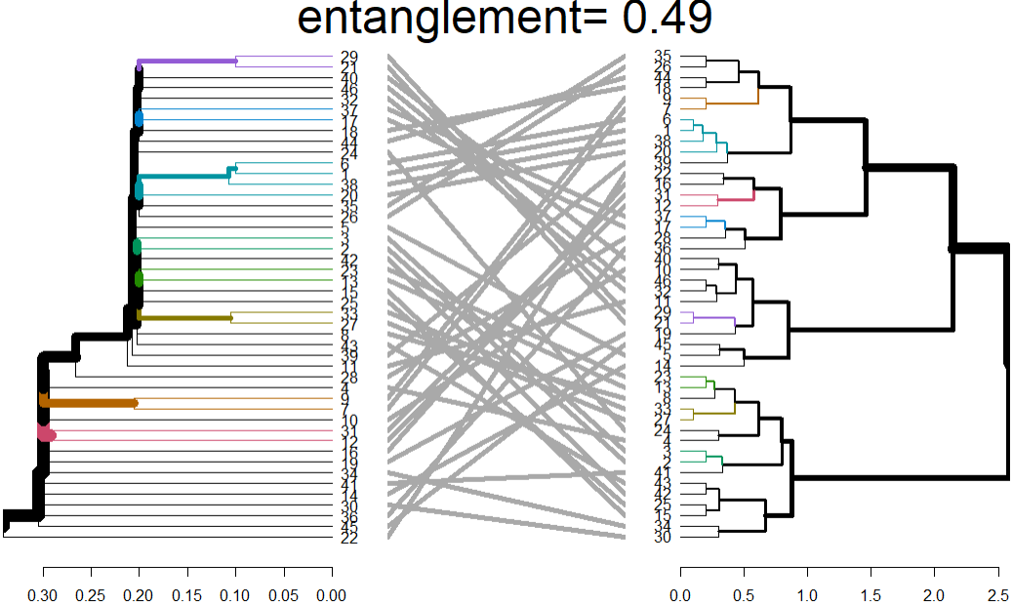
Single vs Ward.D

Slide 20
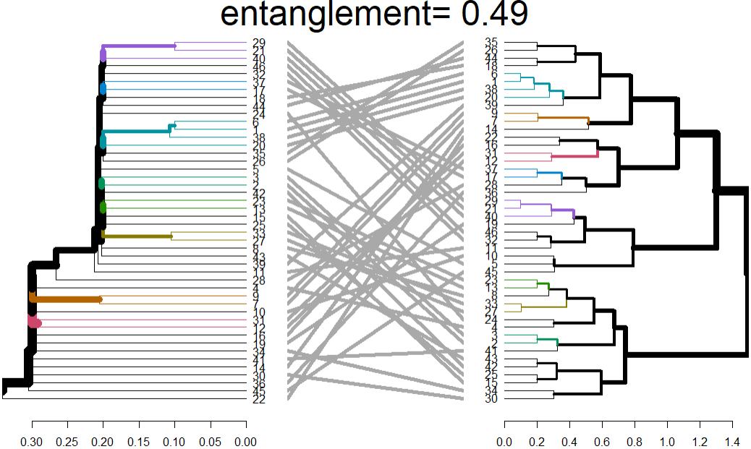
Single vs Ward.D2

Slide 21
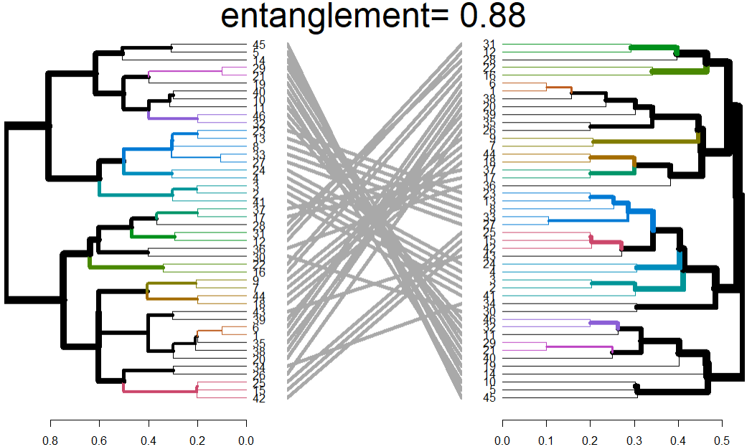
Complete vs Average

Slide 22
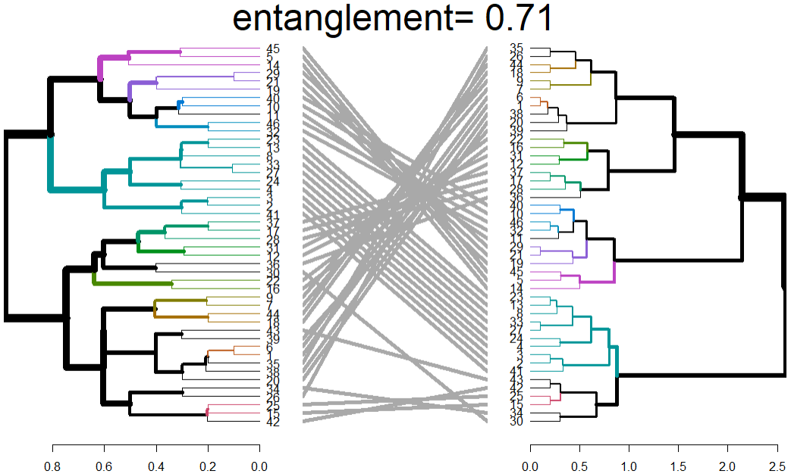
Complete vs Ward.D

Slide 23
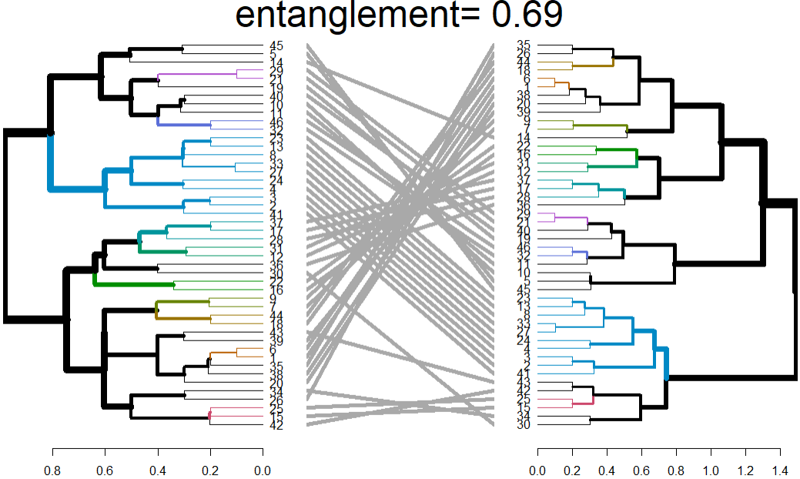
Complete vs Ward.D2

Slide 24
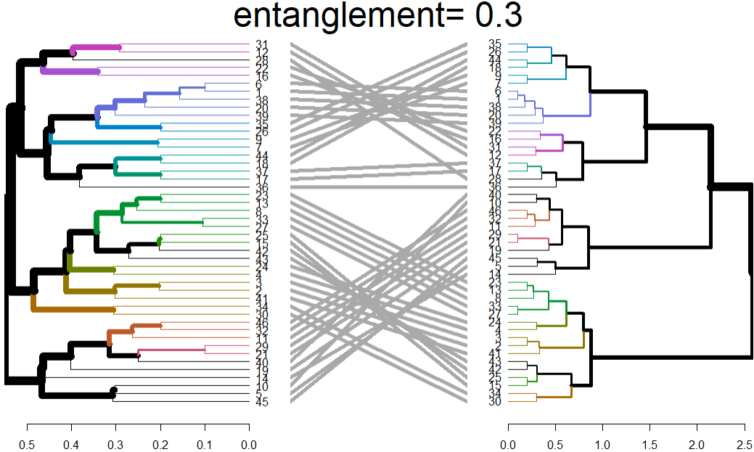
Average vs Ward.D

Slide 25
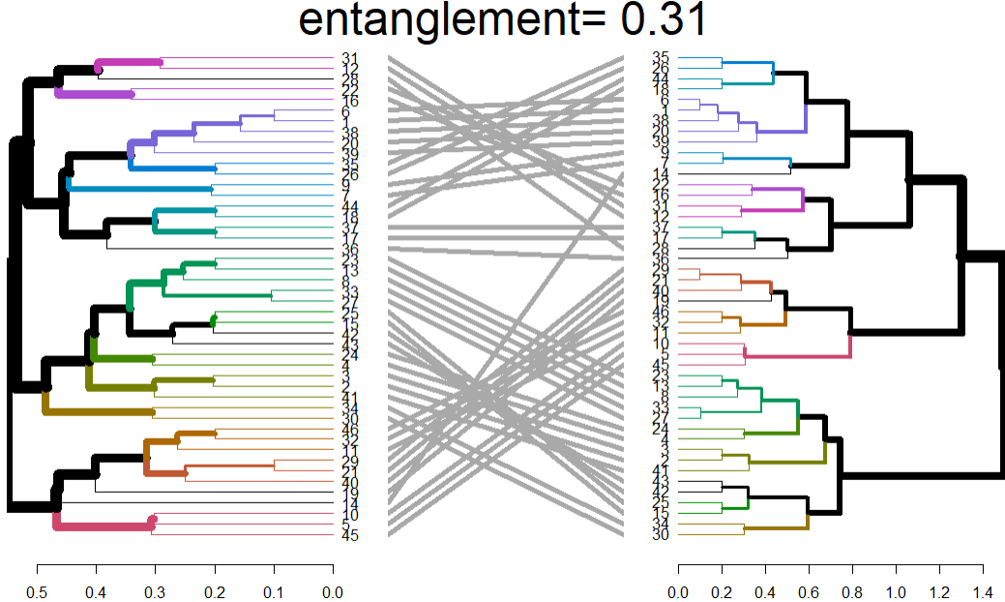
Average vs Ward.D2

Slide 26
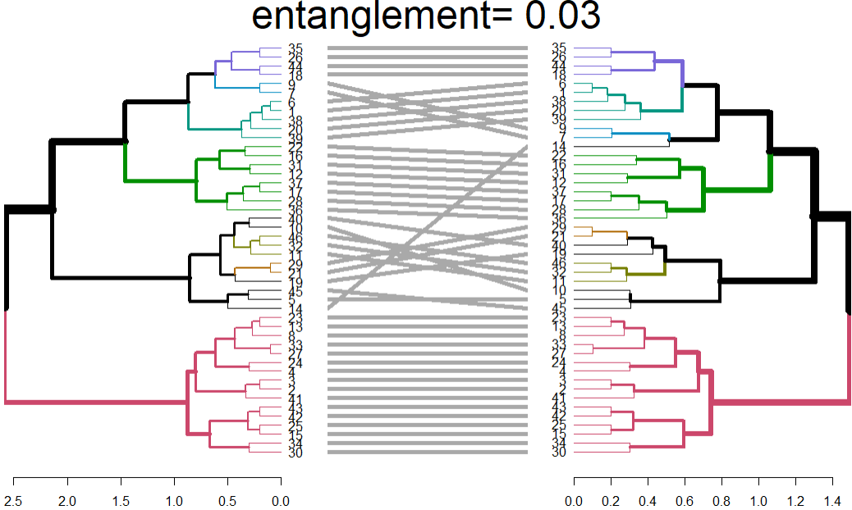
Ward.D vs Ward.D2

Slide 27
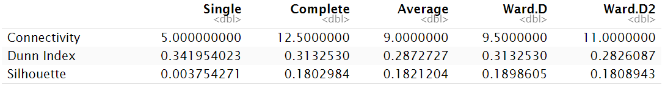
Internal Validation
Based on the internal validation, these are the best from each method:
Connectivity : Single
Dunn Index : Single
Silhouette : Ward.D

Slide 28
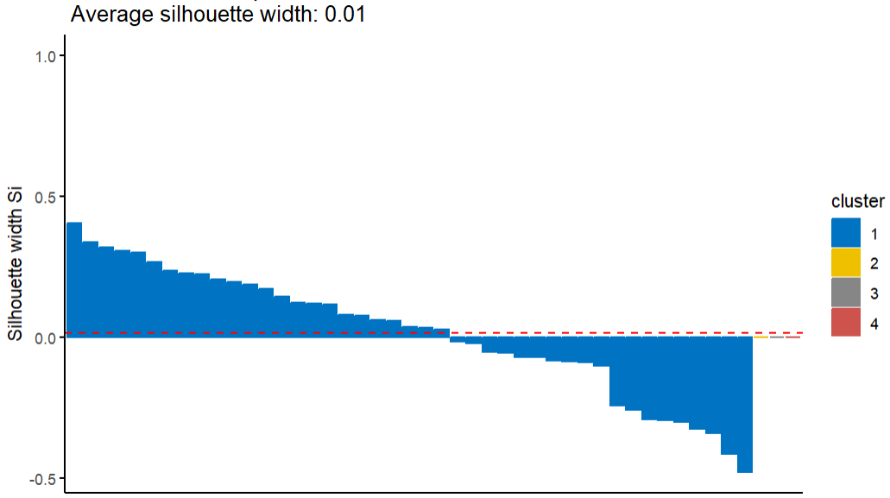
Single Linkage

Slide 29
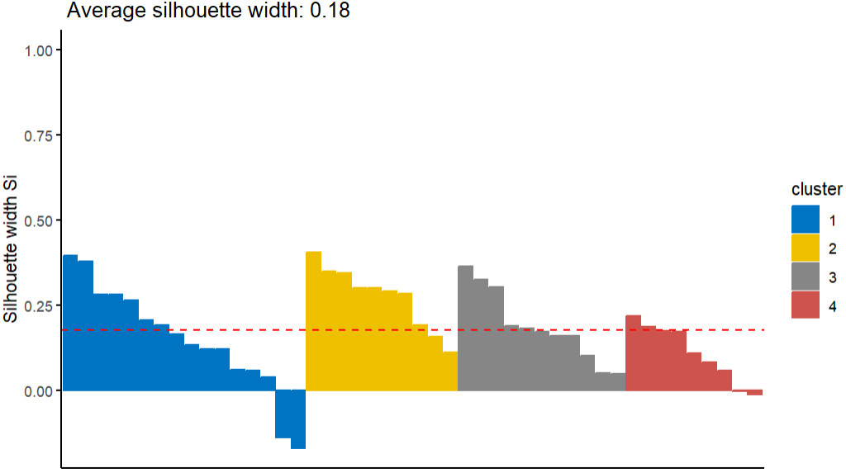
Complete Linkage

Slide 30
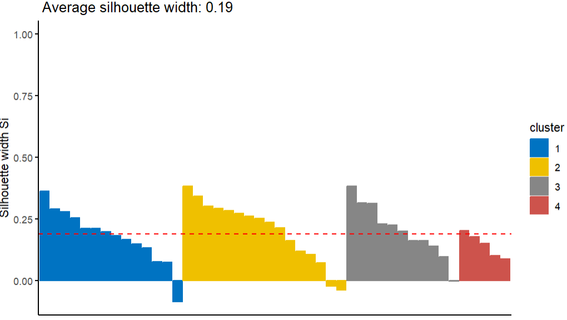
Average Linkage

Slide 31
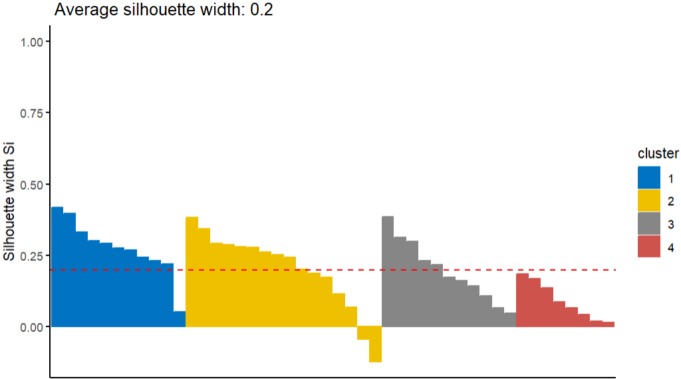
Ward.D Linkage

Slide 32
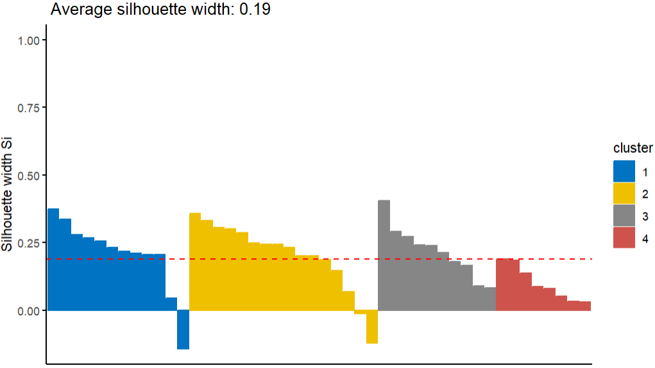
Ward.D2 Linkage

