Slide 1
Interstride App – A critique
By: Suman Sourav
MSIS Candidate, 2018
Foster School of Business, UW

Slide 2
CONTENTS
Background and Scope
App Categorization
Pros
Feedback
Users/Customers Pain Points
Overall App Evaluation
Improvements or Suggestions
Conclusion

Slide 3
Background
This critique aims to help the UW Foster Career Services assess the usefulness of Interstride Apps and identify potential features for early international students at Foster
Scope –
Understand pain points of early international students at Foster(UW)
Trial run the App
Provide qualitative improvement suggestions / feedback
About Interstride: http://interstride.com/

Slide 4
App Categorization
Primary purpose of Interstride App usage: Information, Productivity
Secondary purpose: Social Media(professional)
Ref - https://duckma.com/mobile-app-categories/

Slide 5
Pros
Smooth navigation experience(very easy to navigate)
Useful features that improve productivity
Simple but intuitive UI(no more than 3-4 taps to access a desired menu)
Covers important aspects(online resources, job info, sponsors, etc)
PUTS TOGETHER ALL RELEVANT INFORMATIONAL MATERIALS THAT CAN ASSIST IN NAVIGATION EARLY STUDENT LIFE AND JOB SEARCH EFFORTS

Slide 6
Users/Customer Pain Points
App
Users
International Students
Career Counsellors
Customers
University/ Dept/ Career Services
Early Stage
Late Stage
Admins
An early stage international student worries about:
Navigating School
Navigating Life in US
Navigating Job Search
Admins and Career Counsellors – Also important users, but analysis beyond the scope.

Slide 7
Users/Customer Pain Points(contd)
Visa/ Immigration – Confusing, isn’t it?
Career events, counselling, workshops in school – A lot to track, how do I coordinate?
Want to land up in my dream job – but by doing what and when?
Do my dream companies sponsor international students?
Is my job expectation realistic?
What is the job search process?
What are top skills in demand(different variations of this question)

Slide 8
Overall App Evaluation
Based on the previous pain points, this slide evaluates to what extent the app helps solve those pain points.
Sl.No | Question | 1 | 2 | 3 | 4 | 5
1 | How was the app download and sign up process? |  |  |  |  | ✓
2 | User interface? Is it easy to navigate? |  |  |  | ✓
3 | Career Game Plan |  |  | ✓
4 | Country Insights |  | ✓
5 | Network Tracker |  |  | ✓
6 | Visa Insights |  |  |  |  | ✓
7 | Jobs |  |  |  |  | ✓
5 - highest

Slide 9
Overall App Evaluation(contd.)
Based on the previous pain points, this slide evaluates to what extent the app helps solve those pain points.
Sl.No | Question | 1 | 2 | 3 | 4 | 5
1 | Career |  |  |  | ✓
2 | Communication |  | ✓
3 | Culture |  |  |  | ✓
4 | Network |  |  |  | ✓
5 | Professionalism |  |  | ✓
6 | Academics |  | ✓
5 - highest

Slide 10
Improvements or Suggestions
Visa Insights –
Selection - The student should be able to make multiple selections in a category(Example: Industry – Technology, Computer Science, etc. )
The early student may not have the specific interests figured out
Average Salary – Shown in Rupees, not clear if it is per year, per month

Slide 11
Improvements or Suggestions(contd.)
Resources
Past student experiences video(optional)
Info on Job/ Networking on-campus resources
Useful for early students
* Needs to be moderated by campus admins. Should ask for that flexibility.

Slide 12
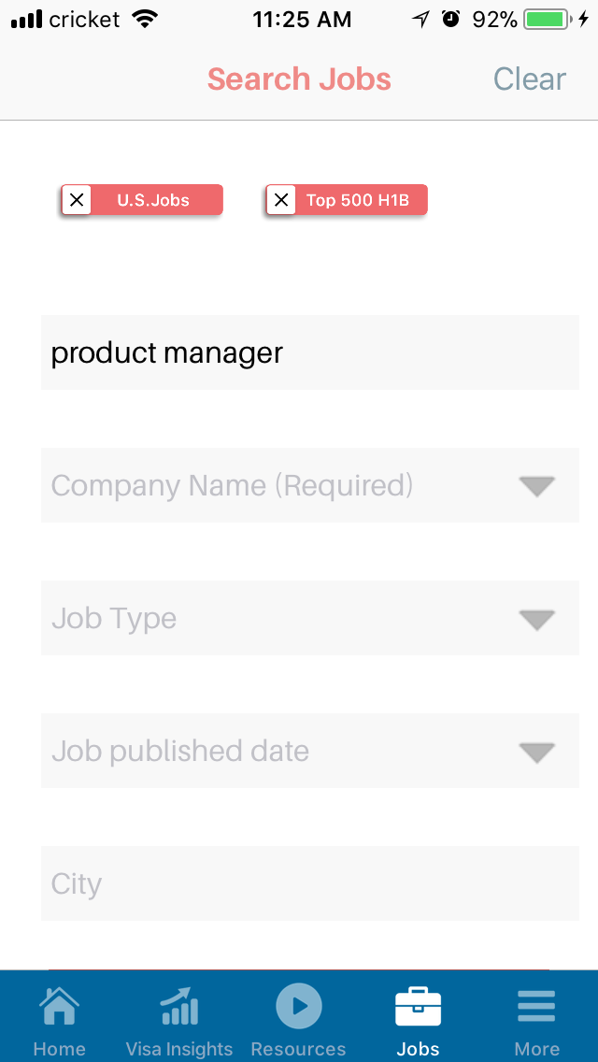
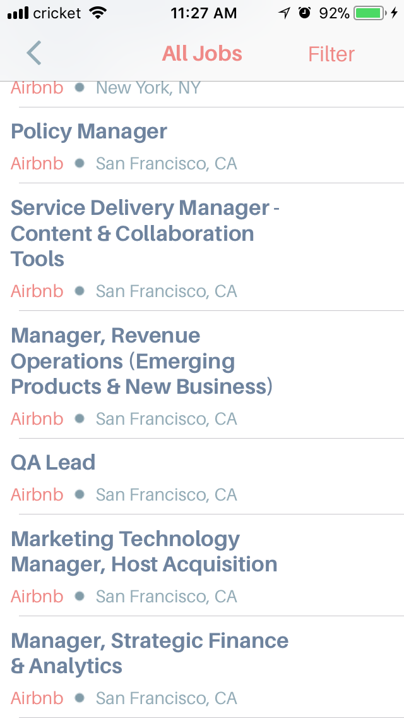
Improvements or Suggestions(contd.)
Jobs
Company Name(Required) – The student should be able to use Search Jobs feature to find an interesting role across companies
Company Name can be made optional
Quality of Search – Somewhat broad.
Narrow is preferred
Have a strict match/ broad match option

Slide 13
Improvements or Suggestions(contd.)
Career Gameplan
The candidate should be able to take this survey when he/ she onboards(optional)
Questions should somehow capture the quality of info and not just quantity(Ex: Which prof orgs, what position?)
Probability changes too much with minimal changes in answers(My tests - 72% to 82% with just 2 answers changed.)

Slide 14
Improvements or Suggestions(contd.)
Country Insights
The student should be able to search US easily.
The quality of data on a country could to be refined.

Slide 15
Improvements or Suggestions(contd.)
Checklist
Deleting an item from checklist is currently not possible
Individual checklists for each company/ interview should be supported

Slide 16
Improvements or Suggestions(contd.)
Newsfeed
Moderating new content added should be present
Newsfeed can contain on-campus events information

Slide 17
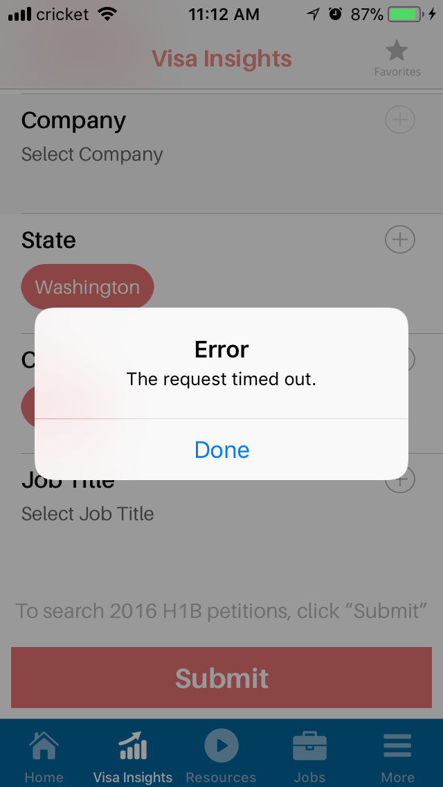
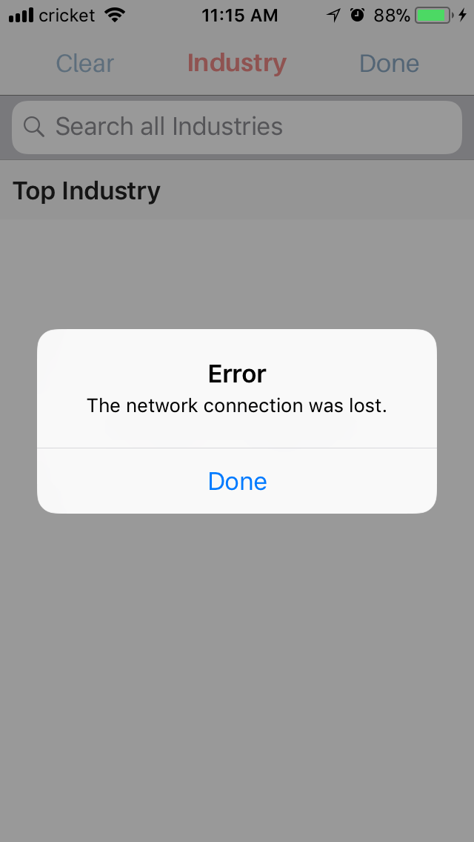
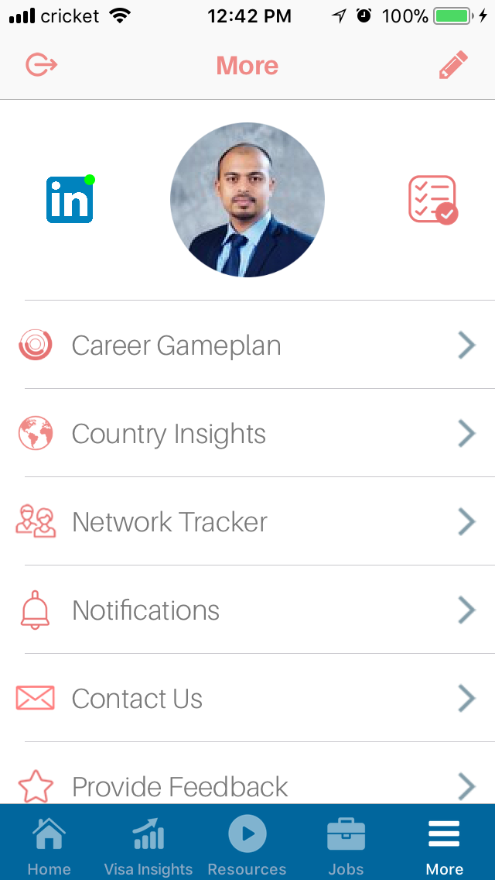
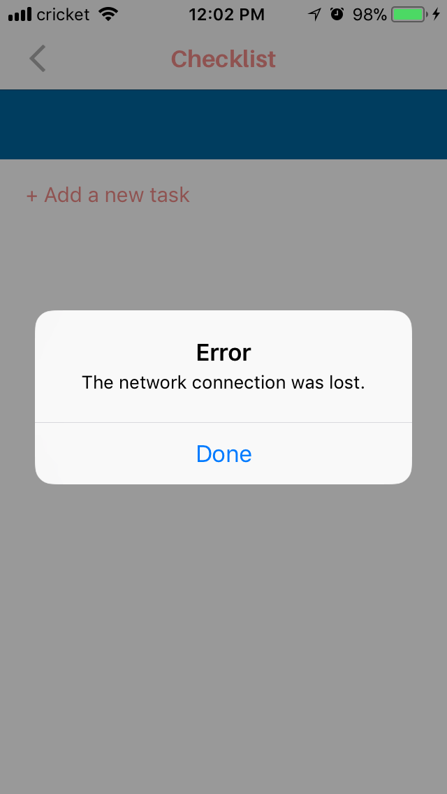
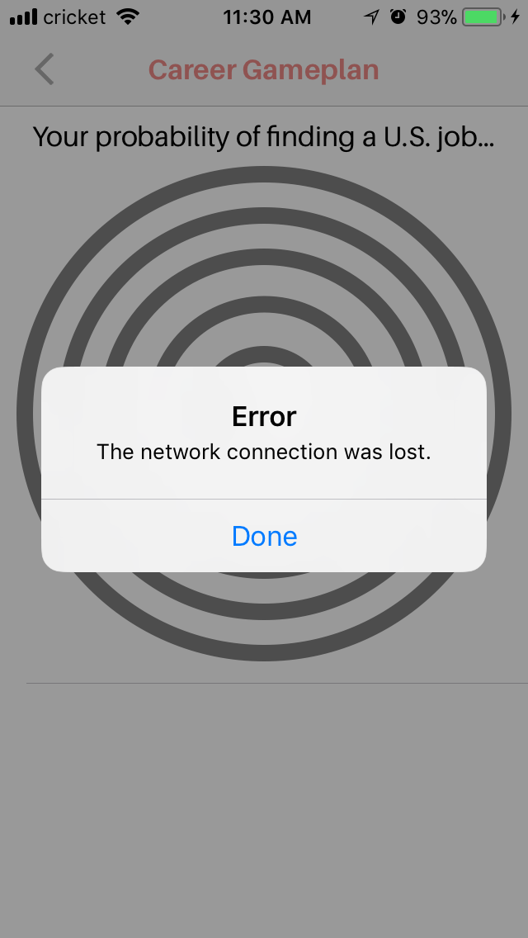
Improvements or Suggestions(contd.)
Others
Fixing App Connectivity Issues
Program-wise Demographics, placement, industry stats
Sign-out icon should be moved to less visible area.
Did not know what that meant and got signed out multiple times.

Slide 18
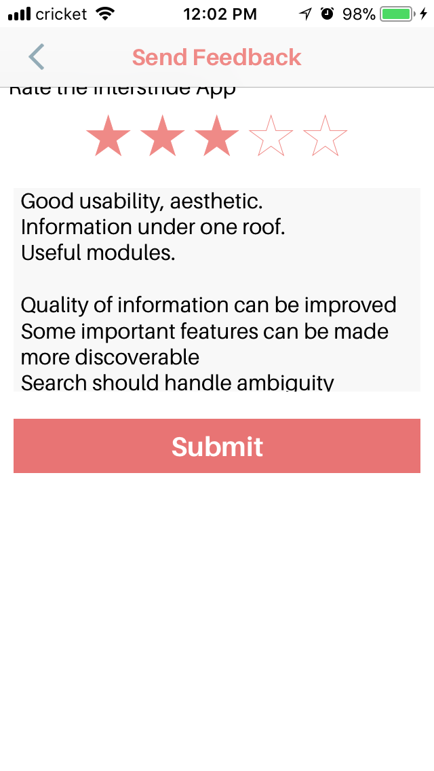





Conclusion
Quality of Information the app provides
Degree of productivity the app facilitates
3.5, but no option to enter that ☹
The quality of information can be improved by:
Letting the school do some moderations
Refining data sources – company names, country info, etc.
The degree of productivity can be improved by:
More useful checklists, making gameplan more visible, and some other suggestions in prev slides

Slide 19
QnAs

