Slide 1
PASSENGER1
Critiquing the website design
By:
Suman Sourav Dikshit University of Washington(MSIS)

Slide 2
Approach
Scratching the surface
More generic comments
Superficial
Detailed, tailored, holistic – TBD
I should gather more information first!

Slide 3
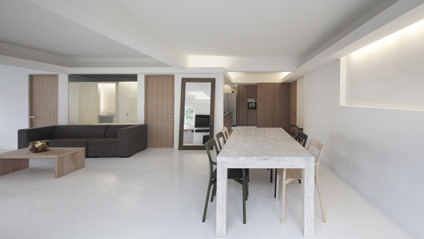
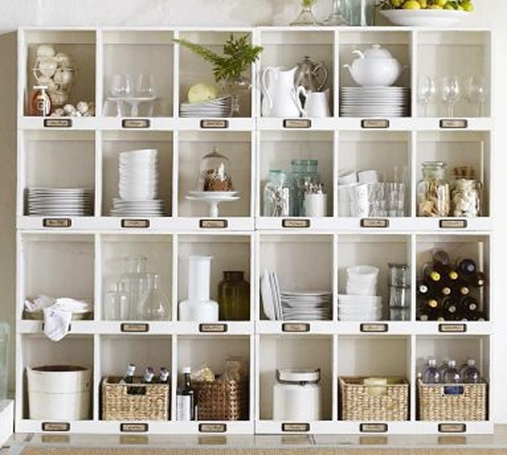
Great things first!
Minimalistic Design
User receives when required!
Organized and easy to use

Slide 4

Search Relevance
This Photo by Unknown Author is licensed under CC BY-SA

Slide 5
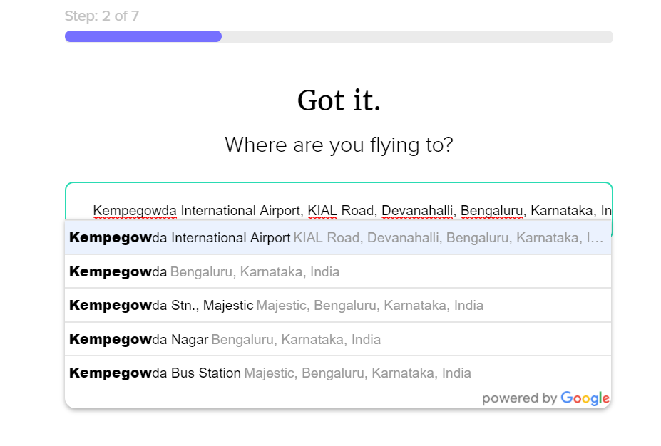
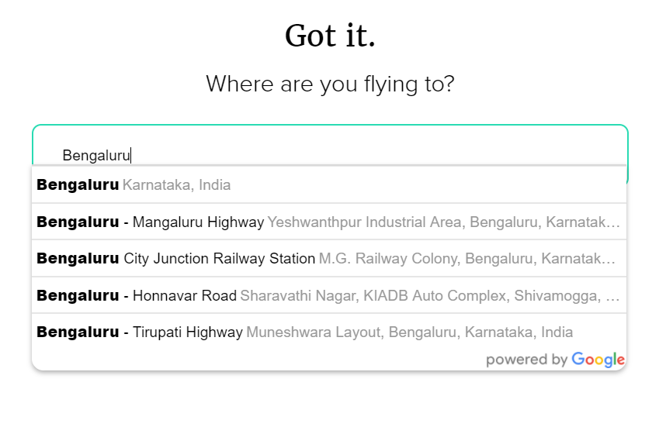
Search Relevance
That is correct! Un-intuitive though!
Search for a place, get the airport – Cool Feature!
BUT
Can confuse user!
Can disrupt user’s further planning – How?
Can we consider 3 letter code for the airport to optimize!
Wait! These are not airports!

Slide 6
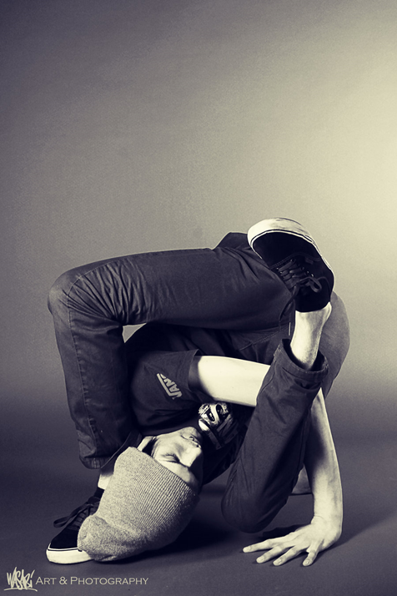
Flexibility

Slide 7
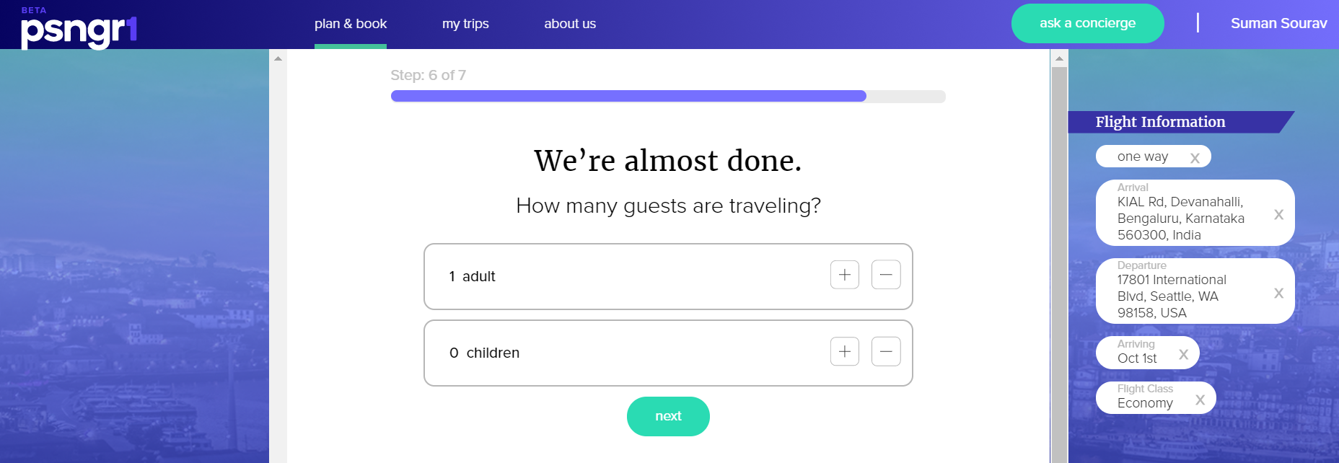
Accommodate user’s changing need without much hassle!
Ex: Helping user change between hotel only, flights only without re-starting from scratch!
You know what! I just realized that I need a hotel too!

Slide 8

Emergency

Slide 9
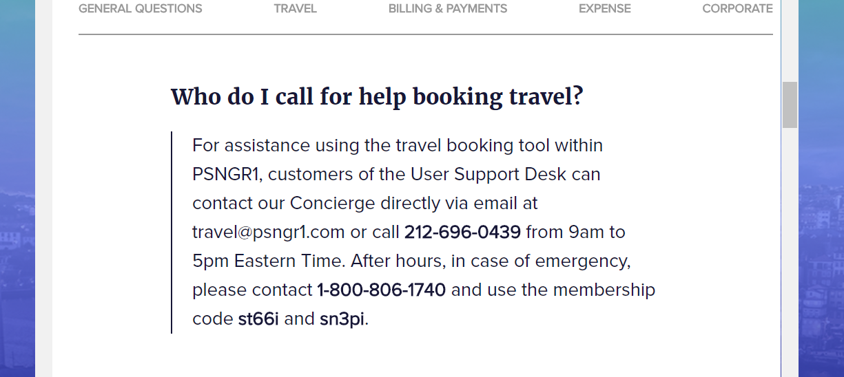
Help user in case of emergency:
Need to make the Emergency contact information visible.
Now, inside FAQs and less visible.
Need to be careful
We don’t want this number to be used as a Customer Care number
We have the Ask a Concierge feature too! – Users should leverage that first!

Slide 10
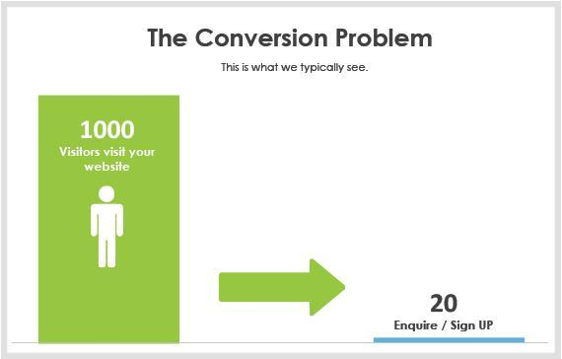
Conversion

Slide 11
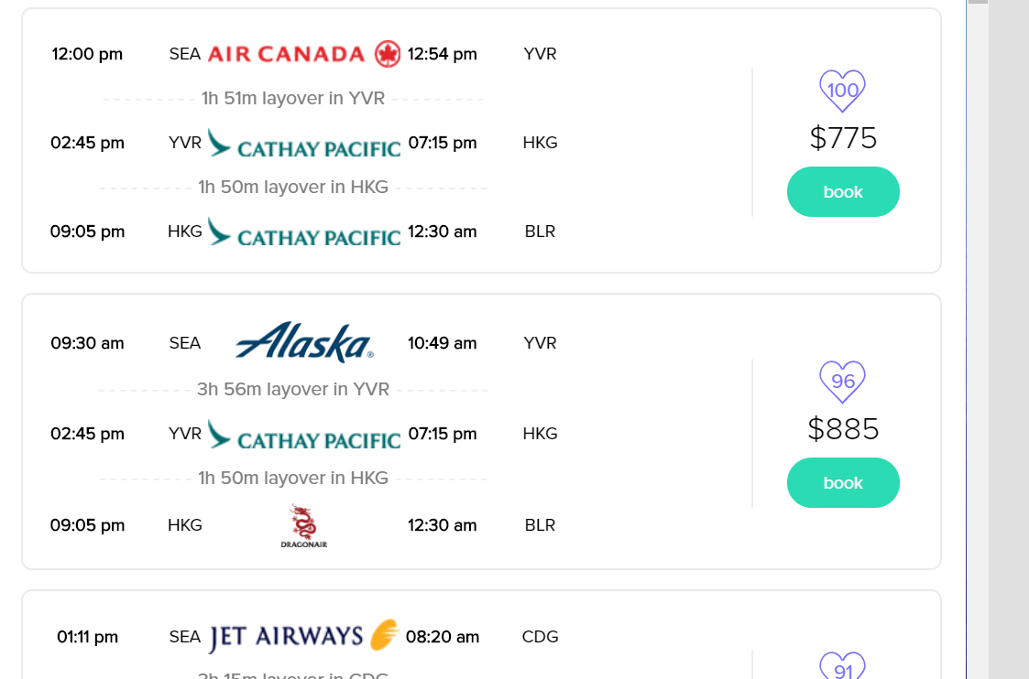
Summarizing the total duration
X hours & Y minutes
X hours & Y minutes

Slide 12
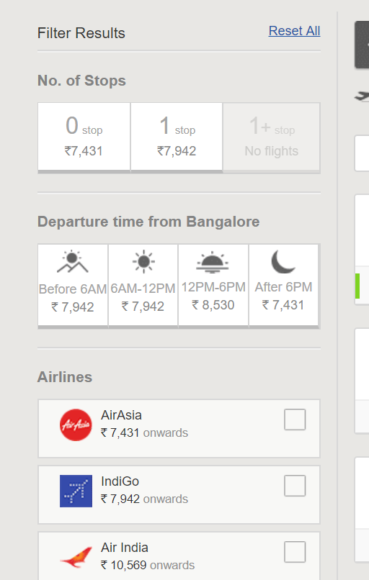
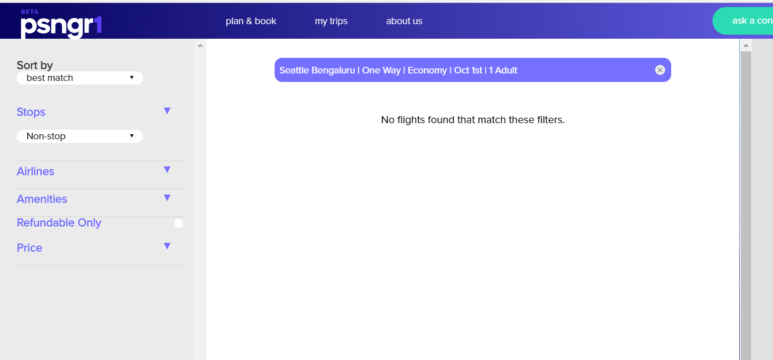
Fast filters
Vs
User knows which filter does not have a result, the easy way!

Slide 13

Miscellaneous

Slide 14
Think about it!
A suitable explainer video at the home page
https://www.youtube.com/watch?v=dp3NK7TMMzw
Any promotion with deals/ coupons on the home page
New user’s tool-tips

Slide 15
My thoughts
Design is only a part of how we make an user feel
Design critique should be done iteratively and often
Design works in tandem with the following:
The business goals
Usefulness
How easy to understand
‘And as little design as required!’

Slide 16
References
Links
https://www.smashingmagazine.com/2016/08/running-a-ui-design-critique/
Books
Decode and Conquer
Other products/ websites
https://www.makemytrip.com/
https://www.concur.com/

Slide 17
THANK YOU

