Slide 1
Blockchain Project Proof of concept for online peer-to-peer transactional Application using Blockchain.
By Suman Sourav and team.

Slide 2
Agenda
Introduction
Demo
Improvements and Challenges

Slide 3
Introduction
Project:
Topic 1: Implement a simple block-chain, make it available to the class
There’s working open source code for this e.g.
https://github.com/dvf/blockchain
Explained here: https://hackernoon.com/learn-blockchains-by-building-one-117428612f46
To make this truly available, we would need a cloud resource

Slide 4
The Setup
Prashant
Suman
P2P n/w
Gaurav
Miner
Regular Peer
Regular Peer

Slide 5
Demo

Slide 6
Improvements and Challenges
Sl.No | Protocol | Reference Code | Improvements
1 | Transaction Broadcast for discovery | No Broadcast | Request-response based transaction discovery New end points for discovery Purge ‘transactions’ already accounted for
2 | Chain Immutability | Vulnerable | Improved Hashing by including previous hash
3 | Authorized access | No access control | No access control
4 | Coin base Verification | No Verification | No Verification
5 | Encrypted transactions | No encryption | No encryption
6 | Race Condition Resolution | Corner Case Scenario - Transactions drop | Transactions drop. Implemented logic to make excluded transactions available for re-mining.
7 | Automatic transaction mining, consensus | Manual Steps | Manual Steps

Slide 7
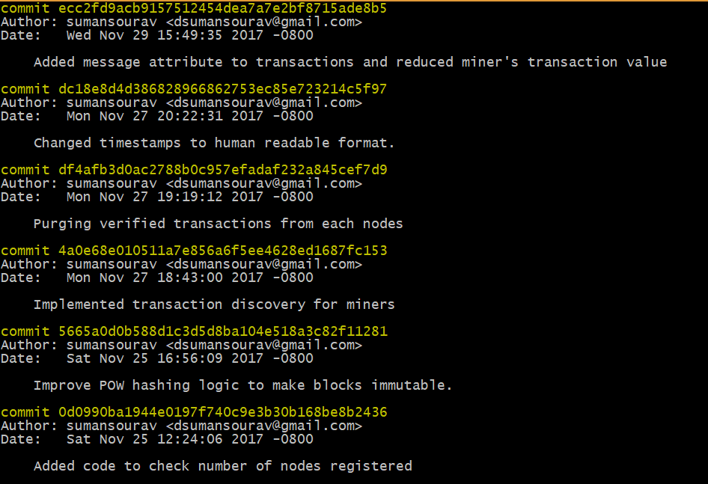
Appendix1
List of all changes

Slide 8
Appendix2
References:
https://hackernoon.com/learn-blockchains-by-building-one-117428612f46
https://medium.com/@rodkey/deploying-a-flask-application-on-aws-a72daba6bb80
https://www.khanacademy.org/economics-finance-domain/core-finance/money-and-banking/bitcoin/v/bitcoin-overview

Slide 9
THANK YOU

