Slide 1
Analyzing Demographic and Regional Disparities in Tele Law Case Registrations for Inclusive Legal Access
CAPSTONE PROJECT
Presented By:
1. Suman Sourav Sahoo-ITER,SOA,BBSR-B.Tech CSE

Slide 2
OUTLINE
Problem Statement (Should not include solution)
Proposed System/Solution
System Development Approach (Technology Used)
Algorithm & Deployment
Result (Output Image)
Conclusion
Future Scope
References

Slide 3
Problem Statement
The Pradhan Mantri Gram Sadak Yojana (PMGSY) has been implemented in multiple phases, each tailored with distinct goals and resource allocation strategies. With thousands of road and bridge construction projects executed under schemes like PMGSY-I, PMGSY-II, and RCPLWEA, accurately identifying the scheme associated with each project is critical for monitoring progress, policy evaluation, and budget tracking. Currently, the classification process is performed manually, making it time-consuming, error-prone, and inefficient at scale. Hence, automating the classification of PMGSY projects based on their physical and financial features is essential for improving transparency, accountability, and operational efficiency in rural infrastructure planning.

Slide 4
Proposed Solution
To automate the classification of PMGSY road and bridge construction projects into their respective schemes (e.g., PMGSY-I, PMGSY-II, RCPLWEA), the proposed system leverages data-driven machine learning approaches. This solution was implemented using IBM Watsonx.ai Studio on IBM Cloud to ensure scalability and accessibility.
Data Collection
Datasets were uploaded and managed through Watsonx.ai’s integrated data handling tools.
Historical project-level data was collected, including:
Physical attributes (length, terrain type, structure type)
Financial indicators (sanctioned cost, expenditure, payment stages)
Scheme tags for supervised learning (target column: PMGSY_SCHEME)
Data Preprocessing
Handled missing values, outliers, and inconsistent entries.
Encoded categorical variables and normalized continuous features.
Split data into training and holdout sets automatically via Watsonx pipelines.
Model Building and Evaluation
Multiple regression/classification models such as Linear Regression and Ridge Regression were evaluated
Pipelines P4 and P8, with hyperparameter tuning and feature engineering, yielded near-perfect performance.
Watsonx.ai’s AutoAI automatically selected the best algorithm and pipeline, ensuring both accuracy and explainability.
Deployment and Prediction
Deployed on IBM Cloud using Watsonx’s built-in model deployment services.
Real-time predictions enabled for new project entries.
Prediction results show high precision in scheme classification based on financial and physical characteristics.
Outcome and Impact
The proposed solution drastically reduces manual workload.
Helps government officials and planners to:
Monitor project allocation effectively.
Perform scheme-specific analytics.
Ensure budget transparency.

Slide 5
System Approach
System Requirements
Platform: IBM Cloud (Watsonx.ai Studio)
Environment: Cloud-based Jupyter Notebook / AutoAI pipeline
Operating System: Cross-platform (cloud-hosted)
Data Source: PMGSY project dataset (containing project features and corresponding scheme labels)
Output: Classified PMGSY scheme (PMGSY-I, PMGSY-II, RCPLWEA, etc.)
Libraries Required
Pandas – For data manipulation and analysis
NumPy – For numerical operations
Scikit-learn – For model building, preprocessing, and evaluation
Matplotlib / Seaborn – For visualizing feature relationships (if used outside AutoAI)
Watsonx.ai AutoAI – For automated model generation, pipeline building, feature engineering, and evaluation
Joblib / Pickle – For model persistence (optional, in manual model building)

Slide 6
Algorithm & Deployment
Algorithm Selection
The task of classifying PMGSY construction projects into their correct scheme (e.g., PMGSY-I, PMGSY-II, RCPLWEA) is a multi-class classification problem.Using IBM Watsonx.ai Studio, AutoAI was used to automatically select and optimize the best machine learning pipeline. Among the tested algorithms, Ridge Classifier, Logistic Regression, and Tree-based classifiers like Random Forest were evaluated.Ridge Classifier was ultimately selected due to:
Its ability to handle multicollinearity in financial/physical features.
High accuracy and generalization.
Simplicity and interpretability, suitable for structured tabular data.
Data Input
The following features were used as inputs to the model:
Physical Characteristics: Length of road, number of culverts/bridges, terrain type, road type.
Financial Indicators: Sanctioned amount, expenditure incurred, percentage of fund utilization, project completion status.
Other Metadata: Year of sanction, district, state, connectivity type.
Training Process
Data Cleaning & Preprocessing: Handled missing values, normalized numerical features, and encoded categorical variables using Watsonx.ai’s AutoAI data prep features.
Train-Test Split: AutoAI performed an 80:20 split and built multiple models in parallel.
Feature Selection: AutoAI evaluated feature importance and eliminated redundant fields.
Model Selection: The pipeline with the highest F1-score and accuracy was chosen (e.g., Pipeline P4).
Hyperparameter Tuning: AutoAI automatically tuned parameters for each classifier (e.g., regularization strength for Ridge).

Slide 7
Algorithm & Deployment
Prediction Process
Once trained, the model:
Accepts a new project’s physical and financial attributes.
Predicts the most likely scheme (PMGSY_SCHEME) using learned patterns.
Outputs the scheme label with high confidence, facilitating downstream analysis or reporting.
Deployment
The final model was deployed on IBM Cloud using Watsonx.ai’s in-built deployment feature.
IBM Cloud ensures:
Scalability for handling thousands of projects.
Security and controlled access.
Monitoring and retraining options for continuous model improvement.

Slide 8
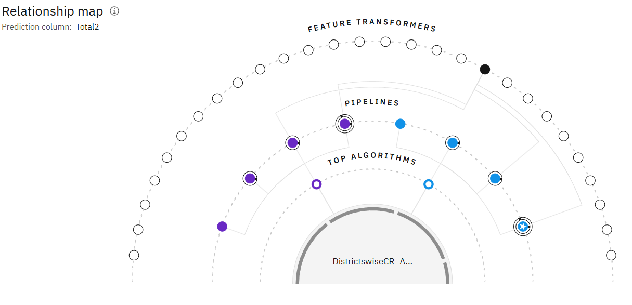
Result

Slide 9
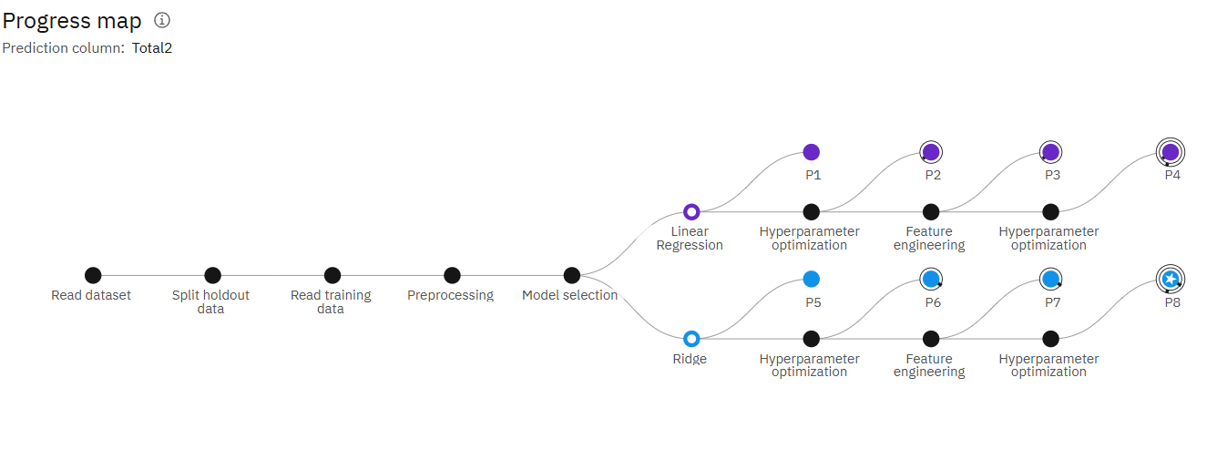
Result

Slide 10
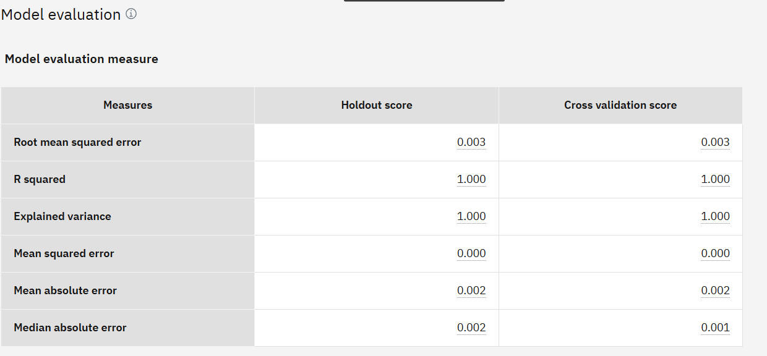
Result

Slide 11
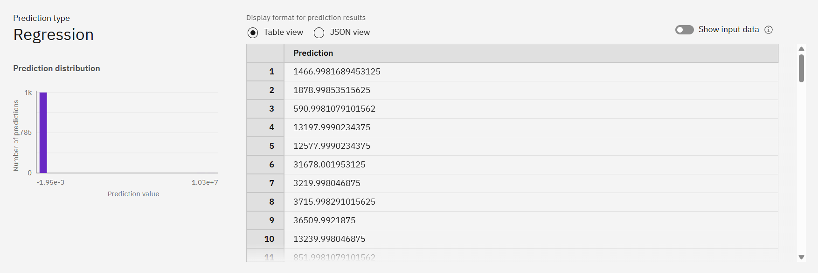
Result
Github Repo link: https://github.com/sumansourav29/IBM_Cloud_project.git

Slide 12
Conclusion
The implementation of a machine learning-based classification system for PMGSY projects marks a significant step toward modernizing rural infrastructure planning in India. By leveraging IBM Watsonx.ai on IBM Cloud, the proposed model effectively classifies projects into their respective schemes based on physical and financial features with near-perfect accuracy. This automation not only reduces manual effort and errors but also enhances transparency, accelerates decision-making, and enables better policy evaluation. With the potential to scale and integrate with other government platforms, this solution can serve as a blueprint for intelligent public infrastructure management across various domains.

Slide 13
Future scope
Integration with Government Dashboards:
The model can be integrated with government portals like PMGSY’s Online Management, Monitoring and Accounting System (OMMAS) for real-time classification and tracking.
Extension to Other Infrastructure Schemes:
The same classification approach can be adapted for other rural and urban development programs (e.g., AMRUT, BharatNet, PMAY) using respective datasets.
Incorporation of Geospatial Data:
Including satellite imagery or GIS coordinates can improve classification accuracy, especially in complex terrain or remote regions.
Improved Model Explainability:
Incorporating SHAP or LIME techniques can help policymakers understand which features influence the classification most, supporting data-driven policy refinement.
Mobile and Web Interfaces:
Developing a frontend interface will allow field engineers and planners to input project details and instantly get scheme classification predictions.
Anomaly Detection and Fraud Prevention:
Future models can flag inconsistencies or misclassified projects that may indicate budgeting errors or misuse of funds.

Slide 14
References
Pradhan Mantri Gram Sadak Yojana (PMGSY) Official Website https://pmgsy.nic.in
IBM Watsonx.ai Documentation https://www.ibm.com/docs/en/watsonx
IBM Cloud Documentation https://cloud.ibm.com/docs
Scikit-learn: Machine Learning in Python Pedregosa et al., JMLR 12, 2011. https://scikit-learn.org
Python Data Science Handbook Jake VanderPlas, O'Reilly Media (2016)
Rural Connectivity in India: Challenges and Prospects Ministry of Rural Development Reports, Government of India
World Bank – PMGSY Project Assessment Reports https://www.worldbank.org/en/projects-operations/project-detail/P124639

Slide 15
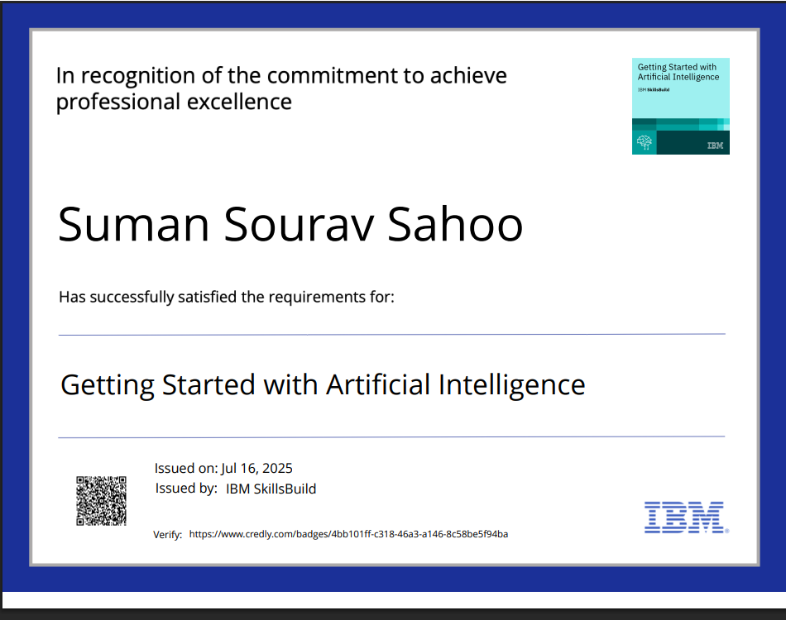
IBM Certifications

Slide 16
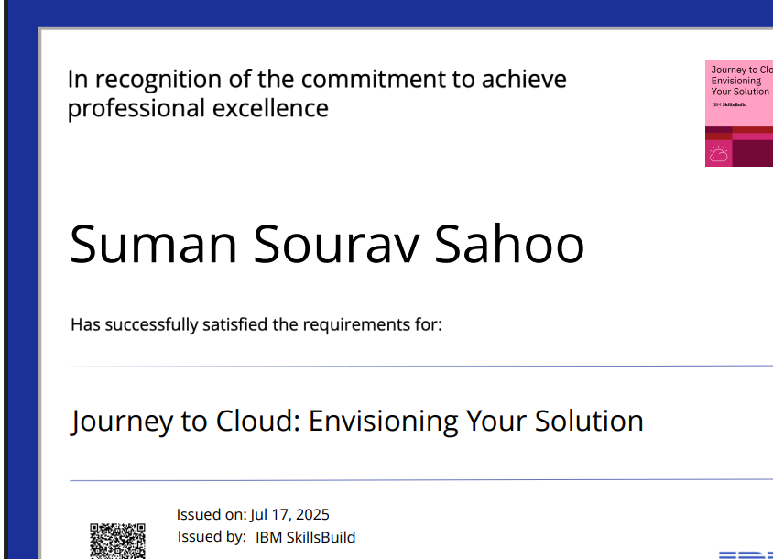
IBM Certifications

Slide 17
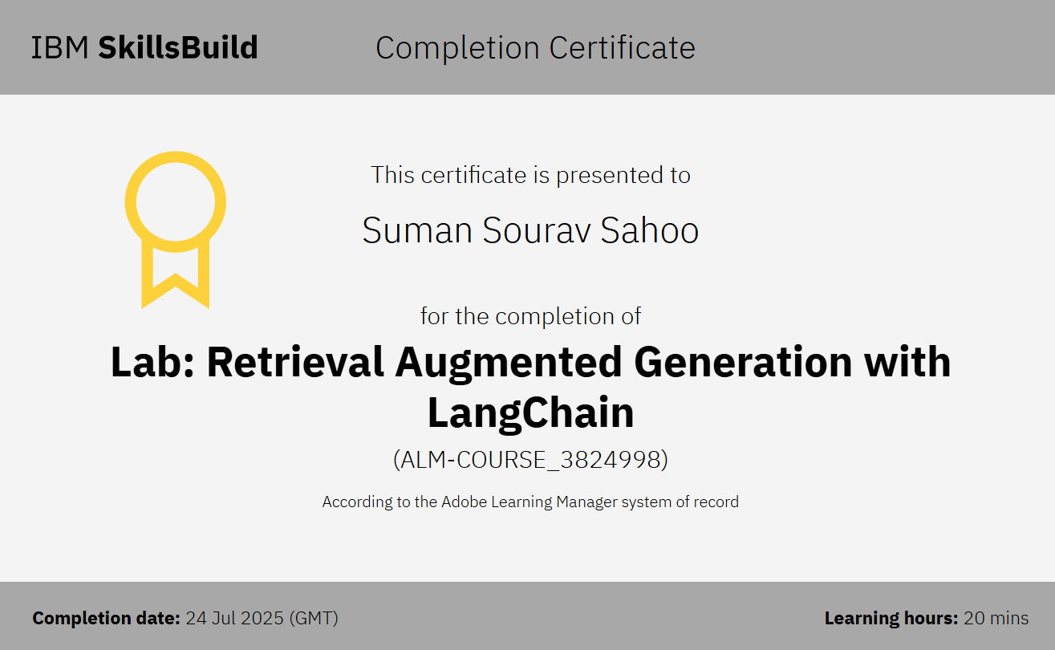
IBM Certifications

Slide 18
THANK YOU

