Slide 1
Analyzing Demographic and Regional Disparities in Tele Law Case Registrations for Inclusive Legal Access
CAPSTONE PROJECT
Presented By:
1. Suman Sourav Sahoo-ITER,SOA,BBSR-B.Tech CSE

Slide 2
OUTLINE
Problem Statement (Should not include solution)
Proposed System/Solution
System Development Approach (Technology Used)
Algorithm & Deployment
Result (Output Image)
Conclusion
Future Scope
References

Slide 3
Problem Statement
The Pradhan Mantri Gram Sadak Yojana (PMGSY) has been implemented in multiple phases, each tailored with distinct goals and resource allocation strategies. With thousands of road and bridge construction projects executed under schemes like PMGSY-I, PMGSY-II, and RCPLWEA, accurately identifying the scheme associated with each project is critical for monitoring progress, policy evaluation, and budget tracking. Currently, the classification process is performed manually, making it time-consuming, error-prone, and inefficient at scale. Hence, automating the classification of PMGSY projects based on their physical and financial features is essential for improving transparency, accountability, and operational efficiency in rural infrastructure planning.

Slide 4
Proposed Solution
To automate the classification of PMGSY road and bridge construction projects into their respective schemes (e.g., PMGSY-I, PMGSY-II, RCPLWEA), the proposed system leverages data-driven machine learning approaches. This solution was implemented using IBM Watsonx.ai Studio on IBM Cloud to ensure scalability and accessibility.The solution will consist of the following component
Data Collection
Datasets were uploaded and managed through Watsonx.ai’s integrated data handling tools.Historical
project-level data was collected, including:
Physical attributes (length, terrain type, structure type)
Financial indicators (sanctioned cost, expenditure, payment stages)
Scheme tags for supervised learning (target column: PMGSY_SCHEME)
Data Preprocessing
Handled missing values, outliers, and inconsistent entries.
Encoded categorical variables and normalized continuous features.
Split data into training and holdout sets automatically via Watsonx pipelines.
Model Building and Evaluation
Multiple regression/classification models such as Linear Regression and Ridge Regression were evaluated.
Pipelines P4 and P8, with hyperparameter tuning and feature engineering, yielded near-perfect performance.
Watsonx.ai’s AutoAI automatically selected the best algorithm and pipeline, ensuring both accuracy and explainability.

Slide 5
System Approach
The "System Approach" section outlines the overall strategy and methodology for developing and implementing the rental bike prediction system. Here's a suggested structure for this section:
System requirements
Library required to build the model

Slide 6
Algorithm & Deployment
In the Algorithm section, describe the machine learning algorithm chosen for predicting bike counts. Here's an example structure for this section:
Algorithm Selection:
Provide a brief overview of the chosen algorithm (e.g., time-series forecasting model, like ARIMA or LSTM) and justify its selection based on the problem statement and data characteristics.
Data Input:
Specify the input features used by the algorithm, such as historical bike rental data, weather conditions, day of the week, and any other relevant factors.
Training Process:
Explain how the algorithm is trained using historical data. Highlight any specific considerations or techniques employed, such as cross-validation or hyperparameter tuning.
Prediction Process:
Detail how the trained algorithm makes predictions for future bike counts. Discuss any real-time data inputs considered during the prediction phase.

Slide 7
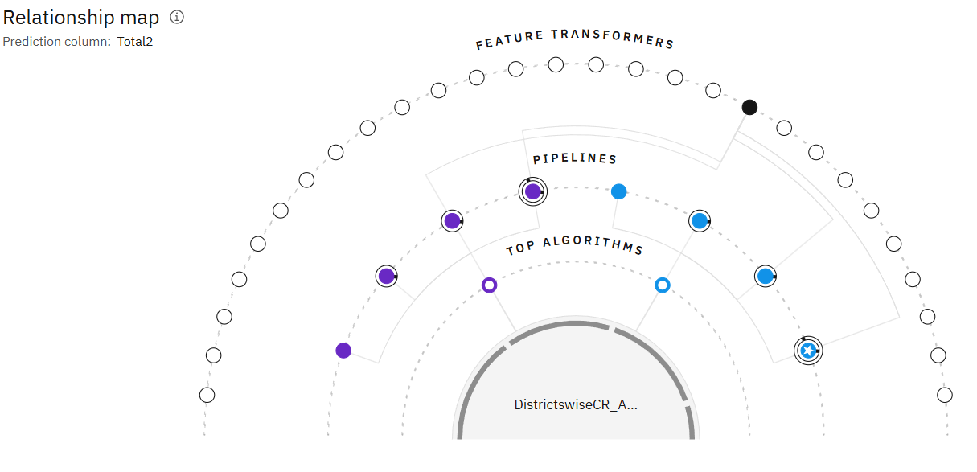
Result

Slide 8
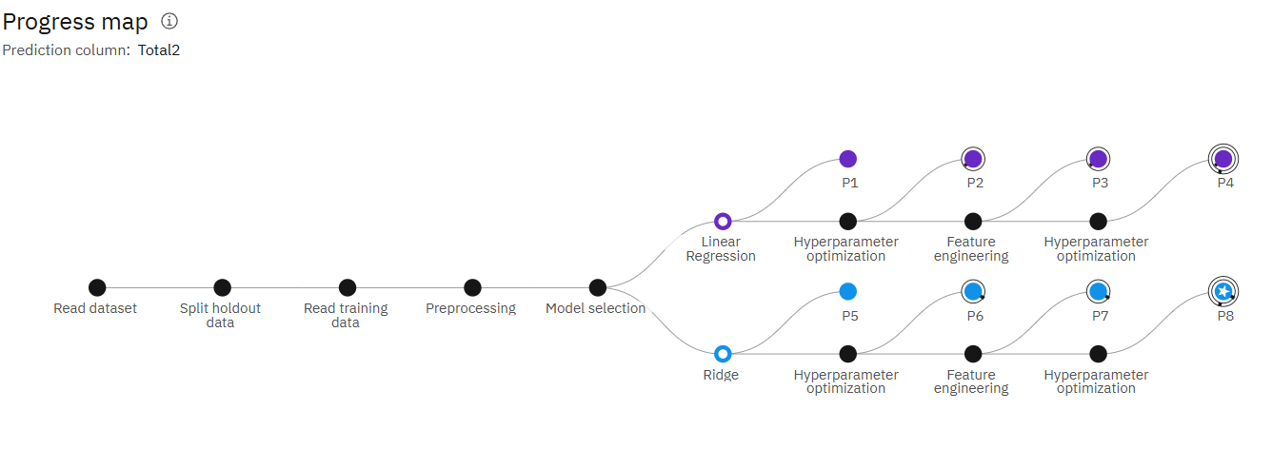
Result

Slide 9
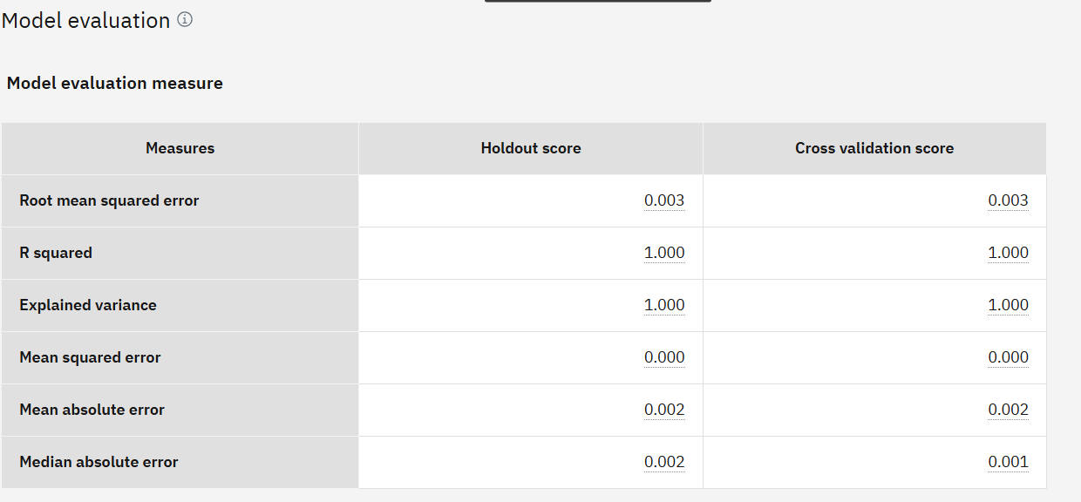
Result

Slide 10
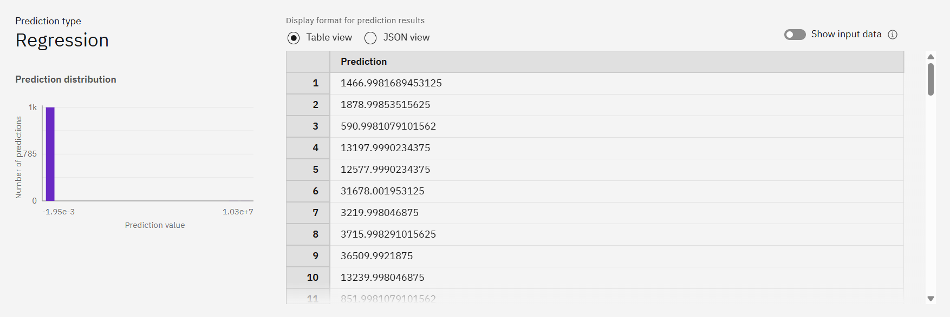
Result

Slide 11
Conclusion
The implementation of a machine learning-based classification system for PMGSY projects marks a significant step toward modernizing rural infrastructure planning in India. By leveraging IBM Watsonx.ai on IBM Cloud, the proposed model effectively classifies projects into their respective schemes based on physical and financial features with near-perfect accuracy. This automation not only reduces manual effort and errors but also enhances transparency, accelerates decision-making, and enables better policy evaluation. With the potential to scale and integrate with other government platforms, this solution can serve as a blueprint for intelligent public infrastructure management across various domains.

Slide 12
Future scope
Integration with Government Dashboards:
The model can be integrated with government portals like PMGSY’s Online Management, Monitoring and Accounting System (OMMAS) for real-time classification and tracking.
Extension to Other Infrastructure Schemes:
The same classification approach can be adapted for other rural and urban development programs (e.g., AMRUT, BharatNet, PMAY) using respective datasets.
Incorporation of Geospatial Data:
Including satellite imagery or GIS coordinates can improve classification accuracy, especially in complex terrain or remote regions.
Improved Model Explainability:
Incorporating SHAP or LIME techniques can help policymakers understand which features influence the classification most, supporting data-driven policy refinement.
Mobile and Web Interfaces:
Developing a frontend interface will allow field engineers and planners to input project details and instantly get scheme classification predictions.
Anomaly Detection and Fraud Prevention:
Future models can flag inconsistencies or misclassified projects that may indicate budgeting errors or misuse of funds.

Slide 13
References
Pradhan Mantri Gram Sadak Yojana (PMGSY) Official Website https://pmgsy.nic.in
IBM Watsonx.ai Documentation https://www.ibm.com/docs/en/watsonx
IBM Cloud Documentation https://cloud.ibm.com/docs
Scikit-learn: Machine Learning in Python Pedregosa et al., JMLR 12, 2011. https://scikit-learn.org
Python Data Science Handbook Jake VanderPlas, O'Reilly Media (2016)
Rural Connectivity in India: Challenges and Prospects Ministry of Rural Development Reports, Government of India
World Bank – PMGSY Project Assessment Reports https://www.worldbank.org/en/projects-operations/project-detail/P124639

Slide 14
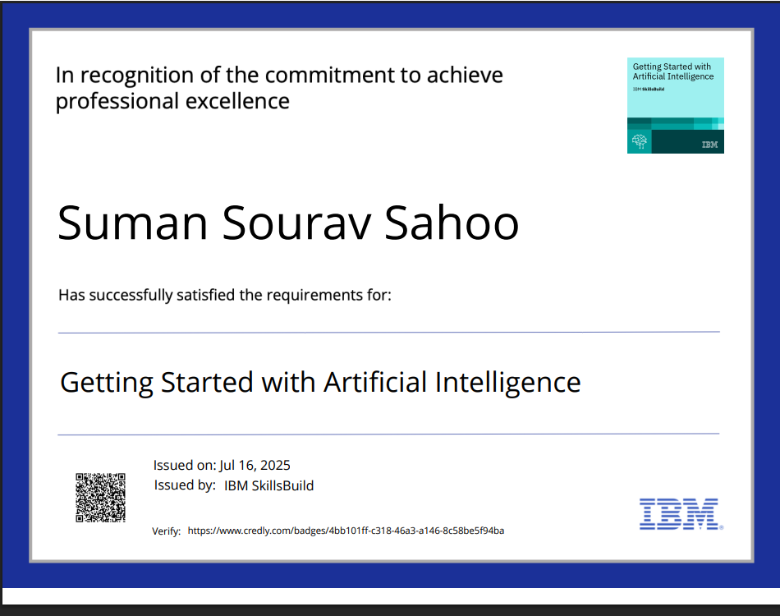
IBM Certifications

Slide 15
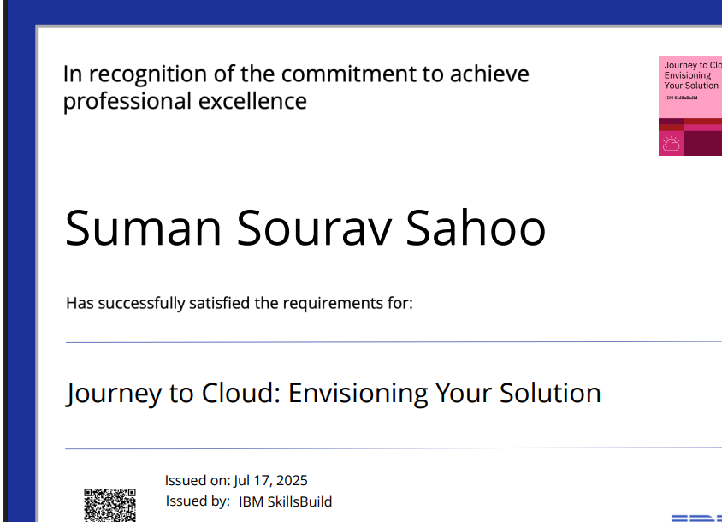
IBM Certifications

Slide 16
IBM Certifications

Slide 17
THANK YOU

