Slide 1
Location Changes in iOS – 8
By: Sumanta Rout

Slide 2
What’s new in iOS 8
Location Authorization
Visit Monitoring
Indoor Positioning

Slide 3
Location Authorization

Slide 4

Location Authorization
It has two options
  Always
  When-In-Use
Application may statically supports it.
Application may request for authorization
We can launch settings app with below API (This is a new API):
Note: Status bar icon – solid or hollow

Slide 5

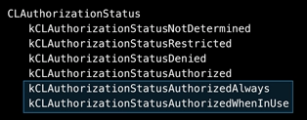

Location Authorization – How to use!
Info.plist
Authorization Status Enum Values
Authorization Request APIs

Slide 6

Location Authorization – Case Study
Fitness App:
  Location
  Background location
Project Settings – Capabilities
  Enable Background Modes and then select “Location Updates”
Info.plist
  Need to add Key: NSLocationWhenInUseUsageDescription: “Your message goes here”
Authorization Request APIs

Slide 7

Location Authorization – Case Study
Home App:
  Info.plist
  NSLocationAlwaysUsageDescription: “Your message goes here”
Authorization Request APIs

Slide 8
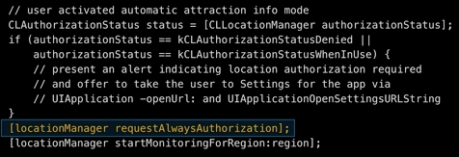
Location Authorization – Case Study
Amusement Park App:
  Info.plist
  NSLocationAlwaysUsageDescription: “Your message goes here”
  NSLocationWhenInUseUsageDescription: “Your message goes here”

Slide 9

Location Authorization
Supporting for both iOS 7 and iOS 8:

Slide 10
Location – UILocalNotification
Now supports region based triggering
Look into CLRegion class
This requires either authorization.
  Specify the desired key in info.plist
  Call the corresponding authorization API

Slide 11
Visit Monitoring

Slide 12
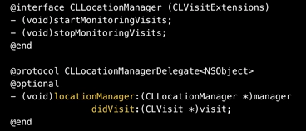
Visit Monitoring
Monitors for destinations
Launches your app, when it detects a visit
Requires always authorization
Power efficient
Opportunistic location use
Utilizes information from the whole system
CLLocationManager APIs

Slide 13
Visit Monitoring
Monitors for destinations
Launches your app, when it detects a visit
Requires always authorization
Power efficient
Opportunistic location use
Utilizes information from the whole system
CLLocationManager APIs

Slide 14

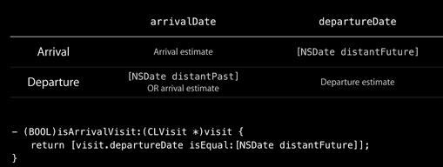
Visit Monitoring
CLVisit class:
Identifying arrival:

Slide 15
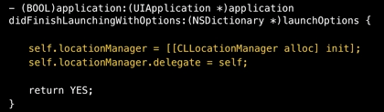
Visit Monitoring
Steps:
  Adopt new authorization
  Create CLLocationManager
  Write start/stop methods
  Handle visits (delegate methods)
CLLocationManager

Slide 16
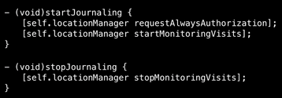
Visit Monitoring
Start/Stop methods:
Note:
  Visit Monitoring does not replace region monitoring
  It is also does not replace significant location change monitoring

Slide 17
Indoor Navigation

Slide 18
Indoor Navigation
Positioning Technology:
  Cellular
  GPS
  WiFi
We all know the limitation and advantages of each technology
Additional Work done by Apple:
  RF Parametric Data
  Motion Sensors

Slide 19
Indoor Navigation
As I understand it, in order for the indoor maps to be accurate, some rather sophisticated RF calibration needs to be done to map signal strength of all of the various GPS, cellular and wifi signals to physical locations within the venue.
It's not simply an iOS 8 thing.
Apple starts with building(s) CAD files, converts them to Apple's graphic presentation standards (vector data). They store these data on their map server.
They either send a team with specialized gear to the venues to take RF readings at key points, or they give you a specialized app and instructions on how to do the RF mapping yourself.
Apple will anonymously use anyone's M7 motion sensor equipped iPhone to “crowd source” that data, making the indoor positioning accuracy improve over time.
This is not clear yet by Apple

Slide 20
Indoor Navigation
Apple purchased a company that developed proprietary RF mapping algorithms. They literally took a picture of an exit-route type floor map on the wall, then they walked through the halls, tapping on the map at various intersections and corners that corresponded to their real-world location. Once they finished their calibration/mapping walk of the floor, the app was able to precisely track their location on the floor map as they moved about
They demonstrated through a video.
WWDC, Apple engineers gave a demo of this features. Now this Sample application is available to download and learn – “footprint project”
Apple has integrated this features in following buildings:
  California Academy Of Science, San Francisco
  Westfield San Francisco, San Francisco
  Mineta San Jose International Airport, San Jose
Apple releases an Website for this purpose:
  https://mapsconnect.apple.com

Slide 21
Indoor Navigation
I had submitted a request for Cybage Towers and received below response:
Dear Applicant,
Thank you for your interest in Apple’s new indoor positioning technology. We have received an overwhelming response on this service and we are prioritizing our efforts to focus on venues with the following attributes:
• Accessible to the general public
• Annual visitors in excess of 1 million per year
• Availability of complete, accurate and scaled reference maps
• Enabled with Wi-Fi throughout
• Associated app is authorized by venue owner
Please do feel free to reply to this email if you feel that you are able to meet these criteria. As a possible solution for your use case, may we also recommend that you investigate iBeacon technology.
Thank you again for your interest.

Slide 22

Indoor Navigation
How to use?
  Device Unlocked
  WiFi ON
  Exact same core location API
  Floor Number
CLFloor – New class introduced in core-location API

Slide 23
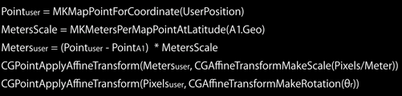
Indoor Navigation
Conversion of 3D coordinate systems into 2D coordinate system
Here is some helper function:
Two Anchor points:
    Anchor point = Latitude /Longitude + floor plan pixel
Scale: pixels per meter
  P2 = MKMapPointForCoordinate(A1.Geo)
  P2 = MKMapPointForCoordinate(A2.Geo)
  MKMetersBetweenMapPoints(P1, P2)
  hypot(A2.Pixels.x – A1.Pixels.x, A2.Pixels.y – A1.Pixels.y)
Identification of Orientation
Summary:

Slide 24
Indoor Navigation – Integration With iBeacons
Indoor Positioning
  Position
  Navigation
IBeacons
  Proximity
  Notification

Slide 25

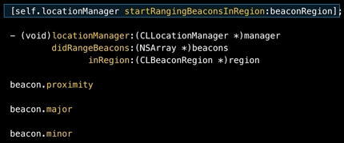
Indoor Navigation – Integration With iBeacons
Beacon At Entrance:
Identification of proximity

Slide 26
Questions ???
Thank You!!!

