Slide 1

Safe Reinforcement Learning via Shielding
By: Mohammed Alshiekh, Roderick Bloem, Ruediger Ehlers, Bettina Könighofer, Scott Niekum, Ufuk Topcu Reproduced by: Carl Hildebrandt
October 20, 2019

Slide 2
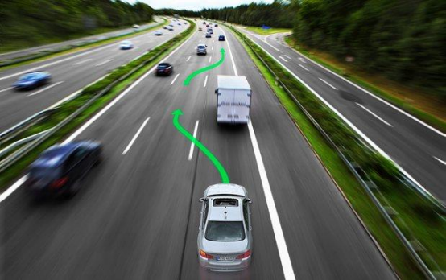
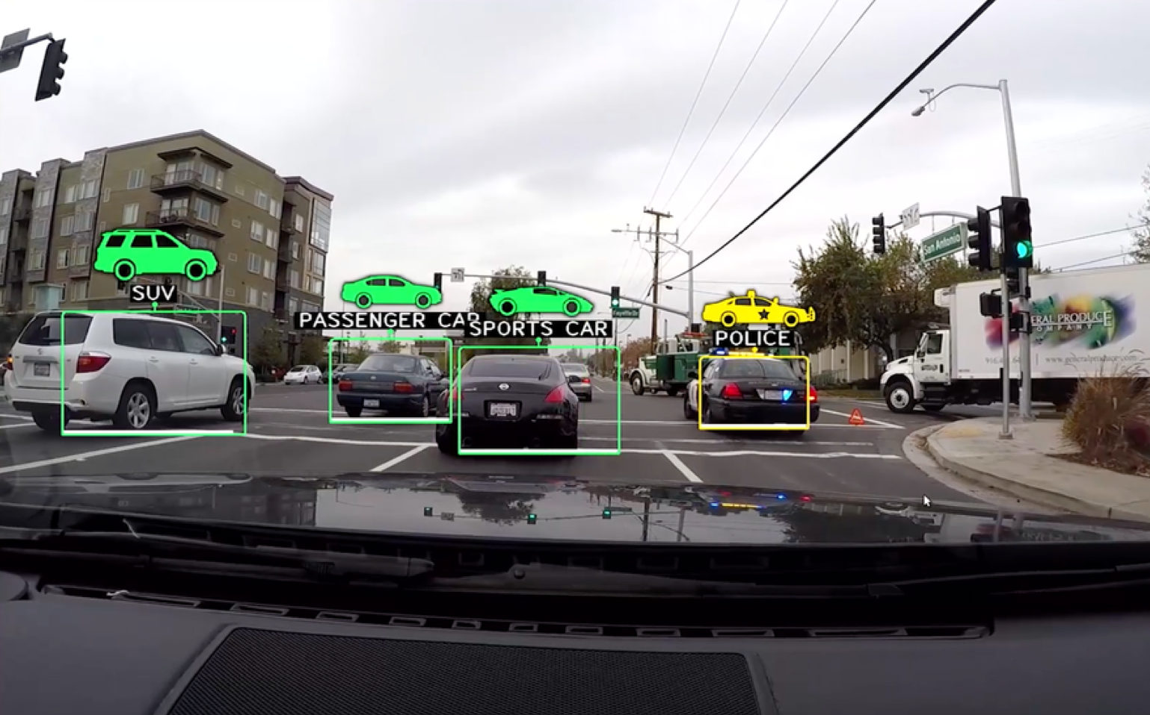
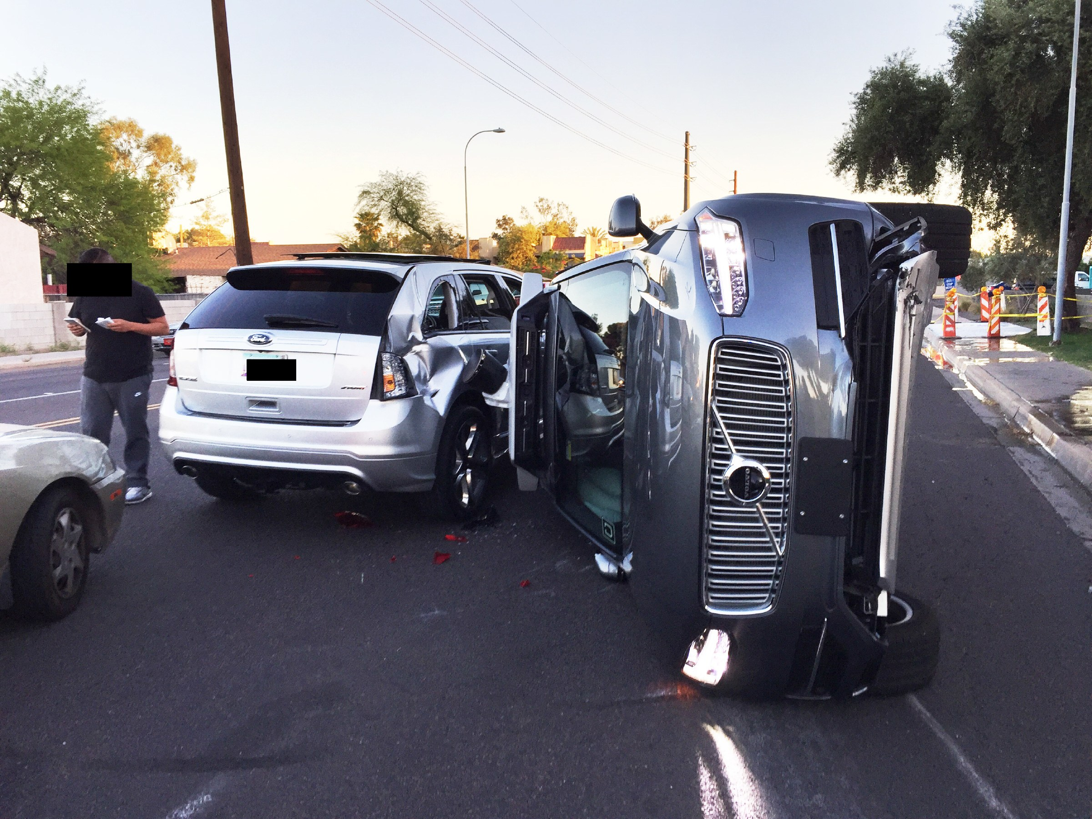


Motivation
Advances in machine learning have given rise to autonomous systems
One particular type of machine learning is reinforcement learning which is good at:
Complicated Tasks¹
Dynamic Environments²
Safety³
https://towardsdatascience.com/planning-the-path-for-a-self-driving-car-on-a-highway-7134fddd8707
https://fortune.com/2016/09/08/self-driving-cars-environment/
https://www.wired.com/2017/03/uber-redeploys-self-driving-cars-wreck-arizona/
Notes:
The motivation of this project

Slide 3
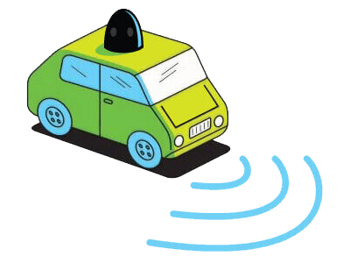
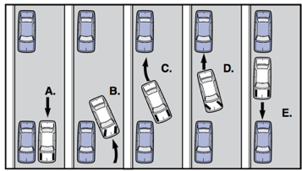
Background
Reinforcement learning - discover policies that maximize a reward
Reinforcement learning - does not guarantee safety
1
Example: Parallel Parking
Maximize Reward
2
Safety
1. https://1funny.com/wp-content/uploads/2009/04/bad-parking.jpg
2. https://www.drivingtips.com/minimizing-risks-of-accidents-while-driving/

Slide 4
Related Work
Definition: An exploration process is called safe if no undesirable states are ever visited[14]
Two mostly isolated threads of work:
Safety in reinforcement learning
Safety in formal methods
Safety achieved by incorporating external knowledge[8][14]
Using temporal logic to generate invariance properties[8][1]
Using a teacher network [22][4]
Using a human teacher [15][19]
Receding horizon control which combines continuous control and discrete correctness guarantees[24]
Simple safe controllers can be computed directly [9] and more complex ones can be computed using a combination of low level controllers[5]
Shield synthesize to enforce safety properties on controller[3]
…

Slide 5
Target Task
This paper sets out to generate a technique which guarantees safety and correctness of a learning agent
They aim to do this using the correctness guarantees provided by formal methods and combine it with the optimality provided by reinforcement learning
Goals:
Enforce safety properties in a traditional reinforcement learning setting.
Restrict the agent as little as possible by having minimum interference.
Create a system which clearly separates safety and optimality.
Correctness and Safety
Optimality
Safe Optimal Solution
+
=
Formal Methods
Reinforcement Learning
Safe Learning
Notes:
Here, we make the claim of this project.

Slide 6
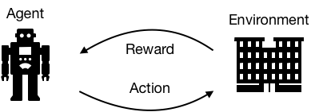
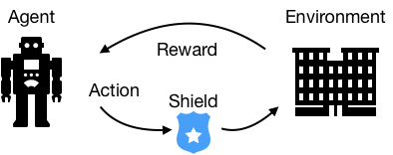
An Intuitive Figure Showing WHY Claim
Reinforcement learning leans by taking an action in an environment and getting a reward which it uses to update its policy:
The idea of this paper is to block actions which are unsafe, before they are enacted in the environment:
Notes:
Here, we make the claim of this project.

Slide 7
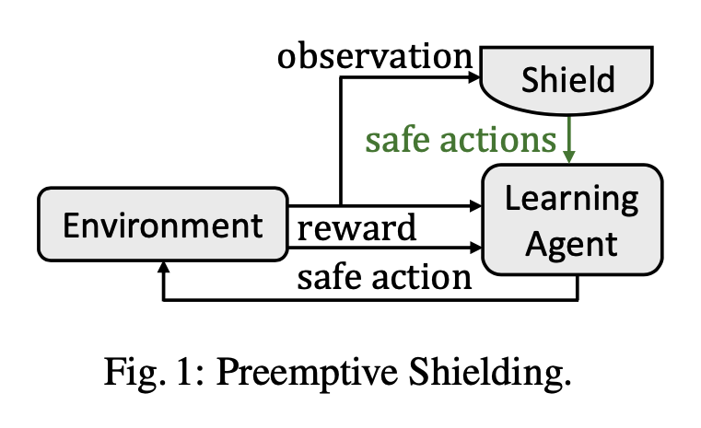
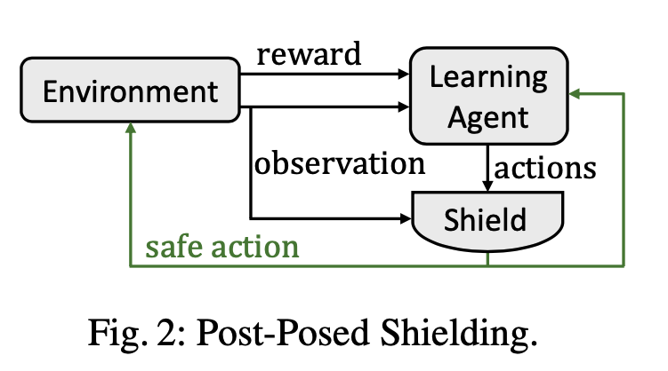
Proposed Solution
Generate a set of system specifications and an abstraction of the agents environment expressed as temporal logic.
Synthesize a reactive system (shield) which enforces the safety properties of the systems specifications.
Modify the learning loop (as shown on the right) by placing the shield in 1 of 2 places:
Before the learning agent, thus removing any unsafe actions.
After the learning agent, thus monitoring the selected actions and correcting them only if an unsafe action is chosen.
Notes:
Here is our proposed solution.

Slide 8




Implementation
System specifications are given as temporal logic. For instance to state that an autonomous car must never run out of fuel: G(fuel_level > 0)
Convert the safety specifications into an automaton in which only safe states F may be visited:
Convert the environment abstraction (often modeled as a Markov Decision Process) into an automaton:
Use reactive synthesis to enforce 𝜑^{s} by solving a safety game built from 𝜑^{s} and 𝜑^{M} which is won if the system only ever visits safe states F.
Notes:
In the rest of this presentation, I’m going to talk about following contents:

Slide 9
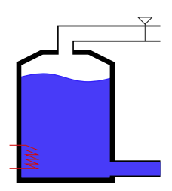
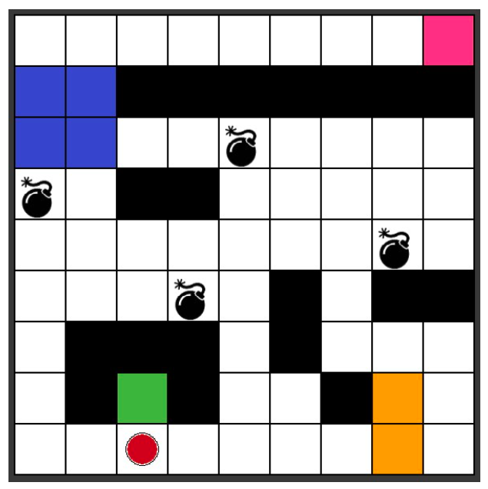
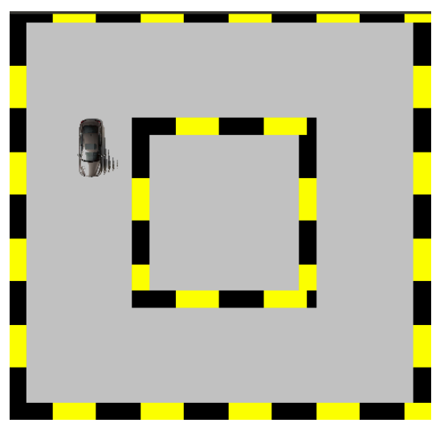
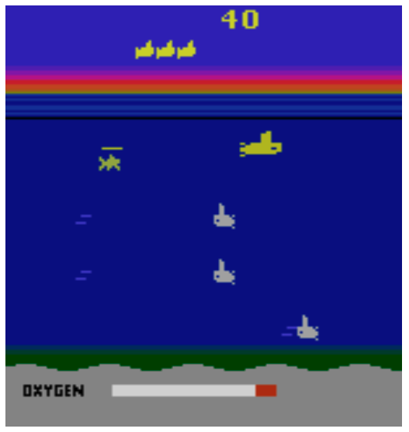
Data Summary
They use four test environments to test their proposed solution to safety.
Water Tank
Grid World
Self-Driving Car
Atari SeaquestTM
Keep water warm while minimizing energy consumption. Water runs out of tank constantly. Cold water runs into take through controllable switch. Can not overflow or run empty.
Visit all colored regions in a given order while not crashing into walls or sitting on bombs for more than two consecutive steps.
Drive clockwise around the track. The car can only turn 7.5 degrees and moves 3 pixels each time step. Avoid crashing into walls.
Control a submarine to collect divers while avoiding obstacles. The submarine needs to surface before running out of oxygen.
Notes:
In the rest of this presentation, I’m going to talk about following contents:

Slide 10
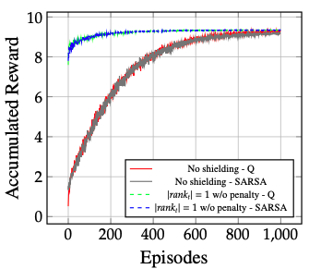
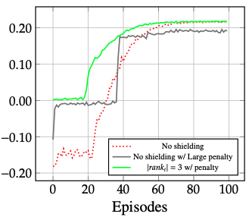
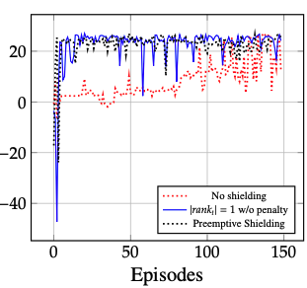
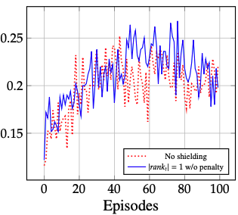
Experimental Results
The main experimental results are shown below.
Water Tank
Grid World
Self-Driving Car
Atari SeaquestTM
Shielded learning is shown in blue and green dashed lines. Unshielded learning is shown in red and gray solid lines.
Shielded learning is shown in the solid green line. Unshielded learning is shown in red dashed line and gray line. Gray line represents large negative penalty.
Red dashed line shows unshielded learning. Blue and black lines show shielded learning.
Red dashed line shows unshielded learning. Blue solid line shows shielded learning.
Notes:
In the rest of this presentation, I’m going to talk about following contents:

Slide 11
Experimental Analysis
The main observation are:
Water Tank
Grid World
Self-Driving Car
Atari SeaquestTM
1)Both unshielded techniques get negative rewards - implying they violate a safety constraint during training
2) High negative reward does not convert to optimal policy
1)Unshielded technique still crashes at the end of training.
2)Shielded techniques learn more rapidly.
1)Shielding did not change the performance of the learning agent.
2) Safety properties never violated when shield was implemented.
1) Both unshielded and shielded learning reaches optimal policy.
2) Shielded learning converges to optimal policy much faster.
Notes:
In the rest of this presentation, I’m going to talk about following contents:

Slide 12



Result Reproduction
Why I selected this paper:
Water Tank
Grid World
Self-Driving Car
Atari SeaquestTM
Carl
There are 4 scenarios (1 per group member):
The entire approach is applied to each scenario.
Reproducing 1 set of results requires understanding and implementing the entire paper.
I selected to implement the self-driving car as this is the closest to my research.

Slide 13
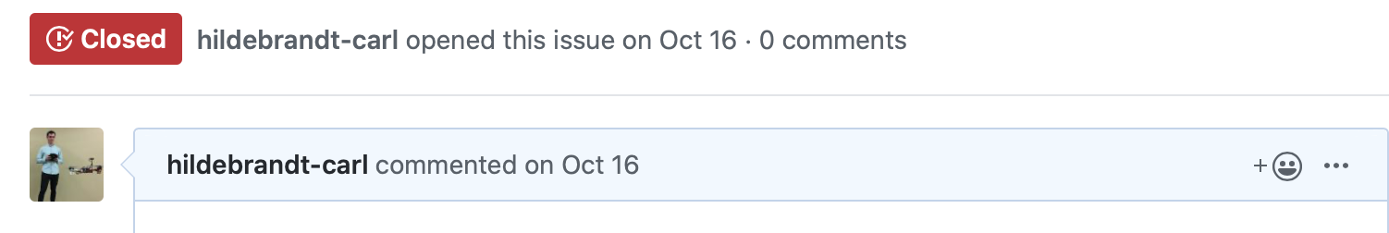
Result Reproduction
Why replicating papers is beneficial:
You get a deeper understanding of the approach.
You confirm that the results are correct, and not tailored to look good.
You benefit the developer by checking their work.
I found a security issues on their Github repo and was able to submit a issue which was fixed and closed.
Here is a link to my review of the code: https://github.com/hildebrandt-carl/SafeReinforcementLearning

Slide 14
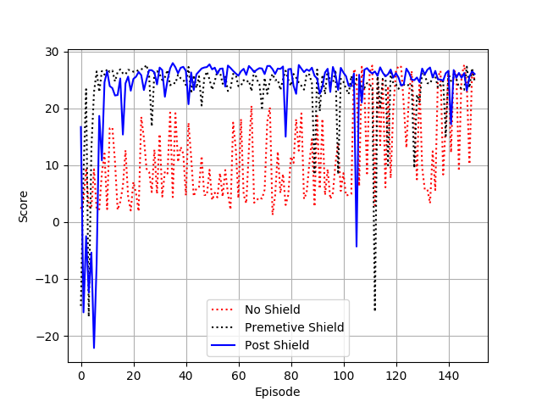
Result Reproduction
My Results
Original Results

Slide 15
Conclusion and Future Work
They provide a method for reinforcement learning under safety constraints expressed as temporal logic specifications.
Their technique enforces safety constraints without changing the (often complex) inner workings of reinforcement learning algorithm.
Demonstrate that the shielded agents perform at least as well as unshielded agents. However in most cases improve performance.
They show that their shielded agents do not violate their safety constraints.
Downside is that you need an approximate model which describes which actions are unsafe.
Future work is not mentioned in this paper.

Slide 16
References
References are given the same number as in the paper for convenience.
[8] Garcıa, Javier, and Fernando Fernández. "A comprehensive survey on safe reinforcement learning." Journal of Machine Learning Research 16.1 (2015): 1437-1480.
[14] Moldovan, Teodor Mihai, and Pieter Abbeel. "Safe exploration in Markov decision processes." arXiv preprint arXiv:1205.4810 (2012).
[1] Baier, Christel, and Joost-Pieter Katoen. Principles of model checking. MIT press, 2008.
[22] Quintía Vidal, Pablo, et al. "Learning on real robots from experience and simple user feedback." (2013).
[19] Thomaz, Andrea Lockerd, and Cynthia Breazeal. "Reinforcement learning with human teachers: Evidence of feedback and guidance with implications for learning performance." Aaai. Vol. 6. 2006.
[4] Clouse, J. "On Integrating Apprentice Learning and Reinforcement Learning TITLE2." (1997).
[15] Pecka, Martin, and Tomas Svoboda. "Safe exploration techniques for reinforcement learning–an overview." International Workshop on Modelling and Simulation for Autonomous Systems. Springer, Cham, 2014.
[24] Wongpiromsarn, Tichakorn, Ufuk Topcu, and Richard M. Murray. "Receding horizon temporal logic planning." IEEE Transactions on Automatic Control 57.11 (2012): 2817-2830.
[5] DeCastro, Jonathan A., and Hadas Kress-Gazit. "Nonlinear controller synthesis and automatic workspace partitioning for reactive high-level behaviors." Proceedings of the 19th International Conference on Hybrid Systems: Computation and Control. ACM, 2016.
[9] Henzinger, Thomas A., and Peter W. Kopke. "Discrete-time control for rectangular hybrid automata." Theoretical Computer Science 221.1-2 (1999): 369-392.
[3] Bloem, Roderick, et al. "Shield synthesis." International Conference on Tools and Algorithms for the Construction and Analysis of Systems. Springer, Berlin, Heidelberg, 2015.

