Slide 1

Parental Control System
Sumant Bhise - (22106095)
Gaurav Kolambe - (22106085)
Ashutosh Pandey - (22106078)
Project Guide
Prof. Viki Patil

Slide 2
Introduction
Children are exposed to online risks like inappropriate content, excessive screen time, and cybersecurity threats
Existing parental control solutions are either too complex, lack real-time monitoring, or can be easily bypassed
Motivation:
The widespread use of smartphones among children has led to concerns about excessive screen time, exposure to inappropriate content, and online threats.
There is a need for a comprehensive and user-friendly solution that enables parents to remotely monitor and control their child’s device usage in real time

Slide 3
Objectives:
Develop a web-based admin panel where parents can monitor and manage their child’s smartphone usage.
Create a mobile application that enforces restrictions, monitors usage, and syncs data with the admin panel.
Provide real-time insights and controls, including app usage tracking, content filtering, and screen time management.
Ensure security and ease of use, allowing parents to effectively regulate device usage without complex configurations.

Slide 4
Literature Survey
Existing solutions in the real world:
Various parental control applications exist, such as Google Family Link, Norton Family, and Qustodio.
These solutions provide app blocking, screen time limits, and web filtering to restrict inappropriate content.
Some solutions integrate AI for monitoring and content categorization.
Issues present in the surveyed solutions:
Many existing solutions are complicated to set up and require extensive technical knowledge.
Limited real-time monitoring capabilities in free versions, requiring paid subscriptions for full functionality.

Slide 5
Sr. No | Authors | Title | Abstract
1. | Xiaoqin Zhu, Chen Deng, Wanyue Bai | “Parental control and adolescent internet addiction: the moderating effect of parent child relationships.”
2. | Wendy S. Grolnick, Eva M. Pomerantz | “Issues and Challenges in Studying Parental Control: Toward a New Conceptualization”
3. | Wesley Sanders, Justin Parent, Rex Forehand | “Parenting to Reduce Child Screen Time: A Feasibility Pilot Study’’

Slide 6
Sr. No | Authors | Title | Abstract
4. | Xiaoqin Zhu, Chen Deng, Wanyue Bai | “Parental control and adolescent internet addiction: the moderating effect of parent child relationships.”
5. | Wendy S. Grolnick, Eva M. Pomerantz | “Issues and Challenges in Studying Parental Control: Toward a New Conceptualization”
6. | Wesley Sanders, Justin Parent, Rex Forehand | “Parenting to Reduce Child Screen Time: A Feasibility Pilot Study’’

Slide 7
Problem statement
To develop a Parental Control System that enables parents to monitor and manage their child’s digital activities, ensuring safe browsing, balanced screen time, and real-time supervision for a secure online environment.
The system should provide content filtering, usage tracking, and remote accessibility to help parents set restrictions and receive alerts.
By offering a user-friendly platform, it should promote healthy digital habits and online safety for children.

Slide 8
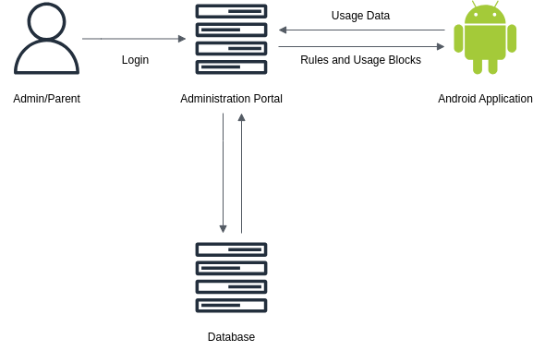
Proposed System Design

Slide 9
Explanation of the approach:
Admin/parent: This represents the user (parent or administrator) who logs into the system to monitor
Administration Portal: This serves as the control center where parents can set rules, view usage data, and apply restrictions. It acts as a bridge between the parent and the Android application installed on the child's device
Application: Installed on the children’s device, it enforces the rules set by the parent. It sends usage data back to the Administration Portal and receives rules and usage blocks that restrict certain activities.
Database: Stores login credentials, rules, usage data, and restrictions. Connected to the Administration Portal, ensuring real-time updates between the parental dashboard and the childeren’s device.

Slide 10
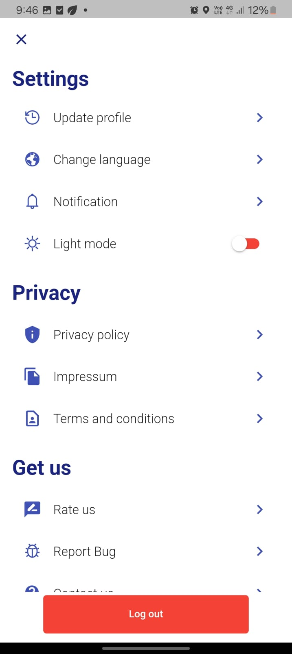
Implementation

Slide 11
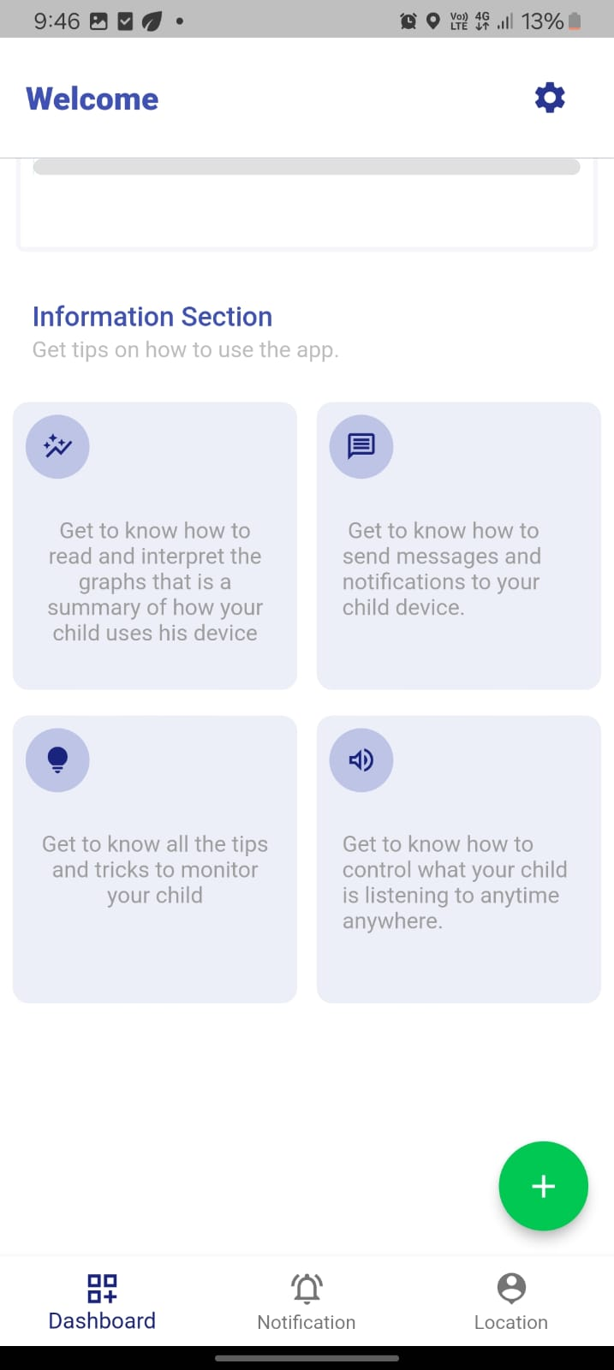

Slide 12
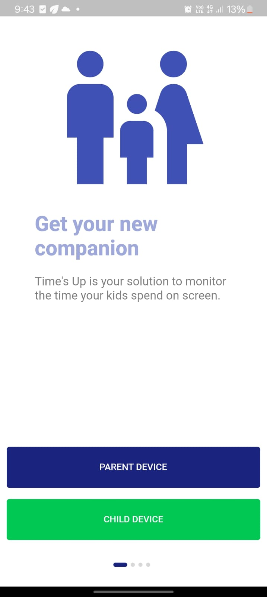

Slide 13
References
[1] Xiaoqin Zhu, Chen Deng, Wanyue Bai. Parental control and adolescent internet addiction: the moderating effect of parent child relationships. The Department of Applied Social Sciences, The Hong Kong Polytechnic University, Kowloon. (2023)
https://pmc.ncbi.nlm.nih.gov/articles/PMC10248257
[2] Wendy S. Grolnick, Eva M. Pomerantz. Issues and Challenges in Studying Parental Control: Toward a New Conceptualization. Clark University, University of Illinois, Urbana-Champaign. (2019)
https://pmc.ncbi.nlm.nih.gov/articles/PMC2813058/
[3] Wesley Sanders, Justin Parent, Rex Forehand. Parenting to Reduce Child Screen Time: A Feasibility Pilot Study. University of Vermont,Boston VA Hospital, Alpert Medical School of Brown University. (2018)
https://pmc.ncbi.nlm.nih.gov/articles/PMC5747554

Slide 14
[4] Norah Alqahtani, A State of the Art Review of Internet Risks on Children. Centre for Security, Communications and Network Research, Plymouth University, Plymouth, Hemaya Group,(2018)
https://ieeexplore.ieee.org/document/7905273
[5] C. Yang and H. Guiqiong. Self-regulation and Supervision: A Study on Online Privacy Protection of Chinese and American Children in Mobile Apps, 2022 IEEE 8th International Conference on Cloud Computing and Intelligent Systems (CCIS), Chengdu, (2022)
https://ieeexplore.ieee.org/document/10016403
[6] Lynn Schofield Clark, Parental Mediation Theory for the Digital Age, Department of Media, Film and Journalism Studies, University of Denver, (2021)
https://onlinelibrary.wiley.com/doi/abs/10.1111/j.1468-2885.2011.01391.x
[7] Meyran Boniel-Nissim, Yaniv Efrati & Michal Dolev-Cohen. Parental Mediation Regarding Children’s Pornography Exposure: The Role of Parenting Style, Protection Motivation and Gender, School of Social Sciences and Humanities, Kinneret Academic College, Department of Education and Society and Culture, Beit Berl College, Department of Educational Counseling, (2022)
https://pubmed.ncbi.nlm.nih.gov/30925073/

