Slide 1

Chatting Application Using Flutter
Project Guide
Prof. Monali Korde
10 Mithil Bhosale 22106134
09 Sumant Bhise 22106065
41 Tejas Joshi 22106018
21 Devang Dhuri 22106036

Slide 2
Outline
Introduction
Objectives
Problem statement
Literature Survey of the existing systems
System Design
Implementation
Technologies and methodologies
Conclusion
References

Slide 3
Introduction
Current Vulnerability:
Users communicate on social media platforms
Weak authentication mechanisms can lead to unauthorized access
Most current applications focus on basic messaging without integrating advanced features like AI-driven chatbots
Many chat applications monetize user data by sharing it with third parties, raising ethical concerns about privacy
Why Use Flutter?
Secure authentication methods to protect user data.
Flutter allows you to write one codebase that runs on both Android and iOS
Flutter applications are compiled directly to native code, ensuring smooth performance
Flutter’s widget-based architecture allows for highly customizable and adaptive UI

Slide 4
Objective
User-Friendly Interface:
Our Application boasts an intuitive and visually appealing interface, ensuring a smooth and enjoyable user experience.
The design prioritizes simplicity without compromising functionality.
Real-time Messaging
Users can engage in real-time conversations, making communication instantaneous and dynamic.
The application supports both one-on-one and group messaging, enhancing its versatility.
Cross-Platform Compatibility
We have developed a single codebase that runs on both IOS and Android Platform
This Provides user a seamless and Interactive user experience

Slide 5
Problem statement
User Needs: Users seek a comprehensive solution that addresses the limitations of current platforms. Real-time collaboration, cross-platform compatibility, and enhanced security are among the key user requirements.
Real-Time Messaging: Implementing a efficient real-time communication features. Develop a real-time messaging that supports instant texting and file sharing features.
Cost and Development Efficiency: We leverage flutter coss-platform capabilities to reduce application development time and cost along with feature rich application.

Slide 6
Literature Survey of the existing system
SR NO. | HEADLINE | AUTHOR | IMPLEMENTED
1. | "Developing Real-Time Chat Applications Using Flutter and Firebase," International Journal of Mobile Computing and Multimedia Communications | N. Kumar | It provides a comprehensive guide to building a real-time chat application using Flutter, a popular UI toolkit, and Firebase, a cloud-based platform.

Slide 7
Literature Survey of the existing system
SR NO. | HEADLINE | AUTHOR | IMPLEMENTED
2. | "Cross-Platform Chat Application Development Using Flutter," Journal of Software Engineering and Applications | A. Shah | The application supports key features such as real-time messaging, group chats, and push notifications, making it a versatile tool for communication. The development process described in the article places a strong emphasis on performance and scalability.

Slide 8
Literature Survey of the existing system
SR NO. | HEADLINE | AUTHOR | IMPLEMENTED
3. | "Building Secure Chat Applications Using Flutter and End-to-End Encryption” | B.N.Sharma | The article "Building Secure Chat Applications Using Flutter and End-to-End Encryption" by Sharma, published in IEEE Access in 2020, focuses on the development of a secure messaging application inspired by Signal, utilizing Flutter as the development framework.

Slide 9
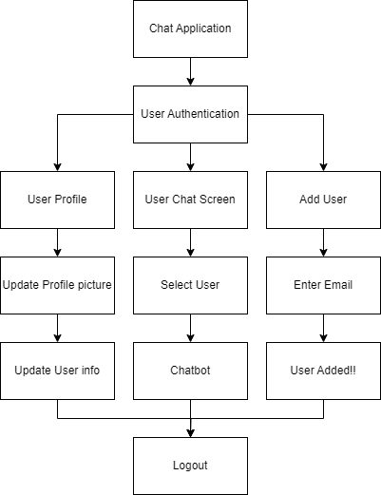
System Design

Slide 10
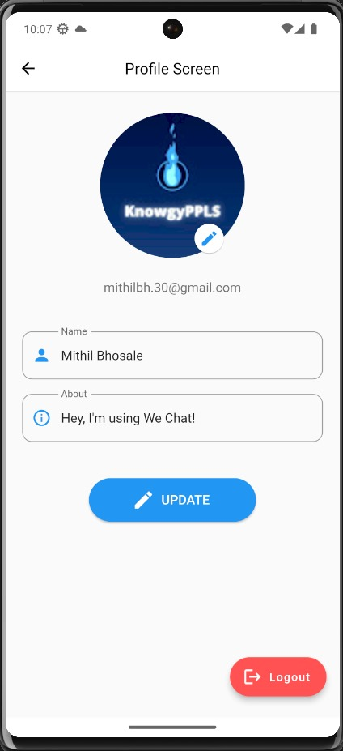
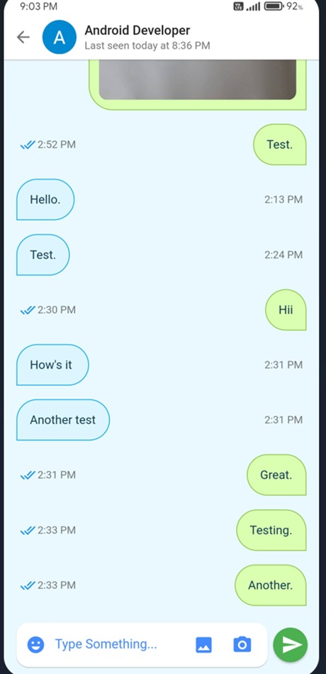
Implementation

Slide 11
Technology Used
Flutter SDK
Firebase Console
VS Code
Dart
Android Studio

Slide 12
Conclusion
In the journey of conceptualizing, designing, and implementing, our team has ventured into the realm of digital communication with a commitment to innovation and user-centricity. As we conclude this project, it is evident that stands not just as a culmination of code and features, but as a testament to our dedication to overcoming the limitations inherent in existing chatting applications.
Our Project is more than just a solution; it is a response to the evolving needs of users in an interconnected world. This project is not just a closing chapter; it's an opening statement for the future of online conversations.

Slide 13
References
N. Kumar, "Developing Real-Time Chat Applications Using Flutter and Firebase," International Journal of Mobile Computing and Multimedia Communications [1]
A. Shah, "Cross-Platform Chat Application Development Using Flutter," Journal of Software Engineering and Applications, vol. 14, no. 7, pp. 450-462, 2020 [2]
Sharma, "Building Secure Chat Applications Using Flutter and End-to-End Encryption," IEEE Access, vol. 8, pp. 160-172, 2020 [ 3]
https://docs.flutter.dev/
https://firebase.google.com/docs
https://ijiird.com/wp-content/uploads/050142.pdf
https://www.ijcrt.org/papers/IJCRT2410189.pdf
https://www.ijraset.com/research-paper/a-privacy-focused-chat-application-build-using-flutter

Slide 14
Thank You...!!

