Slide 1

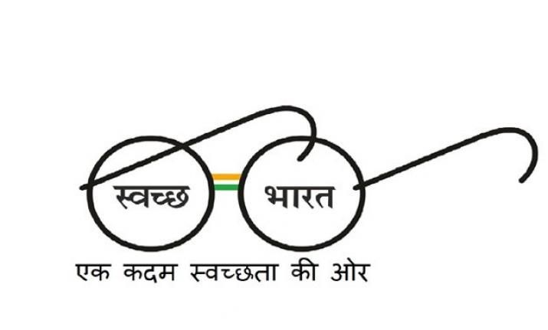
(AN ISO 9001: 2015 CETRIFIED COMPANEY)
This is to certify that Miss. Lakshmi Kumari daughter of Late. Wakil Mehto is working with our esteem organization under the title of Max Maintenance Limited since 11th January 2021. We found her fully committed to her job and totally sincere toward this organization ESIC Modal Hospital, Basaidarapur, New Delhi 110015, as a Nursing Officer posted in OT department 3rd floor. Her salary is 35,000 per month.
Due salary because of Leave and Technical error.
In Aug (13/8/2021) salary credit 26923, due to technical error, In Sep (9/9/2021) salary credit 41731 (arrear) of Aug. In Oct (22/10/2021) salary credit 33654 due to taken leave for two days.
We are issuing the letter on the specific request of our employee.
Thanking you,
For Max Maintenance Limited
SANDHYA KUMARI
CO_ORDINATOR
M-8595525961
Dated- 14.10.2021
TO WHOME IT MAY CONCERN
Regd. Office: C-5/99-100, New Kondli, Mayur Vihar-III, Delhi-110096
Ph: 011-22610095, Helpline No : 8595525961-974
E-mail : mml@maxmaintenanceltd.com, sales@maxmaintenanceltd.com
support@maxmaintenanceltd.com, Web : www.maxmaintenanceltd.com
“CLEAN, GREEN, SAFE & SECURE INDIA”
सुरक्षित भारत की तैयारी जिम्मेदारी आपकी और हमारी

