Slide 1
Exploring Symbolic Regression Techniques for Equation Discovery
Sumant Chopde, 20201118
Supervisor: Dr Joy Merwin Monteiro
Mentor: Hardik Shah

Slide 2
Symbolic Regression (SR)
A type of regression analysis to find the model that best fits a given dataset, both in terms of accuracy and simplicity.
e.g. I know that Z is a function of X and Y, but I do not know the functional form. I have N values for X & Y and the corresponding Z values. I will run SR to get a functional form f for Z = f(X,Y).
The SR model will train itself on the N tuples and return an equation which maximises a particular score.
There is a trade-off between the accuracy (the predicted Z vs the actual Z) and the simplicity of the equation (5 terms vs 50 terms).

Slide 3
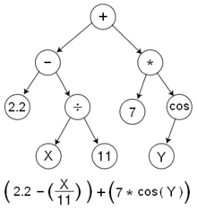
Executing Symbolic Regression
There are various ways of performing SR, including evolutionary algorithms, Bayesian methods and neural networks.
PySR, a Python library performs SR using “a multi-population evolutionary algorithm”.
The user can provide binary and unary operators and the library uses these to build expression trees.
Then, the evolutionary algorithm, involving steps like mutations, cross-overs, survival of the fittest, etc. is performed over multiple populations.
The best expression tree is then converted into the outputted equation.
An example of expression tree

Slide 4
Rayleigh–Bénard Convection
My dataset for exploring symbolic regression consists of the output arrays of Rayleigh–Bénard convection.
It is a type of natural convection, occurring in a planar horizontal layer of fluid heated from below.
After an initial disturbance, the fluid develops a regular pattern of convection cells: Bénard cells.
The buoyancy and the vorticity of the fluid can be estimated using SR.

Slide 5
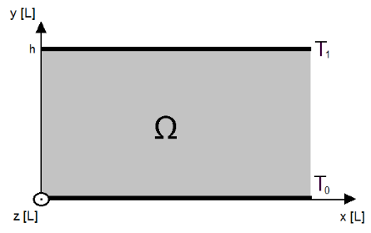
The Problem statement
Consider two infinitely large plates with a distance h between them. The lower and upper plates have a temperature of T0 and T1 respectively, such that T0 > T1. Between the plates we have a fluid with:
  density ρ,
  kinematic viscosity ν,
  thermal difussivity κ and
  thermal expansion coefficient α
The space, Ω, in which this fluid is situated is defined as
Ω : 0 < y < h, −∞ < x, z < ∞.

Slide 6
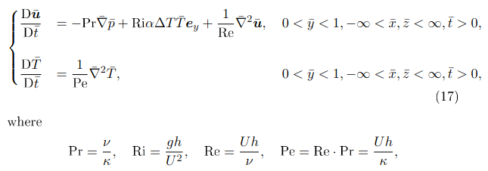
The equations to be approximated
Using Navier-Stokes equation and the conservation statements, we get the PDEs describing the system.
We perform non-dimensionalisation and get the following equations:

Slide 7
Methodology
Setting up a Linux virtual machine and understanding the Dedalus, PySR and H5Py packages in Python
Writing programmes for saving and loading the arrays of quantities and their gradients, their derivatives wrt time for all the time steps
Running simulations of RBC in Dedalus (of size 256x64 for 50 time steps) in various slices and saving the arrays to files
Loading the arrays using PySR and performing SR to predict the gradient of velocity using the other quantities
Plotting and analysing the results of SR

Slide 8
My Model
The first model is a pretty simple one: uses only the binary operators "+", "*" and "-" and nothing more.
The input variables are buoyancy, pressure and its gradients only.
It has to predict the gradient of velocities (u_x and u_z) in both x and z directions, according to equation 1 that we saw.
I have performed mean-pooling to reduce the shape from (256, 64) to (128, 32).
Despite being so simple, it gives appreciable results, which can be used as baselines for more complicated models.
The R^2 values are between 0 to 0.2, which can be improved further.

Slide 9
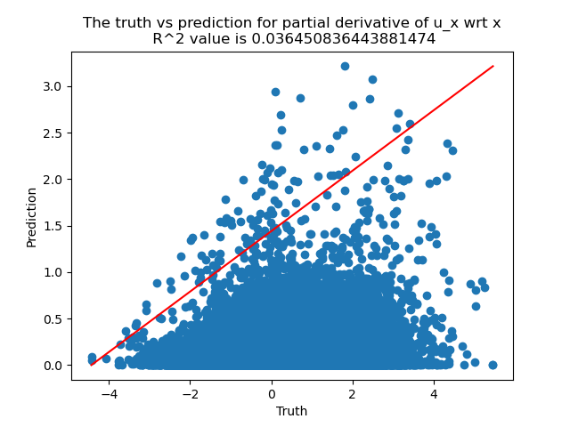
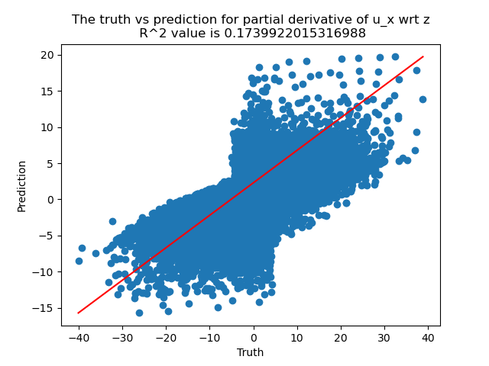
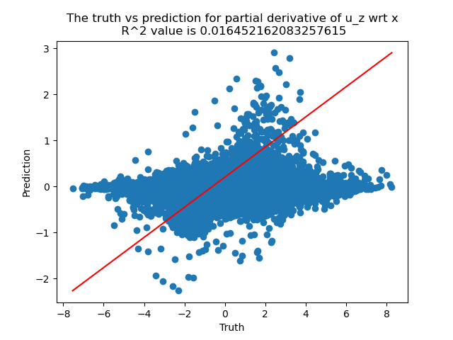
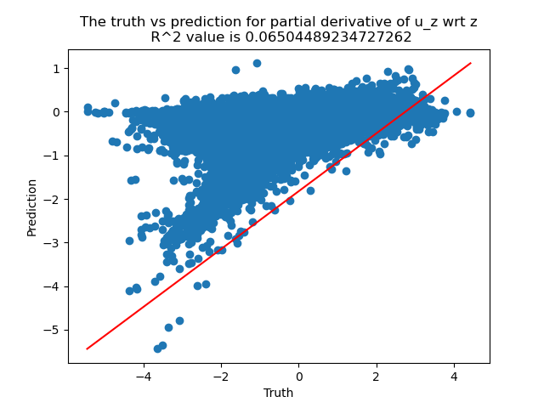
Truth vs prediction plots

Slide 10
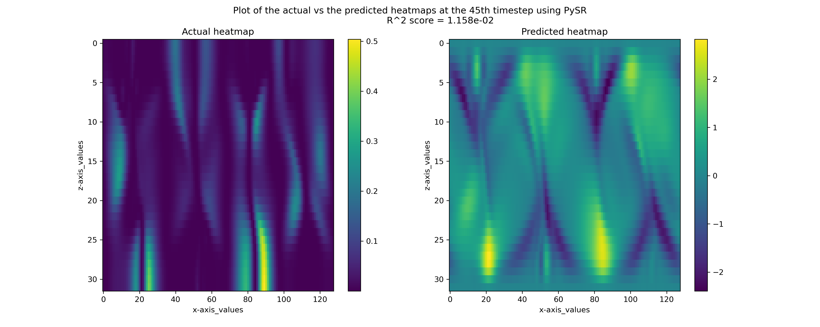
Results at one particular timestep

Slide 11
Future work
Testing the sensitivity of the model to resolution and added noise.
Explore trade-offs between the expression length and error.
Investigating other kind of fluid-flows too, to see if the effects observed here are seen in those flows too.

Slide 12
References
Dedalus documentation
PySR documentation
H5Py documentation
“Rayleigh-Bénard convection” - Bachelor degree project by Maja Sandberg, Niclas Berg and Gustav Johnsson
https://www.diva-portal.org/smash/get/diva2:571135/FULLTEXT01.pdf
Rayleigh-Bénard convection - Wikipedia

