Slide 1
Abode of Knowledge
Exploring Raj Yoga and Bhakti Yoga

Slide 2
RAJA YOGA Definition :
In Sanskrit, the word raja translates as king, chief, or royal. Thus, raja yoga is considered to be the best path to attaining the highest state of yoga—samadhi or enlightenment.
Swami Vivekananda describes this internal meditative practice as a path towards mastering the whole universe. He writes, “Raja-Yoga proposes to start from the internal world, to study internal nature, and through that, control the whole—both internal and external.”

Slide 3
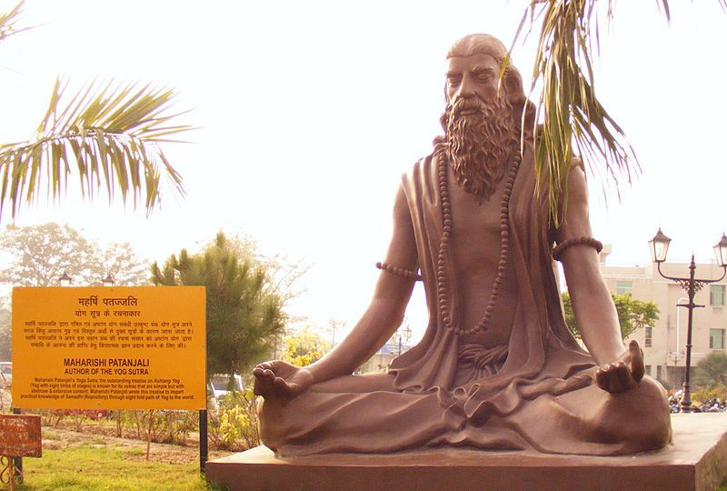
The practice of raja yoga was compiled by the sage Patanjali in his famous Yoga Sutras during the second century CE
Patanjali only instructs the Raja yogi to observe and slow the breath down to the point where one cannot distinguish between the inhalation and the exhalation

Slide 4
The Benefits of Raja Yoga :
Through a dedicated practice of raja yoga, one develops detachment towards worldly objects, our thoughts, and the results of our actions. This develops an understanding of our true nature and leads to the cultivation of inner peace and tranquility.

Slide 5
Steps in Raja Yoga :
Yama
Niyama
Asana
Pranayama
Pratyahara
Dharana
Dhyana
Samadhi

Slide 6
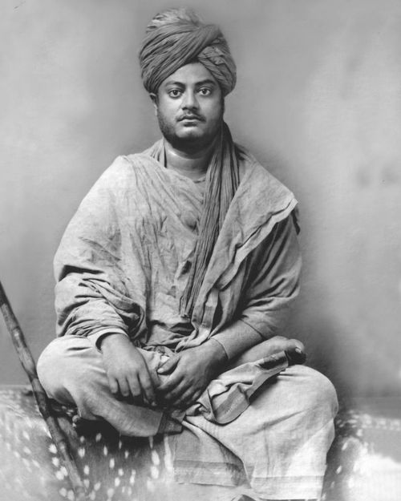
The steps to practicing raja yoga appear complex and difficult at first, but will become easier with patience and continued practice. As Swami Vivekananda writes, “Practice is absolutely necessary. You may sit down and listen to me by the hour every day, but if you do not practice, you will not get one step further. It all depends on practice. We never understand these things until we experience them. We will have to see and feel them for ourselves.”

Slide 7
Bhakti Yoga:
Bhakti means “devotion” or “love”, and this Sanskrit term originates from the root word “bhaj,” which translates as “devotion, worship or to serve God”
Bhakti Yoga is one of the four main yogic paths to enlightenment.
Bhakti Yoga is considered the easiest yogic path to master and the most direct method to experience the unity of mind, body, and spirit

Slide 8
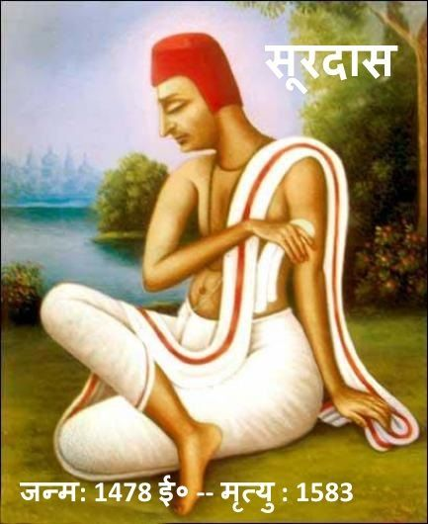

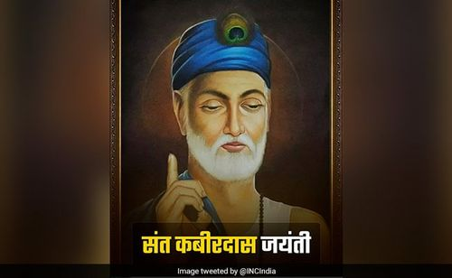
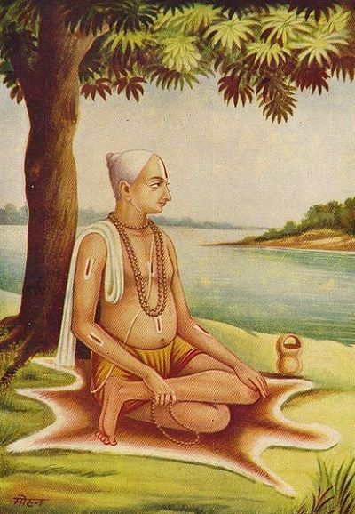

Some of the prominent Bhakti saints include Mirabai, Surdas, Kabir, Tulsidas, and Chaitanya Mahaprabhu

Slide 9
The Nine Limbs of Devotion:
Shravana
Kirtana
Smarana
Padasevana
Archana
Vandana
Dasya
Sakhya
Atmanivedana

Slide 10
References :
https://www.yogabasics.com/learn/raja-yoga-oneness-through-meditation/
https://www.yogabasics.com/learn/bhakti-yoga-the-yoga-of-devotion/

Slide 11
THANK YOU

