Slide 1

INTRODUCTION TO CRYPTOGRAPHY
Sumanth Simha C
Samarth S
Dept of CSE
BMS College of Engineering

Slide 2
Topics that are covered
Cryptography vs Cryptanalysis
Crypto- Past and Present
Hashing vs Encryption
Classical Cryptosystems
Public Key Cryptography
Zero knowledge Proofs
Digital Signatures
Applications of Cryptography
Post Quantum Cryptography
Homomorphic Encryption

Slide 3
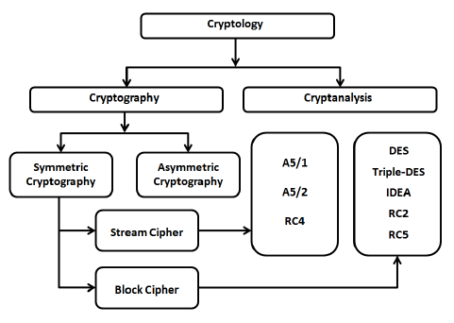

Slide 4
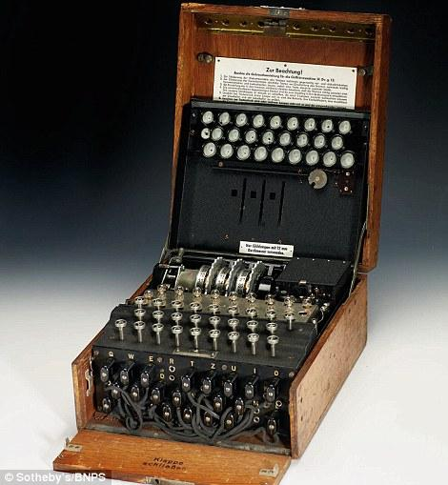
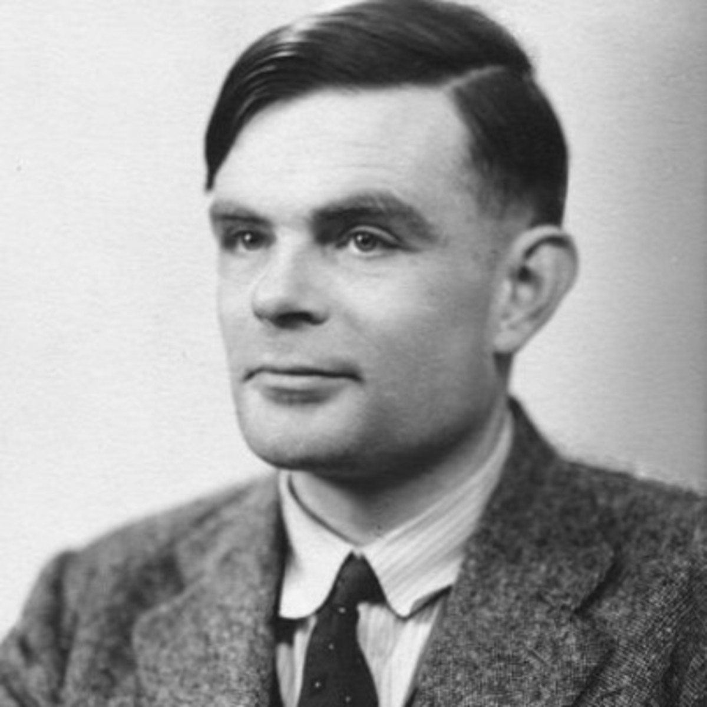
CRYPTO : PAST AND PRESENT
ALAN TURING

Slide 5
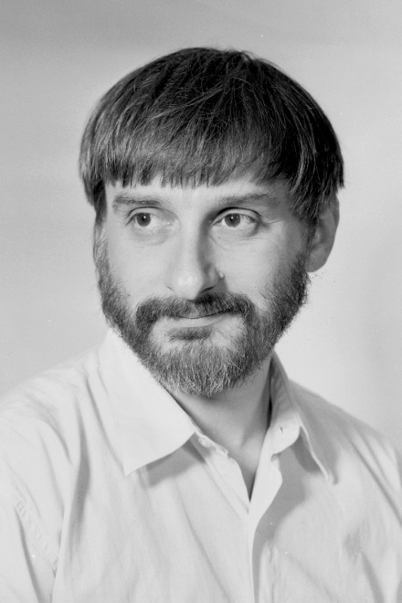
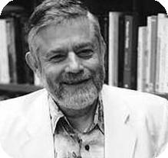
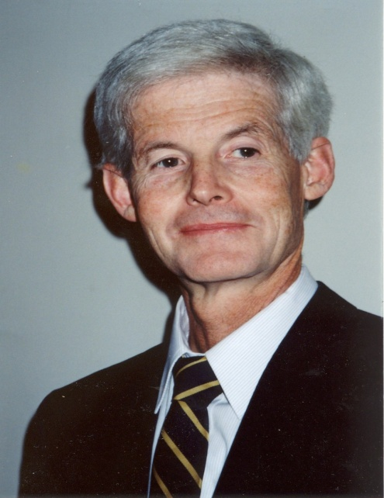
MANUEL BLUM
LEONID LEVIN
STEPHAN COOK

Slide 6
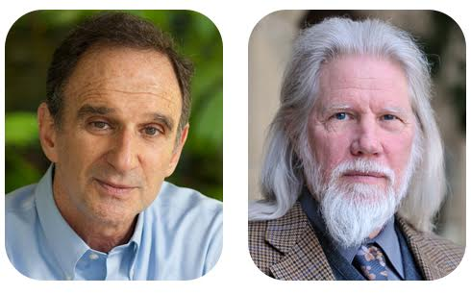
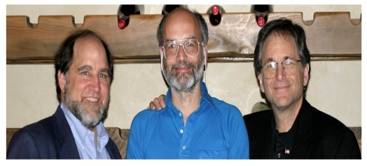
Whitfied Diffie and Martin Hellman
Rivest, Shamir, Adleman

Slide 7
ENCRYPTION
Encryption is the process of encoding a message or information in such a way that only authorized parties can access it and those who are not authorized cannot.
It is done with the help of a pseudorandom key which both the parties use to encrypt and decrypt the message.

Slide 8
Hashing vs Encryption
It is a mathematical algorithm that maps data of arbitrary size to a bit string of a fixed size (a hash) and is designed to be a one-way function ("hard to invert“ ), that is, a function which is infeasible to invert. The only way to recreate the input data from an ideal cryptographic hash function's output is to attempt a brute-force search of possible inputs to see if they produce a match.

Slide 9
PROPERTIES OF HASH FUNCTIONS
It is deterministic so the same message always results in the same hash
It is infeasible to generate a message from its hash value except by trying all possible messages.
A small change to a message should change the hash value so extensively that the new hash value appears uncorrelated with the old hash value
It is infeasible to find two different messages with the same hash value ( Collision Resistant )

Slide 10
EXAMPLE
Encryption
7 + 3 = 10
Decryption
10 – 3 = 7
You got back 7 !
Hashing
22 % 7 = 1
1 ? 7 = 22
1 ? 22 = 7
Cannot find the operator ?

Slide 11
CLASSICAL CRYPTOSYSTEMS
They are mostly symmetric cipher models i.e they use the same key for encryption and for decryption
The algorithm is usually made publically available and only the key is kept a secret - this mainly reduces the cost
The algorithm should be so strong that even with multiple ciphertexts and corresponding plain texts it shouldn’t be feasible to get the secret key
The key needs to be distributed over a secure channel
Some techniques:
Substitution Techniques
Transposition Techniques
Rotor mechanics
Steganography

Slide 12
Substitution Ciphers
Mono-alphabetic Ciphers : Once a key is chosen, each alphabetical character of plaintext is mapped onto a unique alphabetical character of a ciphertext.
Examples :
Shift Cipher (Caesar’s Cipher)
Mono Alphabetic Substitution Cipher
Digrams
Polyalphabetic ciphers : is any cipher based on substitution, using multiple substitution alphabets.
Examples :
Vignere Cipher
Hill Cipher

Slide 13
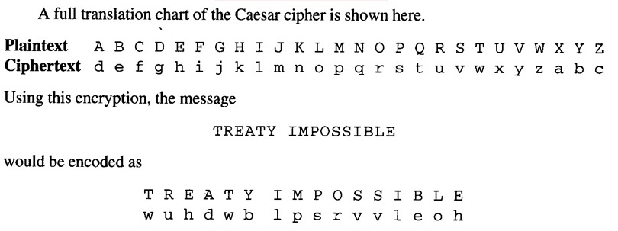
CAESER’S CIPHER
Caeser’s cipher is very easy to crack as there are only 26 keys possible !!!

Slide 14
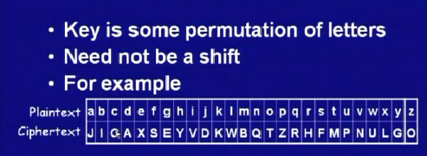
SUBSTITUTION CIPHER
But still the cipher can be attacked quite easily !!!

Slide 15
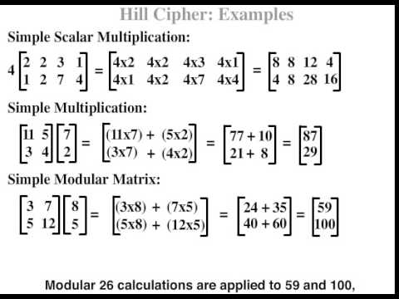
Hill Cipher

Slide 16
Modern Symmetric Key Cryptography
Block Ciphers:
Data Encryption Standard (uses 56bit key and blocks are 64bits)
Advanced Encryption Standard(uses 256 bit key and blocks are 128bits)
International Data Encryption Algorithm
BlowFish
Stream Ciphers
Rivest Cipher 4
One Time Pad

Slide 17
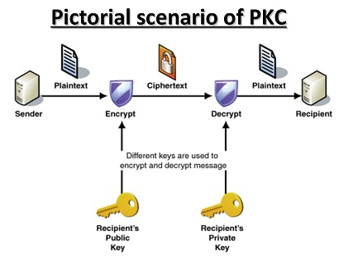
Public Key Cryptography
Each system generates a pair of keys.
Each system publishes its public key keeping its companion key private.
If Alice wishes to send a message to Bob, then Alice encrypts the message using Bob’s public key.
When Bob receives the message, he decrypts the message using its private key. No one else can decrypt the message because only Bob knows its private key.

Slide 18
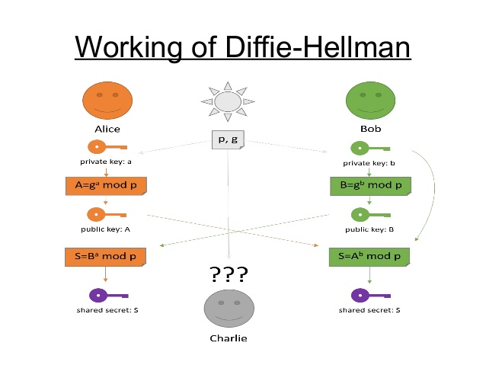
Diffie-Hellman

Slide 19
RSA Encryption
RSA ( Rivest, Shamir and Adleman) is the first practical public key cryptosystem published in 1977 at MIT widely used for secure data transmission.
Every number can be expressed as a product of primes and this prime factorization is a NP-hard problem and has exponential time complexity. But on the other hand, multiplication of two numbers is very easy with less time complexity.
The RSA algorithm has three stages – key generation, encryption and decryption.

Slide 20
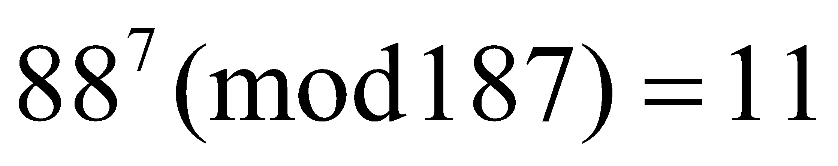
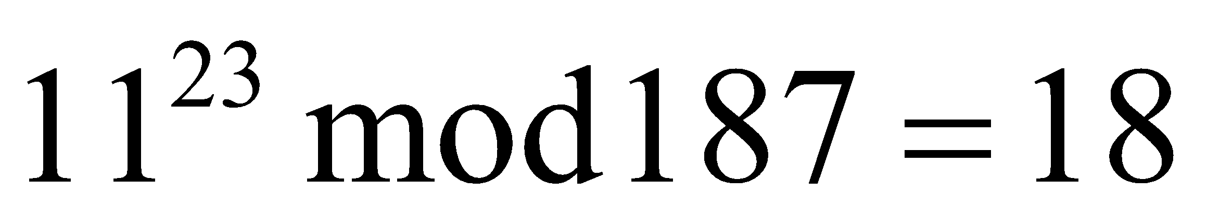
RSA EXAMPLE
RSA Key Generation :
Select Primes : p = 17 and q = 11
Compute n = pq = 17 X 11 = 187
Compute φ(n) = (p-1)(q-1) = 16 X 10 = 160
Choose b such that gcd(b, φ(n)) = 1, i.e. b and φ(n) are co-prime. Let b = 7.
ab Ξ 1(mod φ(n)), so a = 23.
Bob publishes the public key (n,b) = (187, 7) as public key.
Bob keeps secret / private key (n,a) = (187, 23).
Sample RSA Encryption / Decryption :
If Aice has to send the message M = 88 ( 88 < 187 )
Encryption :
Decryption :

Slide 21
APPLICATIONS OF RSA ENCRYTION
RSA is used along with AES Algorithm to :
Guarantee email privacy and authenticity in PGP ( Pretty Good Privacy )
Guarantee Remote Connection in SSH ( Secure Shell )
Can RSA encryption having larger key bit length (2048) be cracked ?
Can be cracked with a quantum computer ( Shor’s Algorithm) !!!

Slide 22
ZERO KNOWLEDGE PROOFS ( INTERACTIVE PROOFS)
Intuitively, what should we require from an efficient theorem-proving procedure?
That it should be possible to “prove” a true theorem.
2. That it should be impossible to “prove” a false theorem.
3. That communicating the “proof” should be efficient. Namely regardless of how much time it takes to come up with the proof, its correctness should be efficiently verified.

Slide 23
Zero knowledge Transfer between the Prover and the Verifier
The verifier accepts or rejects the proof after multiple challenges and responses
Probabilistic Proof Protocol
Overcomes Problems with Password Based Authentication

Slide 24
ADVANTAGES OF ZKP
As name Suggests – Zero Knowledge Transfer
Computational Efficiency – No Encryption
No Degradation of the protocol
Based on problems like discrete logarithms and integer factorization

Slide 25
APPLICATIONS OF ZKP
Watermark Verification
Show the presence of watermark without revealing information about it
prevents from removing the watermark and reselling multiple duplicate copies.
Others – e-voting, e-cash etc.
SRP ( Secure Remote Password Protocol )
Zerocoin.

Slide 26
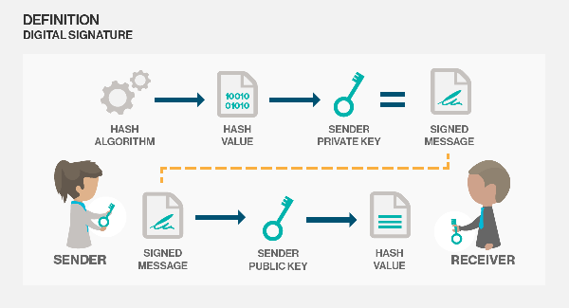
DIGITAL SIGNATURES

Slide 27
Applications of Cryptography
Secure Shells
PGP/GPG
TrueCrypt - used to encrypt disks and files
HDCP - High Definition Content Protection
TOR
BlockChains and CryptoCurrencies
Youtube Offline videos
FairPlay on Apple Devices
many many more…...

Slide 28
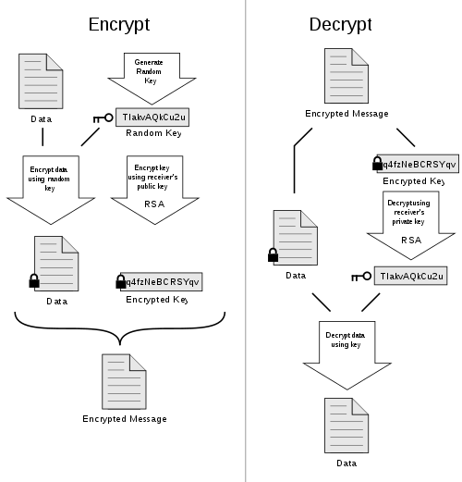
PGP

Slide 29
POST-QUANTUM CRYPTOGRAPHY
Here's the one-minute introduction: "Imagine that it's fifteen years from now. Somebody announces that he's built a large quantum computer. RSA is dead. DSA is dead. Elliptic curves, hyperelliptic curves, class groups, whatever, dead, dead, dead. So users are going to run around screaming and say 'Oh my God, what do we do?' Well, we still have secret-key cryptography, and we still have some public-key systems. There's hash trees. There's NTRU. There's McEliece. There's multivariate-quadratic systems. But we need more experience with these. We need algorithms. We need paddings, like OAEP. We need protocols. We need software, working software for these systems. We need speedups. We need to know what kind of key sizes to use. So come to PQCrypto and figure these things out before somebody builds a quantum computer."
-- pqcrypto.org

Slide 30
HOMOMORPHIC ENCRYPTION
Homomorphic encryption is a form of encryption that allows computation on ciphertexts, generating an encrypted result which, when decrypted, matches the result of the operations as if they had been performed on the plaintext.
The purpose of homomorphic encryption is to allow computation on encrypted data.
Can be used in Cloud Platforms

