Slide 1
Principal Component Analysis ( PCA )

Slide 2
Principal Components Analysis ( PCA)
An exploratory technique used to reduce the dimensionality of the data set to 2D or 3D
Can be used to:
Reduce number of dimensions in data
Find patterns in high-dimensional data
Visualize data of high dimensionality
Example applications:
Face recognition
Image compression
Gene expression analysis

Slide 3
Principal Components Analysis Ideas ( PCA)
Does the data set ‘span’ the whole of d dimensional space?
For a matrix of m samples x n genes, create a new covariance matrix of size n x n.
Transform some large number of variables into a smaller number of uncorrelated variables called principal components (PCs).
developed to capture as much of the variation in data as possible

Slide 4
Geometric Rationale of PCA
objective of PCA is to rigidly rotate the axes of this p-dimensional space to new positions (principal axes) that have the following properties:
ordered such that principal axis 1 has the highest variance, axis 2 has the next highest variance, .... , and axis p has the lowest variance
covariance among each pair of the principal axes is zero (the principal axes are uncorrelated).
the eigenvalue represents the variance displayed (“explained” or “extracted”) by the k^{th} axis

Slide 5
Principal components
1. principal component (PC1)
The eigenvalue with the largest absolute value will indicate that the data have the largest variance along its eigenvector, the direction along which there is greatest variation
2. principal component (PC2)
the direction with maximum variation left in data, orthogonal to the 1. PC
In general, only few directions manage to capture most of the variability in the data.

Slide 6
PC axes are a rigid rotation of the original variables
PC 1 is simultaneously the direction of maximum variance and a least-squares “line of best fit” (squared distances of points away from PC 1 are minimized).
PC 1
PC 2

Slide 7
Principal components
1. principal component (PC1)
The eigenvalue with the largest absolute value will indicate that the data have the largest variance along its eigenvector, the direction along which there is greatest variation
2. principal component (PC2)
the direction with maximum variation left in data, orthogonal to the 1. PC
In general, only few directions manage to capture most of the variability in the data.

Slide 8
Principal components
General about principal components
linear combinations of the original variables
uncorrelated with each other
capture as much of the original variance as possible.

Slide 9
Limitations of PCA
If we have some of the variables in our dataset that are linearly correlated, PCA can find directions that represents data.But but if the data is not linearly correlated (i.e. in spiral, where x=t*cos(t) and y =t*sin(t) ), the principal axes will not be an efficient and informative summary of the data.
Relies on orthogonal tranformations.
For a image with 256 ×256 pixels ,covariance matrix will be of dimension 65536×65536. Thus it requires huge memory to store and computation will also tend to be slow.

Slide 10
ICA
While PCA seeks directions that represents data best in a Σ|x₀ – x|² sense, ICA seeks such directions that are most independent from each other.
Used primarily for separating unknown source signals from their observed linear mixtures.
Typically used in Blind Source Separation problems. ICA is also used in feature extraction.
Notes:
Blind source separation: (1) instantaneous mixtures or (2) convolutive mixtures

Slide 11
What is ICA?
In signal processing, independent component analysis (ICA) is a computational method for separating a multivariate signal into additive subcomponents. This is done by assuming that the subcomponents are non-Gaussian signals and that they are statistically independent from each other.

Slide 12

The simple “Cocktail Party” Problem
Mixing matrix A
s₁
x₁
Observations
Sources
x₂
s₂
x = As
n sources, m=n observations

Slide 13
Classical ICA (fast ICA) estimation
Observing signals
Original source signal
ICA
0.10
0.05
V4
0.00
-0.05
-0.10
0
50
100
150
200
250

Slide 14
ICA
ICA Mixture model: x=As
A is mixing matrix; s is matrix of source signals
Goal
Find some matrix W, so that
s = Wx
W = inverse of A
Notes:
Now that we understand the model of our incoming mixtures, the ICA model can be defined as x = As
Where A is some unknown mixing matrix, s is our source signals and x is our observed mixtures.
With this model we can then see that the goal of ICA is to find some matrix W, so that s = Wx
This means that the ideal solution to ICA would be to find W so that it is the inverse of the mixing matrix A

Slide 15
Assumptions
Source signals are statistically independent
Knowing the value of one of the components does not give any information about the others
The source signals have nongaussian distributions.
Notes:
In order to solve this problem using ICA there are several assumptions that have to be made in order to correctly determine the independent components.
The first assumption is that all source signals are statistically independent.
This means that knowing the value of one of the components does not give any information about the other components.
In order to do so these ICS have to have some unknown nongaussian distributions.
If we knew the distributions to the sources, then this problem could be siimplified and you wouldn’t need ICA to solve it
This assumption is not totally correct because BSS problem can be solved if there is at most one Gaussian source.
I will talk later about why there needs to only be at most only one gaussian source
The last assumption from the ICA algorithm is that the recovered sources will not be equal to the original source.
They will be some permutated and scaled form the original signal

Slide 16
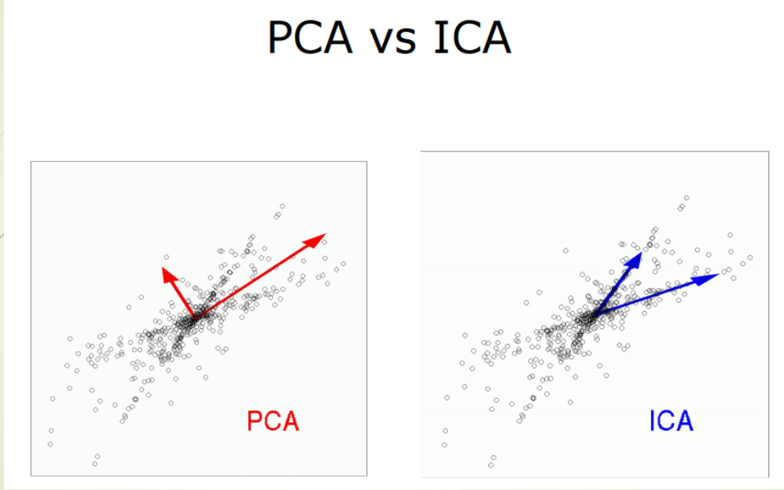

Slide 17
PCA VS ICA
PCA helps to find a reduced-rank representation of your data(compress data)
PCA yields orthogonal vectors of high energy contents in terms of the variance of the signals
ICA helps when you want to find a representation of your data as independent sub-elements.(separate data)
ICA identifies independent components for non-Gaussian signals.

Slide 18
Why autoencoders is required?
PCA projects the data onto a low dimensional surface and it restricts that surface to be linear. In the real world, this can be restrictive.Many data in the real world are non linear. Autoencoder doesn’t impose that restriction. Autoencoders is non linear dimensionality reduction technique which can learn complex representations of data.

Slide 19
Autoencoders

Slide 20
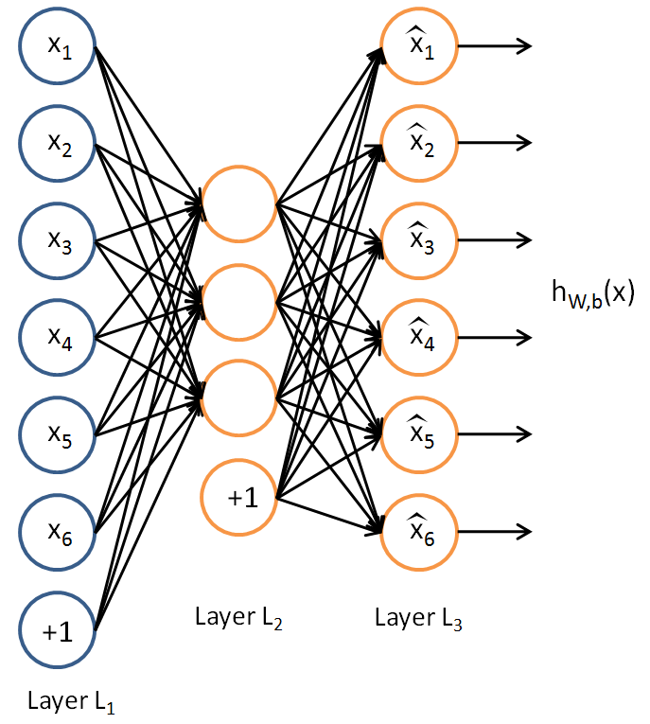
Autoencoders with one hidden layer
The aim of an autoencoder is to learn a representation (encoding) for a set of data, typically for the purpose of dimensionality reduction.
X
Y
Z

Slide 21
Algorithm
X is the input data
Y is the hidden layer activations
Z is the predicted output or the reconstruction of the input X.
W denote the weights from input to hidden layer
b is the input and hidden layer bias
s(.) denote the sigmoidal function
Step 1: Take the input X ε [0,1] and map it ( with an encoder ) to a hidden representation y ε [0,1] through a deterministic mapping.
Step 2 : The latent representation , or code is then mapped back (with a decoder) into a reconstruction of the same shape as . The mapping happens through a similar transformation.

Slide 22
Step 3 :The reconstruction error is calculated using the cross- entropy loss function.
Step 4 : The weights are updated using the equation :

Slide 23
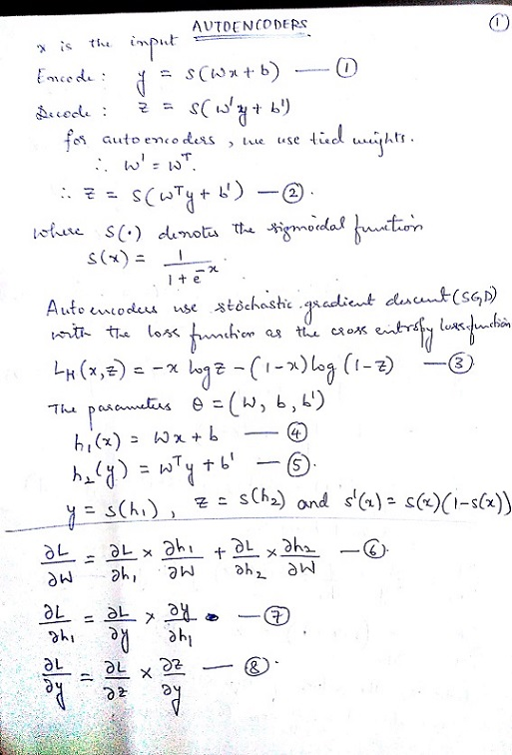
Autoencoders derivation with one hidden layer

Slide 24
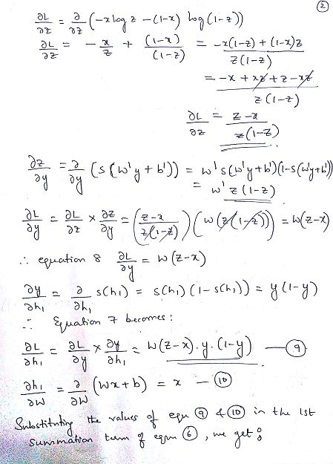

Slide 25
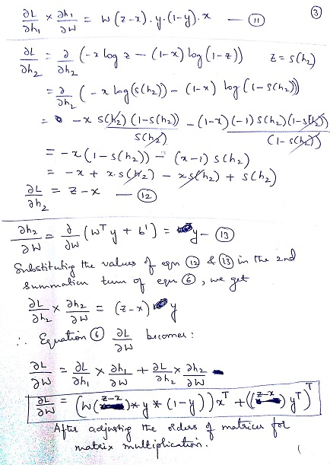

Slide 26
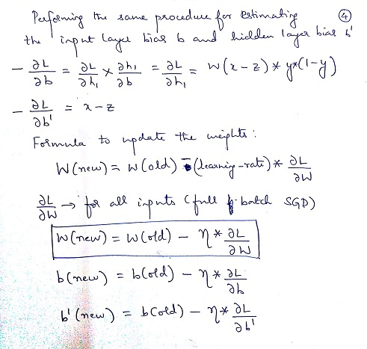

Slide 27
Deep Autoencoders

Slide 28
Historical background: First generation neural networks
Perceptrons (~1960) used a layer of hand-coded features and tried to recognize objects by learning how to weight these features.
There was a neat learning algorithm for adjusting the weights.
But perceptrons are fundamentally limited in what they can learn to do.
Bomb
Toy
output units e.g. class labels
non-adaptive
hand-coded
features
input units e.g. pixels
Sketch of a typical perceptron from the 1960’s

Slide 29
Second generation neural networks (~1985)
Compare outputs with correct answer to get error signal
Back-propagate error signal to get derivatives for learning
outputs
hidden layers
input vector

Slide 30
What is wrong with back-propagation?
It requires labeled training data.
Almost all data is unlabeled.
The learning time does not scale well
It is very slow in networks with multiple hidden layers.
It can get stuck in poor local optima.

Slide 31
Overcoming the limitations of back-propagation
Adjust the weights to maximize the probability that a generative model would have produced the sensory input.
Learn p(image) not p(label | image)
Use unsupervised pretraining to overcome limitations of backpropogation which is a generative model.

Slide 32
Why unsupervised pre-training is required ?
Using unsupervised pre-training , the model learns the features well and the weights are trained.
If the random initialization of weights is of lower value, the gradient drops to 0 with backpropogation over multiple hidden layers which might lead to overfitting.
If the random initialization of weights is large, the gradient is large and hence the error is large.
The unsupervised pretraining gives a good estimate of the weights so that it can perform a local search instead of a global search.

Slide 33
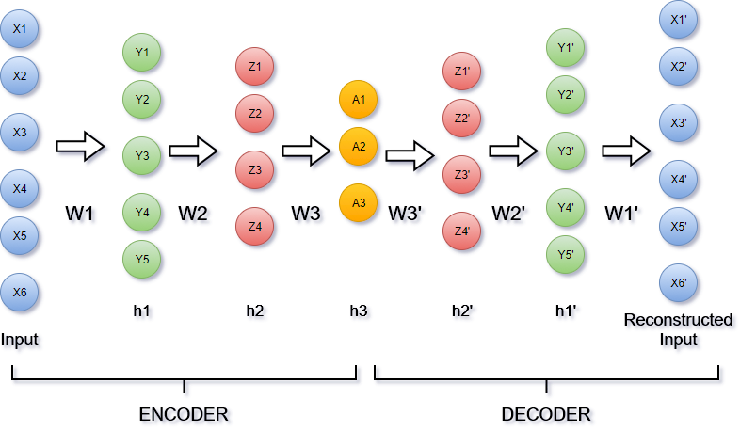
Example of Training Deep Autoencoders

Slide 34
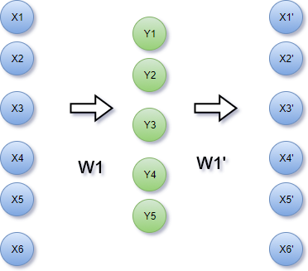
Unsupervised Pre-Training 1

Slide 35
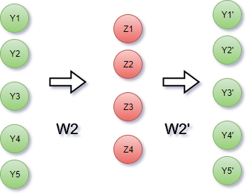
Unsupervised Pre-Training 2

Slide 36
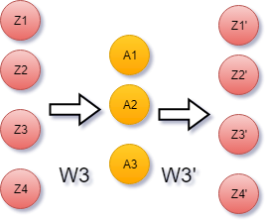
Unsupervised Pre-Training 3
At the end of unsupervised pre-training, all the weights W1, W2 and W3 are trained.

Slide 37
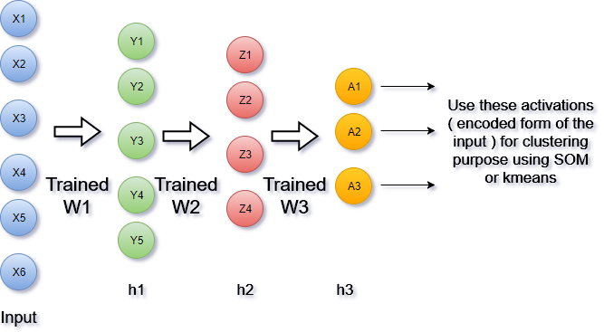
Fine Tuning 1
Using the weights W1, W2, W3 trained using unsupervised pre-training perform a feedforward pass from the input layer to the last hidden layer using sigmoidal activation function to obtain the last hidden layer’s activations

Slide 38
Fine Tuning 2
To get the reconstructed input use a softmax classifier ( multi label classification ), the label as the input itself and backpropogate the error between the reconstructed input and predicted input and adjust the weights between the last hidden layer and the output layer.
Perform the same for some number of epochs.
Using the fine tuned weights, predict the reconstructed input.
This is not required for our clustering purpose as we have already obtained the encoded hidden layer activations. This is for the decoder layer to obtain the reconstructed input.

Slide 39
Algorithm for Deep Autoencoders
X be the input
h1, h2, …….,hn be the hidden layers
Y be the output
W1, W2, W3……Wn be the weights of the encoder layers
Consider sigmoidal hidden layers
A softmax output layer to reconstruct the input at the last hidden layer.

Slide 40
Unsupervised Pre-Training :
Step 1 :
1. Recursively train the weights starting from INPUT->h1, h1->h2 and so on till hn-1->hn as separate autoencoders passing the activations of one hidden layer to another using sigmoidal activation function and cross-entropy loss function.
2. Unroll the layers to construct the decoder part and fix the weight of the decoder layer as :
Fine-Tuning
Step 2 : Do a feedforward pass from the INPUT layer to the last hidden layer hn and obtain its activations. These encoded activation of the INPUT are used for clustering purpose.
Step 3 :To get the reconstructed input use a softmax classifier ( multi label classification ), the label as the input itself and backpropogate the error between the reconstructed input and predicted input and adjust the weights between the last hidden layer and the output layer.
Perform the same for some number of epochs.
Step 4: Using the fine tuned weights, predict the reconstructed input.

Slide 41
Comparison of Deep Boltzmann Machine with Deep Autoencoders
Deep Boltzmann Machine is seen to outperform PCA, which demonstrates the expressive power of Deep Boltzmann Machine. We achieve good compression since we’re able to estimate the probability distribution of the images well. We also train a deep auto-encoder using stacked autoencoder pre-training method. We note that in this case, this method of pre-training isn’t as effective as Deep Boltzmann Machine, and isn’t really much better than PCA, although the performance rapidly improves upon fine tuning via back-propagation.
Deep Boltzmann Machine is used for better feature extraction whereas Deep Autoencoders is used as a compression technique for encoding the input and the images.

Slide 42
References
Reducing the Dimensionality of Data with Neural Networks - G. E. Hinton* and R. R. Salakhutdinov
Stacked Denoising Autoencoders: Learning Useful Representations in a Deep Network with a Local Denoising Criterion – Pascal Vincent, Hugo Larochelle, Isabelle Lajoie, Yoshua Bengio, Pierre-Antoine Manzagol
The Next Generation of Neural Networks by Geoffrey Hinton - https://www.youtube.com/watch?v=AyzOUbkUf3M
Deep Autoencoders by Geoffrey Hinton
https://www.youtube.com/watch?v=_Ex1Ur85AVs&t=181s
http://ufldl.stanford.edu/wiki/index.php/Stacked_Autoencoders
http://deeplearning.net/tutorial/dA.html

