Slide 1
Boltzmann Machine

Slide 2
Statistical Mechanics
Consider a physical system with large number of possible states
and many degrees of freedom. Let pi be the occurrence probability of state i, such that :
At thermal equilibrium, state i occurs with probability :
Ei is the energy of the system,
is the Boltzmann constant
T is the temperature.
is called the partition function

Slide 3
In the context of neural nets, the parameter T ( which controls thermal fluctuations ) represents the effect of synaptic noise. Hence, =1 is set and pi and Z getting the form :
follows the Boltzmann Distribution
As the temperature T of the system decreases, the probability pi increases i.e. the probability of occurrence of state i increases.

Slide 4
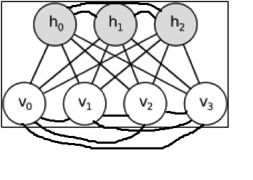

Introduction To Boltzmann Machine
Boltzmann Machine are good at modeling training data.
Given a training set of binary vectors, fit a model that will assign probability to each training vector.
In Boltzmann machine everything is defined in terms of energies of joint configurations of the visible and hidden units.

Slide 5
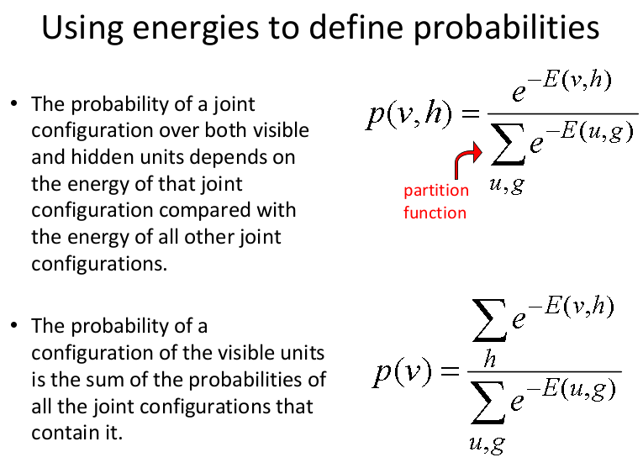

Slide 6
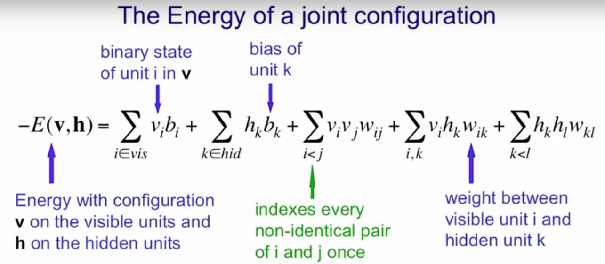

Slide 7
Training a Boltzmann Machine
There are two phases to Boltzmann machine training :
One is the "positive“ phase where the visible units' states are clamped to a particular binary state vector from the training set denoted by P⁺(V_{α}) where V_{α} denotes a vector over the visible units.
2. The other is the "negative" phase where the network is allowed to run freely, i.e. no units have their state determined by external data denoted by P⁻(V_{α}).

Slide 8


Training a Boltzmann Machine
The cost function used for Boltzmann machines, G, is given as:
This cost function would seem to be complicated to perform gradient descent with. Suprisingly though, the gradient with respect to a given weight, w_{ij},at thermal equilibrium is given by the very simple equation:
is the probability of both the units i and j being on the positive phase.
is the probability of both the units i and j being on the negative phase.

Slide 9
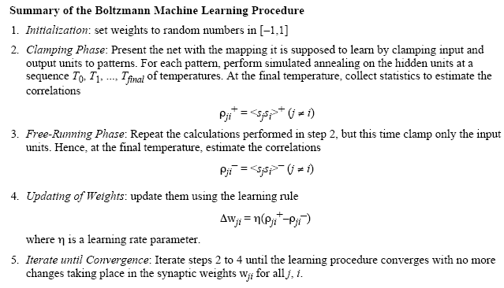
Algorithm for Boltzmann Machine

Slide 10
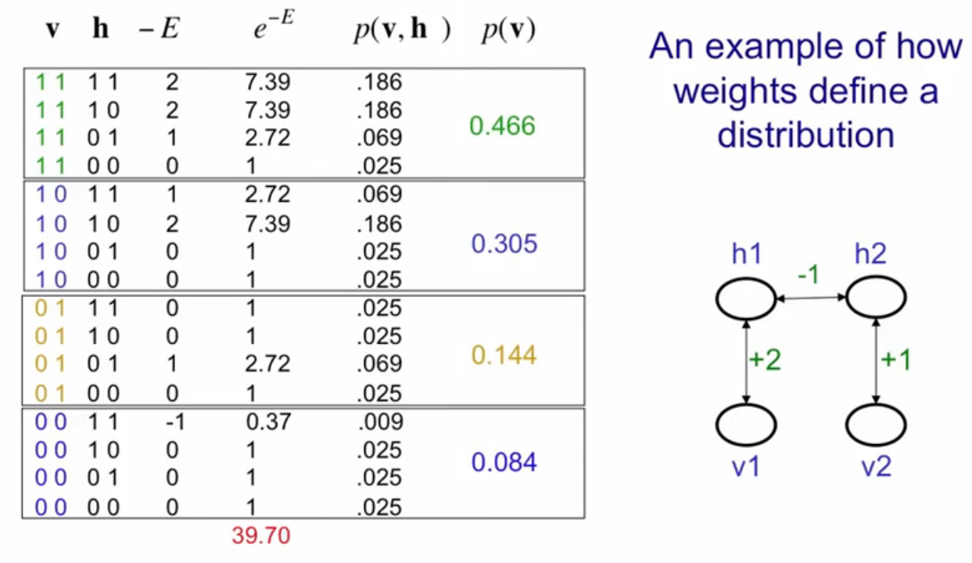
Numerical Illustration

Slide 11
Restricted Boltzmann Machine

Slide 12
Restricted Boltzmann Machines with one hidden layer
We restrict the connectivity to make learning easier.
Only one layer of hidden units.
We will deal with more layers later
No connections between hidden units.
In an RBM, the hidden units are conditionally independent given the visible states.
So we can quickly get an unbiased sample from the posterior distribution when given a data-vector.
This is a big advantage over directed belief nets
hidden
j
i
visible

Slide 13
The Energy of a joint configuration (ignoring terms to do with biases)
binary state of hidden unit j
binary state of visible unit i
Energy with configuration v on the visible units and h on the hidden units
weight between units i and j

Slide 14
Weights → Energies → Probabilities
Each possible joint configuration of the visible and hidden units has an energy
The energy is determined by the weights and biases (as in a Hopfield net).
The energy of a joint configuration of the visible and hidden units determines its probability:
The probability of a configuration over the visible units is found by summing the probabilities of all the joint configurations that contain it.

Slide 15
A picture of the maximum likelihood learning algorithm for an RBM
j
j
j
j
a fantasy
i
i
i
i
t = 0 t = 1 t = 2 t = infinity
Start with a training vector on the visible units.
Then alternate between updating all the hidden units in parallel and updating all the visible units in parallel.

Slide 16
A quick way to learn an RBM ( Contrastive Divergence )
j
j
Start with a training vector on the visible units.
Update all the hidden units in parallel
Update the all the visible units in parallel to get a “reconstruction”.
Update the hidden units again.
i
i
t = 0 t = 1
data
reconstruction
This is not following the gradient of the log likelihood. But it works well. It is approximately following the gradient of another objective function (Carreira-Perpinan & Hinton, 2005).

Slide 17
Derivation of probabilities in terms of sigmoidal function using the energy equation of joint configuration of visible and hidden neurons

Slide 18
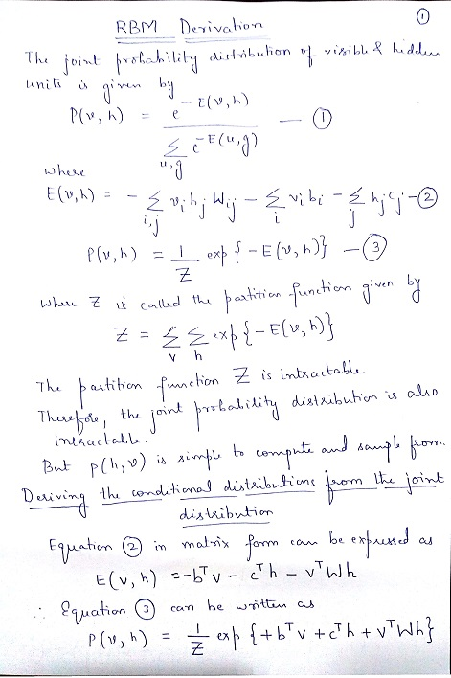
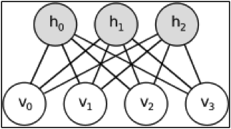

Slide 19
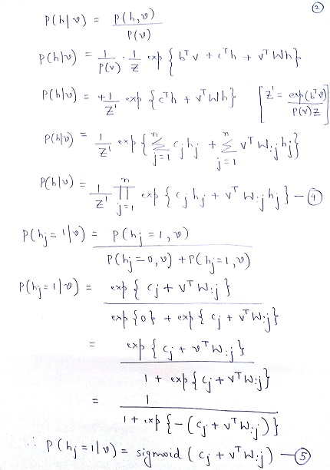

Slide 20
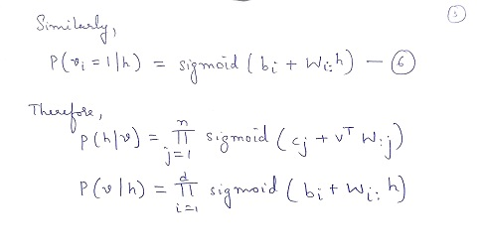

Slide 21
Algorithm for Restricted Boltzmann Machine with one hidden layer
Vi denote the visible units
hi denote the hidden units
b denote the visible biases and hidden biases
ε denote the learning rate
Normalize the data before applying RBM
Step 1 : Positive Contrastive Divergence :
Step 2 : Negative Contrastive Divergence :
Step 3 : Weight Updation Step :
j
j
i
i
t = 0 t = 1
data
reconstruction

Slide 22
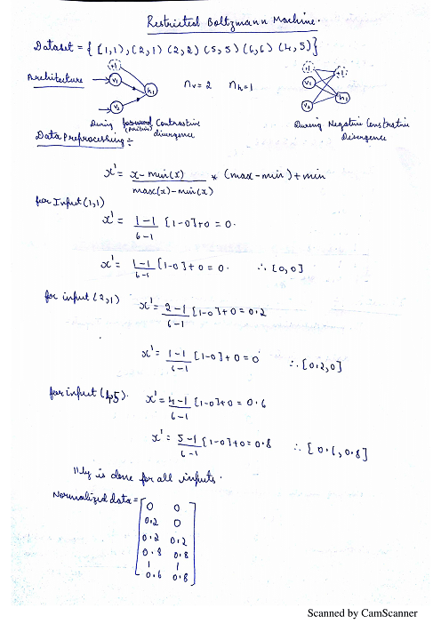
Numerical Illustration

Slide 23
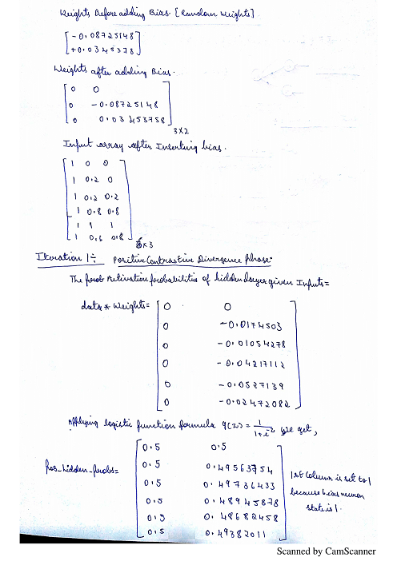

Slide 24
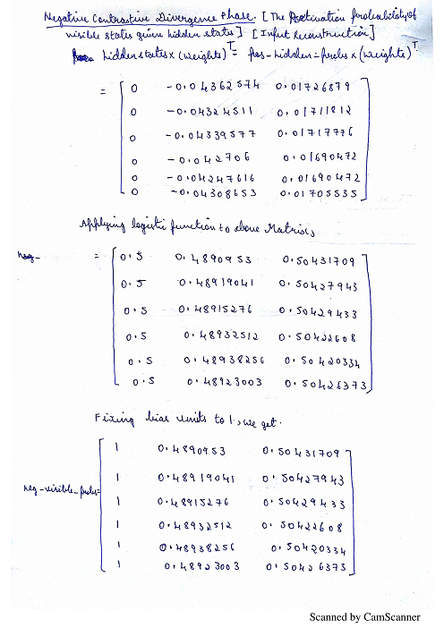

Slide 25
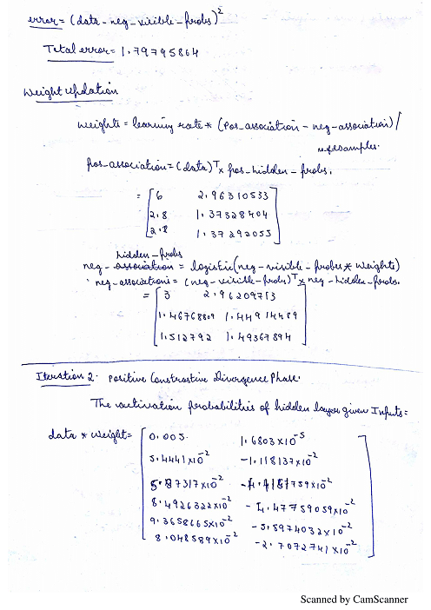

Slide 26
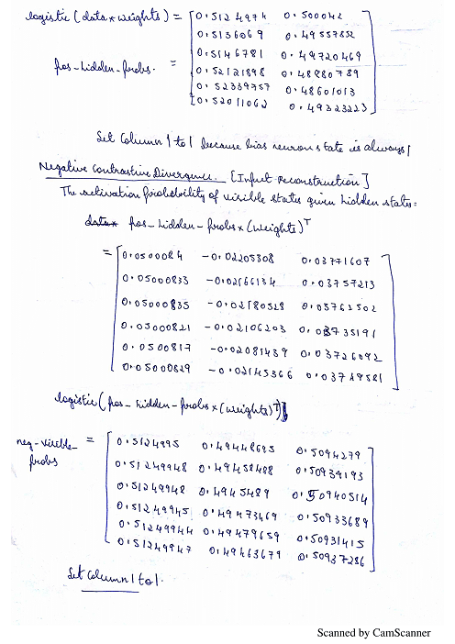

Slide 27
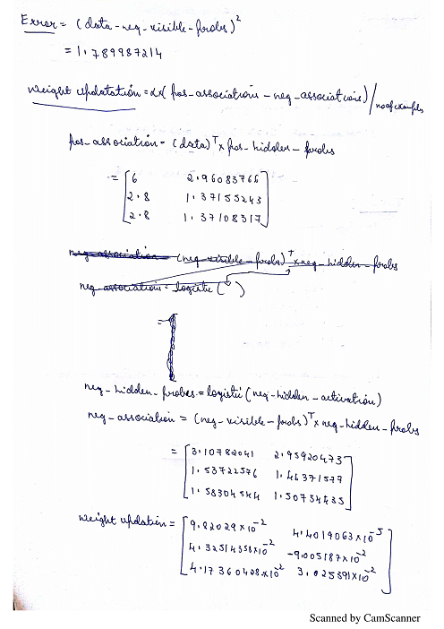

Slide 28
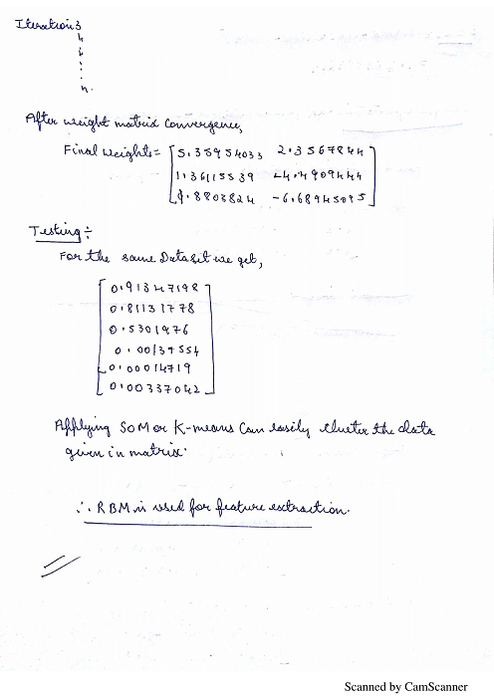

Slide 29
Comparison of Boltzmann Machine and Restricted Boltzmann Machine
Boltzmann Machine | Restricted Boltzmann Machine
Architecture | Architecture
Energy Equation | Energy Equation

Slide 30
Boltzmann Machine | Restricted Boltzmann Machine
There are visible-to-visible and hidden-to-hidden interactions | There are no visible-to-visible and hidden-to-hidden interactions
Since, there are hidden-to-hidden interactions, it is very difficult to get an unbiased sample of the posterior P(h|v) given the prior P(v) | Since, there are no hidden-to-hidden interactions, it is very difficult to get an unbiased sample of the posterior P(h|v) given the prior P(v)
If there are more than a few hidden units we cannot compute the partition function because it has exponentially many terms. Hence, learning becomes difficult and computationally expensive. | The no of terms are comparatively less which increases with time, learning is fast and computationally less expensive.

Slide 31
Stacking Restricted Boltzmann Machines
First learn a layer of hidden features.
Then treat the feature activations as data and learn a second layer of hidden features.
And so on for as many hidden layers as we want.
second layer of features
RBM2
data is activities of first layer of features
first layer of features
RBM1
data

Slide 32
Stacking Restricted Boltzmann Machines
Is learning a model of the hidden activities just a hack?
It does not seem as if we are learning a proper multilayer model because the lower weights do not depend on the higher ones.
Can we treat the hidden layers of the whole stack of RBM’s as part of one big generative model rather than a model plus a model of a model etc.?
If it is one big model, it definitely is not a Boltzmann machine. The first hidden layer has two sets of weights (above and below) which would make the hidden activities very different from the activities of those units in either of the RBM’s.

Slide 33
The overall model produced by composing two RBM’s
second layer of features
W2
second layer of features
data is activities of first layer of features
W2
first layer of features
W1
first layer of features
W1
data
data

Slide 34
The generative model
To generate data:
Get an equilibrium sample from the top-level RBM by performing alternating Gibbs sampling for a long time.
Perform a single top-down pass to get states for all the other layers.
The lower-level, bottom-up connections are not part of the generative model. They are there to do fast approximate inference.
h3
h2
h1
data

Slide 35
Why does stacking RBM’s produce this kind of generative model?
It is not at all obvious that stacking RBM’s produces a model in which the top two layers of features form an RBM, but the layers beneath that are not at all like a Boltzmann Machine.
To understand why this happens we need to ask how an RBM defines a probability distribution over visible vectors.

Slide 36
How an RBM defines the probabilities of hidden and visible vectors
The weights in an RBM define p(h|v) and p(v|h) in a very straightforward way (lets ignore biases for now)
To sample from p(v|h), sample the binary state of each visible unit from a logistic that depends on its weight vector times h.
To sample from p(h|v), sample the binary state of each hidden unit from a logistic that depends on its weight vector times v.
If we use these two conditional distributions to do alternating Gibbs sampling for a long time, we can get p(v) or p(h)
i.e. we can sample from the model’s distribution over the visible or hidden units.

Slide 37
Back-fitting
After we have learned all the layers greedily, the weights in the lower layers will no longer be optimal.
The weights in the lower layers can be fine-tuned in several ways.
For the generative model that comes next, the fine-tuning involves a complicated and slow stochastic learning procedure.
If our ultimate goal is discrimination, we can use backpropagation for the fine-tuning.

Slide 38
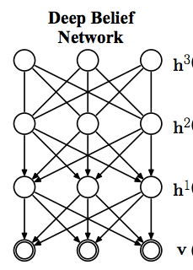
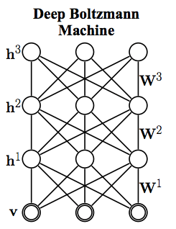
Comparison of Deep Belief Networks (DBN ) and Deep Boltzmann Machine ( DBM )
Deep Belief Networks | Deep Boltzmann Machine
Architecture | Architecture
Deep Belief Networks (DBN) is a hybrid of undirected graphical model ( RBM ) at the top layer and directed graphical model at the bottom layer | Deep Boltzmann Machines (DBM) are completely undirected graphical models

Slide 39
Deep Belief Networks | Deep Boltzmann Machine
weights are trained only one from bottom to top | weights are trained in both directions
The directed graph model (DBN) has some limitations, since it only uses visible nodes from previous layer. | The DBM model proposed by Salakhutdinov and Hinton uses the undirected graph model. DBM uses both the former layer and the next layer's nodes, and the hidden nodes sampling will be more accurate.

Slide 40
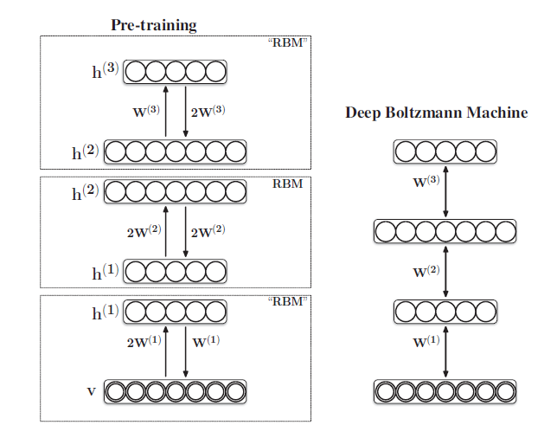
Deep Boltzmann Machine ( DBM )
Greedy Layer Wise Pre-training Works

Slide 41
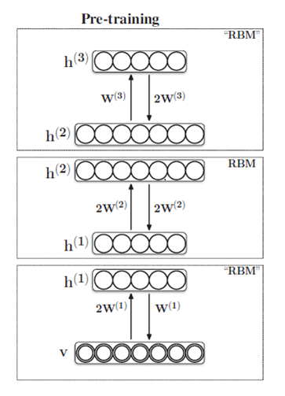
Algorithm for Deep Boltzmann Machine
Step 1 : Train the 1st layer RBM using one-step contrastive divergence and obtain the reconstructions of the visible vectors. During learning, constrain the bottom-up weights to be
, to be twice the top-down weights .
Step 2: Freeze and use the first layer sampled features from as the data for training the 2nd RBM . This is a proper RBM with weights in both directions and obtain the reconstructions of the visible units.

Slide 42
Step 3 : Freeze and use the first layer sampled features from as the data for training the 2nd RBM . This is a proper RBM with weights in both directions and obtain the reconstructions of the visible units.
Step 4: Proceed recursively upto layers L-1.
Step 5 : Train the top level RBM using one –step contrastive divergence with reconstructions of the visible vectors. During learning, constrain the bottom-up weights to be , to be half of the top-down weights .
Step 6 : Use all the weights to compose a Deep Boltzmann Machine

Slide 43
References
A Learning Algorithm for Boltzmann Machines – David H Ackley, Geoffrey Hinton, Terrence J Sejnowski
https://www.cs.toronto.edu/~hinton/absps/guideTR.pdf
https://www.cs.toronto.edu/~hinton/csc2535/notes/lec4new.pdf
https://www.youtube.com/watch?v=JvF3gninXi8
https://uwaterloo.ca/data-analytics/sites/ca.data-analytics/files/uploads/files/dbn2.pdf

