Slide 1
Self Organizing Maps (SOM)

Slide 2
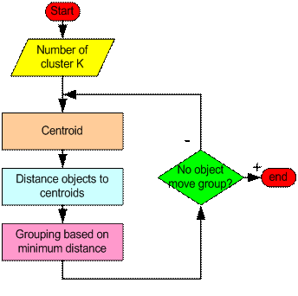
How does k-means work ?

Slide 3
Reason for choosing SOM over k-means as Clustering Algorithm
SOM is superior in dealing with processes which have multiple optima.
SOM offers the opportunity for an early exploration of the search space, and as the process continues it gradually narrows the search. By the end of the search process (providing the neighborhood radius decreases to zero) the SOM is exactly the same as k-means, which allows for a minimization of the distances between the observations and the cluster centers.

Slide 4
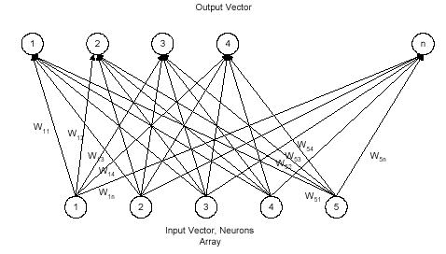
Self Organizing Maps
A Self Organizing Map is a type of Artificial Neural Network (ANN) that is trained using unsupervised learning.
This model was introduced by Finnish Professor Kohonen in the 1980s.
SOM maps a higher dimensional input into a lower dimensional output space and thus used in dimensionality reduction.
The procedure is to place a vector from data space onto the map and find the node with the closest (smallest distance metric) weight vector to the data space vector.

Slide 5
SOM without Neighbourhood Algorithm
Step 1: Initialize the weights of K neurons randomly.
Step 2: Calculate the Discriminant function value for each neuron j to x which is used as the basis for competition.
Using Euclidean Distance
where x input vector of n dimension and w_{ij} is the weight vector connecting the i^{th} component of the input vector to the j^{th} neuron.
The winning neuron is the one which closely matches with the input, i.e. the neuron for which the discriminant function value is minimum.
Step 3: Update the weights of the winning neuron and its neighbours.
where indicates the difference in the weight and is the time dependent learning rate (decreases with time)
Step 4: The above steps are repeated until there is no further change in the topography

Slide 6
SOM without Neighbourhood Flowchart
Start
Calculate neuron K
Initialize weights of K
Calculate value of Discriminant function
No
Stopping Criteria
Update winning neuron
Yes
Stop

Slide 7
Numerical Illustration
Suppose there are 6 input patterns .
Let the learning rate be α(t+1) = α(t)/2.
Let the topological radius R =0.
X1 | X2
1 | 1
2 | 1
2 | 2
4 | 4
4 | 5
5 | 5

Slide 8
For the example in the previous slide, the architecture is given below:
Y2
Let the initial weight matrix be
Y1
w11
0.2 | 0.8
0.6 | 0.5
w12
w22
w21
X1
X2
X2

Slide 9
For the vector (1,1) :
D(1) = = 0.8944
D(2) = = 0.6324 Find the j for which the distance D(j) is
minimum.
As D(2) < D (1) J = 2.
Updating the weights using the formula:
W_{iJ} ( new ) = W_{iJ} ( old ) + α(t) . ( x_{i} - W_{iJ} ( old ) )
w12(new) = w12(old) + α(t) .(x1 – w12(old)) = 0.8 + 0.6 * ( 1 – 0.8) = 0.98
w22(new) = w22(old) + α(t) .(x1 – w22(old)) = 0.4+ 0.3 * ( 1 – 0.4) = 0.94
The updated weight matrix is :
Carry out the same procedure for the vectors (2,1), (2,2), (4,4),(4,5),(5,5) upto 100 iterations until the values of the matrix converge.
0.2 | 0.98
0.6 | 0.94

Slide 10
The updated weight matrix after 100 iterations will converge and is given by :
This matrix can be approximated as :
For the vector (1,1) :
Now, again find the j for which D(j) is minimum and the jth neuron will be the winning neuron.
D(1) = = 2.11
D(2) = = 4.56
Hence, as D(1) < D(2) , J=1 and the first vector (1,1) belongs to Cluster 1.
Repeat the same procedure for the remaining vectors (2,1), (2,2), (4,4),(4,5),(5,5)
1.999990921 | 2.9999912212
4.000233399 | 4.0000145999
2 | 3
4 | 4

Slide 11
Hence, the given 6 vectors are grouped into 2 clusters.
X1 | X2 | Cluster
1 | 1 | 1
2 | 1 | 1
2 | 2 | 1
4 | 4 | 2
4 | 5 | 2
5 | 5 | 2

Slide 12
Limitations of SOM without Neighbourhood
As there is no concept of neighbourhood function, all the neurons are updated by the same amount but in actual situations, the winning neuron has to be updated more and the updation factor should decrease as we move away from the winning neuron.
2. If the points are very close to each other all of them will be grouped into the same cluster.

Slide 13
Algorithm for SOM with Neighbourhood
Step 1: Initialize the weights of K neurons randomly.
Total no of iterations = NIT
Randomly Initialize
is the initial learning rate.
Step 2: Calculate the Discriminant function value for each neuron j to x which is used as the basis for competition.
Using Euclidean Distance :
where x input vector of n dimension and w_{ij} is the weight vector connecting the i^{th} component of the input vector to the j^{th} neuron.
The winning neuron is the one which closely matches with the input, i.e. the neuron for which the discriminant function value is minimum.
Step 3: Calculate the neighbourhood function using the following formula and update the weights of the winning neurons and its neighbours. t is the no of iterations and T2 is the time constant. T2 = Total no of iterations = N

Slide 14
where T1 is also time constant given by
T1=N/log(sigma0)
The neighbourhood function is given by :
Step 4 : Update the winning neuron and its neighbours :
where indicates the difference in the weight and is the time dependent learning rate (decreases with time)
Step 5: The above steps are repeated until there is no further change in the topography

Slide 15
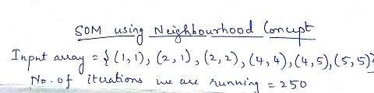
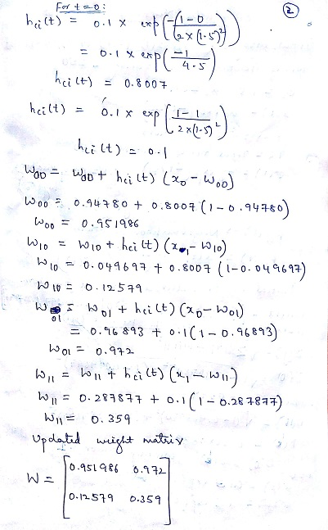
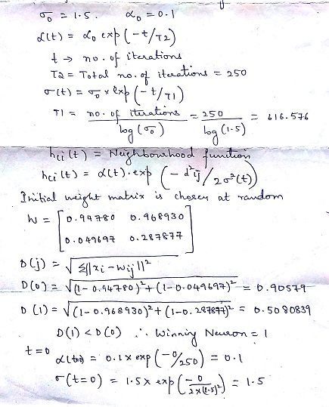
Example : {(1,1),(2,1),(2,2),(4,4),(4,5),(5,5)} into 2 clusters.

Slide 16
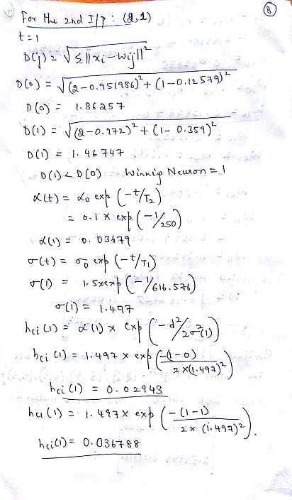
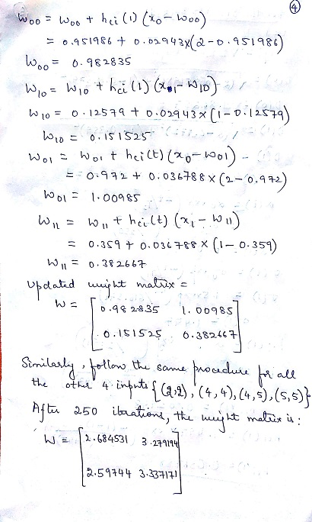

Slide 17
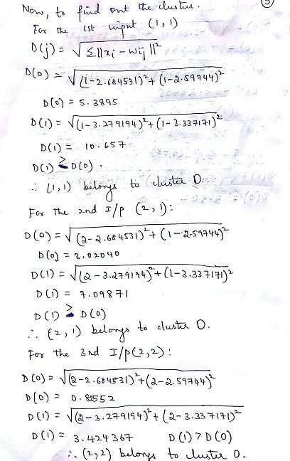
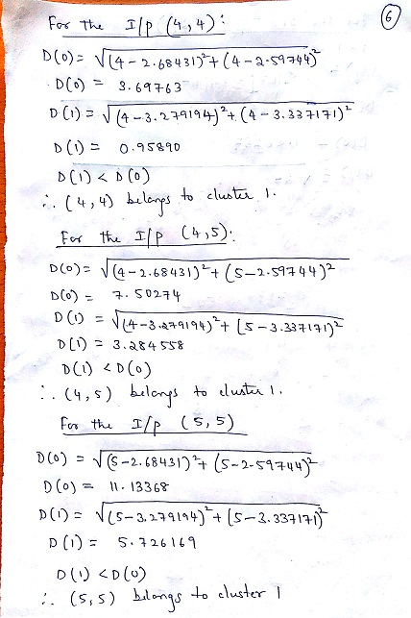

Slide 18
After clustering the inputs :
X1 | X2 | Cluster
1 | 1 | 0
2 | 1 | 0
2 | 2 | 0
4 | 4 | 1
4 | 5 | 1
5 | 5 | 1

Slide 19
Strengths
Simple and easy to implement.
Easy to interpret the clustering results.
Computationally fast and efficient.

Slide 20
Weaknesses
Number of cluster need to be specified beforehand
Sensitive to data points with outliers and noise
Doesn't group efficiently for data distribution with non-circular shape

Slide 21
References
https://en.wikipedia.org/wiki/Self-organizing_map
https://www.youtube.com/watch?v=LjJeT7rwvF4
https://www.youtube.com/watch?v=abF_FdCb5OI
The self-organizing map – T Kohonen :
http://ieeexplore.ieee.org/document/58325/

