Slide 1
Unsupervised Extreme Learning Machines ( US-ELM )

Slide 2
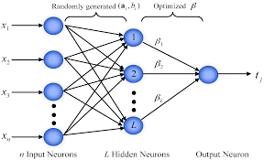
Extreme Learning Machines
Extreme learning machines are feedforward neural network used for classification , regression, clustering and feature extraction.
ELM was first introduced by Huang in 2010 which was for the supervised task.
ELM was extended to perform unsupervised task in 2014 by Gao Huang.
ELM consists of only one hidden layer where the weights between the input layer and the hidden layer are randomly generated and the weights between the hidden layer and the output layer initially are randomly generated but are trained.
ELM only updates the weights between the hidden layer and the output layer !!!

Slide 3
Why is ELM required ?
ELM outperforms SVM in classification and regression problems.
ELM is able to produce good generalization performance and learn thousands of times faster than networks trained using backpropagation.
ELM finds the global minima faster than all the known gradient based algorithms for feature extraction thereby minimizing the error at a faster rate.

Slide 4
Supervised ELMs
Consider a supervised learning problem where we have a training set with N samples : {X,Y} , where X is the input and Y is the corresponding label.
ELM training involves 2 stages :
Stage 1 :
Construct the hidden layer using a fixed number of randomly generated mapping neurons, which can be any nonlinear piecewise continuous functions, such as the Sigmoid function.
Let H be the hidden layer activations where
Let be the weights between the hidden layer and the output layer where
The outputs of the network is given by
where X is the input.
Notes:
β

Slide 5



Stage 2 :
In the second stage, ELMs aim to solve the output weights by minimizing the sum of the squared losses of the prediction errors, which leads to the following formulation:
where the first term in the objective function is a regularization term against over-fitting, e is the error vector and C is a penalty coefficient
on the training errors.
By substituting the constraints into the objective function, we obtain the following equivalent unconstrained optimization problem:
By differentiating the above equation, w.r.t to , we get

Slide 6

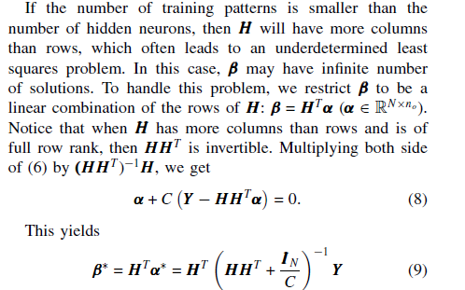
If H has more rows than columns and is of full column rank, which is usually the case where the number of training patterns is larger than the number of the hidden neurons, the above equation is overdetermined ( i.e. more equations than unknowns or an inconsistent system ) :
In short, where is the pseudo-inverse of the matrix H.

Slide 7

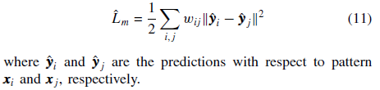
Manifold Regularization Framework
Semi-supervised learning is built on the following two assumptions:
both the labeled data Xl and the unlabeled data Xu are drawn from the same marginal distribution PX
(2) if two points x1 and x2 are close to each other, then the conditional probabilities P(y|x1) and P(y|x2) should be similar as well.
The cost function is given by :
Where is the pairwise similarity between the points xi and xj.
The conditional probability is difficult to compute. Hence, we approximate the above equation to :

Slide 8


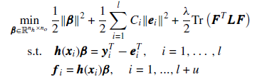
The above equation can be written in matrix form as :
Where Tr(.) denotes the trace of a matrix.
is known as the graph Laplacian.
D is the diagonal matrix having its diagonal elements as
The objective function of semi-supervised ELM by modifying the objective function of supervised ELM is given by :
Where is the hidden to output weights.
is the tradeoff parameter
F is the output matrix of the network
e is the error

Slide 9
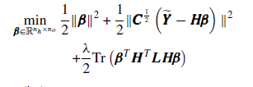




We substitute the constraints into the objective function, and rewrite the above formulation in a matrix form
Where is the augmented training target with first rows is equal to and rest of the rows is 0.
Again, we compute the gradient of the objective function with respect to , we get :
Then, we compute the output weights , which is given by :
The alternative solution to the above equation is given by :

Slide 10
References
https://en.wikipedia.org/wiki/Self-organizing_map
https://www.youtube.com/watch?v=LjJeT7rwvF4
https://www.youtube.com/watch?v=abF_FdCb5OI
The self-organizing map – T Kohonen :
http://ieeexplore.ieee.org/document/58325/

