Slide 1

Potoo Brand Health
Team 5
Gowtham Ramachandran, Harshitha Pulichintha, Sai Sumanth Tadikonda
Swathi Sukumar, Yogesh Thupda

Slide 2

Table of Contents
Business Problem
Approach
Methodology
Data Modeling
Results & Insights
Recommendations
Appendix

Slide 3
Business Problem
Business Case:
Since 50% of sales come from third party sellers, improving the brand’s integrity by regulating third party sellers can help improve business outcomes. Identifying factors that negatively impact brand’s reputation is critical as it impacts business outcomes. By leveraging data points like base price, MAP, sales etc and through statistical modeling, we can provide meaningful insights on sellers and other factors that affect business.
Our objectives were:
To track the brand’s health by flagging sellers that constantly fluctuate the MSRP of products.
To build a predictive model that will flag offers that are potentially harming a brand’s value.
To identify sellers that engage in mostly unhealthy offers.

Slide 4
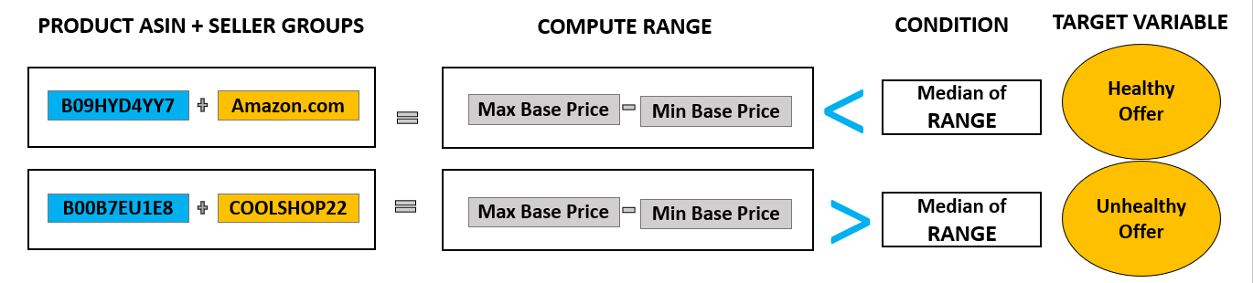
Approach – Flagging the unhealthy offers
Approach

Slide 5
Methodology Slide - Predicting Unhealthy Offers
Data-Preprocessing
Drop columns
Impute missing values
Drop rows
Convert categorical variables into numerical variables.
Build Model
Logistic regression and Random Forest models were built to understand relationship with Target.
Precision was metric to choose model for future modeling.
Step 2
Step 4
Step 1
Step 3
Create Target Variable
Compute the range
Compare it with median of range
Model Analysis
Each of the variables brand, seller etc were compared with offer health.
Notes:
like Product Upc','Product SKU','Marketplace Links','ASP','Product URL.
for columns like MAP,Offer Strength,Country
with negative base price and shipping values.
for variables like Fulfilment by, Offer Strength

Slide 6

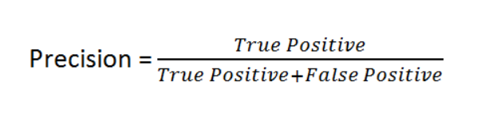
Data Modeling – Preprocessing And Assumptions
Dropped records with negative shipping and base price rows.
MAP not considered for modeling.
Discount was imputed from MAP and hence unreliable.
The metric used to choose model is Precision.
Higher Precision implies lower number of False positives.
False positive is when a Healthy offer is classified as an Unhealthy offers.
ACTUAL | PREDICTED
Healthy Offer | Unhealthy Offer

Slide 7
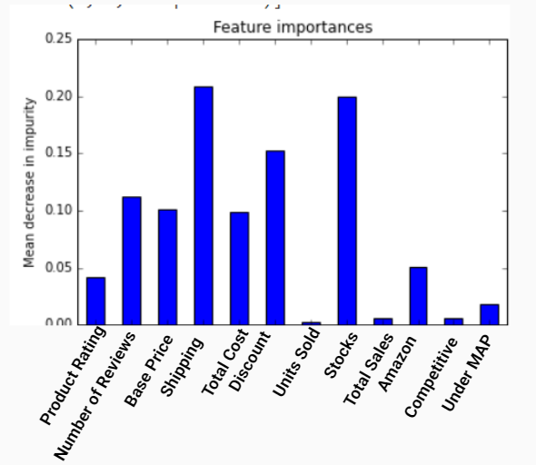
Data Modeling - Variables Likely to Predict the Target Variable
Summary Statistics from Logistic Regression Model
Feature Importance from Random Forest Model
Variable | Co-efficient | P-Value
Amazon (Fulfilment by) | 0.7831 | 0.000
Competitive (Offer Strength) | 0.4092 | 0.000
Discount | 0.1841 | 0.000
Product Rating | -0.0271 | 0.000
Units Sold | 0.0078 | 0.000
Stocks | -0.0011 | 0.000

Slide 8
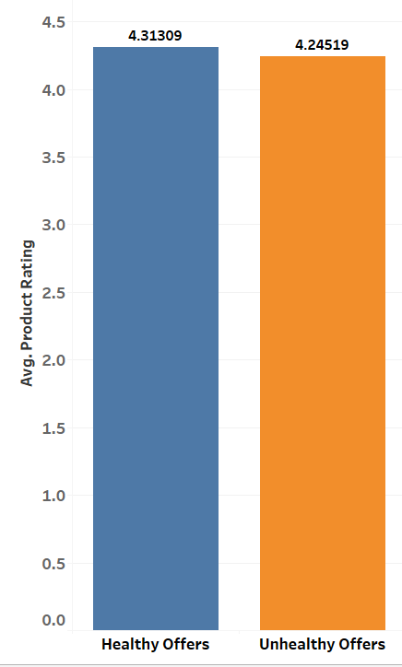
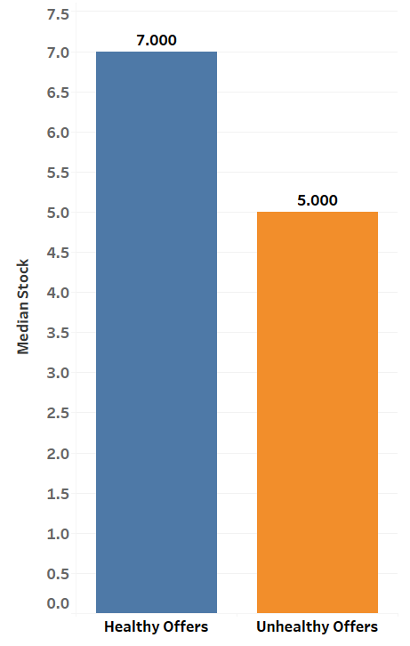
Data Modeling - Summary
Unhealthy offers seem to have a lower average of Product Rating and lower median of Stock values
Objective: To build a model that will help us understand the predictors of the Offer health.
Data Models built: We chose Logistic
Random Forest - 99% precision (Over Fitting)
Logistic Regression - 68% precision
Fulfillment By, Offer Strength, Discount, Product Rating, Unit Sold and Stocks were the most important features.

Slide 9
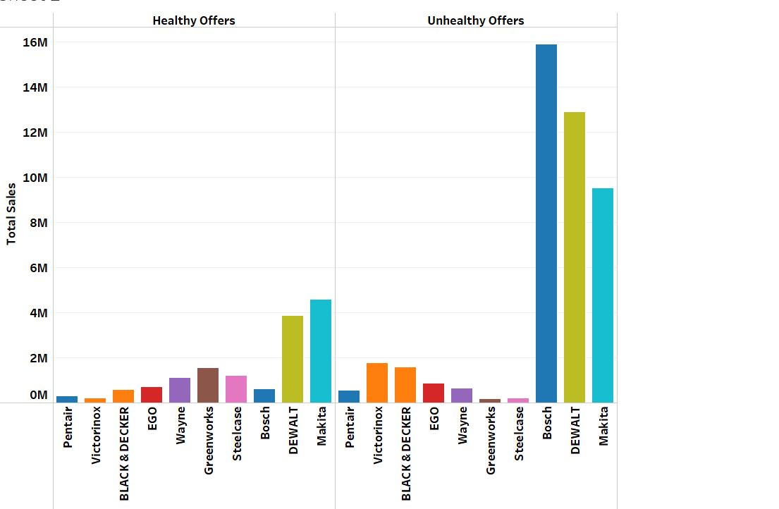
Top 10 Brands’ Performance Across Offer Health
Top 10 Brand’s Performance Across Offer Health
Bosch made highest sales through Unhealthy offers compared to DEWALT & Makita.
Bosch as a brand has 95% higher unhealthy sales than healthy sales.
Sellers associated to Bosch are consistently fluctuating the base price that can impact the brand health eventually.

Slide 10
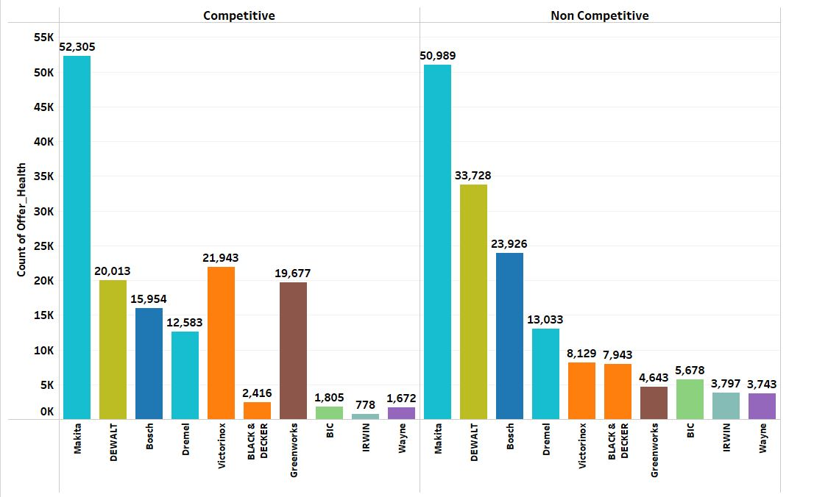
Top 10 Brands’ Performance Across Offer Strength
Top 10 Brands’ Performance Across Offer Strength
Noncompetitive sellers could be aggressively quoting low rated offers to stay in competition.
Our model will help us identify sellers that mostly associated to such deals.

Slide 11
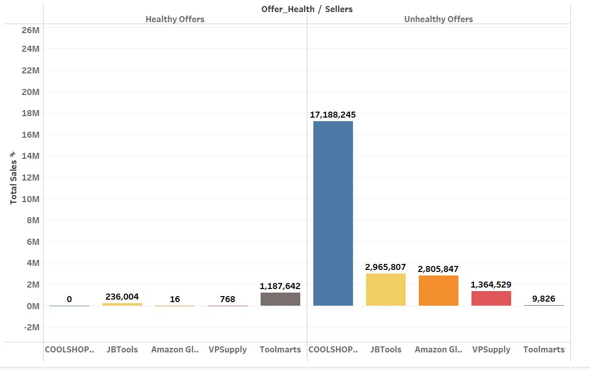
Top 5 Sellers’ Engagement in Unhealthy Offers Across All Brands
Top 5 Sellers’ engagement in Unhealthy Offers Across All Brands
The top 5 sellers that account for most of unhealthy offers are:
COOLSHOP22
JBTools
Amazon Global.
Amazon Global - Not surprising!
COOLSHOP22 has 0 healthy offers.
This seller has more varying base price compared to median variation.

Slide 12
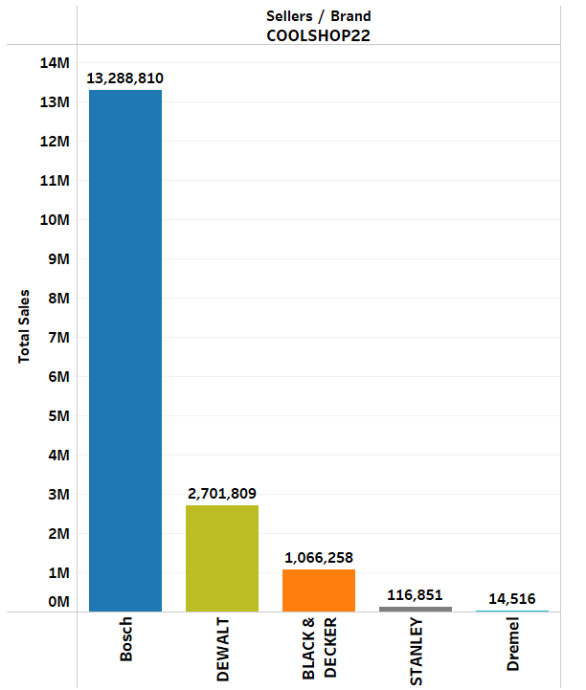
Top 5 Brands Sold By COOLSHOP22
Top 5 Brands Sold By COOLSHOP 22
COOLSHOP22 was identified as one of the seller with most number of Unhealthy offers.
Bosch and Dewalt account for most of this seller’s sales.
Bosch and Dewalt also account for more non-competitive sales.
Regulating COOLSHOP22 could imply stabilising a base price that does not vary greatly over time frequently.

Slide 13
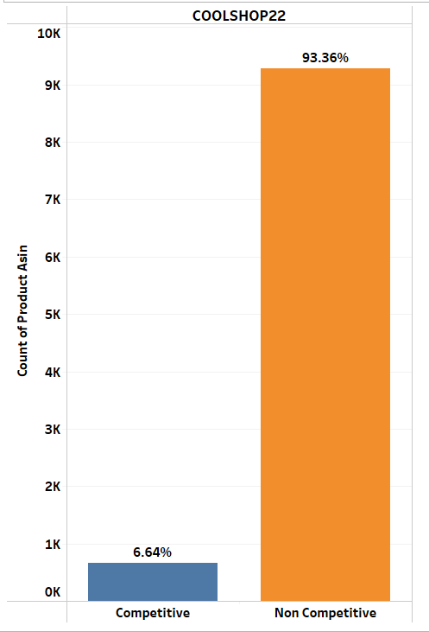
COOLSHOP22’s Behaviour Across Offer Strength
COOLSHOP22’s Behaviour Across Offer Strength
Offer strength was also a predictor of offer health.
94% approximately of total products sold by COOLSHOP 22 come from a non-competitive offer strength.
Most offers for COOLSHOP22 does not qualify for the Buy Box .
Regulating these kind of sellers can make more sellers to become eligible for Buy Box deals and establish a better quality of Sales.

Slide 14
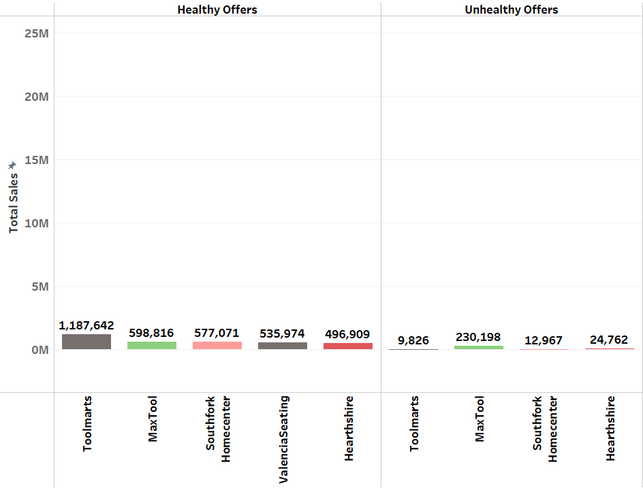
Top 5 Good Sellers
Top 5 Good Sellers that engage in more number of Healthy Sales
These 5 sellers across all brands having higher proportion of sales through Healthy offers.
Toolmarts made nearly 99% of total sales from Healthy offers.
These sellers engage in more number of competitive sales, do not vary their base price as often as the poor sellers.

Slide 15
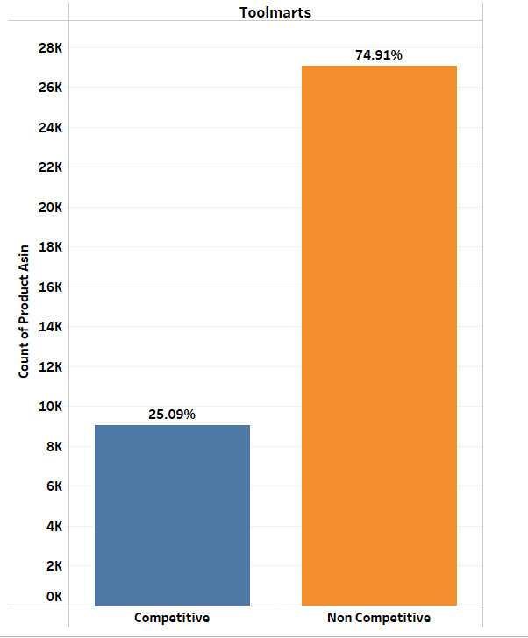
TOOLMARTS’s Behaviour with Offer Strength
While competitive deals are lesser than non-competitive deals, the % variation is better.
75% approximately of total products sold by TOOLMARTS come from a non-competitive offer strength.
25% is still eligible for the Buy Box .
Promoting these sellers and regulating the ones who have more non-competitive deals can help with creating a better quality and ecosystem for sales.
TOOLMARTS’s Behaviour with Offer Strength

Slide 16
Recommendations
Since the model identifies offer strength as potential predictors of offer health, it is important to focus on sellers that are often engaging in non-competitive deals.
Regulate the non competitive sellers as this may help protect the brand health because they have been observed selling at very poor offers.
Brand like Bosch should be cautioned which has 95 percent unhealthy sales and this may result in brand killing.
Request to brands should be made to evaluate their seller policies to ensure that products are sold by sellers at respectable margins and value is provided to the service.

Slide 17
Thank You

Slide 18
Appendix

Slide 19
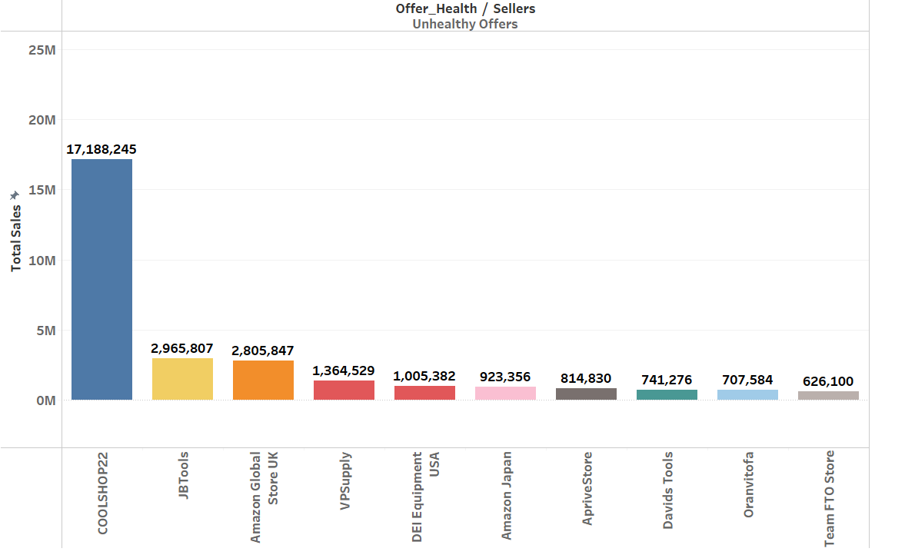
Top 10 Sellers with More Sales From Poor Offers

Slide 20
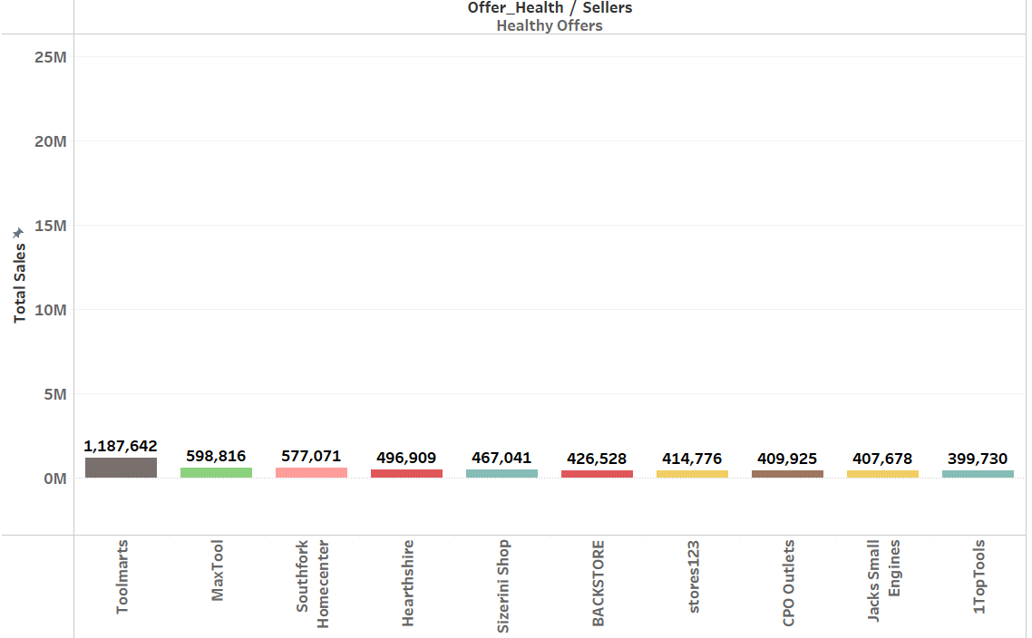
Top 10 Sellers with More Sales From Good Offers

