Slide 1
Student Data Analysis Using Map reduce framework
-M.SUMAnth Reddy
1602-16-73-050

Slide 2
To perform analysis which consists of previous placement dataset and student results data set and predict the placement chances.

Slide 3
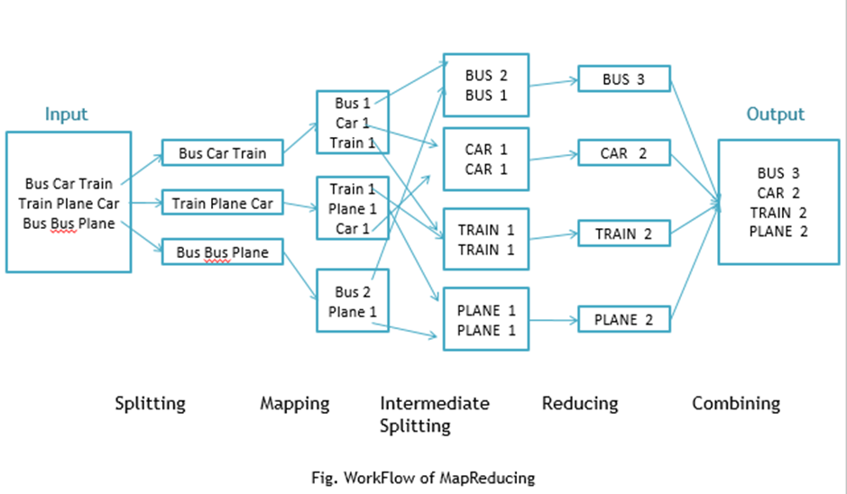
Key value pair

Slide 4
Problem Solving
Step 1: Student marks data gathering from college
Step 2: Data preprocessing task is carried out.
Step 3: In MapReduce concept, Mapper partitions the student data with key values, after that Reducer aggregates the result using MTSD algorithm. Consequently, the performance of MapReduce strongly depends on how evenly it distributes the student data.
Step 4: Classification is done using decision tree and rule induction.
Step 5: Finally we get a analysis that results in relating placement package with marks data

Slide 5
A dataset containing subjects score and package of the student
Hadoop mapreduce framework for dividing data
Decision trees for performing analysis
language-JAVA

