Slide 1
GitHub repository
https://github.com/sumanth24010/VOIS_AICTE_Oct2025_BoyallaSumanthReddy

Slide 2

AIRBNB HOTEL BOOKING ANALYSIS
Boyalla Sumanth Reddy
INTERNSHIP_17546440516895be537820f

Slide 3

PROBLEM STATEMENT
Airbnb is a popular platform where property owners rent out their homes or apartments to travelers. One of the bigger challenges for hosts is deciding the right price for their listings, since prices vary depending on several factors such the number of bedrooms, number of bathrooms, cleanliness, accuracy of descriptions, a communication quality with guests

Slide 4
Project Description This project is dedicated to developing a machine learning model for predicting optimal pricing for Airbnb listings. Setting an effective price point is a critical challenge for hosts, who must balance competitive rates to attract travelers with the goal of maximizing revenue. The core of this project is a regression model trained on historical Airbnb data, which identifies the relationships between various property features (e.g., number of bedrooms, bathrooms, guest ratings) and the rental price. The resulting tool can be used to forecast prices for new listings, empowering property owners with data-driven insights for their pricing strategies.

Slide 5

WHO ARE THE END USERS?
Airbnb Hosts
To optimize pricing of their listings based on property feat and guest reviews.
Travelers
To evaluate whether a listing is overpriced or reasonably priced
Airbnb Platform Analysts
To improve automated pricing suggestions and increase platform trust.
Researchers/Students
To study the impact of property features reviews on rental pricing

Slide 6

Technology Used
Python-Core programming language
Pandas & NumPy-Data cleaning and preprocessing
Scikit-learn-Machine learning (model training, regression, evaluation)
Matplotlib/Seaborn-Data visualization and Mature importance
Google Colab-Cloud-based environment for running the project
File handling libraries -openpyoxd (for Excel) and built-in CSV handling

Slide 7
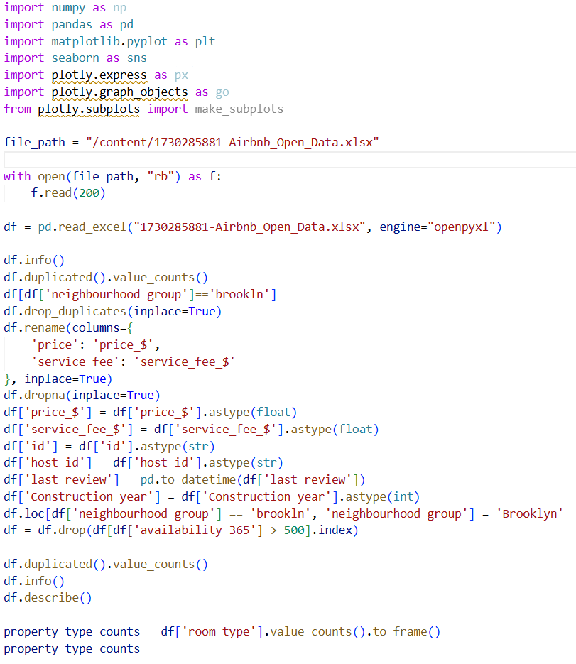
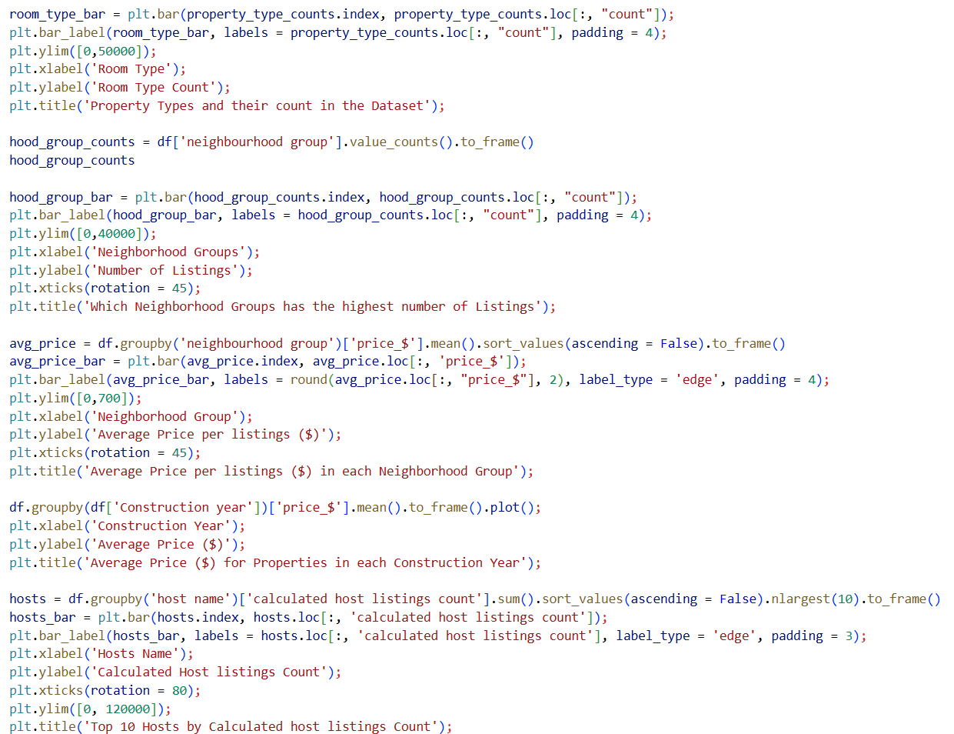
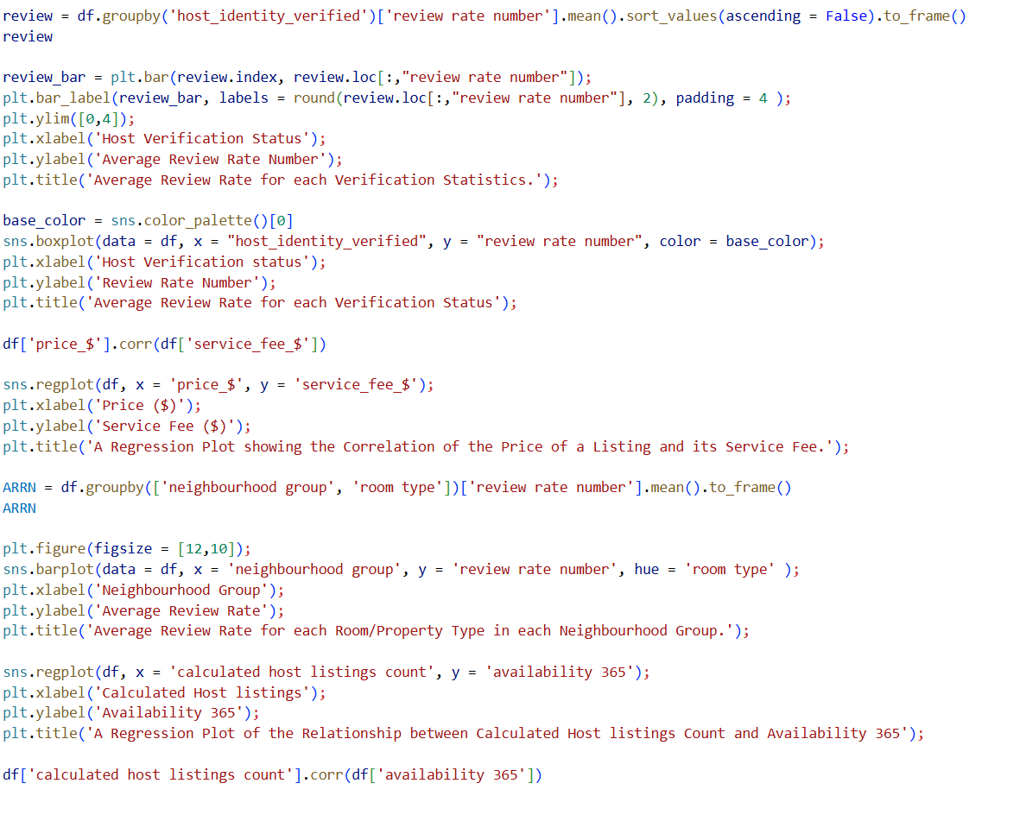

Slide 8
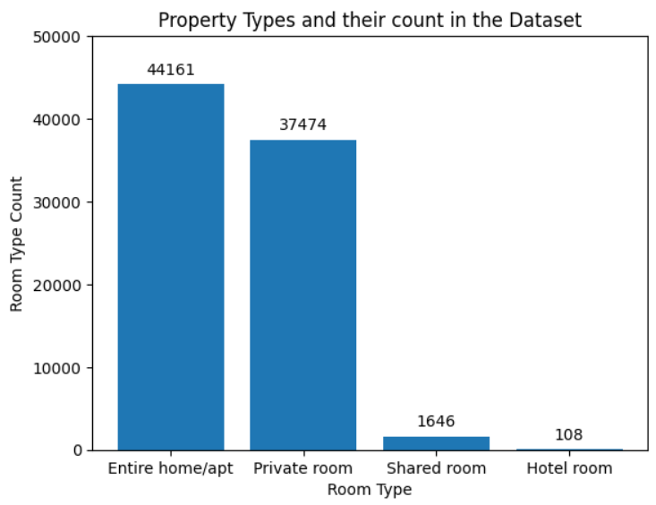
RESULTS

Slide 9
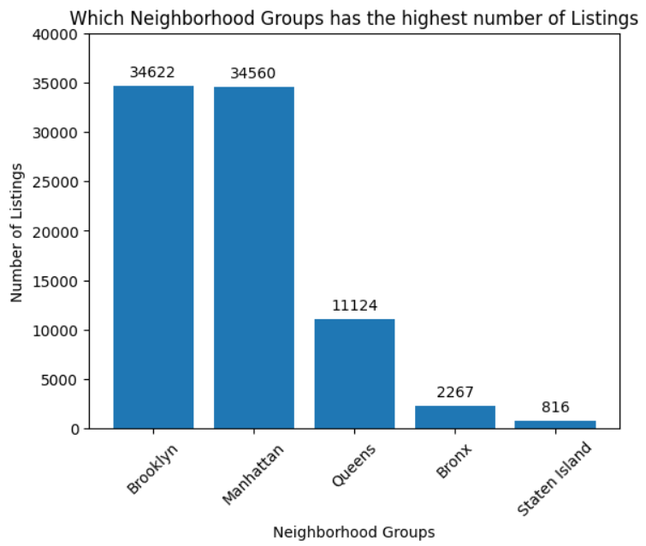
RESULTS

Slide 10
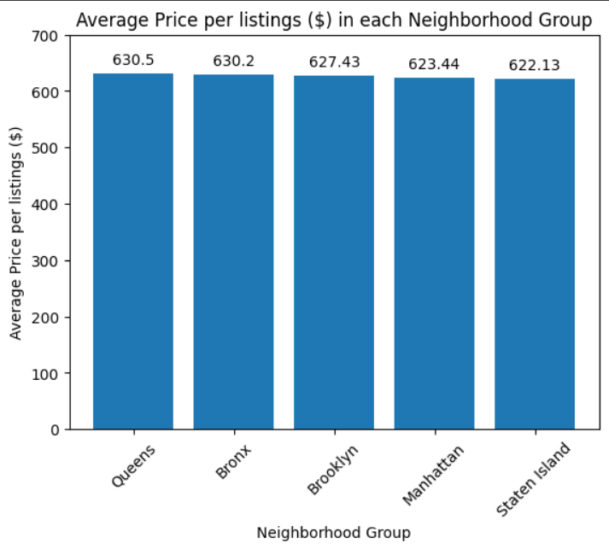
RESULTS

Slide 11
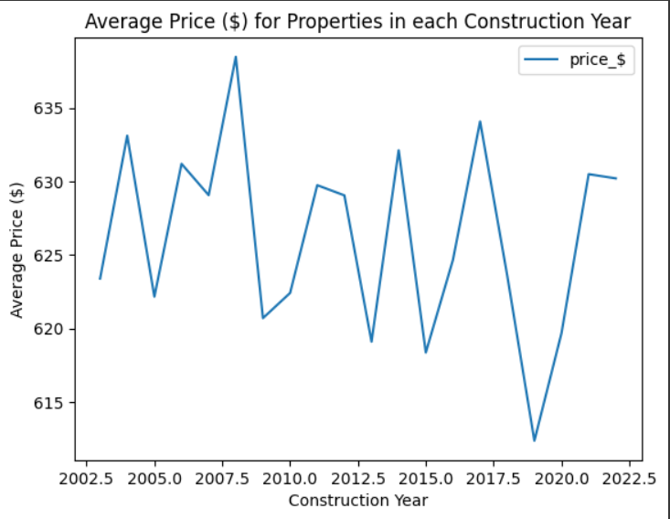
RESULTS

Slide 12
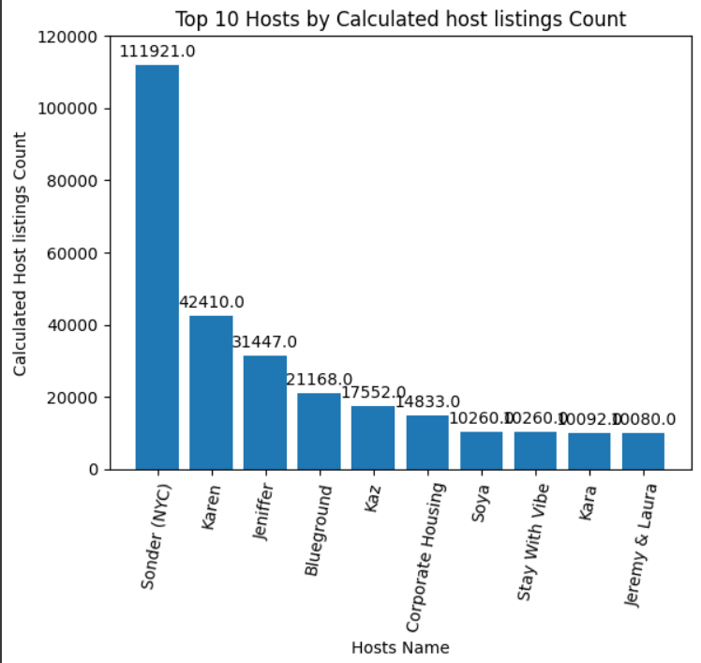
RESULTS

Slide 13
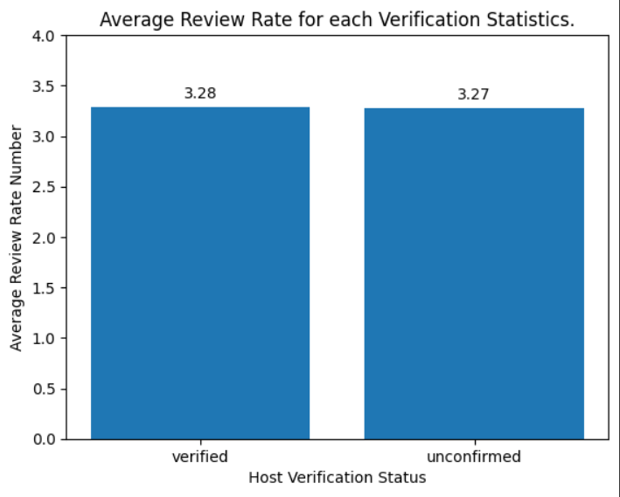
RESULTS

Slide 14
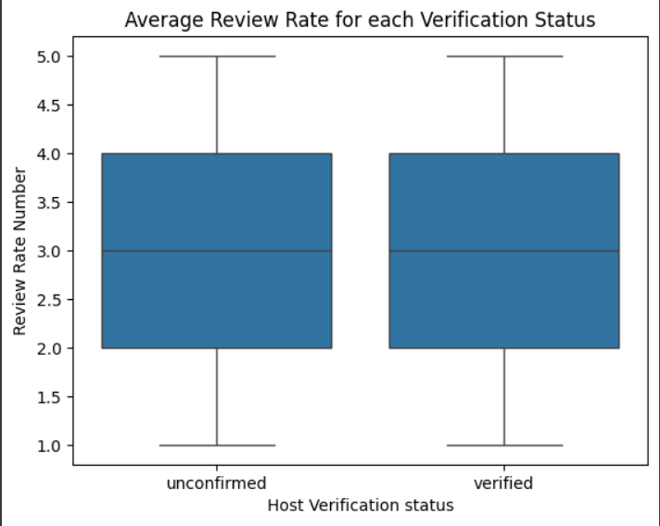
RESULTS

Slide 15
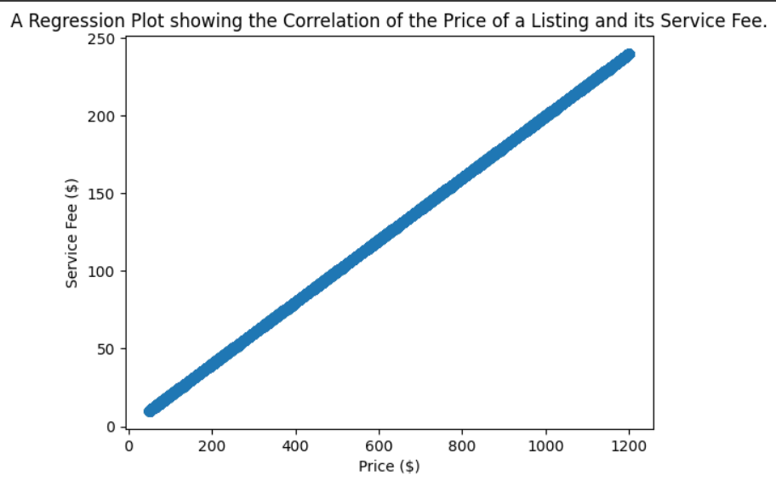
RESULTS

Slide 16
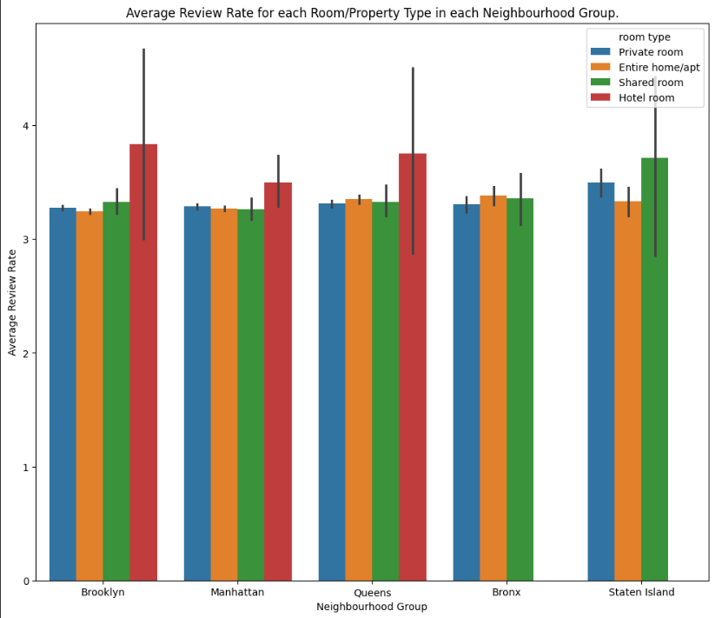
RESULTS

Slide 17
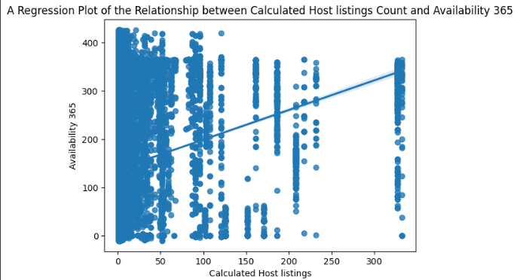
RESULTS

Slide 18
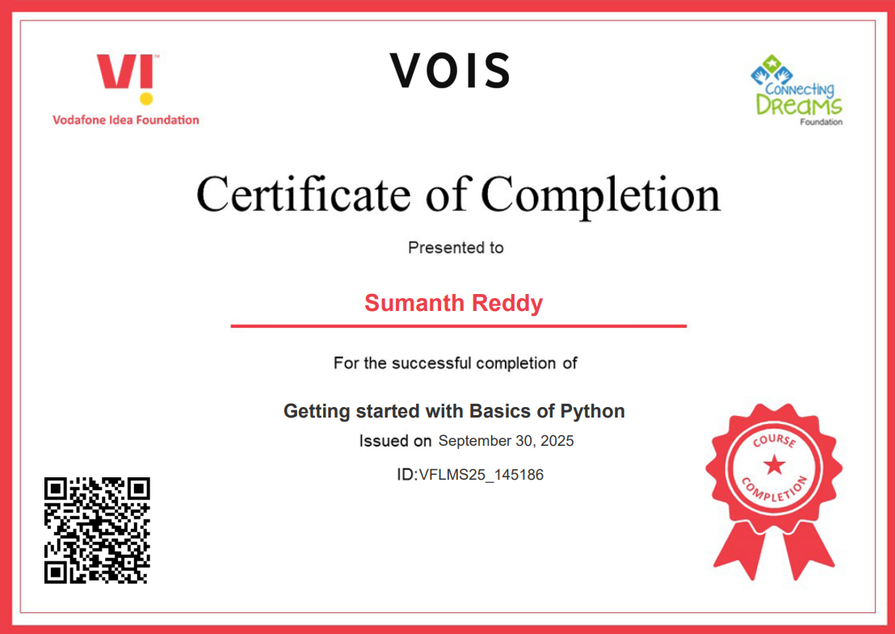
Certificate-1

Slide 19
Certificate-2

Slide 20
Thank you
.
.

