Slide 1
Model to read XML and create database/ tables for Information
By:
Salu Kumari
Y00844961

Slide 2
Introduction
The project involves combining data and implementing it for quick and easy access. By reading multiple XML files, the project is able to present the information in a user-friendly, tabular format. The extraction, transformation, and loading process is completed in a minimal amount of time, allowing for fast generation of information. This project is designed to provide users with easy access to information via the web, with data ready to read on a single click.
Note: port is localhost

Slide 3
Abstract
The aim of this project is to efficiently parse XML files and directly create tables on a database. The performance of the extraction, transformation, and loading (ETL) process is a key consideration in order to ensure that the project is both efficient and user-friendly. The resulting database will then be used to display information about a specific data, utilizing a session-based approach to provide a personalized and tailored experience for the user. By leveraging the power of XML parsing and database technology, this project seeks to provide a seamless and intuitive platform for accessing and displaying information.

Slide 4
Languages
The below languages are used for the project implementation:
● Python
● Node.js
● Html
● CSS
● XML
● SQL (Query Language)

Slide 5
Dependencies, libraries, Modules
The below dependencies and modules are used for the project implementation:
● Morgan
● Mysql
● MariaDB
● Mustache
● handlebars
● express- handlebars
● nodemon
The below libraries used for the project implementation:
● os
● mysql.connector
● error
● xml.etree.ElementTree

Slide 6
Software/ application used
● VS Code editor
● php/myadmin
● Github
● Docker

Slide 7
Data Set
● Data set is an XML file that contains information about awards distributed in a particular year from National Science Foundation
https://www.nsf.gov/awardsearch/download.jsp

Slide 8
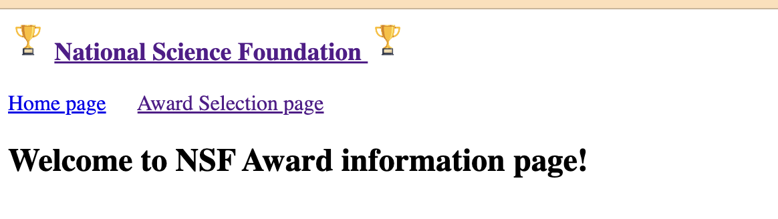
Algorithm
The algorithm used in this project is:
● Check if tables exist in the database based on XML parent and child elements and create them if necessary.
● Check for duplicate columns in the tables.
● Insert data into the tables, while checking for duplicate entries based on the award/data.
● Connect to the database server, which in this case is assumed to be running on localhost.
● Retrieve data from the database and store it in a session.
● Display information about a particular data/award based on the data stored in the session.

Slide 9
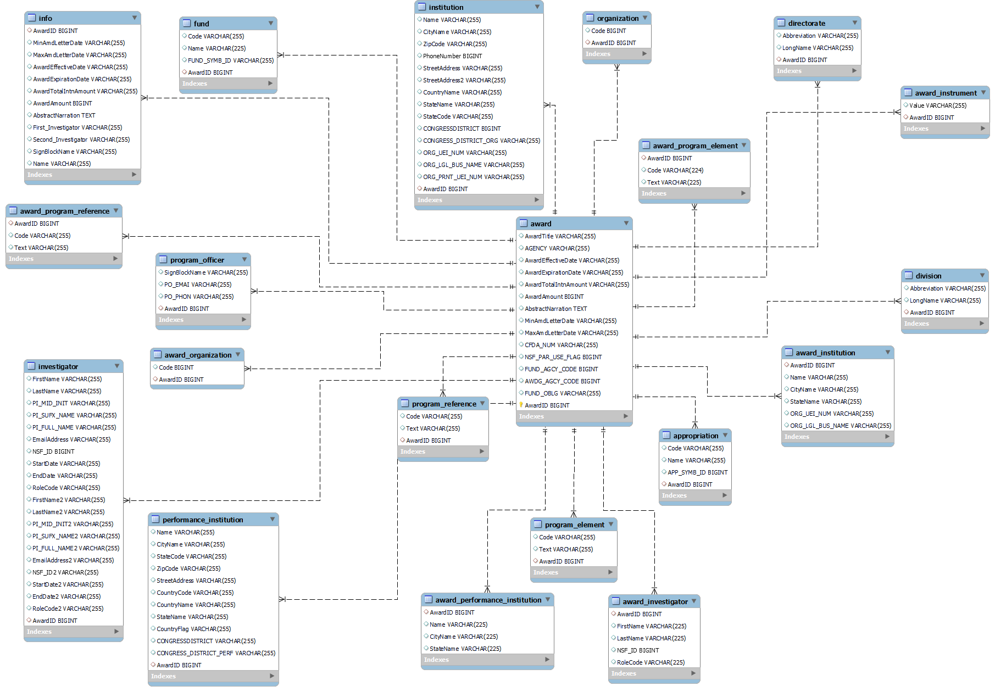
Relation and normalization
ER Diagram

Slide 10
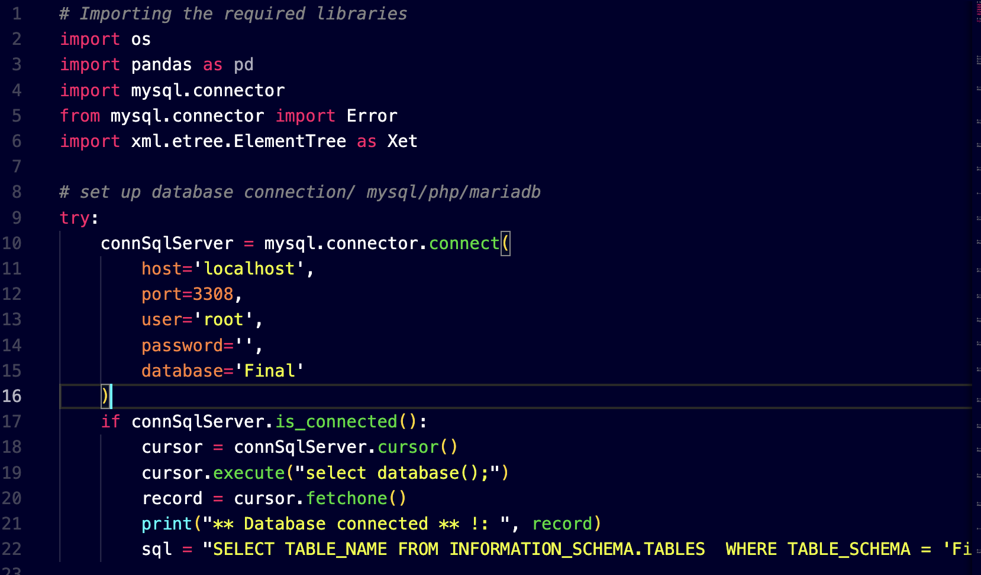
Implementation/
Getting the libraries and establishing database connection

Slide 11
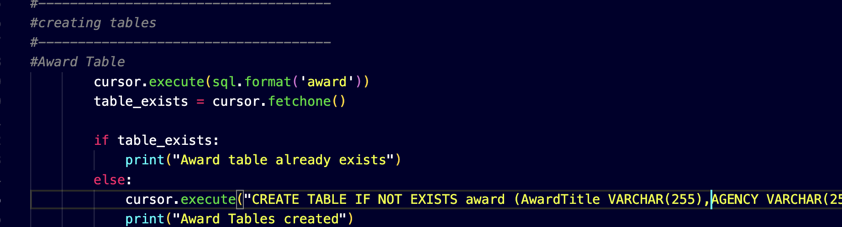
Implementation/
Table creation using sql in python and parse the xml element using etree.ElementTree.parse() :

Slide 12
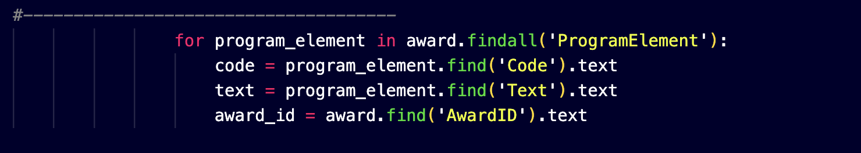
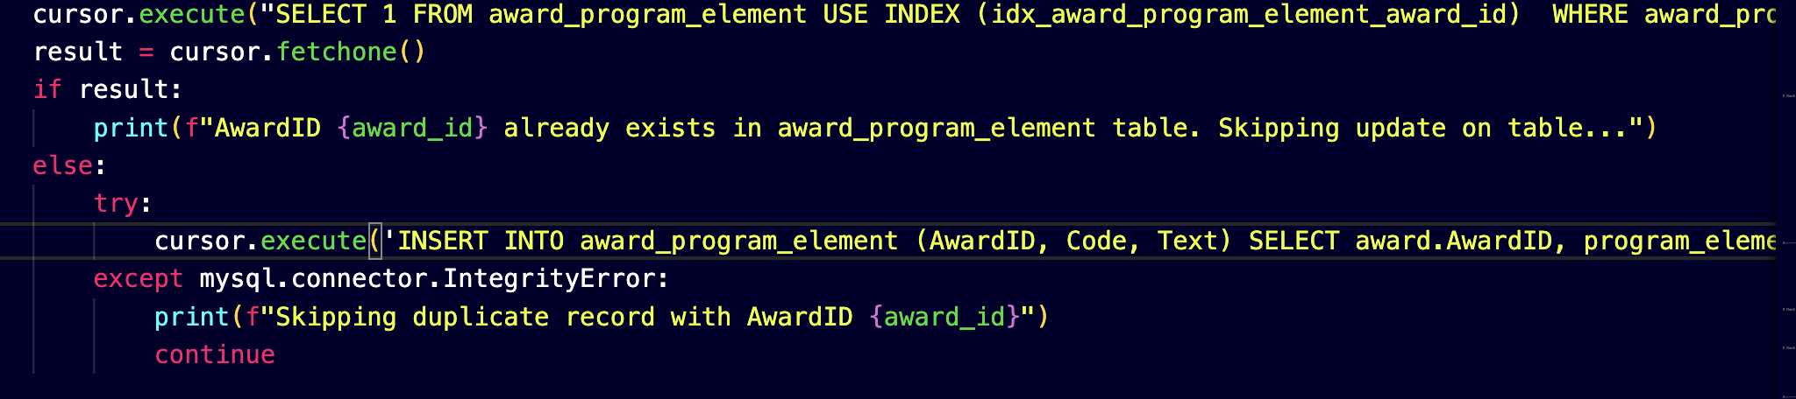
Implementation/
Reading data from XML and joining two tables:

Slide 13
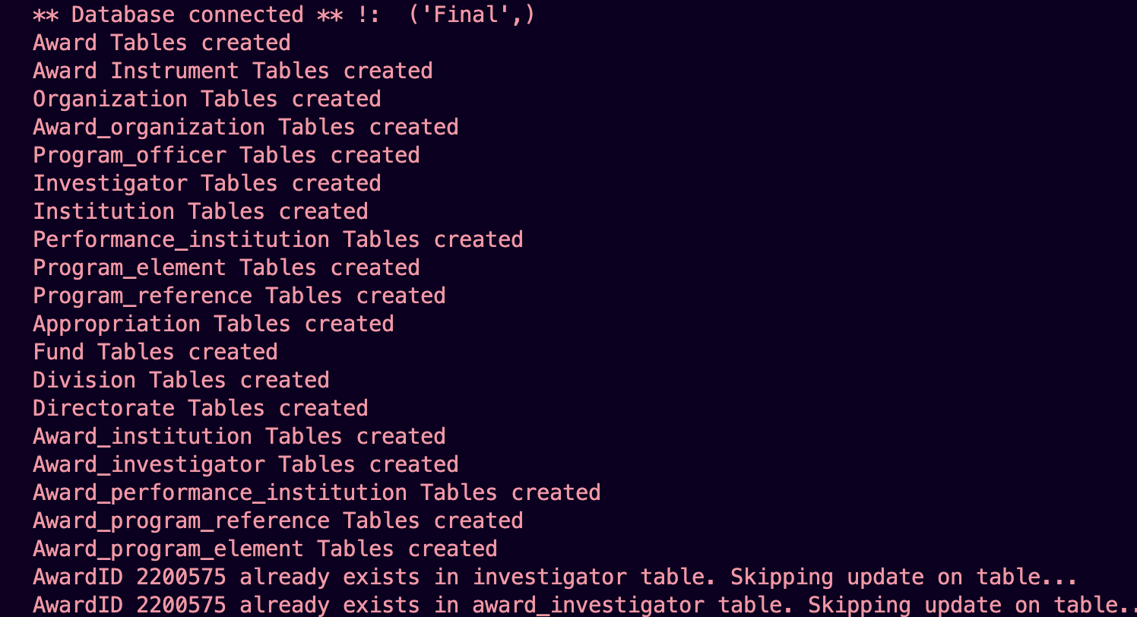
Implementation/
Tables created and also detected if there is duplicate data and prevents that from insertion:

Slide 14
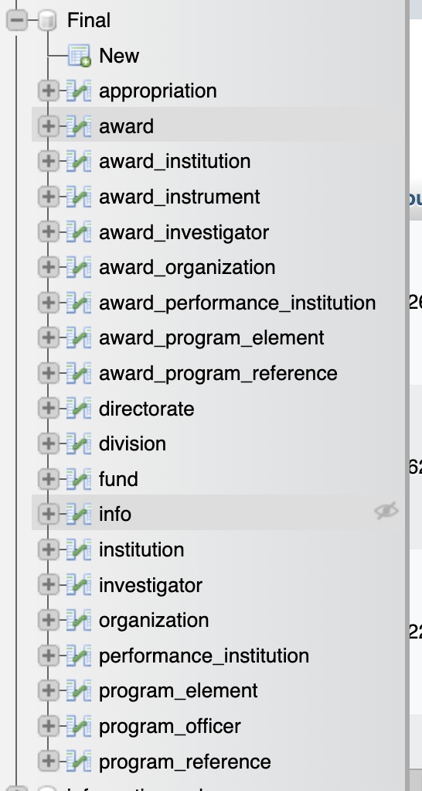
Implementation/
Tables created:

Slide 15
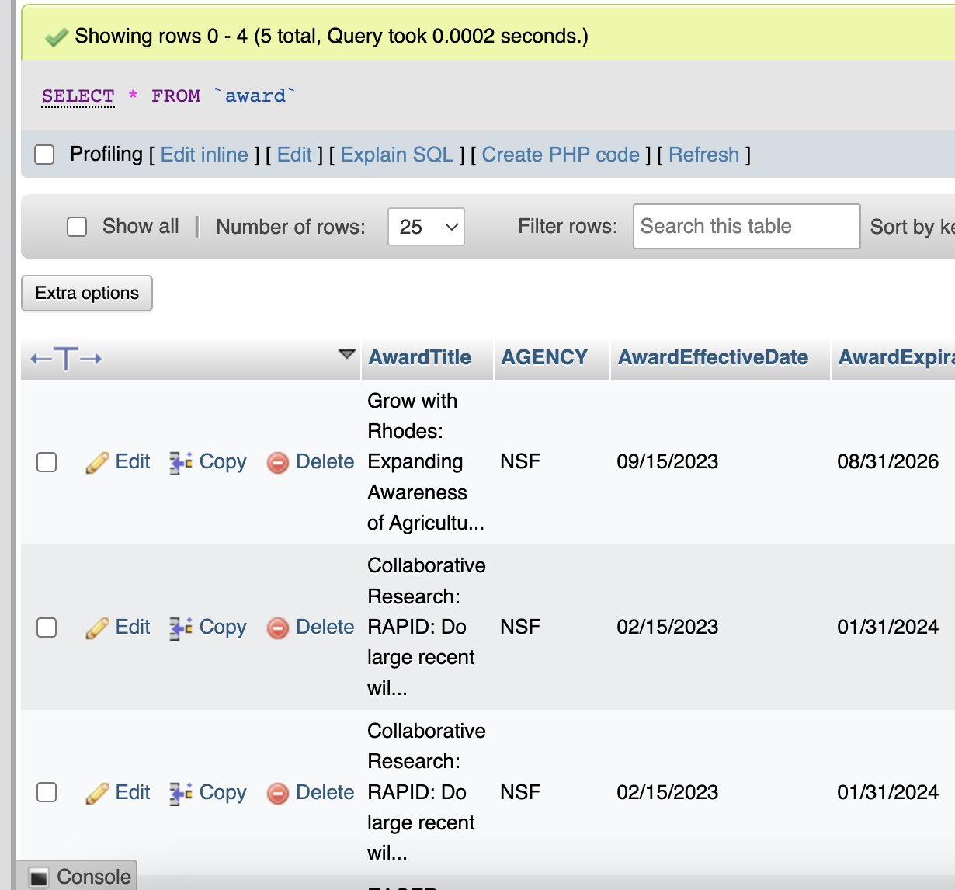
Implementation/
Data inserted:

Slide 16
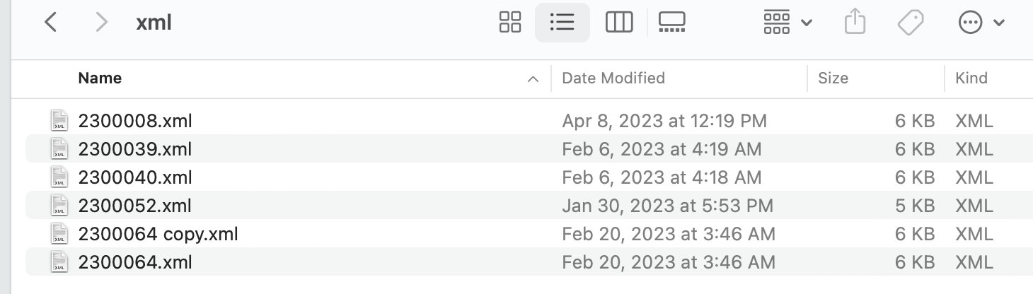
Implementation/
XML Data collection with a duplicate file

Slide 17
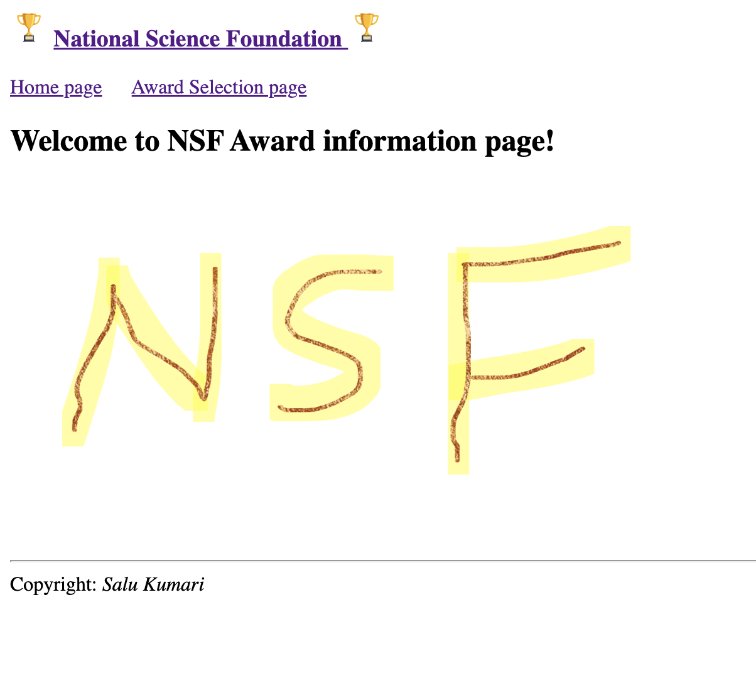
Implementation/
Localhost:3001 or 3002

Slide 18
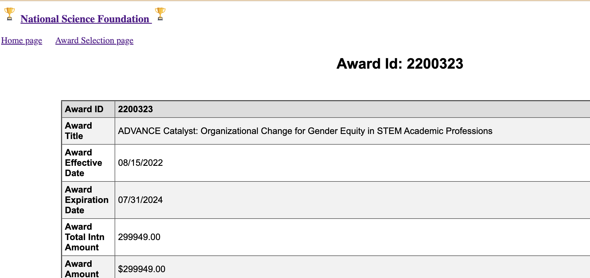
Implementation/
In case if there is award information

Slide 19
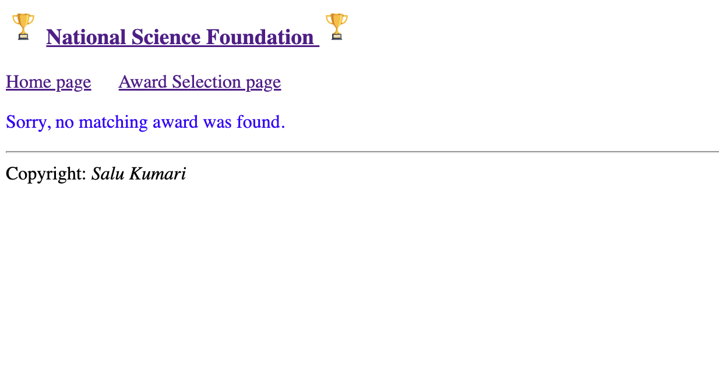
Implementation/
In case if there is no award information

Slide 20
Advantages
● The first part of the project is written in a continuous single page, which makes it easier to track errors as all the code is in one place. This can save time and effort during debugging and maintenance.
● The project is written in a simple and understandable way, which can help with ease of use, maintainability, and future development.
● The project includes functionality to check for redundancy of data and prevent it from duplicity.
This can help ensure data integrity, consistency, and accuracy, which are crucial for decision-making and analysis.
● The information page which is second part of the project will display all the required information about an award, which can provide users with a comprehensive and user-friendly view of the data. This can enhance usability and user satisfaction, as well as support various use cases and scenarios.

Slide 21
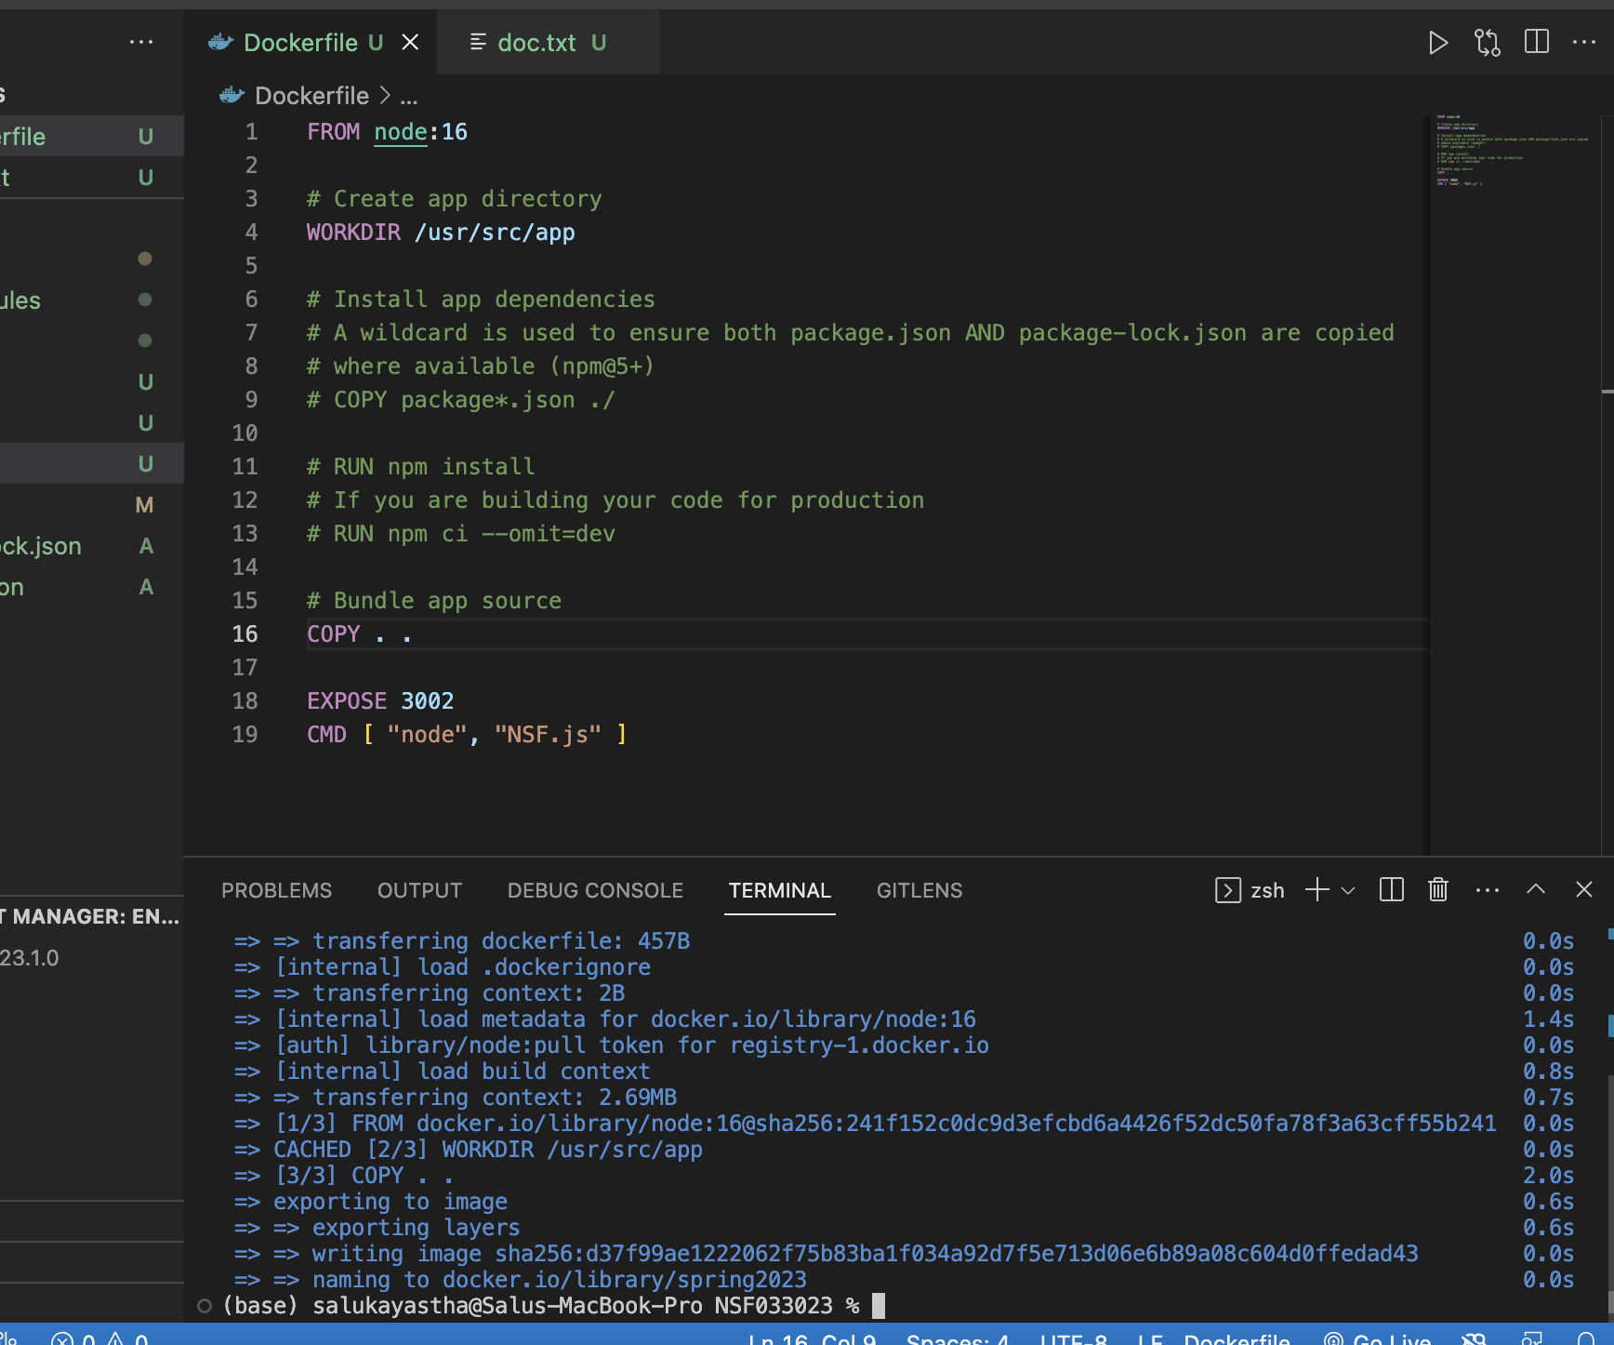
Result
The below are the result of the project
● The project is able to parse multiple XML files efficiently within a short period of time. This can
save time and effort when processing large amounts of data.
● The project is able to connect to a database, which is a crucial functionality for managing and storing data effectively.
● The project ensures that the data is not duplicate and that they are related to each other, which can help ensure data consistency and accuracy.
● The information is displayed in a clear and well-organized way, which can help users easily understand and interpret the data.
● Docker used to save code as an image

Slide 22
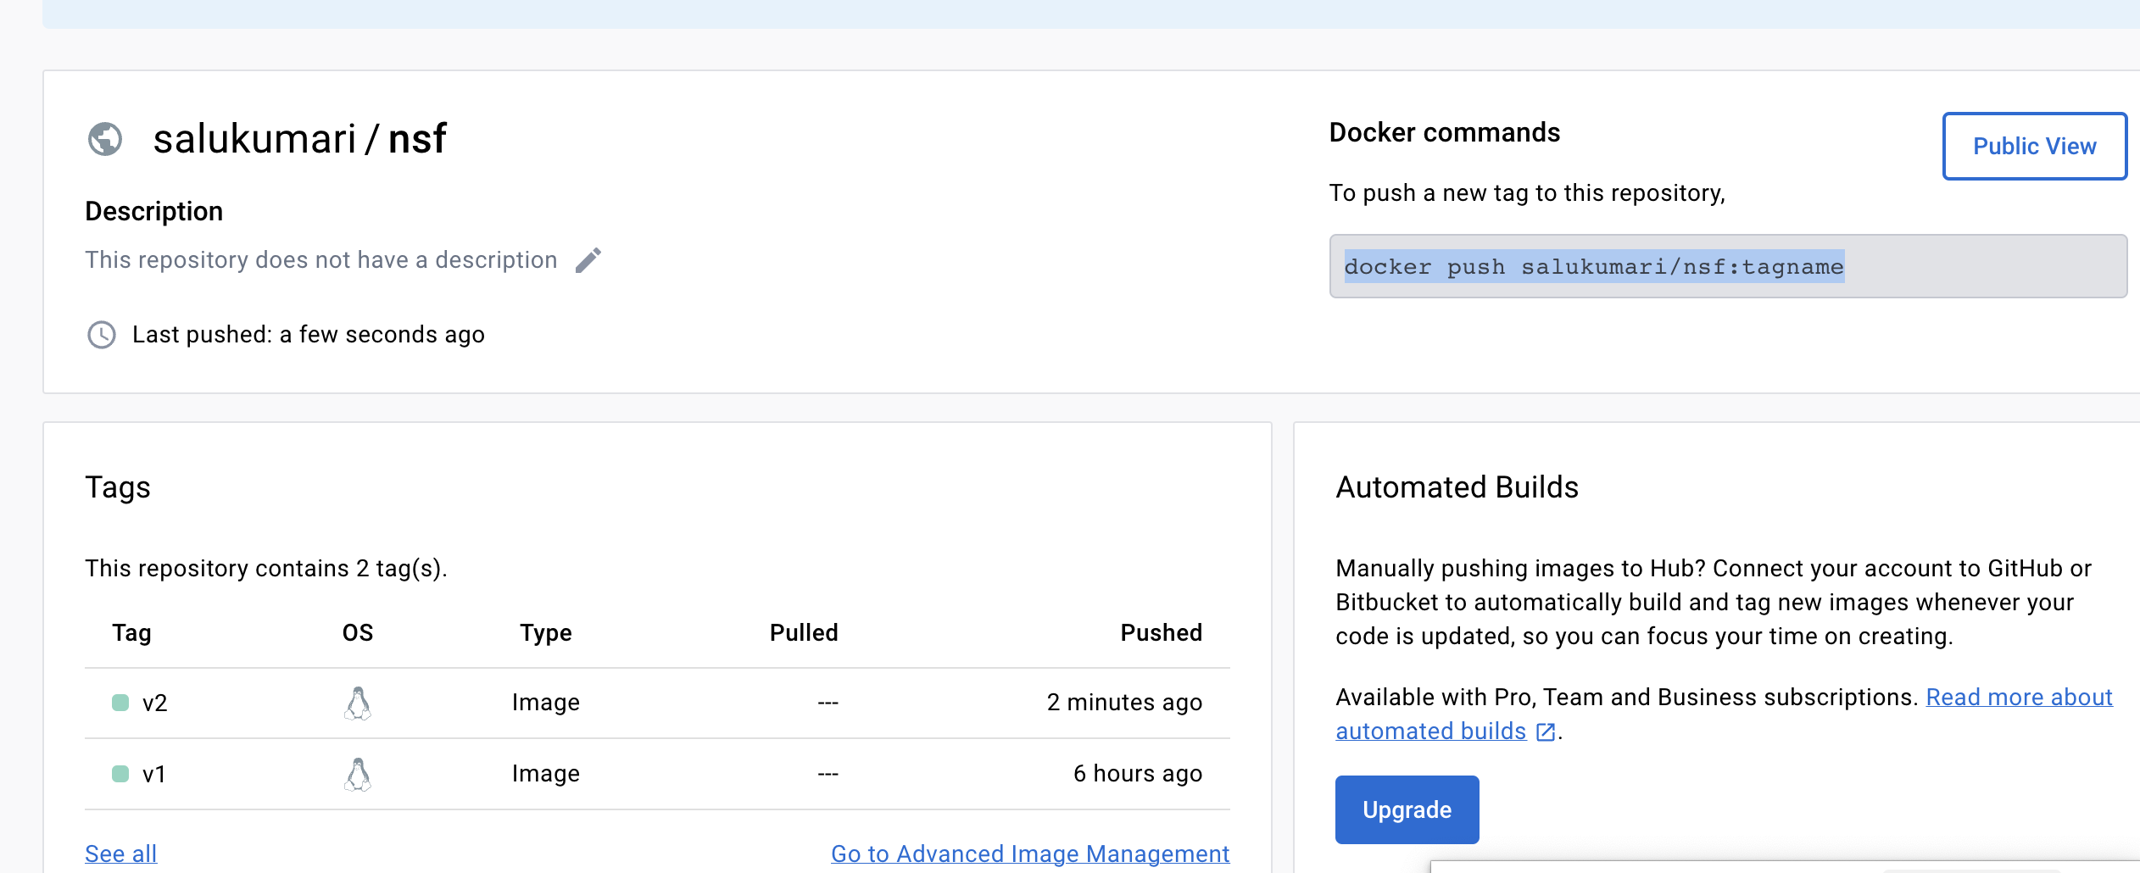
Result Analysis
The result analysis of this project are:
● The element detection of the algorithm (parsing XML element ) is very efficient using python.
● The implementation gives an acceptable result success.
● Result of the project is accurate as per the data, which is coming from the XML

Slide 23
Learning Experiences
The below things were learned during the implementation of the project
● It helped to understand the concept of data interpretation learning.
● It helped to learn different libraries in python, and to develop the concept and algorithm behind work-flow.
● Learning Python and Node.js, which are popular programming languages used for web development and data processing.
● Learning SQL and creating a relational database, which are important skills for managing and analyzing data.
● Understanding the logic behind sessions, which are used to maintain state and store data across multiple requests in web applications.
● Learning about different modules of Node.js, which can help with building scalable and efficient web applications.

Slide 24
Learning Experiences
● Understanding the concept of ETL (Extract, Transform, Load) and data cleaning, which are essential for data integration and preparation.
● Learning about data redundancy reduction and relationship between tables, which are important concepts for database design and optimization.
● Understanding the concept of data interpretation learning, which can help with making sense of data and deriving insights.
● Learning different libraries in Python, which can help with data analysis, visualization, and machine learning.
● Developing the concept and algorithm behind workflow, which can help with organizing and automating data processing tasks
● Learned about Docker and github and its uses for document depository

Slide 25
Problems
The below problems were faced during the project implementation:
● Less application for some operating system like iOS/mac
● Creating environment was difficult
● Cleaning and normalization of data
● Establishing relation between tables was complex
● Syntax issues, database connectivity issues
● Learning new technology with limited resources

Slide 26

https://github.com/salu6066/Spring2023
docker push salukumari/nsf:v2

