Slide 1

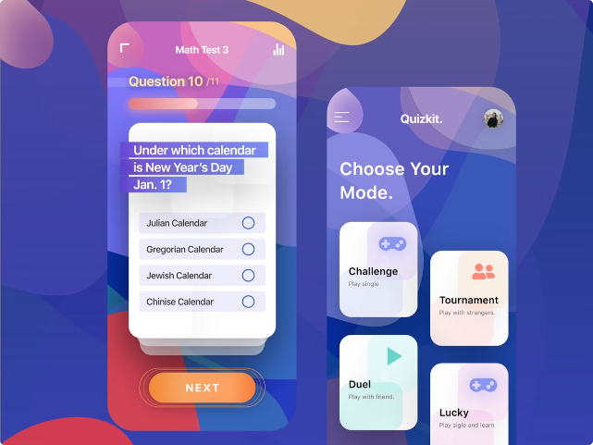

Introduction to Online Quiz System
The online quiz system is a powerful tool that enables educators, trainers, and businesses to create, administer, and analyze interactive quizzes and assessments. With its user-friendly interface and robust features, this system revolutionizes the way knowledge is tested and evaluated in the digital age.

Slide 2
Key Features of the Quiz System
Versatile Question Types
Customizable Quizzes
Instant Feedback
The system supports a wide range of question formats, including multiple-choice, true/false, fill-in-the-blank, and more, allowing for comprehensive assessment of learners' knowledge and skills.
Users can easily create and customize quizzes, set time limits, and adjust scoring parameters to suit their specific needs and learning objectives.
The system provides immediate feedback to learners, allowing them to identify areas for improvement and reinforcing the learning process.

Slide 3

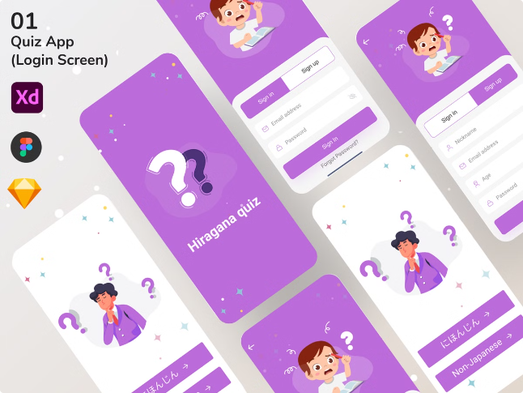
User Registration and Login
Secure Authentication
User Roles and Permissions
The system ensures the confidentiality and integrity of user data through robust authentication mechanisms, including password-protected accounts and multi-factor authentication options.
The system supports different user roles, such as administrators, instructors, and learners, with tailored access and permissions to manage quizzes and user data.
User Dashboard
The intuitive user dashboard provides a centralized hub for users to access their quizzes, review progress, and track their performance over time.

Slide 4

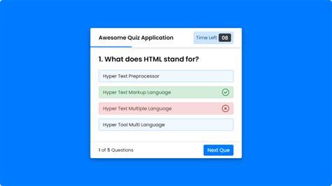
Quiz Creation and Management
1
Question Bank
The system allows instructors to build a comprehensive question bank, categorizing questions by topic, difficulty level, and learning objectives.
2
Quiz Builder
The user-friendly quiz builder enables instructors to easily select questions from the bank, arrange them in a desired order, and customize the quiz settings.
3
Quiz Publishing
Once the quiz is created, instructors can publish it, setting availability windows and access permissions for learners to take the assessment.

Slide 5

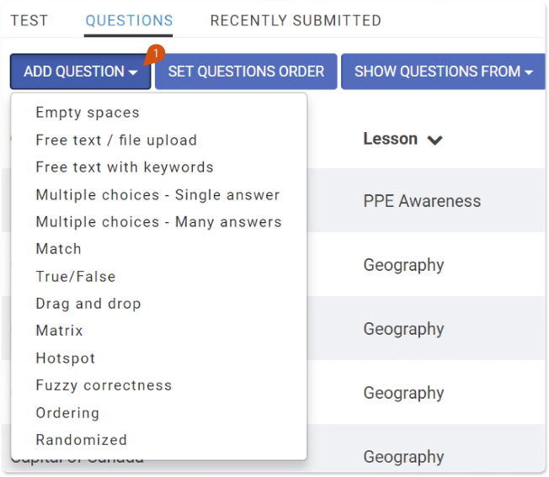
Question Bank and Question Types
1
Multiple Choice
2
True/False
Assess learners' understanding of concepts through multiple-choice questions with single or multiple correct answers.
Quickly test learners' knowledge of factual information with straightforward true or false questions.
3
Fill-in-the-Blank
4
Short Answer
Challenge learners to recall and apply key information by completing sentences or phrases with the correct missing words.
Allow learners to demonstrate their understanding through open-ended responses that require more in-depth explanations.

Slide 6




Quiz Scheduling and Timed Exams
Scheduling Options
Timed Assessments
Automated Grading
The system offers flexible scheduling options, enabling instructors to set specific availability windows and deadlines for learners to complete the quiz.
For high-stakes exams, the system can be configured to enforce time limits, ensuring learners demonstrate their knowledge within a controlled timeframe.
The system's automated grading features provide instant feedback to learners, while also generating detailed reports for instructors to review performance.

Slide 7


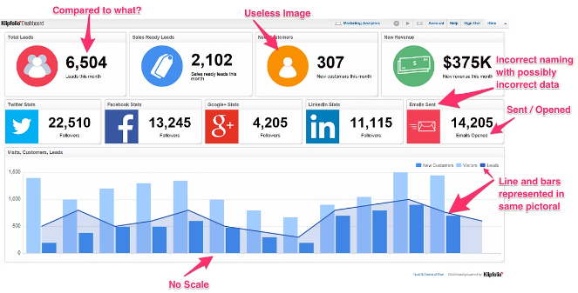


Reporting and Analytics
Performance Tracking
Comprehensive reporting and analytics tools allow instructors to monitor learners' progress, identify areas for improvement, and make data-driven decisions.
Leaderboards
The system can display leaderboards and competition-based features, fostering a spirit of friendly competition and engagement among learners.
Certificates
Learners can be awarded certificates upon successful completion of quizzes, providing a sense of achievement and recognition for their efforts.

Slide 8

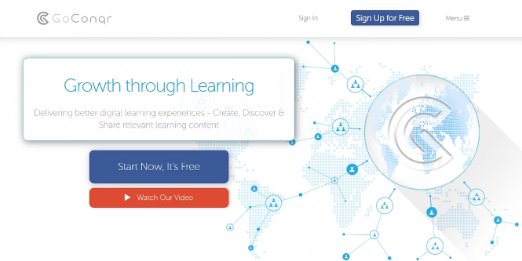
Conclusion and Future Enhancements
Conclusion
The online quiz system offers a comprehensive and user-friendly platform for creating, administering, and analyzing interactive assessments. Its robust features and customization capabilities make it a valuable tool for educators, trainers, and businesses to enhance the learning experience and evaluate learners' knowledge effectively.
Future Enhancements
Potential future enhancements may include integration with learning management systems (LMS), mobile-responsive design, advanced analytics and reporting features, and the ability to incorporate multimedia content within quizzes to further engage learners.

