Slide 1
UNIT 4 Transactions

Slide 2
Transactions
Transaction Concept
Transaction State
Concurrent Executions
Serializability
Recoverability
Implementation of Isolation
Transaction Definition in SQL
Testing for Serializability.

Slide 3
Transaction Concept
A transaction is a unit of program execution that accesses and possibly updates various data items.
Eg.1. Transaction to transfer $50 from account A to account B:
1. read(A)
2. A := A – 50
3. write(A)
4. read(B)
5. B := B + 50
6. write(B)
Two main issues to deal with:
Failures of various kinds, such as hardware failures and system crashes
Concurrent execution of multiple transactions

Slide 4
Example of Fund Transfer
Eg.1. Transaction to transfer $50 from account A to account B:
1. read(A)
2. A := A – 50
3. write(A)
4. read(B)
5. B := B + 50
6. write(B)
Atomicity requirement
if the transaction fails after step 3 and before step 6, money will be “lost” leading to an inconsistent database state
Failure could be due to software or hardware
the system should ensure that updates of a partially executed transaction are not reflected in the database
Durability requirement — once the user has been notified that the transaction has completed (i.e., the transfer of the $50 has taken place), the updates to the database by the transaction must persist even if there are software or hardware failures.

Slide 5
Example of Fund Transfer (Cont.)
Eg.1. Transaction to transfer $50 from account A to account B:
1. read(A)
2. A := A – 50
3. write(A)
4. read(B)
5. B := B + 50
6. write(B)
Consistency requirement in above example:
- the sum of A and B (A+B) is unchanged by the execution of the transaction
In general, consistency requirements include
Explicitly specified integrity constraints such as primary keys and foreign keys
Implicit integrity constraints
e.g. sum of balances of all accounts, minus sum of loan amounts must equal value of cash-in-hand
A transaction must see a consistent database.
During transaction execution the database may be temporarily inconsistent.
When the transaction completes successfully the database must be consistent
Erroneous transaction logic can lead to inconsistency

Slide 6
Example of Fund Transfer (Cont.)
Isolation requirement — if between steps 3 and 6, another transaction T2 is allowed to access the partially updated database, it will see an inconsistent database (the sum A + B will be less than it should be).
T1 T2
1. read(A)
2. A := A – 50
3. write(A) read(A), read(B), print(A+B)
4. read(B)
5. B := B + 50
write(B)
Isolation can be ensured trivially by running transactions serially
that is, one after the other.
However, executing multiple transactions concurrently has significant benefits.

Slide 7
ACID Properties
A transaction is a unit of program execution that accesses and possibly updates various data items. To preserve the integrity of data the database system must ensure:
Atomicity. Either all operations of the transaction are properly reflected in the database or none are.
Consistency. Execution of a transaction in isolation preserves the consistency of the database.
Isolation. Although multiple transactions may execute concurrently, each transaction must be unaware of other concurrently executing transactions. Intermediate transaction results must be hidden from other concurrently executed transactions.
That is, for every pair of transactions T_{i} and T_{j}, it appears to T_{i} that either T_{j}, finished execution before T_{i} started, or T_{j} started execution after T_{i} finished.
Durability. After a transaction completes successfully, the changes it has made to the database persist, even if there are system failures.

Slide 8
Transaction State
Active – the initial state; the transaction stays in this state while it is executing
Partially committed – after the final statement has been executed.
Failed --- after the discovery that normal execution can no longer proceed.
Aborted – after the transaction has been rolled back and the database restored to its state prior to the start of the transaction. Two options after it has been aborted:
restart the transaction
can be done only if no internal logical error
kill the transaction
Committed – after successful completion.

Slide 9
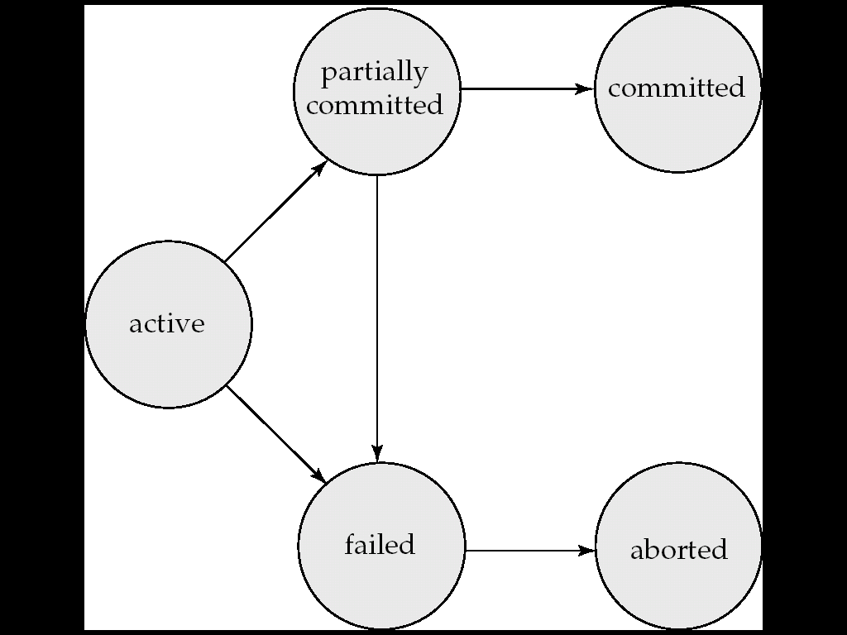
Transaction State

Slide 10
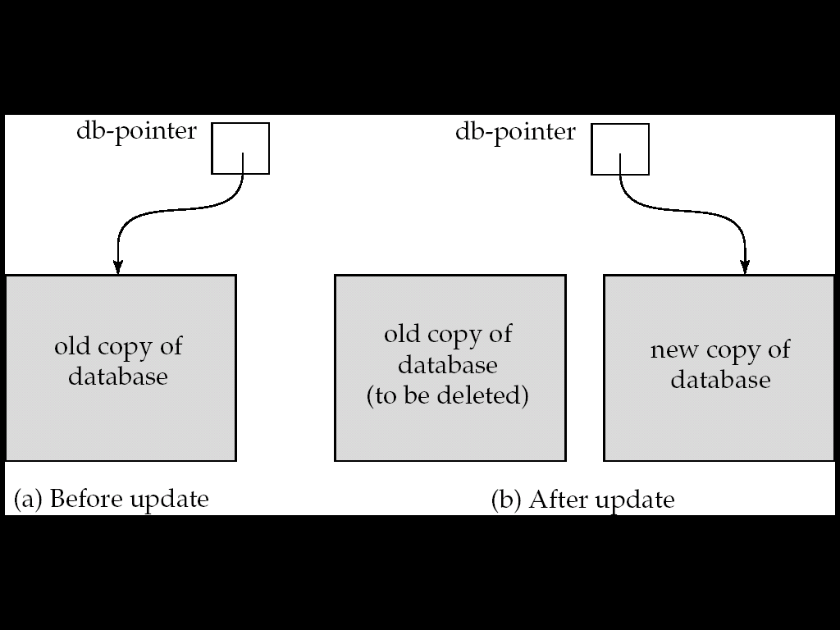
Implementation of Atomicity and Durability
The recovery-management component of a database system implements the support for atomicity and durability.
E.g. the shadow-database scheme:
all updates are made on a shadow copy of the database
db_pointer is made to point to the updated shadow copy after
the transaction reaches partial commit and
all updated pages have been flushed to disk.

Slide 11
Implementation of Atomicity and Durability (Cont.)
db_pointer always points to the current consistent copy of the database.
In case transaction fails, old consistent copy pointed to by db_pointer can be used, and the shadow copy can be deleted.
The shadow-database scheme:
Assumes that only one transaction is active at a time.
Assumes disks do not fail
Useful for text editors, but
extremely inefficient for large databases
As Variant called shadow paging reduces copying of data, but is still not practical for large databases
Does not handle concurrent transactions

Slide 12
Concurrent Execution
A schedule is a collection of many transactions which is implemented as a unit (or) A chronological execution sequence of a transaction is called a schedule. A schedule can have many transactions in it, each comprising of a number of instructions/tasks.
Depending upon how these transactions are arranged in within a schedule, a schedule can be of two types:
Serial: The transactions are executed one after another, in a non-preemptive manner.
Concurrent: The transactions are executed in a preemptive, time shared method.
In Serial schedule, there is no question of sharing a single data item among many transactions, because not more than a single transaction is executing at any point of time. However, a serial schedule is inefficient in the sense that the transactions suffer for having a longer waiting time and response time, as well as low amount of resource utilization.
In concurrent schedule, CPU time is shared among two or more transactions in order to run them concurrently. However, this creates the possibility that more than one transaction may need to access a single data item for read/write purpose and the database could contain inconsistent value if such accesses are not handled properly.

Slide 13
Concurrent Executions
Multiple transactions are allowed to run concurrently in the system. Advantages are:
increased processor and disk utilization, leading to better transaction throughput
E.g. one transaction can be using the CPU while another is reading from or writing to the disk
reduced average response time for transactions: short transactions need not wait behind long ones.
Concurrency control schemes – mechanisms to achieve isolation
that is, to control the interaction among the concurrent transactions in order to prevent them from destroying the consistency of the database.

Slide 14
Schedules
Schedule – a sequences of instructions that specify the chronological order in which instructions of concurrent transactions are executed
a schedule for a set of transactions must consist of all instructions of those transactions
must preserve the order in which the instructions appear in each individual transaction.
A transaction that successfully completes its execution will have a commit instructions as the last statement
by default transaction assumed to execute commit instruction as its last step
A transaction that fails to successfully complete its execution will have an abort instruction as the last statement

Slide 15
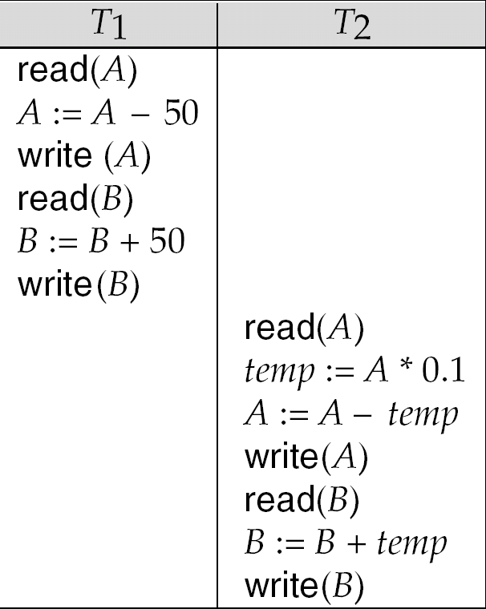
Schedule 1
Let T₁ transfer $50 from A to B, and T₂ transfer 10% of the balance from A to B.
A serial schedule in which T₁ is followed by T₂ :

Slide 16
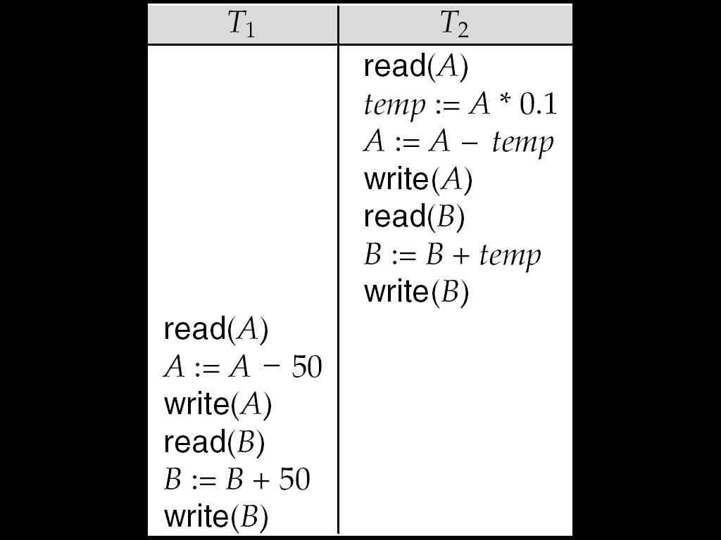
Schedule 2
A serial schedule where T₂ is followed by T₁

Slide 17
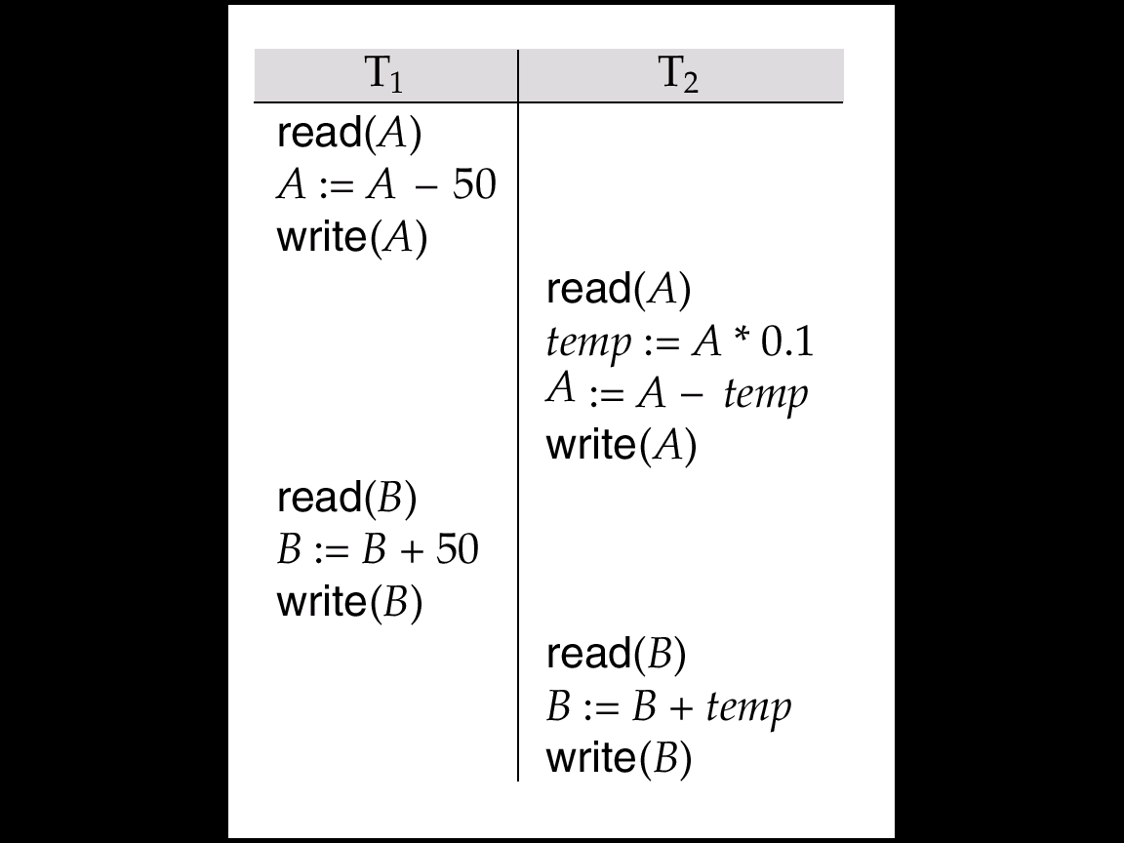
Schedule 3
Let T₁ and T₂ be the transactions defined previously. The following schedule is not a serial schedule, but it is equivalent to Schedule 1.
In Schedules 1, 2 and 3, the sum A + B is preserved.

Slide 18
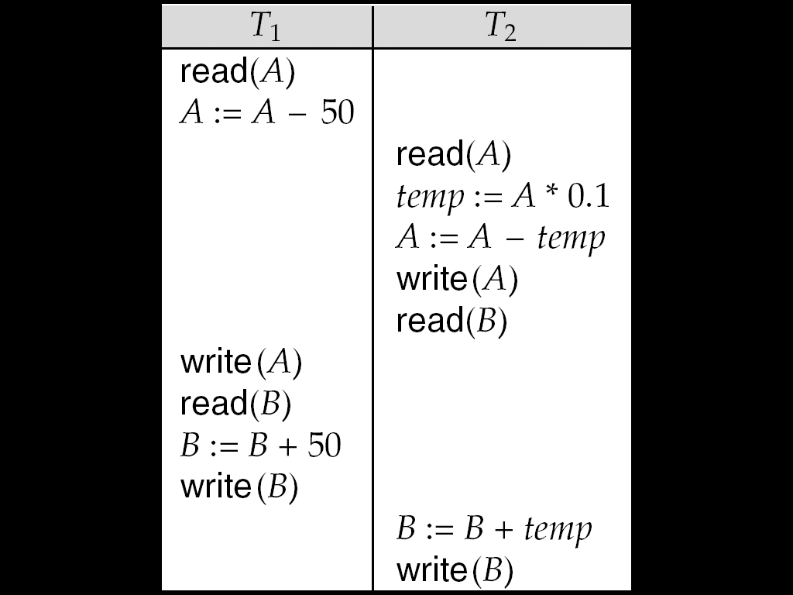
Schedule 4
The following concurrent schedule does not preserve the value of (A + B ).

Slide 19
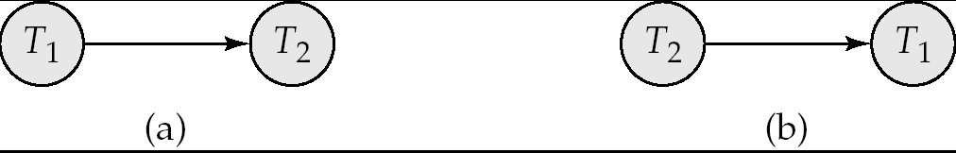
Precedence Graph for (a) Schedule 1 and (b) Schedule 2
Serializability
When several concurrent transactions are trying to access the same data item, the instructions within these concurrent transactions must be ordered in some way so as there are no problem in accessing and releasing the shared data item.
Conflict Serializability Two instructions of two different transactions may want to access the same data item in order to perform a read/write operation. Conflict Serializability deals with detecting whether the instructions are conflicting in any way, and specifying the order in which these two instructions will be executed in case there is any conflict. A conflict arises if at least one (or both) of the instructions is a write operation.
View Serializability: This is another type of serializability that can be derived by creating another schedule out of an existing schedule, involving the same set of transactions.

