Slide 1
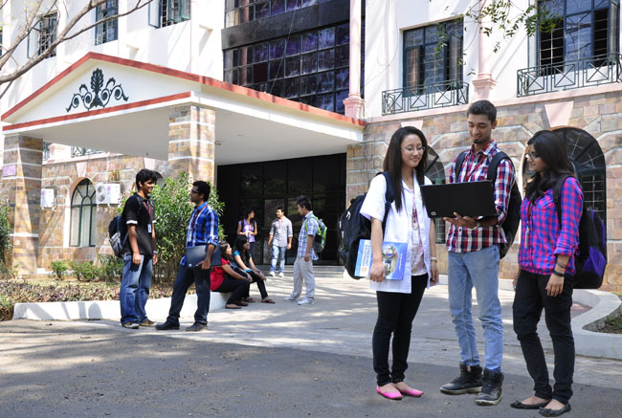

CSB4202 - DATABASE MANAGEMENT SYSTEMS
B.Tech – III Semester
Dr. A. Antonidoss/ Dr.Sathya Priya.S
Associate professor
School of Computing Sciences,
Department of Computer Science and Engineering

Slide 2
Object Oriented Databases – Need for Complex Data types- OO data Model- Nested relations- Complex Types- Inheritance Reference Types - Distributed databases- Querying and Transformation. – Data Mining and Data Warehousing.

Slide 3
Object-Oriented Databases
Need for Complex Data Types
The Object-Oriented Data Model
Object-Oriented Languages

Slide 4
Need for Complex Data Types
Traditional database applications in data processing had conceptually simple data types
Relatively few data types, first normal form holds
Complex data types have grown more important in recent years
E.g. Addresses can be viewed as a
Single string, or
Separate attributes for each part, or
Composite attributes (which are not in first normal form)
E.g. it is often convenient to store multivalued attributes as-is, without creating a separate relation to store the values in first normal form
Applications
computer-aided design, computer-aided software engineering
multimedia and image databases, and document/hypertext databases.

Slide 5
Complex Data Types
Characteristics:
Permit non-atomic domains (atomic ≡ indivisible)
Example of non-atomic domain: set of integers or set of tuples
Allows more intuitive modeling for applications with complex data
Functions:
allow relations whenever we allow atomic (scalar) values — relations within relations
Retains mathematical foundation of relational model
Violates first normal form.

Slide 6
Complex Types and SQL
Extensions introduced in SQL:1999 to support complex types:
Collection and large object types
Nested relations are an example of collection types
Structured types
Nested record structures like composite attributes
Inheritance
Object orientation
Including object identifiers and references
Not fully implemented in any database system currently
But some features are present in each of the major commercial database systems
Read the manual of your database system to see what it supports

Slide 7
Object-Oriented Data Model
An object corresponds to an entity in the E-R model.
The object-oriented paradigm is based on encapsulating code and data related to an object into single unit.
The object-oriented data model is a logical data model (like the E-R model).
Adaptation of the object-oriented programming paradigm (e.g., Smalltalk, C++) to database systems.

Slide 8
Object Structure
An object has associated with it:
A set of variables that contain the data for the object. The value of each variable is itself an object.
A set of messages to which the object responds; each message may have zero, one, or more parameters.
A set of methods, each of which is a body of code to implement a message; a method returns a value as the response to the message
The physical representation of data is visible only to the implementer of the object
Messages and responses provide the only external interface to an object.
The term message does not necessarily imply physical message passing. Messages can be implemented as procedure invocations.

Slide 9
Messages and Methods
Methods are programs written in general-purpose language with the following features
only variables in the object itself may be referenced directly
data in other objects are referenced only by sending messages.
Methods can be read-only or update methods
Read-only methods do not change the value of the object
Strictly speaking, every attribute of an entity must be represented by a variable and two methods, one to read and the other to update the attribute
e.g., the attribute address is represented by a variable address and two messages get-address and set-address.
For convenience, many object-oriented data models permit direct access to variables of other objects.

Slide 10
Object Classes
Similar objects are grouped into a class; each such object is called an instance of its class
All objects in a class have the same
Variables, with the same types
message interface
methods
The may differ in the values assigned to variables
Example: Group objects for people into a person class
Classes are analogous to entity sets in the E-R model

Slide 11
Class Definition Example
class employee { /*Variables */ string name; string address; date start-date; int salary; /* Messages */ int annual-salary(); string get-name(); string get-address(); int set-address(string new-address); int employment-length(); };
Methods to read and set the other variables are also needed with strict encapsulation
Methods are defined separately
E.g. int employment-length() { return today() – start-date;} int set-address(string new-address) { address = new-address;}

Slide 12
Inheritance
Suppose that we have the following type definition for people:
create type Person (name varchar(20), address varchar(20))
Using inheritance to define the student and teacher types create type Student under Person (degree varchar(20), department varchar(20)) create type Teacher under Person (salary integer, department varchar(20))
Subtypes can redefine methods by using overriding method in place of method in the method declaration

Slide 13
Inheritance
E.g., class of bank customers is similar to class of bank employees, although there are differences
both share some variables and messages, e.g., name and address.
But there are variables and messages specific to each class e.g., salary for employees and credit-rating for customers.
Every employee is a person; thus employee is a specialization of person
Similarly, customer is a specialization of person.
Create classes person, employee and customer
variables/messages applicable to all persons associated with class person.
variables/messages specific to employees associated with class employee; similarly for customer

Slide 14
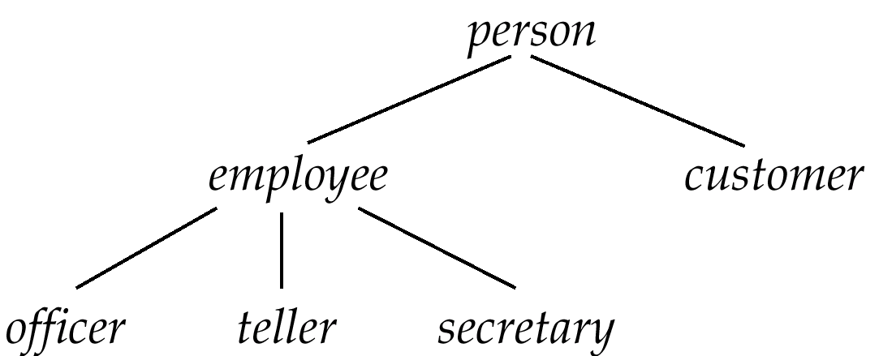
Inheritance (Cont.)
Place classes into a specialization/IS-A hierarchy
variables/messages belonging to class person are inherited by class employee as well as customer
Result is a class hierarchy
Note analogy with ISA Hierarchy in the E-R model

Slide 15
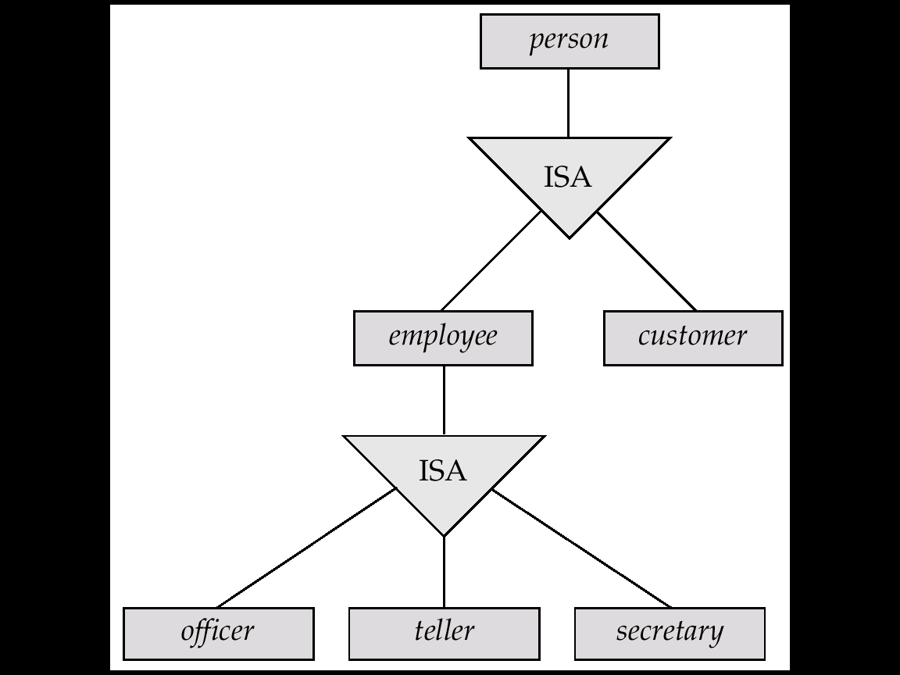
Specialization Hierarchy for the Bank Example

Slide 16
Class Hierarchy Definition
class person{ string name; string address: }; class customer isa person { int credit-rating; }; class employee isa person { date start-date; int salary; }; class officer isa employee { int office-number, int expense-account-number, };
.
.
.

Slide 17
Class Hierarchy Example (Cont.)
Full variable list for objects in the class officer:
office-number, expense-account-number: defined locally
start-date, salary: inherited from employee
name, address: inherited from person
Methods inherited similar to variables.
Substitutability — any method of a class, say person, can be invoked equally well with any object belonging to any subclass, such as subclass officer of person.
Class extent: set of all objects in the class. Two options:
1. Class extent of employee includes all officer, teller and secretary objects.
Class extent of employee includes only employee objects that are not in a subclass such as officer, teller, or secretary
This is the usual choice in OO systems
Can access extents of subclasses to find all objects of subtypes of employee

Slide 18
Multiple Inheritance
SQL:1999 and SQL:2003 do not support multiple inheritance
If our type system supports multiple inheritance, we can define a type for teaching assistant as follows: create type Teaching Assistant under Student, Teacher
To avoid a conflict between the two occurrences of department we can rename them
create type Teaching Assistant under Student with (department as student_dept ), Teacher with (department as teacher_dept )

Slide 19
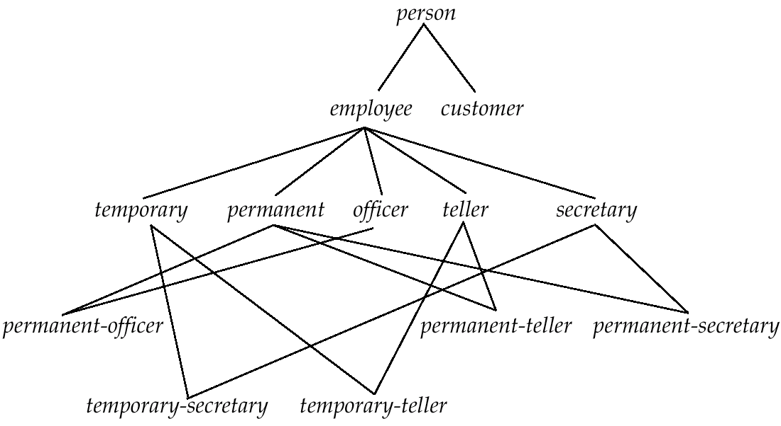
Example of Multiple Inheritance
Class DAG for banking example.

Slide 20
Multiple Inheritance
With multiple inheritance a class may have more than one superclass.
The class/subclass relationship is represented by a directed acyclic graph (DAG)
Particularly useful when objects can be classified in more than one way, which are independent of each other
E.g. temporary/permanent is independent of Officer/secretary/teller
Create a subclass for each combination of subclasses
Need not create subclasses for combinations that are not possible in the database being modeled
A class inherits variables and methods from all its super classes
There is potential for ambiguity when a variable/message N with the same name is inherited from two super classes A and B
No problem if the variable/message is defined in a shared superclass
Otherwise, do one of the following
flag as an error,
rename variables (A.N and B.N)
choose one.

Slide 21
More Examples of Multiple Inheritance
Conceptually, an object can belong to each of several subclasses
A person can play the roles of student, a teacher or footballPlayer, or any combination of the three
E.g., student teaching assistant who also play football
Can use multiple inheritance to model “roles” of an object
That is, allow an object to take on any one or more of a set of types
But many systems insist an object should have a most-specific class
That is, there must be one class that an object belongs to which is a subclass of all other classes that the object belongs to
Create subclasses such as student-teacher and student-teacher-footballPlayer for each combination
When many combinations are possible, creating subclasses for each combination can become cumbersome

Slide 22
Object Identity
An object retains its identity even if some or all of the values of variables or definitions of methods change over time.
Object identity is a stronger notion of identity than in programming languages or data models not based on object orientation.
Value – data value; e.g. primary key value used in relational systems.
Name – supplied by user; used for variables in procedures.
Built-in – identity built into data model or programming language.
no user-supplied identifier is required.
Is the form of identity used in object-oriented systems.

Slide 23
Object Identifiers
Object identifiers used to uniquely identify objects
Object identifiers are unique:
no two objects have the same identifier
each object has only one object identifier
E.g., the spouse field of a person object may be an identifier of another person object.
can be stored as a field of an object, to refer to another object.
Can be
system generated (created by database) or
external (such as social-security number)
System generated identifiers:
Are easier to use, but cannot be used across database systems
May be redundant if unique identifier already exists

Slide 24
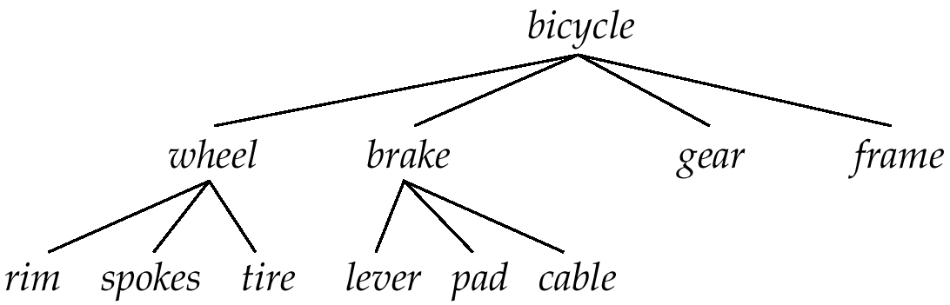
Object Containment
Containment Hierarchy for Bicycle-Design Database
Each component in a design may contain other components
Can be modeled as containment of objects. Objects containing; other objects are called composite objects.
Multiple levels of containment create a containment hierarchy
links interpreted as is-part-of, not is-a.
Allows data to be viewed at different granularities by different users.

Slide 25
Object-Oriented Languages
Object-oriented concepts can be used in different ways
Object-orientation can be used as a design tool, and be encoded into, for example, a relational database
analogous to modeling data with E-R diagram and then converting to a set of relations)
The concepts of object orientation can be incorporated into a programming language that is used to manipulate the database.
Object-relational systems – add complex types and object-orientation to relational language.
Persistent programming languages – extend object-oriented programming language to deal with databases by adding concepts such as persistence and collections.

Slide 26
Distributed Databases
Heterogeneous and Homogeneous Databases
Distributed Data Storage
Distributed Transactions

Slide 27
Distributed Database System
A distributed database system consists of loosely coupled sites that share no physical component
Database systems that run on each site are independent of each other
Transactions may access data at one or more sites

Slide 28
Homogeneous Distributed Databases
In a homogeneous distributed database
All sites have identical software and scheme
Are aware of each other and agree to cooperate in processing user requests.
Each site surrenders part of its autonomy in terms of right to change schemas or software
Appears to user as a single system
In a heterogeneous distributed database
Different sites may use different schemas and software
Difference in schema is a major problem for query processing
Difference in software is a major problem for transaction processing
Sites may not be aware of each other and may provide only limited facilities for cooperation in transaction processing

Slide 29
Distributed Data Storage
Assume relational data model
Replication
System maintains multiple copies of data, stored in different sites, for faster retrieval and fault tolerance.
Fragmentation
Relation is partitioned into several fragments stored in distinct sites
Replication and fragmentation can be combined
Relation is partitioned into several fragments: system maintains several identical replicas of each such fragment.

Slide 30
Data Replication
A relation or fragment of a relation is replicated if it is stored redundantly in two or more sites.
Full replication of a relation is the case where the relation is stored at all sites.
Fully redundant databases are those in which every site contains a copy of the entire database.

Slide 31
Data Replication (Cont.)
Advantages of Replication
Availability: failure of site containing relation r does not result in unavailability of r is replicas exist.
Parallelism: queries on r may be processed by several nodes in parallel.
Reduced data transfer: relation r is available locally at each site containing a replica of r.
Disadvantages of Replication
Increased cost of updates: each replica of relation r must be updated.
Increased complexity of concurrency control: concurrent updates to distinct replicas may lead to inconsistent data unless special concurrency control mechanisms are implemented.
One solution: choose one copy as primary copy and apply concurrency control operations on primary copy

Slide 32
Data Fragmentation
Division of relation r into fragments r₁, r₂, …, r_{n} which contain sufficient information to reconstruct relation r.
Horizontal fragmentation: each tuple of r is assigned to one or more fragments
Vertical fragmentation: the schema for relation r is split into several smaller schemas
All schemas must contain a common candidate key (or superkey) to ensure lossless join property.
A special attribute, the tuple-id attribute may be added to each schema to serve as a candidate key.

Slide 33
Horizontal Fragmentation of account Relation
branch_name
account_number
balance
Hillside
Hillside
Hillside
A-305
A-226
A-155
500
336
62
account₁ = σ_{branch_name=“Hillside”} (account )
branch_name
account_number
balance
Valleyview
Valleyview
Valleyview
Valleyview
A-177
A-402
A-408
A-639
205
10000
1123
750
account₂ = σ_{branch_name=“Valleyview”} (account )

Slide 34
Vertical Fragmentation of employee_info Relation
branch_name
customer_name
tuple_id
Hillside
Hillside
Valleyview
Valleyview
Hillside
Valleyview
Valleyview
Lowman
Camp
Camp
Kahn
Kahn
Kahn
Green
1
2
3
4
5
6
7
deposit₁ = Πbranch_name, customer_name, tuple_id (employee_info )
account_number
balance
tuple_id
A-305
A-226
A-177
A-402
A-155
A-408
A-639
500
336
205
10000
62
1123
750
1
2
3
4
5
6
7
deposit₂ = Πaccount_number, balance, tuple_id (employee_info )

Slide 35
Advantages of Fragmentation
Horizontal:
allows parallel processing on fragments of a relation
allows a relation to be split so that tuples are located where they are most frequently accessed
Vertical:
allows tuples to be split so that each part of the tuple is stored where it is most frequently accessed
tuple-id attribute allows efficient joining of vertical fragments
allows parallel processing on a relation
Vertical and horizontal fragmentation can be mixed.
Fragments may be successively fragmented to an arbitrary depth.

Slide 36
Data Transparency
Data transparency: Degree to which system user may remain unaware of the details of how and where the data items are stored in a distributed system
Consider transparency issues in relation to:
Fragmentation transparency
Replication transparency
Location transparency

Slide 37
Naming of Data Items - Criteria
1. Every data item must have a system-wide unique name.
2. It should be possible to find the location of data items efficiently.
3. It should be possible to change the location of data items transparently.
4. Each site should be able to create new data items autonomously.

Slide 38
Centralized Scheme - Name Server
Structure:
name server assigns all names
each site maintains a record of local data items
sites ask name server to locate non-local data items
Advantages:
satisfies naming criteria 1-3
Disadvantages:
does not satisfy naming criterion 4
name server is a potential performance bottleneck
name server is a single point of failure

Slide 39
Use of Aliases
Alternative to centralized scheme: each site prefixes its own site identifier to any name that it generates i.e., site 17.account.
Fulfills having a unique identifier, and avoids problems associated with central control.
However, fails to achieve network transparency.
Solution: Create a set of aliases for data items; Store the mapping of aliases to the real names at each site.
The user can be unaware of the physical location of a data item, and is unaffected if the data item is moved from one site to another.

Slide 40
Distributed Transactions
Transaction may access data at several sites.
Each site has a local transaction manager responsible for:
Maintaining a log for recovery purposes
Participating in coordinating the concurrent execution of the transactions executing at that site.
Each site has a transaction coordinator, which is responsible for:
Starting the execution of transactions that originate at the site.
Distributing subtransactions at appropriate sites for execution.
Coordinating the termination of each transaction that originates at the site, which may result in the transaction being committed at all sites or aborted at all sites.

Slide 41
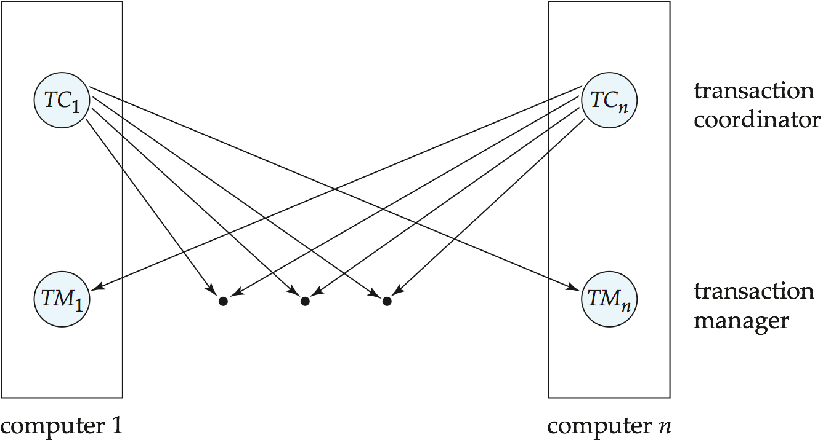
Transaction System Architecture

Slide 42
System Failure Modes
Failures unique to distributed systems:
Failure of a site.
Loss of massages
Handled by network transmission control protocols such as TCP-IP
Failure of a communication link
Handled by network protocols, by routing messages via alternative links
Network partition
A network is said to be partitioned when it has been split into two or more subsystems that lack any connection between them
Note: a subsystem may consist of a single node
Network partitioning and site failures are generally indistinguishable.

Slide 43
Commit Protocols
Commit protocols are used to ensure atomicity across sites
a transaction which executes at multiple sites must either be committed at all the sites, or aborted at all the sites.
not acceptable to have a transaction committed at one site and aborted at another
The two-phase commit (2PC) protocol is widely used
The three-phase commit (3PC) protocol is more complicated and more expensive, but avoids some drawbacks of two-phase commit protocol. This protocol is not used in practice.

Slide 44
Two Phase Commit Protocol (2PC)
Assumes fail-stop model – failed sites simply stop working, and do not cause any other harm, such as sending incorrect messages to other sites.
Execution of the protocol is initiated by the coordinator after the last step of the transaction has been reached.
The protocol involves all the local sites at which the transaction executed
Let T be a transaction initiated at site S_{i}, and let the transaction coordinator at S_{i} be C_{i}

Slide 45
Phase 1: Obtaining a Decision
Coordinator asks all participants to prepare to commit transaction T_{i}.
C_{i} adds the records <prepare T> to the log and forces log to stable storage
sends prepare T messages to all sites at which T executed
Upon receiving message, transaction manager at site determines if it can commit the transaction
if not, add a record <no T> to the log and send abort T message to C_{i}
if the transaction can be committed, then:
add the record <ready T> to the log
force all records for T to stable storage
send ready T message to C_{i}

Slide 46
Phase 2: Recording the Decision
T can be committed of C_{i} received a ready T message from all the participating sites: otherwise T must be aborted.
Coordinator adds a decision record, <commit T> or <abort T>, to the log and forces record onto stable storage. Once the record stable storage it is irrevocable (even if failures occur)
Coordinator sends a message to each participant informing it of the decision (commit or abort)
Participants take appropriate action locally.

Slide 47
Handling of Failures - Site Failure
When site S_{i} recovers, it examines its log to determine the fate of
transactions active at the time of the failure.
Log contain <commit T> record: txn had completed, nothing to be done
Log contains <abort T> record: txn had completed, nothing to be done
Log contains <ready T> record: site must consult C_{i} to determine the fate of T.
If T committed, redo (T); write <commit T> record
If T aborted, undo (T)
The log contains no log records concerning T:
Implies that S_{k} failed before responding to the prepare T message from C_{i}
since the failure of S_{k} precludes the sending of such a response, coordinator C₁ must abort T
S_{k} must execute undo (T)

Slide 48
Handling of Failures- Coordinator Failure
If coordinator fails while the commit protocol for T is executing then participating sites must decide on T’s fate:
If an active site contains a <commit T> record in its log, then T must be committed.
If an active site contains an <abort T> record in its log, then T must be aborted.
If some active participating site does not contain a <ready T> record in its log, then the failed coordinator C_{i} cannot have decided to commit T.
Can therefore abort T; however, such a site must reject any subsequent <prepare T> message from C_{i}
If none of the above cases holds, then all active sites must have a <ready T> record in their logs, but no additional control records (such as <abort T> of <commit T>).
In this case active sites must wait for C_{i} to recover, to find decision.
Blocking problem: active sites may have to wait for failed coordinator to recover.

Slide 49
Handling of Failures - Network Partition
If the coordinator and all its participants remain in one partition, the failure has no effect on the commit protocol.
If the coordinator and its participants belong to several partitions:
Sites that are not in the partition containing the coordinator think the coordinator has failed, and execute the protocol to deal with failure of the coordinator.
No harm results, but sites may still have to wait for decision from coordinator.
The coordinator and the sites are in the same partition as the coordinator think that the sites in the other partition have failed, and follow the usual commit protocol.
Again, no harm results

Slide 50
Recovery and Concurrency Control
In-doubt transactions have a <ready T>, but neither a <commit T>, nor an <abort T> log record.
The recovering site must determine the commit-abort status of such transactions by contacting other sites; this can slow and potentially block recovery.
Recovery algorithms can note lock information in the log.
Instead of <ready T>, write out <ready T, L> L = list of locks held by T when the log is written (read locks can be omitted).
For every in-doubt transaction T, all the locks noted in the <ready T, L> log record are reacquired.
After lock reacquisition, transaction processing can resume; the commit or rollback of in-doubt transactions is performed concurrently with the execution of new transactions.

Slide 51


Slide 52
The End

