Slide 1


CSB4202 - DATABASE MANAGEMENT SYSTEMS
B.Tech – III Semester
Dr. A. Antonidoss
Associate professor
School of Computing Sciences,
Department of Computer Science and Engineering

Slide 2
Models of Database Architecture: Hierarchical, Network and Relational Models.
Some of the board models of database architecture are as follows:
The process of defining the conceptual design of data elements and their inter-relationships is called data modeling.
The traditional applications approach to data organization built different models for each data file.
Such a diversity of ways in which different data elements are linked and stored in data files make these files suit­able only for the applications that they were originally created for.
In fact, the details regarding the exact placement of different data elements in a file have to be documented very carefully.

Slide 3
Models of Database Architecture: Hierarchical, Network and Relational Models
Some of the board models of database architecture are as follows:
Any change in the order in which various data elements are placed results in changes in the application programs using the data file.
The data­base approach uses a common data model for the entire database and the user program is not concerned with the placement of a particular data element.
The database management system (DBMS) acts as an interface between the database and the user programs

Slide 4
Models of Database Architecture: Hierarchical, Network and Relational Models.
The DBMS fetches the data from the database and makes it avail­able to the user program. This feature offers the advantage of data independence in the database approach.
Conceptually, there are three broad options with regard to data­base models. These are:
a. Hierarchical model
b. Network model
c. Relational model

Slide 5
a. Hierarchical model:
This model presents data to users in a hierarchy of data elements that can be represented in a sort of inverted tree.
In a sales order processing system, a customer may have many invoices raised to him and each invoice may have dif­ferent data elements.
Thus, the root level of data is customer, the second level is invoice and the last level is line items such as in­voice number, date, product, quantity, etc.
This structure is quite natural when seen from the event point of view. However, the lower levels are owned by higher level data elements, and elements at the same level have no linkage at all.

Slide 6
a. Hierarchical model:
As a result, the query such as what products are purchased by which customer, in the above example, shall be difficult to carry out in the hierarchical struc­ture.
The query as to which customer purchased which product would be convenient.
Thus, where there are many-to-many rela­tionships between two entities, this model would not be appropri­ate. Figure shows the hierarchical model of data for a sales order processing application.

Slide 7
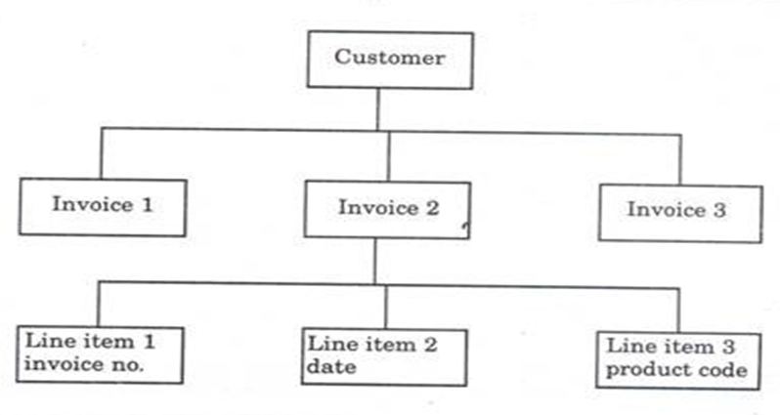
a. Hierarchical model:
Hierarchical Model of data for sales order processing

Slide 8
Features of the Hierarchical Database Model:
Many to many relationships: It only supports one – to – many relationships. Many to many relationships are not supported.
Problem in Deletion: If a parent is deleted then the child automatically gets deleted.
Hierarchy of data: Data is represented in a hierarchical tree-like structure.
Parent-child relationship: Each child can have only one parent but a parent can have more than one children.
Pointer: Pointers are used for linking records that tell which is a parent and which child record.

Slide 9
Features of the Hierarchical Database Model:
Disk input and output is minimized: Parent and child records are placed or stored close to each other on the storage device which minimizes the hard disk input and output.
Fast navigation: As parent and child are stored close to each other so access time is reduced and navigation becomes faster.
Predefined relationship: All relations between root, parent and child nodes are predefined in the database schema.
Re-organization difficulty: Hierarchy prevents the re-organization of data.
Redundancy: One to many relationships increases redundancy in the data which leads to the retrieval of inaccurate data.

Slide 10
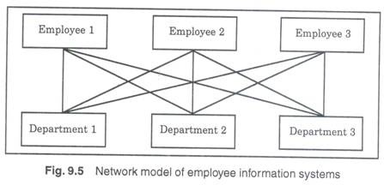
b. Network model:
In the network model of database, there are no levels and a record can have any number of owners and also can have ownership of several records.
Thus, the problem raised above in the sales order processing will not arise in the network model.

Slide 11
b. Network model:
As there is no definite path defined for retrieval of data, the number of links is very large and thus network databases are complex, slow and difficult to implement.
In view of the difficulty in implementation, network model is used only when all other options are closed.
The typical ex­ample of a network database may be the employee and the depart­ment he/she has worked or can work with in future. Figure shows the network model of data for an employee information system.

Slide 12
b. Network model:
The network model has the following major features −
It can represent redundancy in data more efficiently than that in the hierarchical model.
There can be more than one path from a previous node to successor node/s.
The operations of the network model are maintained by indexing structure of linked list (circular) where a program maintains a current position and navigates from one record to another by following the relationships in which the record participates.
Records can also be located by supplying key values.

Slide 13
c. Relational model:
The most recent and popular model of data­base design is the relational database model.
This model was devel­oped to overcome the problems of complexity and inflexibility of the earlier two models in handling databases with many-to-many rela­tionships between entities.
These models are not only simple but also powerful. In the relational database, each file is perceived as a flat file (a two dimensional table) consisting of many lines (records), each record having key and non-key data item(s).
The key item(s) is the data element(s) that identifies the record. Figure 9.6 shows the files, and the fields that each record shall have in a customer invoicing system.

Slide 14
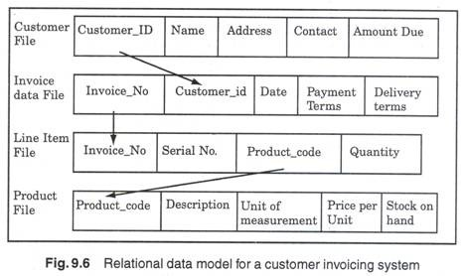
In the network model of database, there are no levels and a record can have any number of owners and also can have ownership of several records. Thus, the problem raised above (c) Relational model:
The most recent and popular model of data­base design is the relational database model. This model was devel­oped to overcome the problems of complexity and inflexibility of the earlier two models in handling databases with many-to-many rela­tionships between entities.
These models are not only simple but also powerful. In the relational database, each file is perceived as a flat file (a two dimensional table) consisting of many lines (records), each record having key and non-key data item(s). The key item(s) is the data element(s) that identifies the record. Figure 9.6 shows the files, and the fields that each record shall have in a customer invoicing system.
in the sales order processing will not arise in the network model.
As there is no definite path defined for retrieval of data, the number of links is very large and thus network databases are complex, slow and difficult to implement. In view of the difficulty in implementation, network model is used only when all other options are closed.
The typical ex­ample of a network database may be the employee and the depart­ment he/she has worked or can work with in future. Figure 9.5 shows the netIn the network model of database, there are no levels and a record can have any number of owners and also can have ownership of several records. Thus, the problem raised above in the sales order processing will not arise in the network model.
As there is no definite path defined for retrieval of data, the number of links is very large and thus network databases are complex, slow and difficult to implement. In view of the difficulty in implementation, network model is used only when all other options are closed.
The typical ex­ample of a network database may be the employee and the depart­ment he/she has worked or can work with in future. Figure 9.5 shows the network model of data for an employee information system.
work model of data for an employee information system.
c. Relational model:

Slide 15
c. Relational model:
Tables − In relational data model, relations are saved in the format of Tables. This format stores the relation among entities. A table has rows and columns, where rows represents records and columns represent the attributes.
Tuple − A single row of a table, which contains a single record for that relation is called a tuple.
Relation instance − A finite set of tuples in the relational database system represents relation instance. Relation instances do not have duplicate tuples.

Slide 16
c. Relational model:
Relation schema − A relation schema describes the relation name (table name), attributes, and their names.
Relation key − Each row has one or more attributes, known as relation key, which can identify the row in the relation (table) uniquely.
Attribute domain − Every attribute has some pre-defined value scope, known as attribute domain.

Slide 17
Quiz
Hierarchical model is also called
a. Tree structure
b. Plex Structure
c. Normalize Structure
d. Table Structure

Slide 18
Quiz
Hierarchical model is also called
a. Tree structure
b. Plex Structure
c. Normalize Structure
d. Table Structure
Answer a

Slide 19
Quiz
Data Model is collection of conceptual tools for describing.
a. Data
b. Data Schema
c. Consistency Constraints
d. All of these

Slide 20
Quiz
Data Model is collection of conceptual tools for describing.
a. Data
b. Data Schema
c. Consistency Constraints
d. All of these
Answer d

Slide 21


Slide 22
The End

