Slide 1
DB2 SQL
DB2 Training class 07

Slide 2
VIEWS

Slide 3
Introduction to VIEWS
Views are used to provide a different way of looking at the data stored in one or more base tables. Essentially, a view is a named specification of a result table that is populated whenever the view is referenced in an SQL statement.
They are two types of Views
1. Updateable View
2. Read-only View
  CREATE VIEW [VIEWNAME] <([COLUMNNAME] ,...)> AS [SELECTSTATEMENT] <WITH <LOCAL | CASCADED> CHECK OPTION>

Slide 4
Updatable VIEW
A VIEW set to be UPDATABLE VIEW when it satisfies all below condition.
The SELECT statement should contain all the not null columns.
VIEW is created on a single table.
No aggregate function or arithmetic function use.
No GROUP BY, DISTINCT clause are used.
No Sub Query is used.
If any of the condition is not satisfied then the VIEW is said to be READ ONLY VIEW

Slide 5
SUBQUERY

Slide 6
SUBQUERY
A query with in a query is called sub query. We can code a maximum of 15 sub queries.
SYNTAX:
SELECT * FROM TABLE WHERE =
(SELECT * FROM TTABLE NAME)
There are two types of sub queries.
1. CORRELATED SUB QUERY
2. NON-CORRELATED SUB QUERY

Slide 7
SUBQUERY
CORRELATED SUB QUERY:
First the outer query is executed and for each row of outer query for the inner query is executed.
NON CORRELATED SUB QUERY:
First the inner query is executed then the outer query
EXAMPLE : To find the 2nd maximum salary from a table.
SELECT MAX(EMPSAL) FROM EMPMAST WHERE SAL <
( SELECT MAX(EMPSAL) FROM EMPMAST)

Slide 8
Built IN Function

Slide 9
Built IN Function
A built-in function is a function that is supplied with DB2 UDB. The result of a function is a single value derived by applying the operation of the function to the arguments.
    COUNT(*)/ COUNT(DISTINCT COL)
    MIN
    MAX
    SUM
    AVG
    LENGTH
    CONCAT
    SUBSTR

Slide 10
COUNT Function
The COUNT function returns the number of rows or values in a set of rows or values. The argument of COUNT(*) is a set of rows.
SELECT COUNT(*) FROM EMPTAB;
The argument of COUNT(DISTINCT expression) is a set of values. The function is applied to the set of values derived from the argument values by the elimination of null values and duplicate values.
  SELECT COUNT(ESAL) FROM EMPTAB;

Slide 11
MAX MIN & SUM
The MAX/MIN column function returns the maximum value in a set of values in a group. The function is applied to the set of values derived from the argument values by the elimination of null values.
The specification of DISTINCT has no effect on the result and is not advised.
SELECT MAX/MIN(ESAL) AS MAX_SAL FROM EMPTAB;
The SUM function returns the sum of a set of numbers. The function is applied to the set of values derived from the argument values by the elimination of null values. If DISTINCT is specified, duplicate values are eliminated.
The result can be null. If the function is applied to the empty set, the result is a null value. Otherwise, the result is the sum of the values in the set.
SELECT SUM(ESAL) AS ESAL FROM EMPTAB;

Slide 12
AVG Function
The AVG function returns the average of a set of numbers. The argument values must be any built-in numeric data type and their sum must be within the range of the data type of the result.
The result can be null. If set of values is empty, Otherwise, the result is the average value of the set.
AVG disregards any NULLS in any column involved
  SELECT AVG(ESAL) AS ESAL FROM EMPTAB;

Slide 13
CONCAT SUBSTR & LENGTH
The CONCAT function combines two arguments. The result of the function is a string that consists of the first argument string followed by the second.
SELECT CONCAT(FIRSTNME, LASTNAME) FROM EMPLOYEE
The SUBSTR and SUBSTRING functions return a substring of a string.
  SELECT SUBSTR(ENAME, 3,4) FROM EMPLOYEE;
The LENGTH function returns the length of a value
SELECT LENGTH(EADDR) FROM EMPLOYEE;

Slide 14
JOINS & UNION

Slide 15
Joining Tables
One of the more powerful features of the SELECT statement is the ability to retrieve data from two or more tables by performing what is known as a join operation
A more common join operation involves collecting data from two or more tables that have one specific column in common and combining the results to create a result data set.
  SELECT LASTNAME, DEPTNAME
  FROM EMPLOYEE E, DEPARTMENT D
  WHERE E.WORKDEPT = D.DEPTNO

Slide 16
Inner joins
An inner join is the simplest type of join operation that can be performed. An inner join can be thought of as the cross product of two tables, in which every row in one table that has a corresponding row in another table is combined with that row to produce a new record.
This type of join works well as long as every row in the first table has a corresponding row in the second table.
SELECT [*|[EXPRESSION] <<AS> [NEWCOLUMNNAME]> ,...] FROM [[TABLENAME1] <<AS> [CORRELATIONNAME1]>] <INNER> JOIN [[TABLENAME2] <<AS> [CORRELATIONNAME2]>] ON [JOINCONDITION]

Slide 17
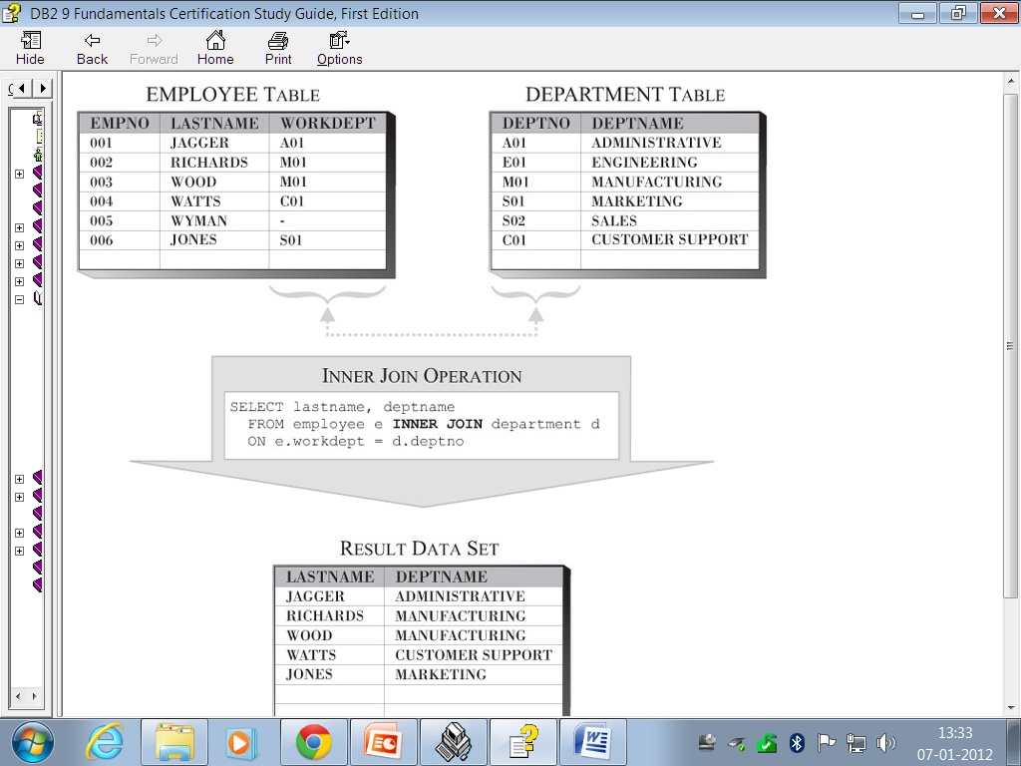

Slide 18
Outer joins
Outer join operations are used when a join operation is required and any rows that would normally be eliminated by an inner join operation need to be preserved.
With DB2, three types of outer joins are available:
    Left outer join.
    Right outer join.
    Full outer join.

Slide 19
OUTER Join
Left outer join. When a left outer join operation is performed, rows that would have been returned by an inner join operation, together with all rows stored in the leftmost table of the join operation.
Right outer join. When a right outer join operation is performed, rows that would have been returned by an inner join operation, together with all rows stored in the rightmost table of the join operation
Full outer join. When a full outer join operation is performed, rows that would have been returned by an inner join operation, together with all rows stored in both tables of the join operation are returned in the result data set produced.

Slide 20
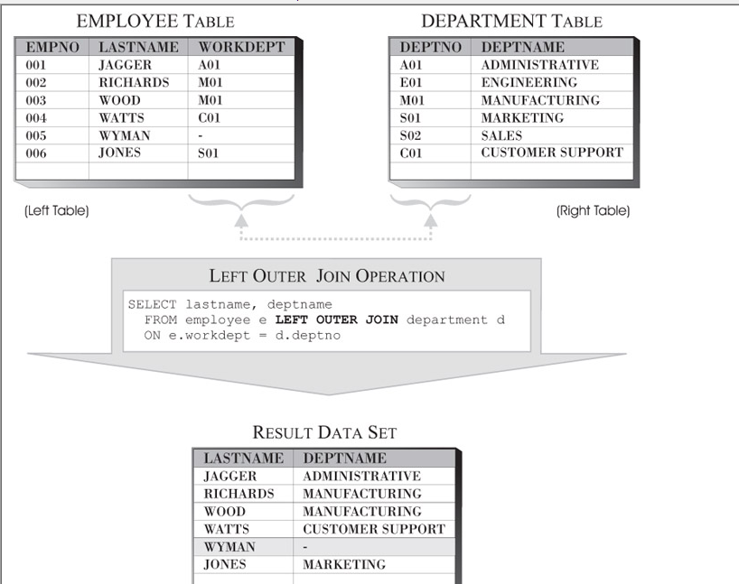

Slide 21
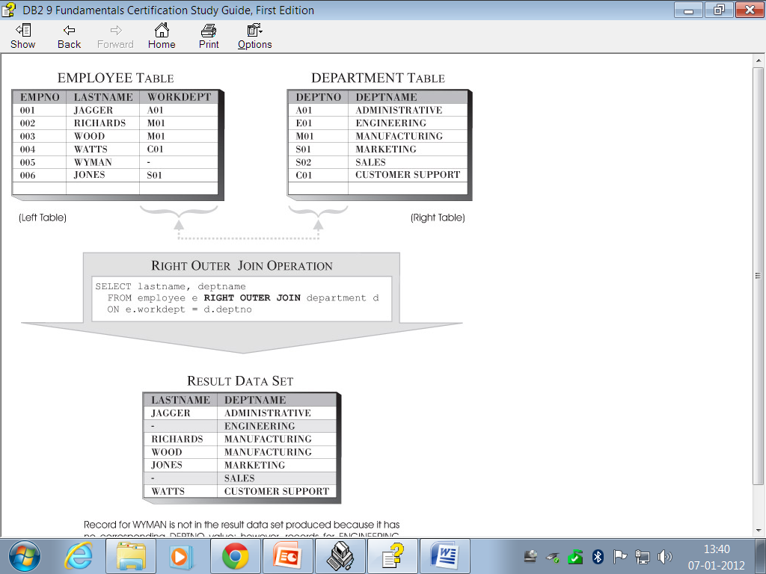

Slide 22
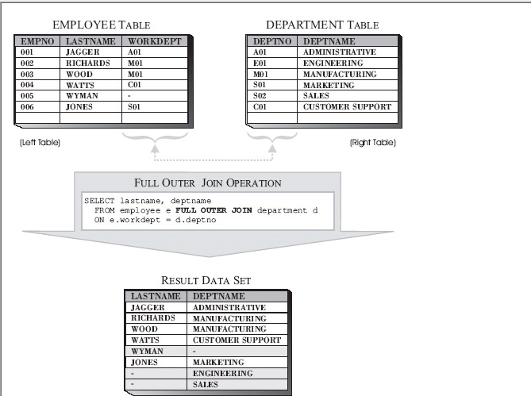

Slide 23
Queries Using a Set Operator
With DB2, it is possible to combine two or more queries into a single query by using a special operator known as a set operator. When a set operator is used, the results of each query executed are combined in a specific manner to produce a single result data set.
UNION. When the UNION set operator is used, the result data sets produced by each individual query are combined and all duplicate rows are eliminated.
UNION ALL. When the UNION ALL set operator is used, the result data sets produced by each individual query are combined; all duplicate rows found are retained.

Slide 24
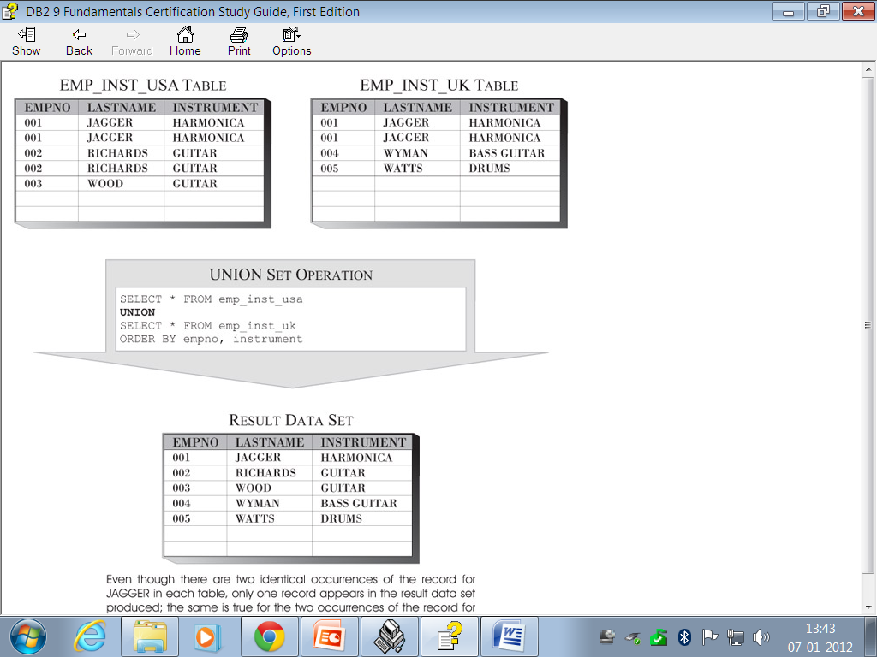

Slide 25
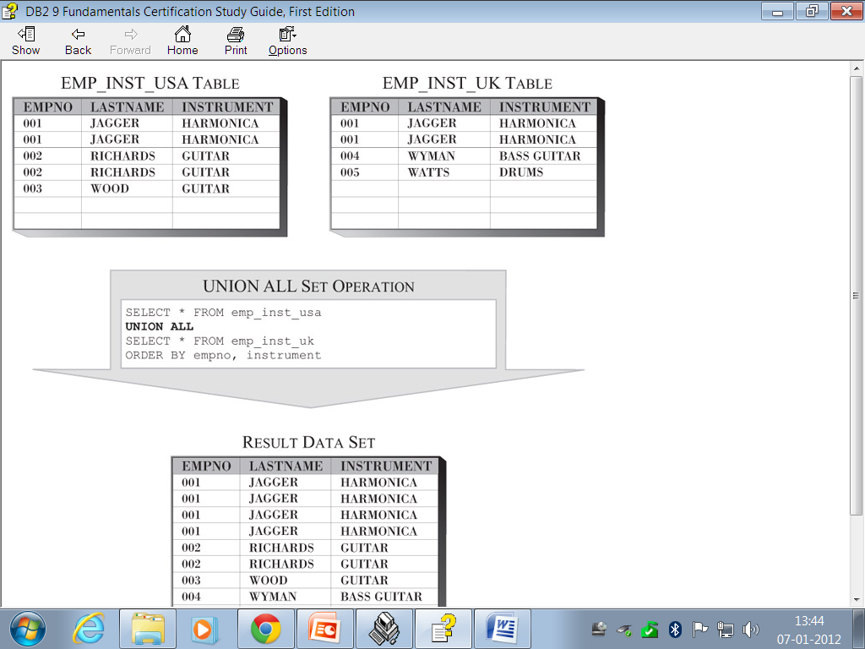

Slide 26
Differences between UNION and JOINS
Union combines the results of two or more queries into a single result set that includes all the rows that belong to all queries in the union.
By using joins, you can retrieve data from two or more tables based on logical relationships between the tables. Joins indicate how SQL should use data from one table to select the rows in another table.
The union operation combines rows joins that combine columns from two tables.

Slide 27
Thank You

