Slide 1
AWS Essentials-Letsupgrade
Batchu Sumanth
sohithsumanth@gmail.com
9949694209

Slide 2
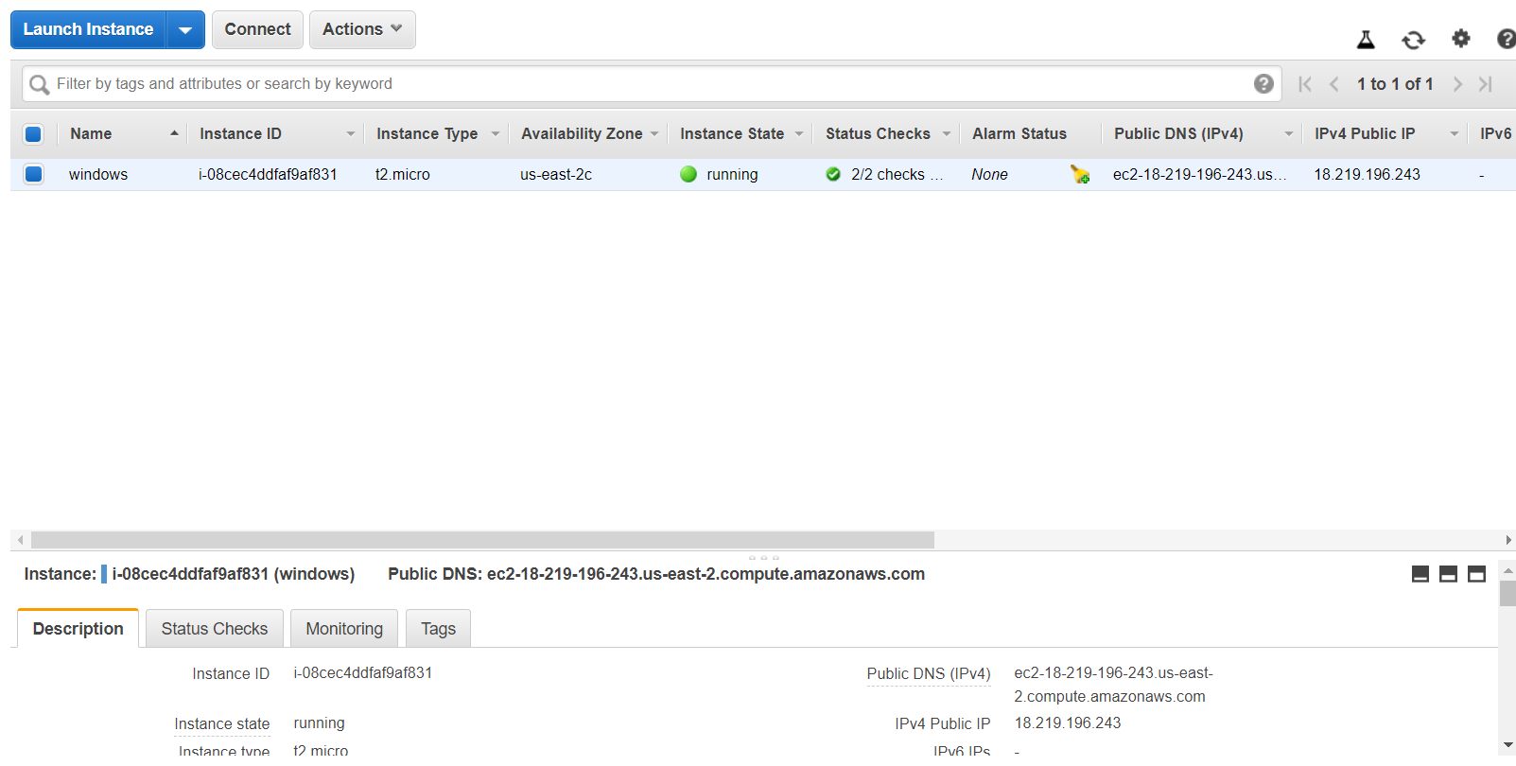

Slide 3
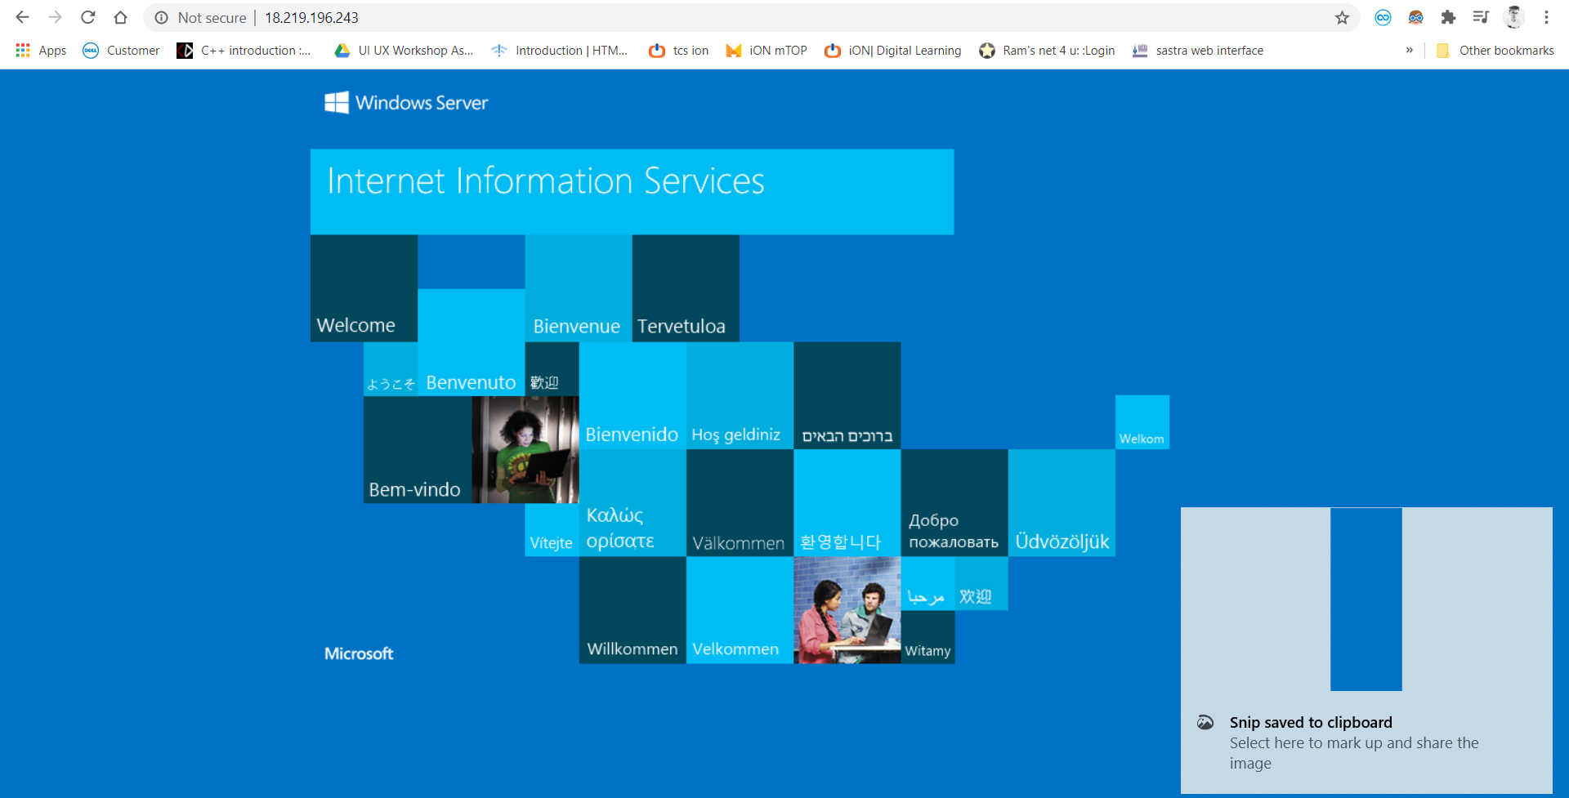

Slide 4
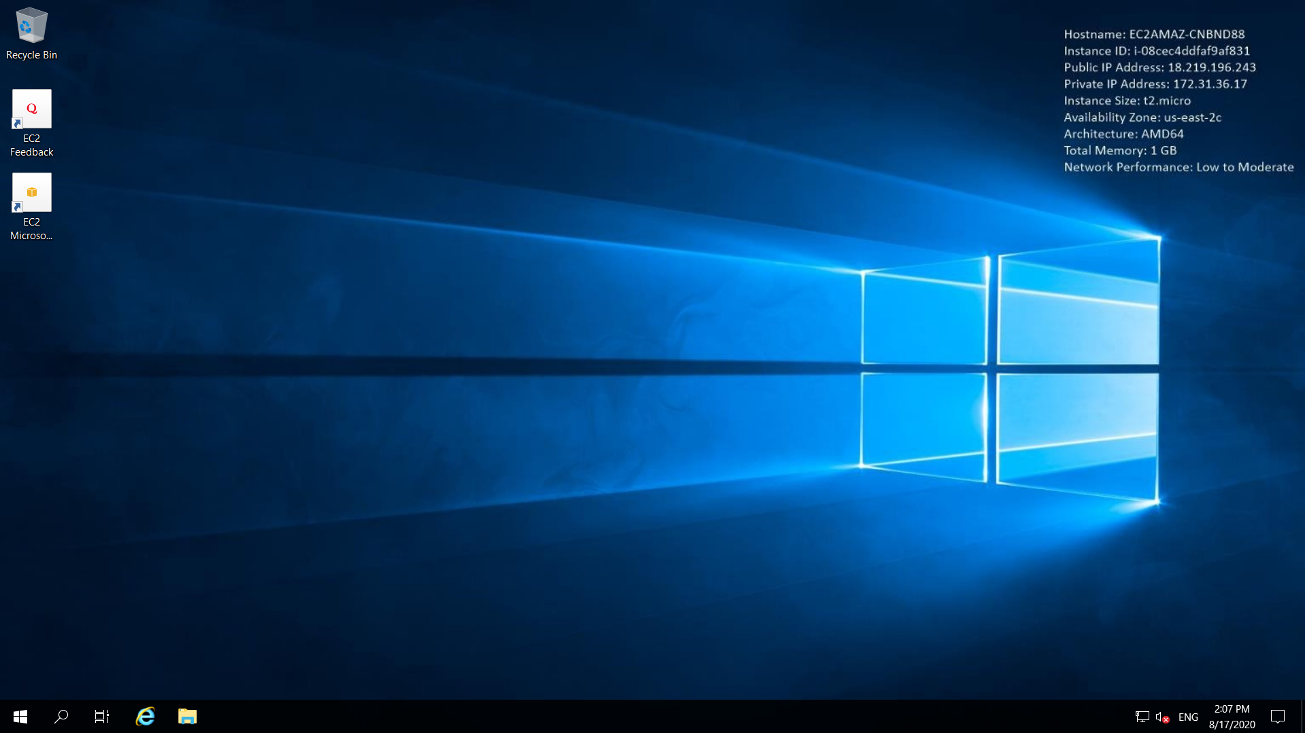

Slide 5
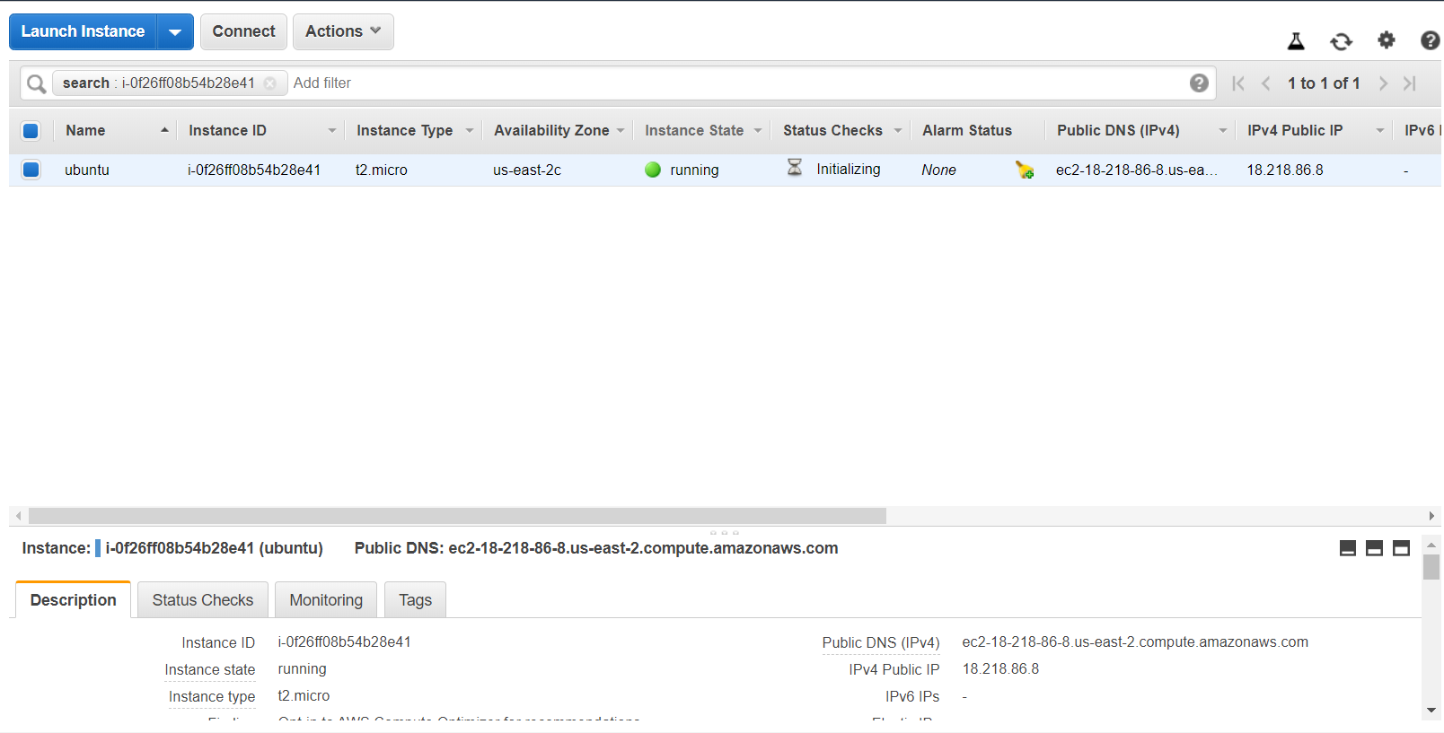

Slide 6
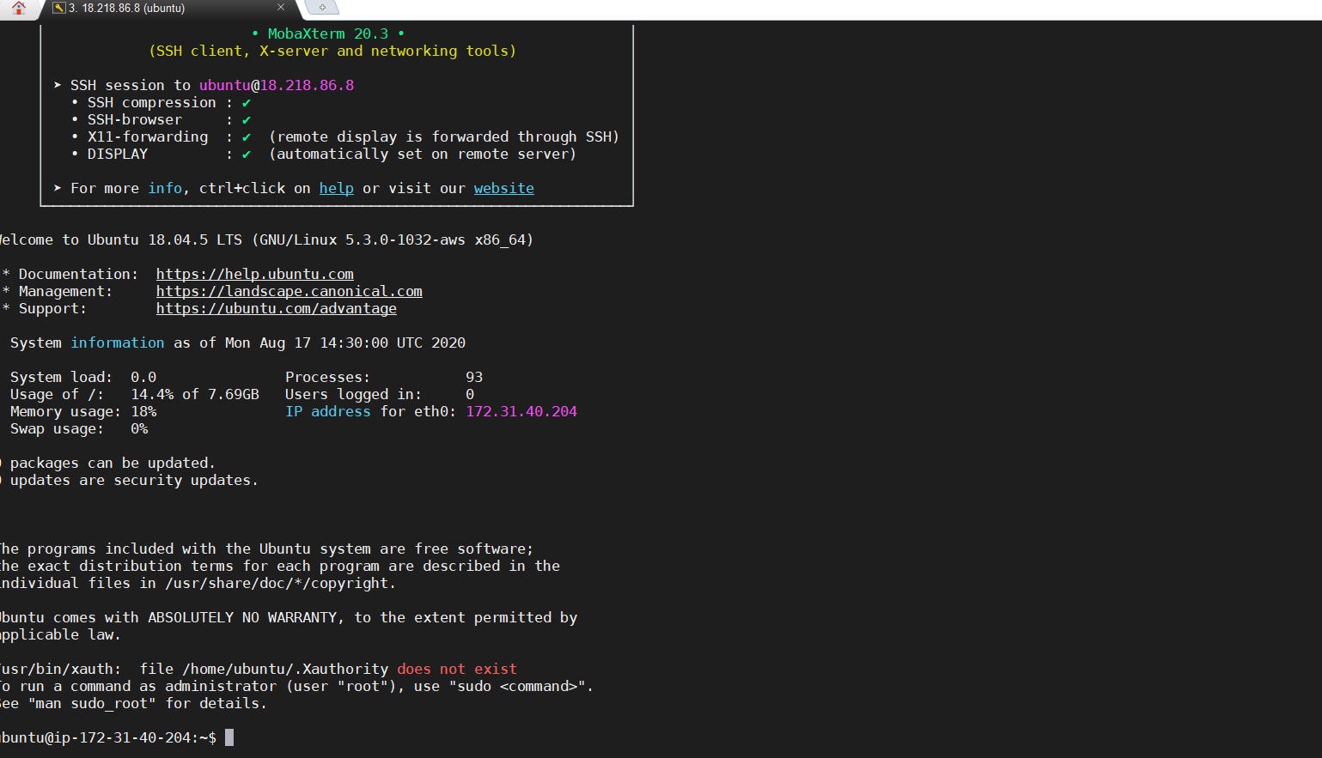

Slide 7
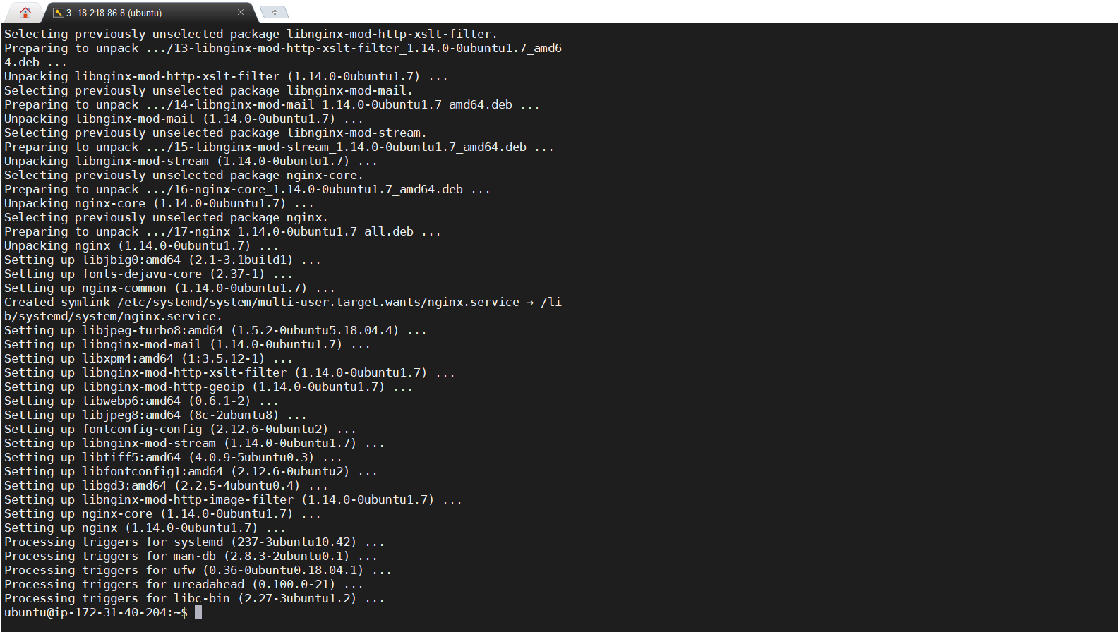

Slide 8
