Slide 1
AWS-Essentials
Batchu Sumanth
9949694209
sohithsumanth@gmail.com

Slide 2
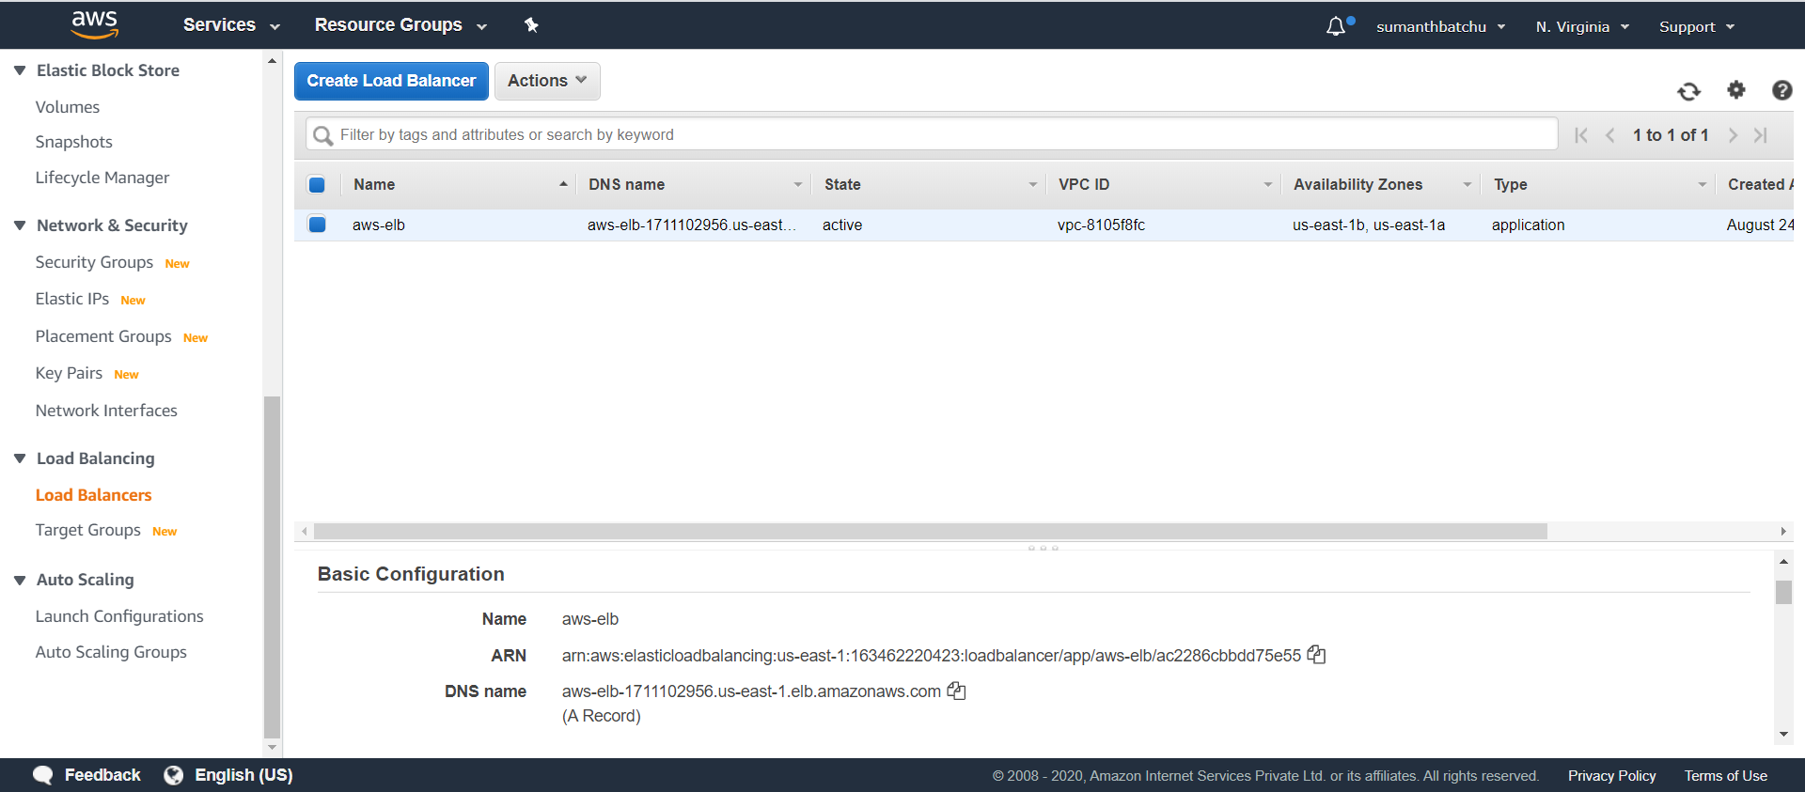

Slide 3
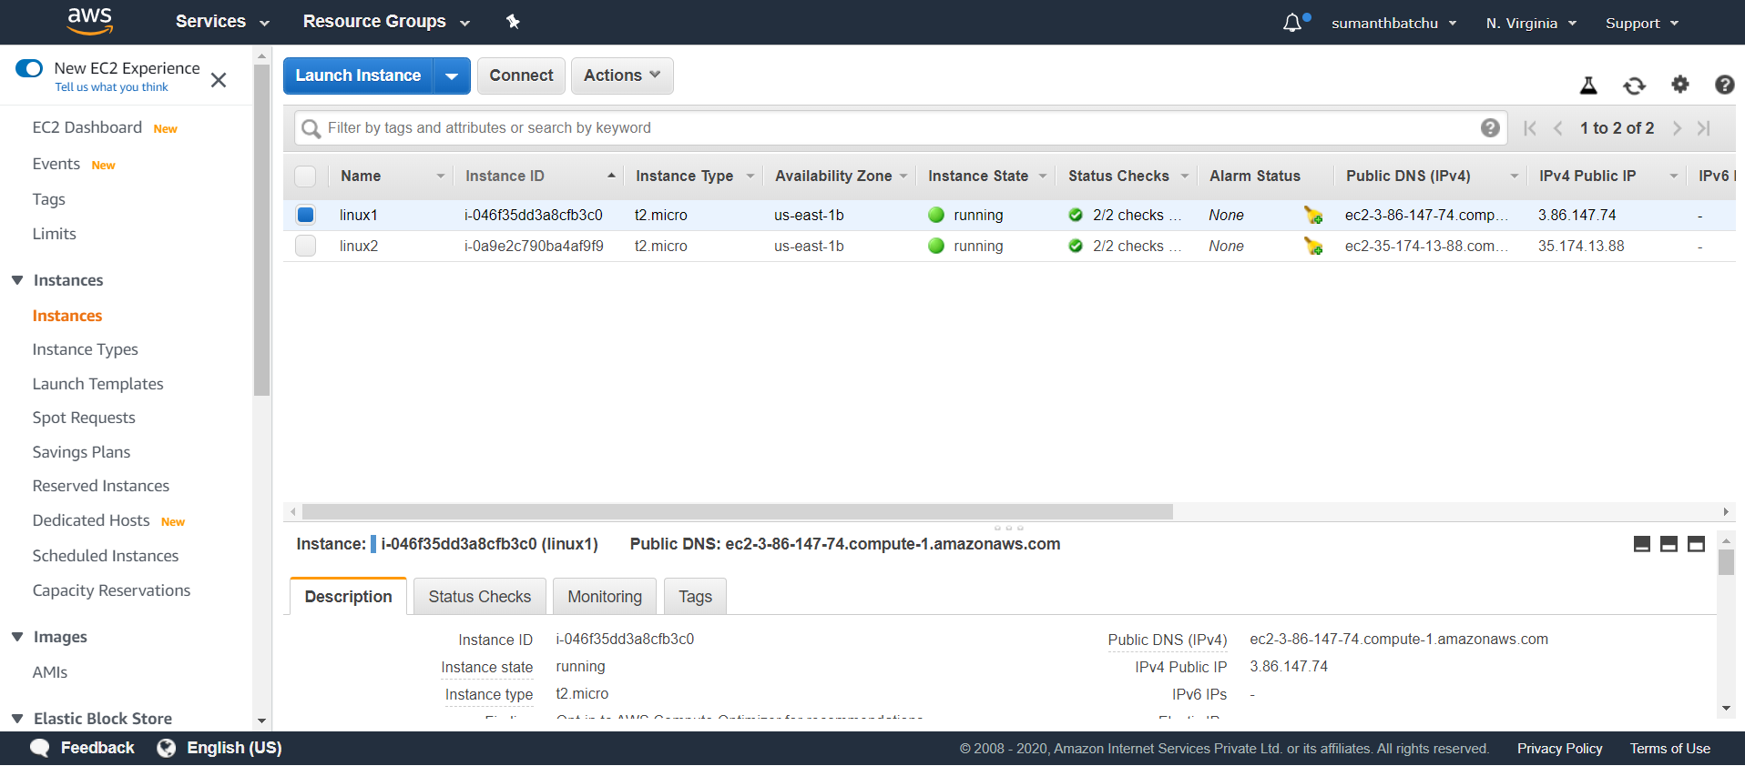

Slide 4
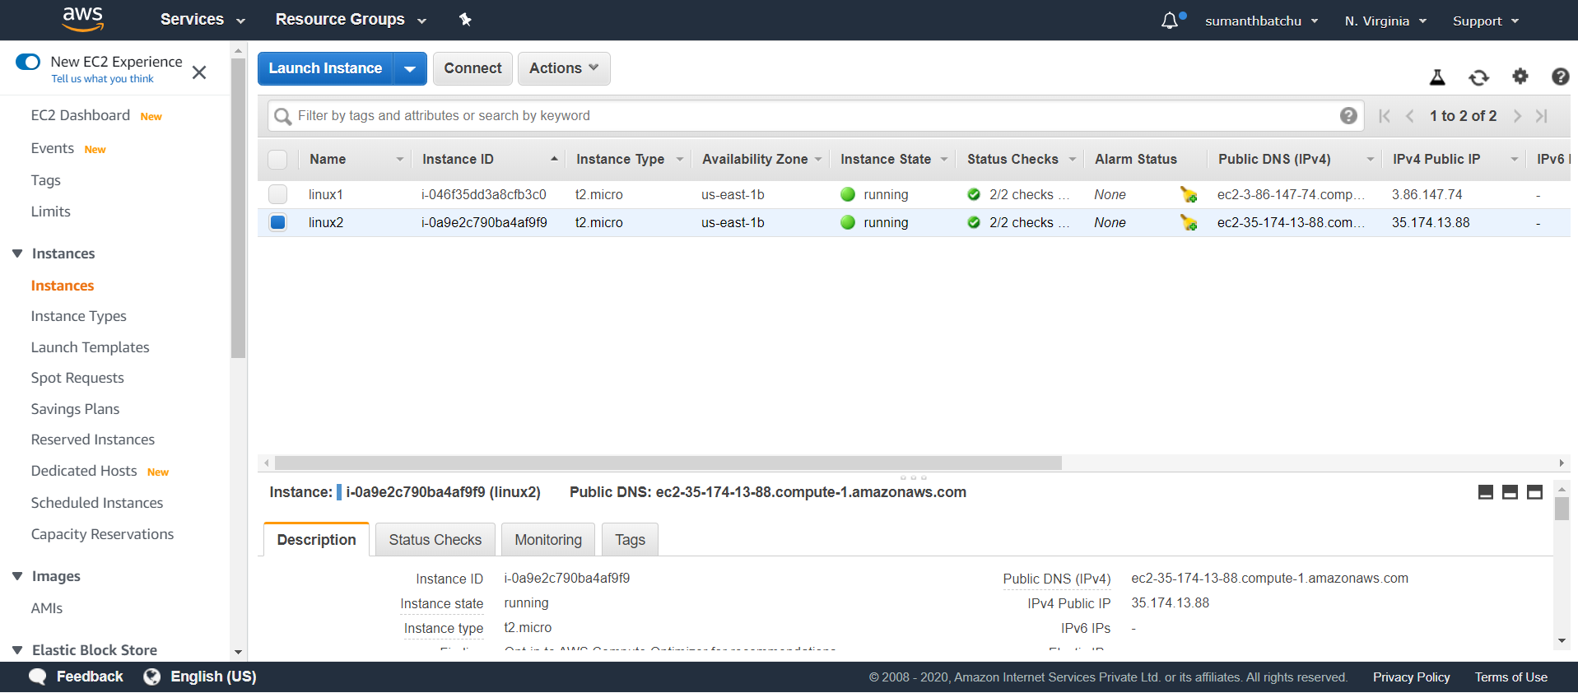

Slide 6
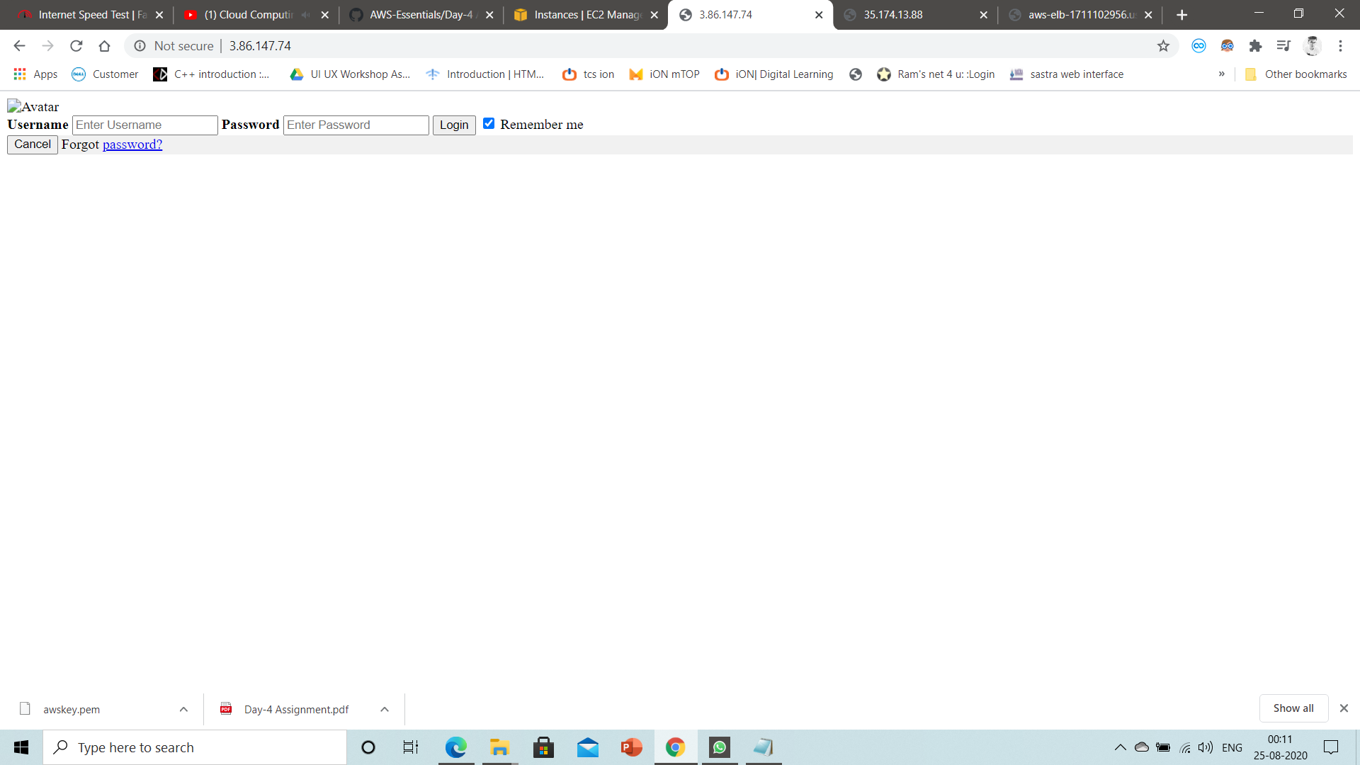

Slide 7
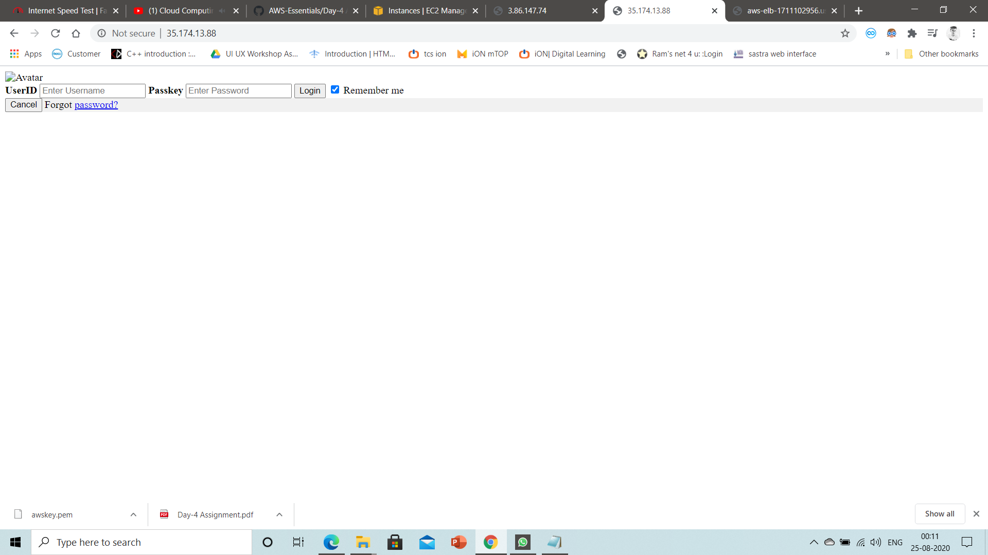

Slide 8
