Slide 1
Principles of multimedia
Hands on version of the course for students with a background in image processing and information theory.

Slide 2
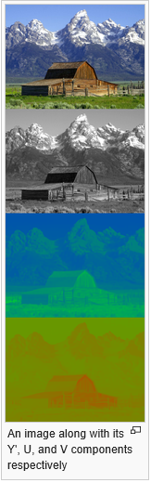
YUV
YUV is a color space that encodes a color image or video taking human perception into account. Y is the Luma component. U & V are the chroma components.
The scope of the terms Y'UV, YUV, YCbCr, YPbPr, etc., is sometimes ambiguous and overlapping. Historically, the terms YUV and Y'UV were used for a specific analog encoding of color information in television systems, while YCbCr was used for digital encoding
-- wikipedia

Slide 3
Color Space Conversion
(a) translate from RGB to YCbCr
(b) translate from YCbCr to RGB
Week <number>
Notes:
<number>

Slide 4
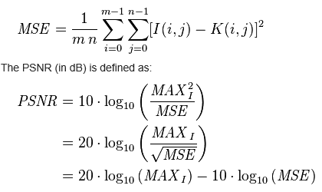
PSNR
PSNR: Peak signal to noise ratio.
MSE: Mean square error
Week 2

Slide 5
Exercise
Convert an RGB image to YUV and:
Revert it back to RGB
Quantize Y, U, V components differently and then revert it to RGB.
Write code to find PSNR between two images and:
Make two copies of an RGB image, edit one and the find the PSNR wrt the original.
Study the impact of quantization in the YUV space on PSNR and see how this does not correlate well with the visually perceived quality.

