Slide 1
8/25/15

Slide 2
Views Add on Modules
There are lot of add on modules for views. We will be looking over the below modules in this session.
1. Views Slide-show
2. Views Accordion
3. Views Data Export

Slide 3
Views Slideshow Module
- Views Slideshow can be used to create a slideshow of any content (not just images) that can appear in a View.
- Adds the slideshow format into the views format settings.
- Requirements:
- Views Slideshow 2.x requires Views 2.
- Views Slideshow 3.x requires Views 3.

Slide 4
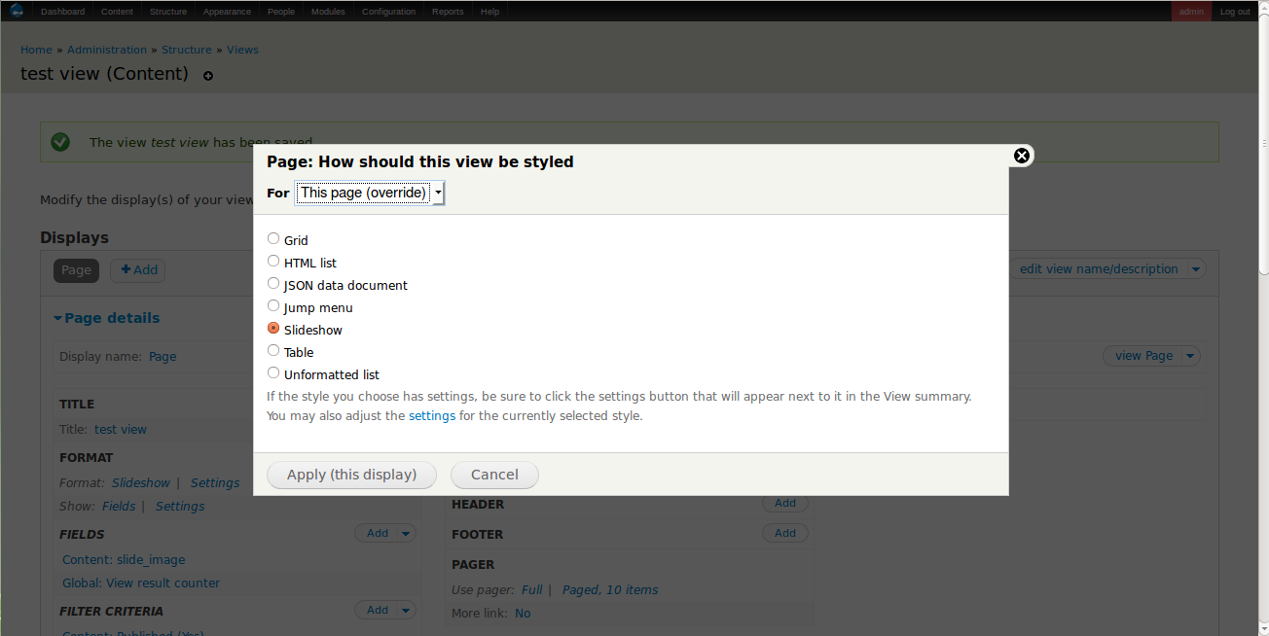
Views - Format Settings

Slide 5
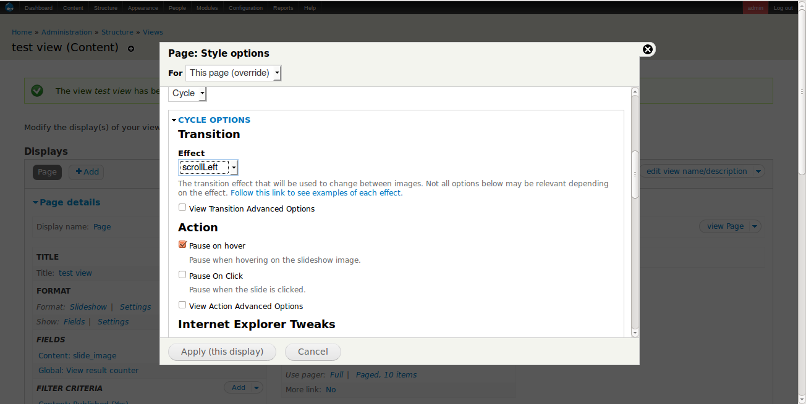
Views - Slideshow Settings

Slide 6
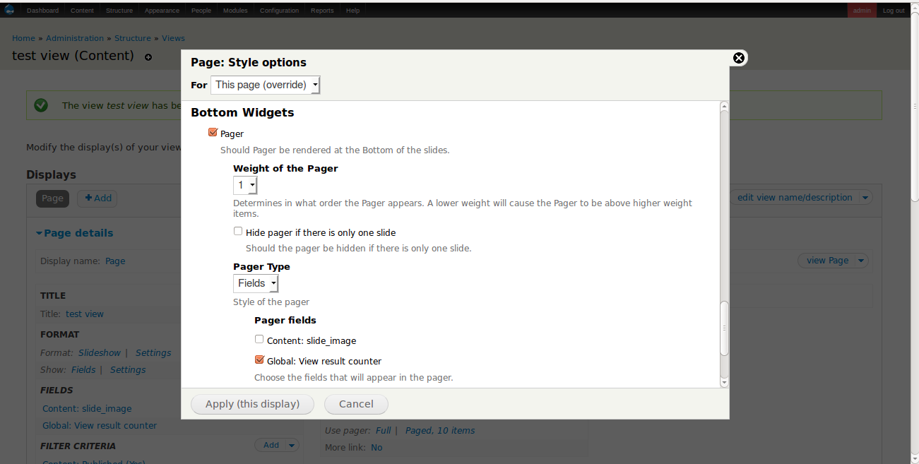
Views - Slideshow Settings

Slide 7
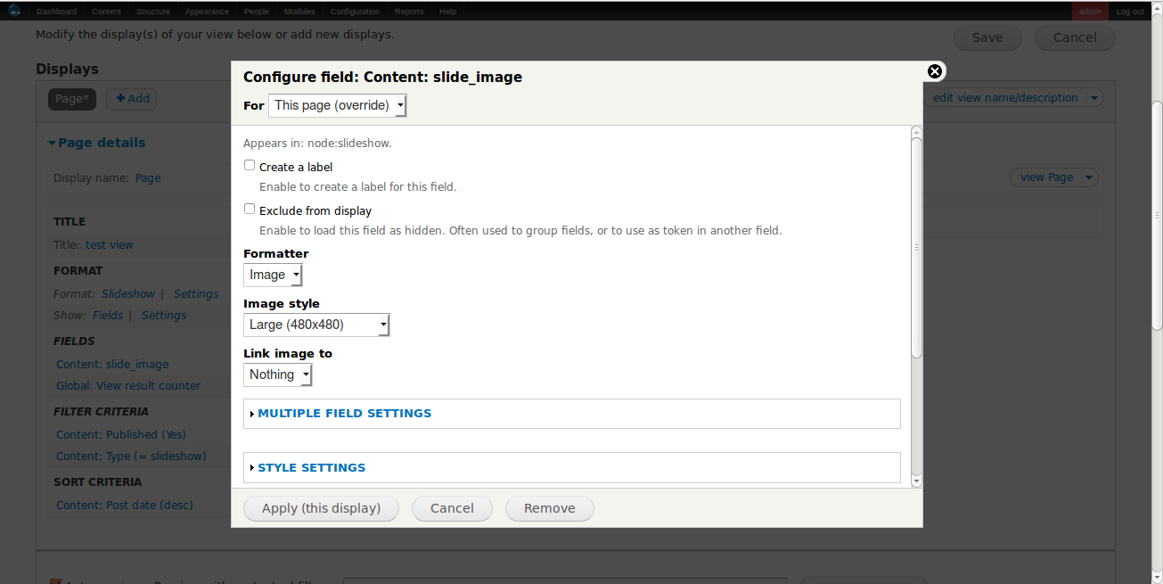
Views - Image Settings

Slide 8
Views Accordion Module
- Views Accordion provides a display style plugin for the Views module.
- It will take the results and display them as a JQuery accordion, using the first field as the header for the accordion rows.

Slide 9
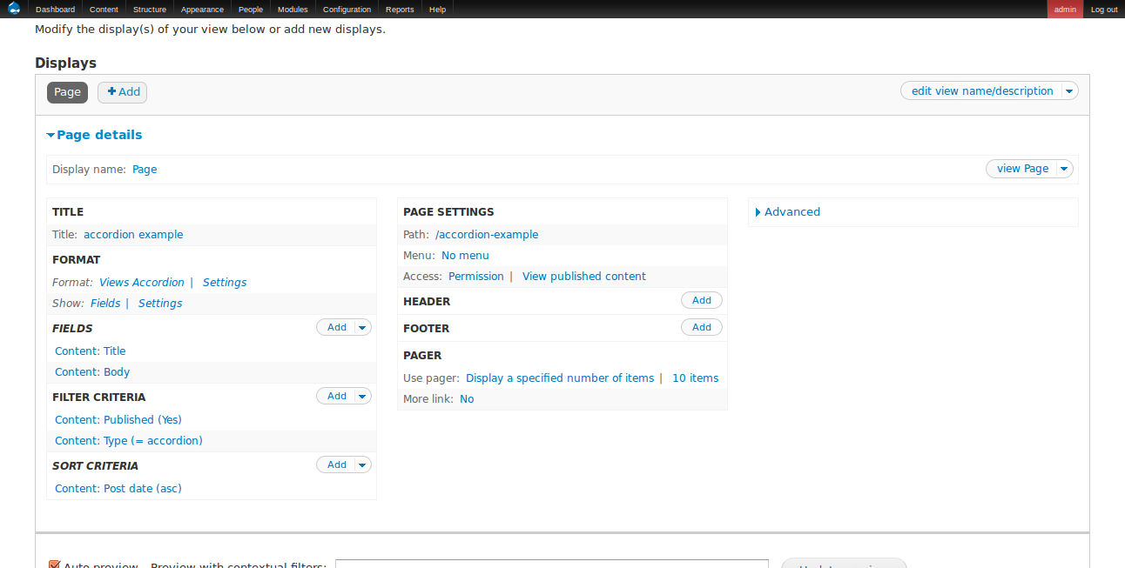
Views - Accordion Settings

Slide 10
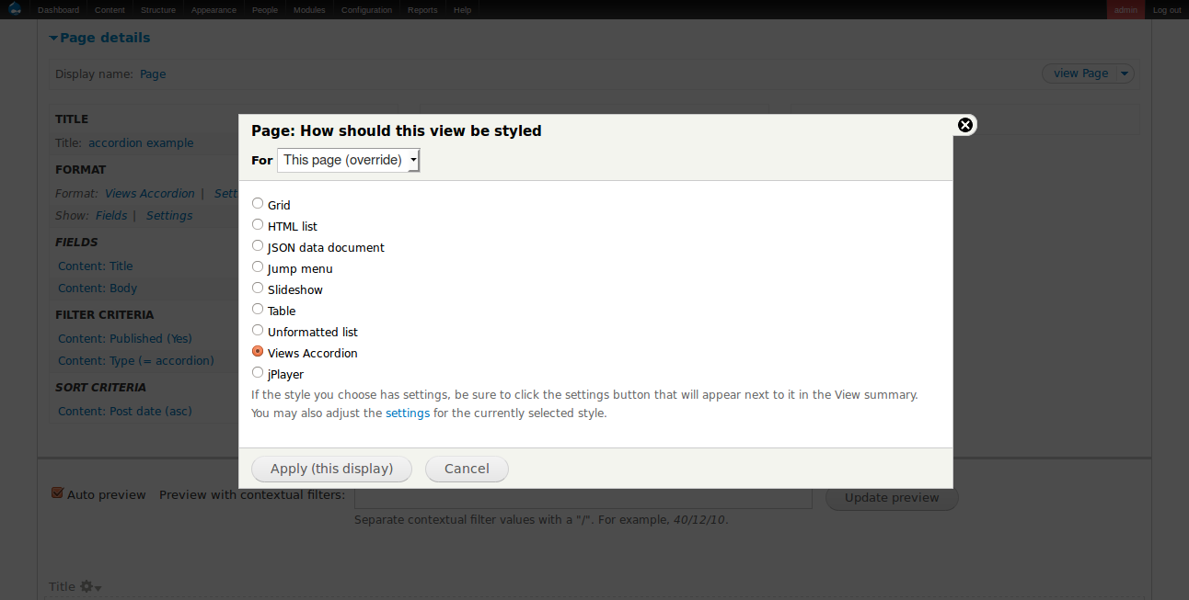
Views - Format Settings

Slide 11
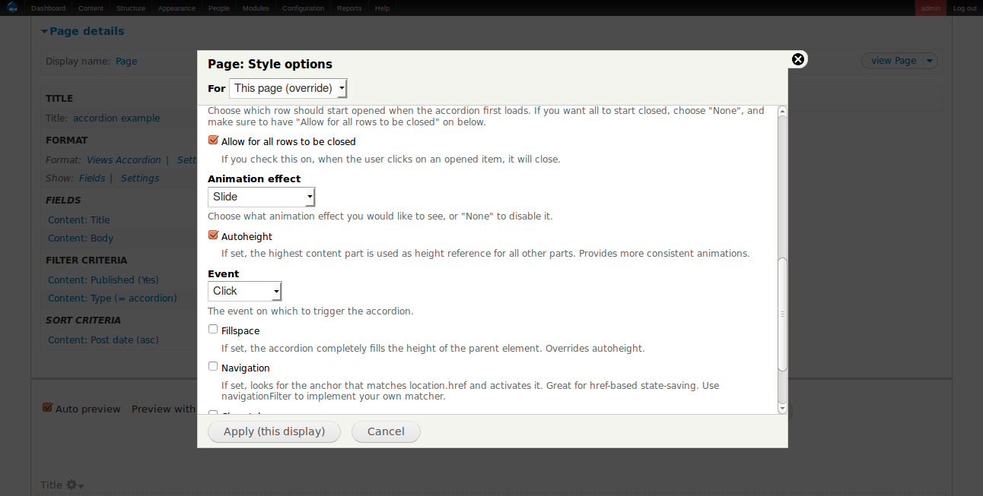
Views - Accordion Settings

Slide 12
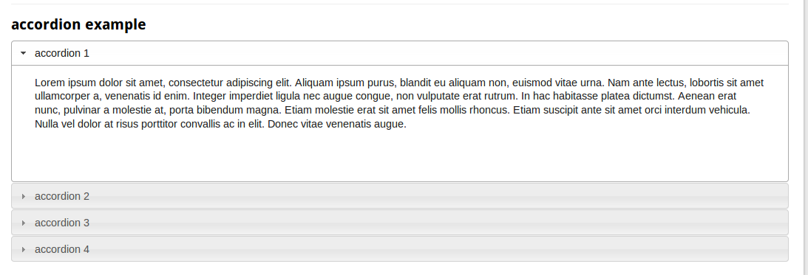
Views Accordion Example

Slide 13
Views Data Export Module
- This module is designed to provide a way to export large amounts of data from views.
- Style plugins are included that support exporting in the following types:
- CSV
- Microsoft XLS
- Microsoft DOC
- Basic TXT
- XML

Slide 14
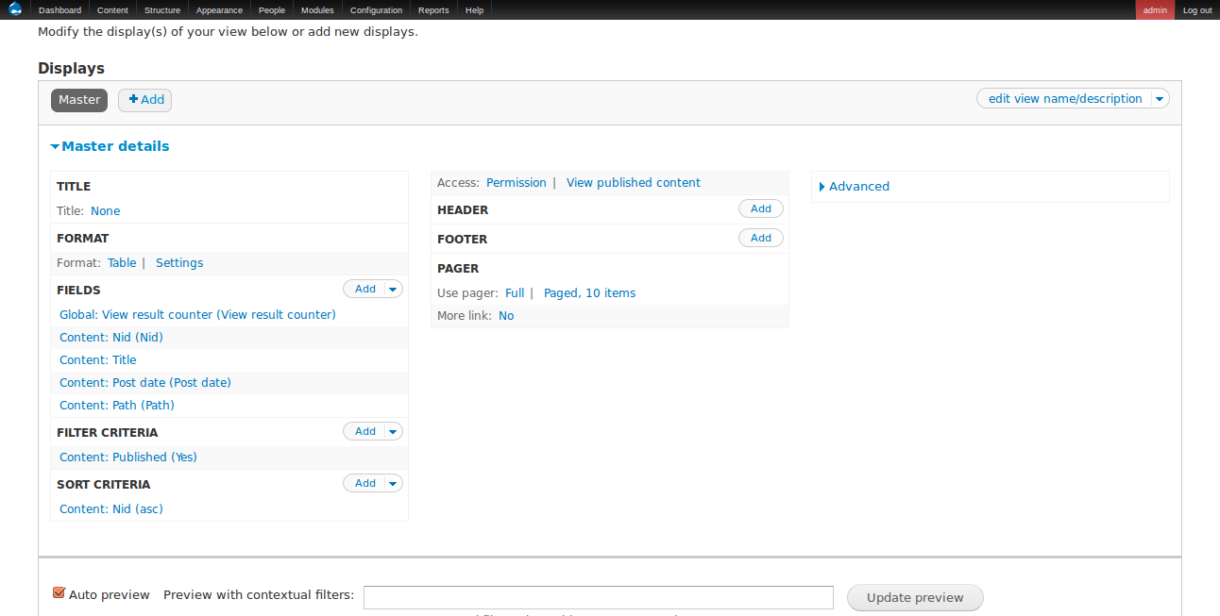
Views Data Export Settings

Slide 15
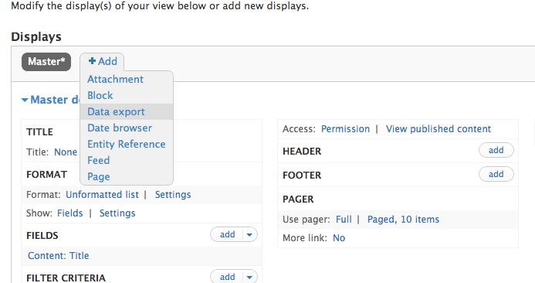
Creating the new data export view from master

Slide 16
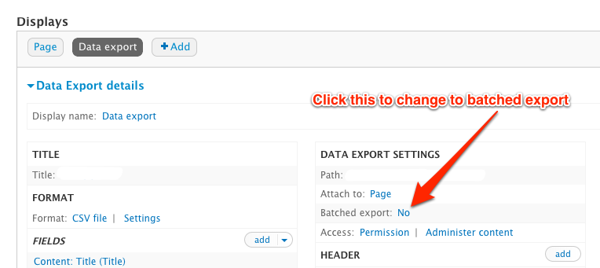
Creating the new data export view from master

Slide 17
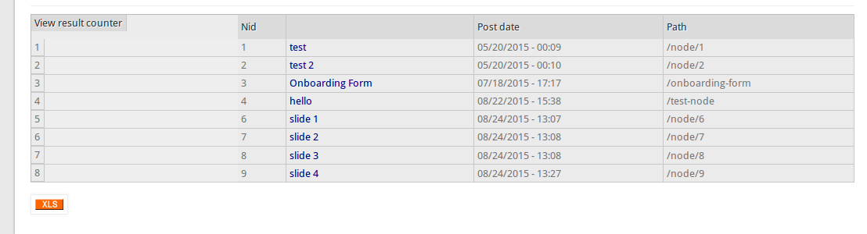
Views Data Export Example

Slide 18
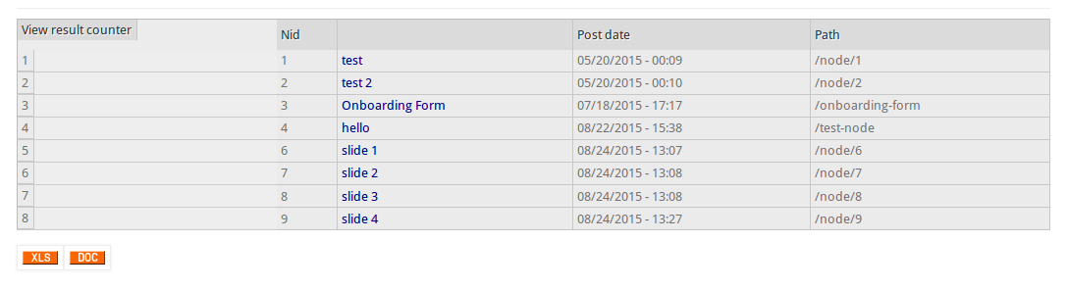
Views Data Export Example

Slide 19

Thank You
Thank You

